Slide 1

Community-Based Water Resiliency
Training Workshop

Slide 2
Section 1: Introduction / Background

Slide 3
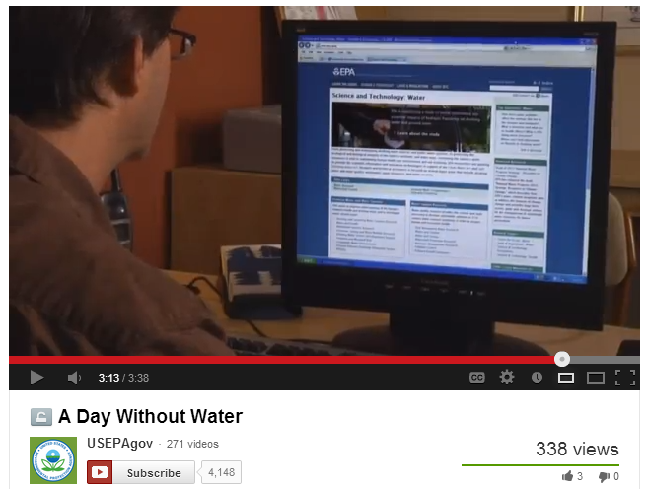
CBWR Video: A Day Without Water
CBWR Video: A Day Without Water

Slide 4

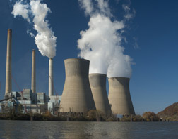
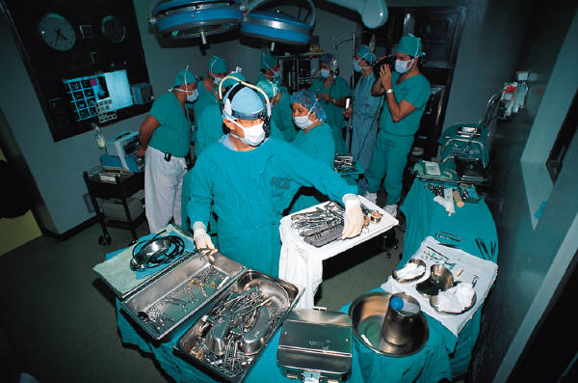

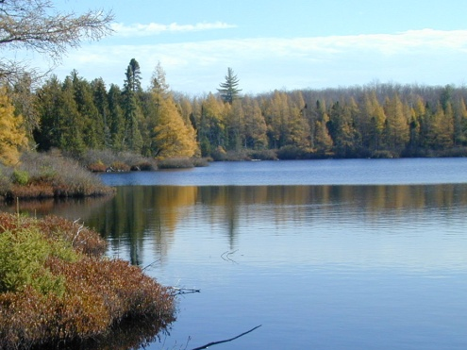

What does water do for you?
Water and wastewater services are essential to:
Life
Energy
Health
Economy
Environment

Slide 5
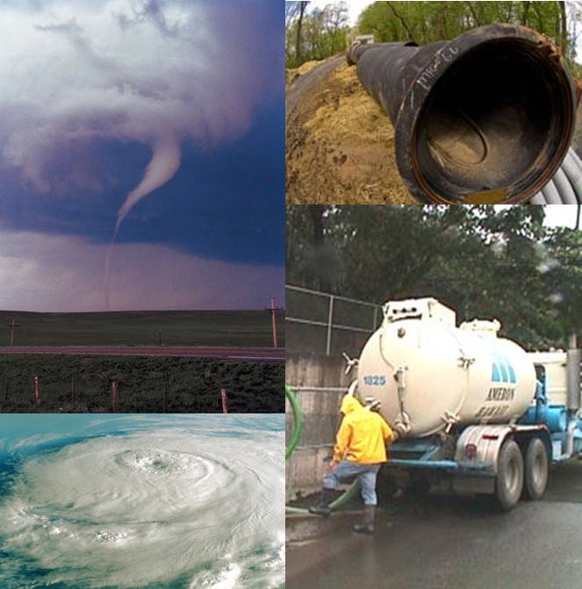

Preparedness for All-Hazards
Water and wastewater utilities face a number of threats:
Hurricanes
Tornadoes
Aging infrastructure
Intentional contamination
Man-made accidents and intentional events

Slide 6
Breakout Group Exercise:
Potential Causes for a
Water Service Interruption

Slide 7
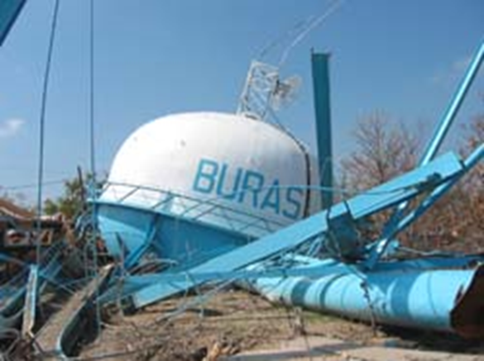
Imagine a Day Without Water
How would you meet your needs for:
Drinking water
Sewage disposal and sanitation
Firefighting
What about…
Energy
Hospitals and dialysis services
Transportation
Food processing and services
Manufacturing
Banking
Infrastructure failures are not a matter of “if” they are a matter of “when”…we all need to be prepared and plan ahead.

Slide 8
What if Things Were Different?
Water utilities regularly coordinated with emergency planners?
Environmental health regularly coordinated with water utilities?
Emergency response plans included utilities?
Citizens understood impacts of drinking water and wastewater service interruptions before they happened?
Area hospitals and businesses had backup water plans?
Businesses and critical community services factored water service interruptions into emergency plans?

Slide 9
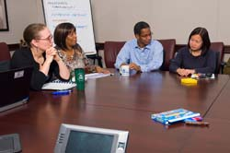
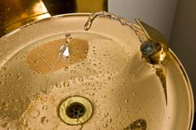
CBWR Addresses the “What if…?”
Brings utilities together with:
  Emergency planners/responders
  Business community
  City/county managers
  Public health officials
  Members of the public
Increases preparedness at the community level by:
  Increasing understanding of critical interdependencies
  Highlighting multiple benefits of preparedness
  Improving integration of Water Sector into community emergency preparedness and response efforts
Goal: Communities, as a whole, are more resilient in the event of a water service interruption

Slide 10
Why CBWR?
CBWR strives to:
Increase overall community preparedness by:
  Raising awareness of Water Sector interdependencies and
  Integrating the Water Sector into community emergency preparedness and response efforts
Increase preparedness and resiliency of drinking water and wastewater utilities by:
  Delivering tools and information to increase community collaboration and bolster security practices

Slide 11
Why Involve the Entire Community?
All emergencies are local, all responses are local
Threats and vulnerabilities vary by community
Utilities play a critical role in public health and safety during water emergencies
Communities need to:
  Understand their unique interdependencies
  Be prepared to work together during a crisis
  Access tools and resources that speak to their roles and responsibilities in advance of a crisis
Water utilities need:
  Regular coordination with law enforcement personnel, community leaders, business leaders and the general public
  Collaboration with interdependent sectors
Water service interruptions can have serious economic, environmental, psychological and public health consequences on a community. Resilient communities can significantly reduce these risks at negligible cost.

Slide 12
Section 2: Community-Based Water Resiliency (CBWR) Tool

Slide 13
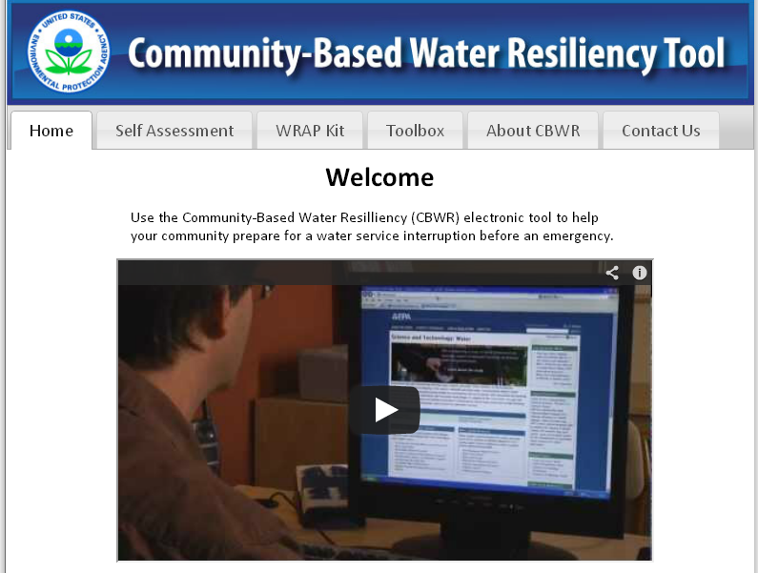
CBWR Tool
The CBWR Tool consists of three main sections:
Stakeholder Self Assessment
CBWR Toolbox
Water Resiliency Action Plan (WRAP) Kit

Slide 14
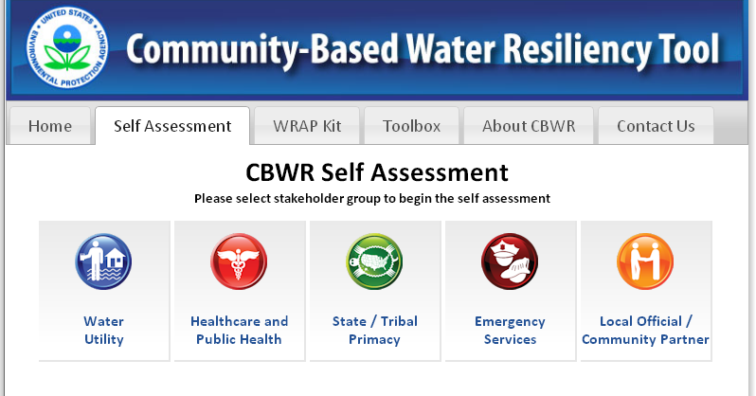
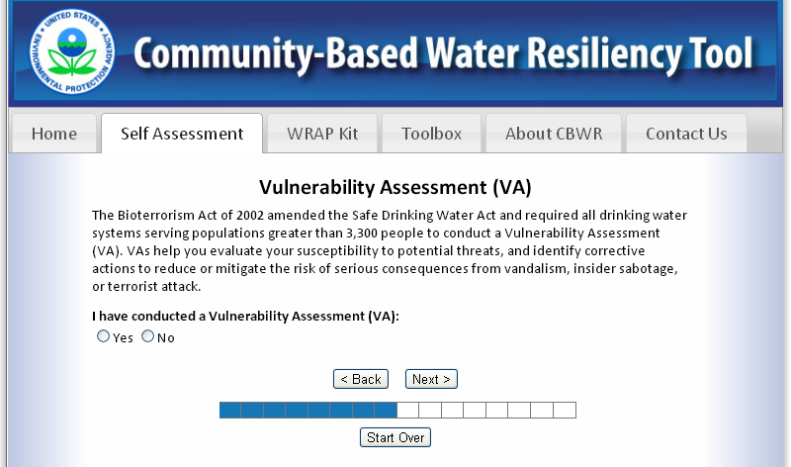
CBWR Tool: Self Assessment

Slide 15
Breakout Group Exercise:
CBWR Tool Self Assessment

Slide 16
Breakout Group Report Out:
CBWR Tool Self Assessment

Slide 17
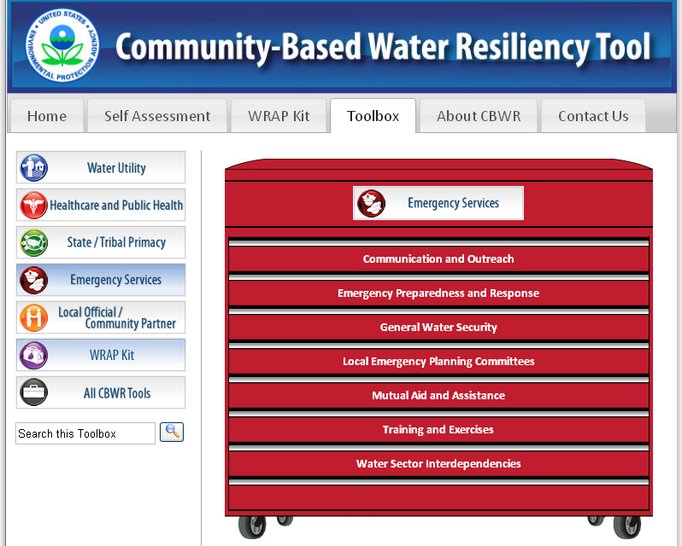
CBWR Tool: Toolbox

Slide 18
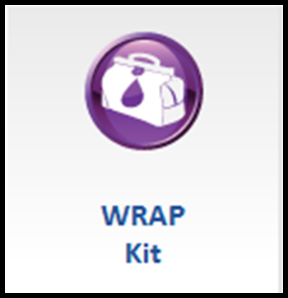
Water Resiliency Action Plan
(WRAP) Kit
Provides users with step-by-step process for planning a water emergency meeting or workshop, and covers:
  Expectations
  Roles and responsibilities
  Capabilities and limitations
  Planning, hosting and follow-up actions
Includes sample:
  Agendas
  Invitations
  Suggested participants
  Logistical templates and scripts for recruitment

Slide 19
Section 3: Importance of Community-Based Approach to Preparedness

Slide 20
Breakout Group Discussion:
Water Emergency Scenario

Slide 21
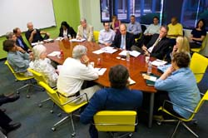

Benefits of Community-Wide Preparedness
Community-wide preparedness helps communities understand:
Importance of water and how people and businesses rely on it for everyday services
Forge partnerships between water utilities and other sectors
Clarify roles and responsibilities of individuals and organizations during a water emergency
Increase community resiliency to water emergencies
Reduce impacts of water service interruptions

Slide 22
Section 4: How to Implement a CBWR Program in Your Community

Slide 23
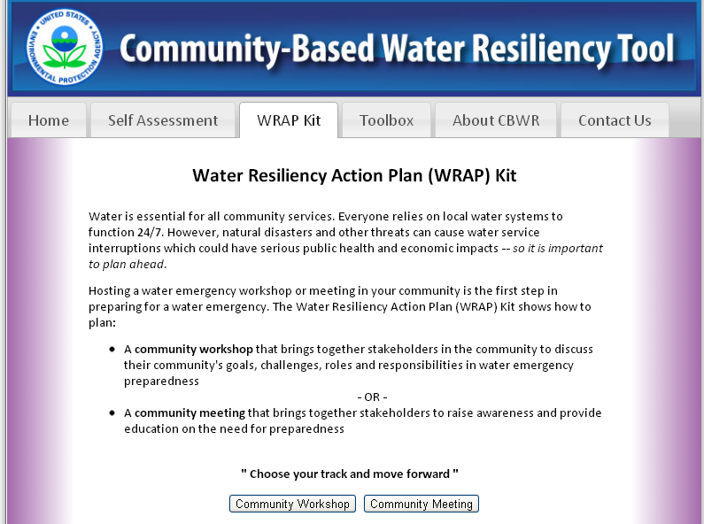
Water Resiliency Action Plan
(WRAP) Kit

Slide 24
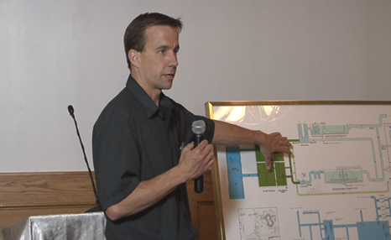
What is a Community Workshop?
A community workshop is an informal meeting with water utilities and members of their communities to become better prepared for a water emergency.
Suggested goals include:
Provide solutions for future water service interruptions
Identify preparedness activities to improve water resiliency
Integrate water utilities into community planning
Suggested activities:
Tour of drinking water and/or wastewater
treatment plant operations
Facilitated breakout discussion on a
response to an incident – actual or hypothetical

Slide 25
Example of a Community Workshop
Evanston Water Emergency Roundtable
September 2009
A water emergency in January 2009, caused by frazil ice build-up on water intakes resulted in the awareness of how critical reliable and resilient water service is to the communities served by the Evanston Water Utility.
The purpose of the invitation-only meeting was to:
Discuss customers’ water needs
Review current emergency response plans
Describe roles and capabilities in a water emergency response
Identify action items to increase preparedness and community resiliency

Slide 26
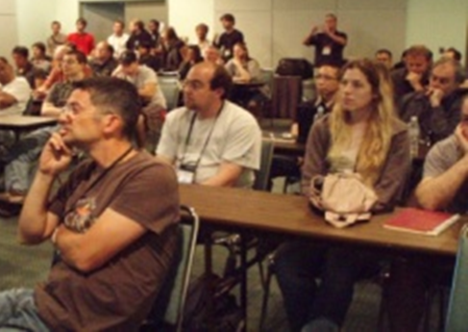
What is a Community Meeting?
A community meeting provides an opportunity to raise awareness of how communities rely on water and how they can work with their water utilities to become better prepared for a water emergency.
Suggested goals include:
Raise awareness of water sector interdependencies within a community
Define roles and responsibilities during
a water emergency
Establish relationships among community
partners and their water utilities

Slide 27
Example of a Community Meeting
Chicagoland Water Preparedness and Business Resiliency Summit
November 2007
The Summit raised awareness of the importance of drinking water and wastewater services, and the potential consequences of a loss of services to the business community.
Key Findings included:
Water is often taken for granted
Many businesses do not realize how much they depend on water
Without immediate access to water, the chemical, manufacturing, pharmaceutical and food processing industries would have to stop production
At the conclusion of the Summit, an ongoing public–private working group was formed to improve preparedness.

Slide 28
Overview of
Key Planning Activities
Key planning activities include:
  Planning the meeting/workshop
  Developing the agenda
  Inviting participants
  Preparing for the meeting/workshop
  Conducting the meeting/workshop
  Wrapping up the meeting/workshop

Slide 29
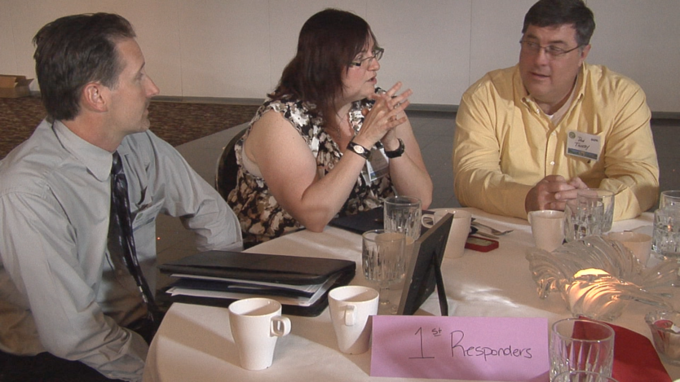
Planning the Meeting or Workshop
Planning activities may include*:
Deciding who should host the meeting
Establishing a planning team
Picking a date and location
Identifying goals and objectives
Assigning roles and responsibilities
*Planning activities will depend on the size and scope of the meeting or workshop.

Slide 30
Developing the Agenda
The WRAP Kit provides suggestions and templates to help you develop your agenda.
You may want to include in your agenda:
  Overview of drinking water and wastewater systems
  Case study from community members impacted by water service interruptions
  Breakout discussions on impacts of water emergency
  Tour of water utility

Slide 31
Inviting Participants
For a successful meeting or workshop, it is critical to get the right people to attend. The WRAP Kit helps you:
Determine your target audience
Develop a compelling invitation
Clearly state the purpose and anticipated outcomes
Facilitate registration process

Slide 32
Preparing for the Meeting or Workshop
Decide in advance who will be responsible for:
  Pre-meeting registration
  On-site check-in
  Note taking
  Development of post-meeting report (if applicable)
The WRAP Kit also provides a list of supplies you might need during your meeting.

Slide 33
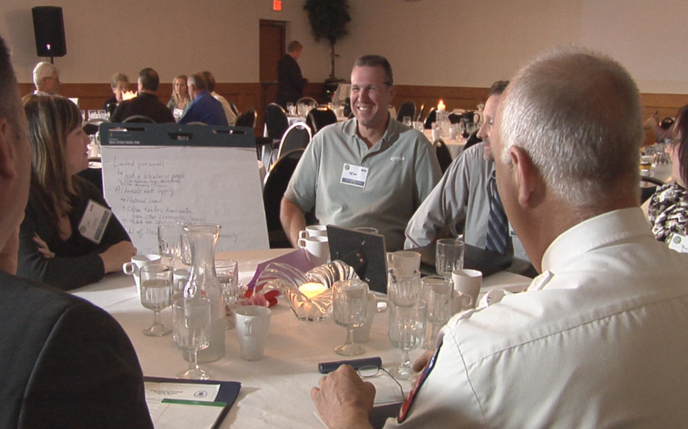
Conducting the Meeting or Workshop
  The WRAP Kit provides suggestions to ensure that your meeting runs smoothly.
  Topics include:
  On-site registration
  Audio-visual setup
  Walk through with presenters and facilitators
  Ensuring presentations stay on schedule

Slide 34
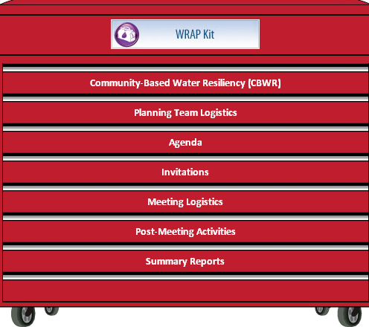
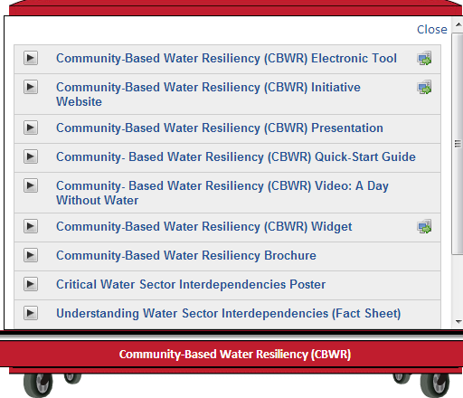
(WRAP) Kit Toolbox

Slide 35
Lessons Learned and
Recommendations
The St. Clair County, Michigan, Water Resiliency Roundtable was held in May 2012.
1. Promoted better understanding of public-private sector interdependencies
2. Fostered greater understanding of water infrastructure and the potential impacts from service interruption
3. Identified actions and resources needed to respond to, and recover from, a water emergency

Slide 36
Lessons Learned and
Recommendations (cont.)
User Group | Recommended Actions
Critical Water Users (hospital, schools, etc.) | Have bulk water available for 72-96 hours Reduce water services for non-essentials Contract with alternate water providers Use alternate sanitary facilities Conduct exercises/drills to test plans Conduct water audits in advance
Water Utilities | Determine flow capabilities and exercise interconnections Set priorities for water provision
First Responders | Include details of alternate water supplies in emergency response plans Implement long-range planning
Emergency Management | Strengthen public/private sector awareness of COOP regarding water service interruption Post County Hazard Mitigation Plans Conduct water audits Raise awareness through education

Slide 37
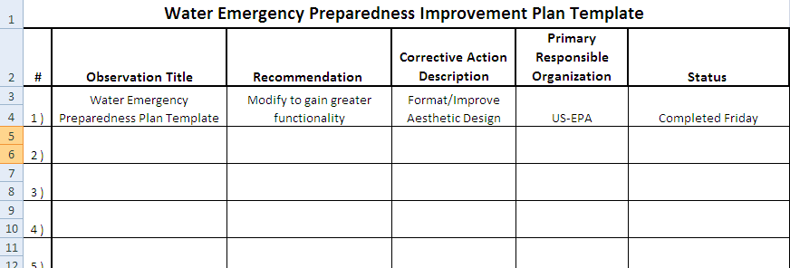
Wrapping Up the Meeting or Workshop
Following your meeting or workshop, it is important to follow up on any actions identified during the meeting.
The WRAP Kit provides a Water Emergency Preparedness Plan template to help identify and track actions through completion.

Slide 38
Group Exercise:
Water Emergency Preparedness Plan

Slide 39
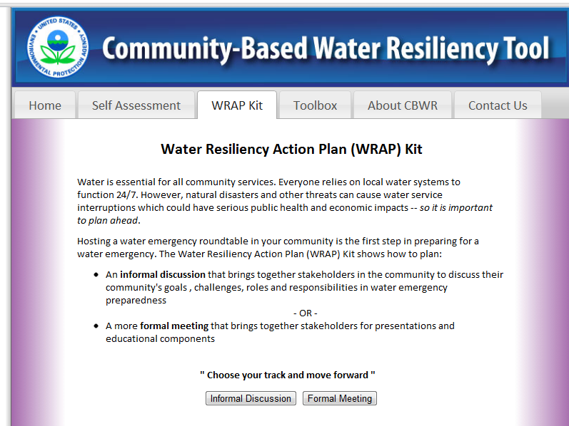
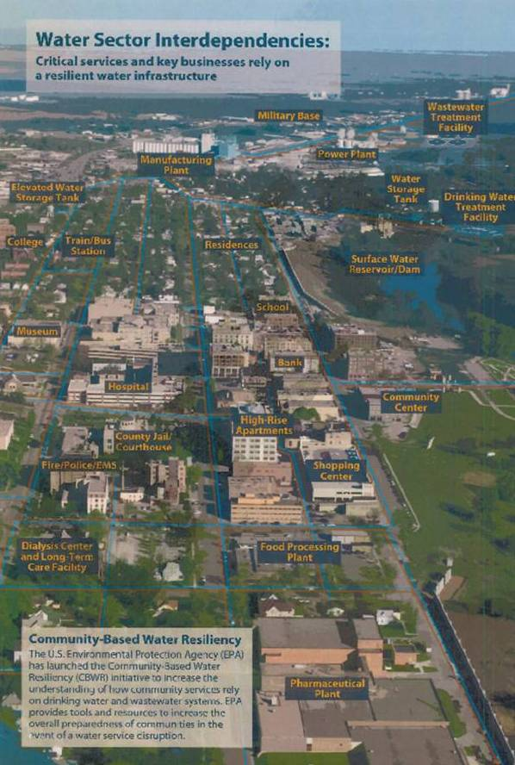
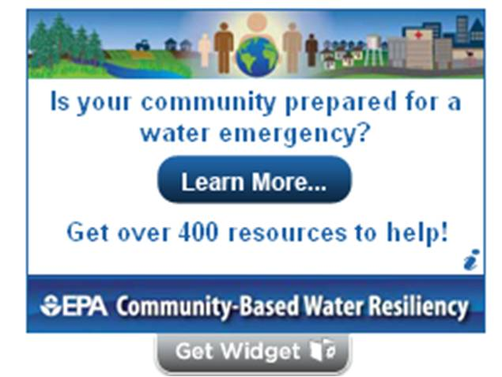
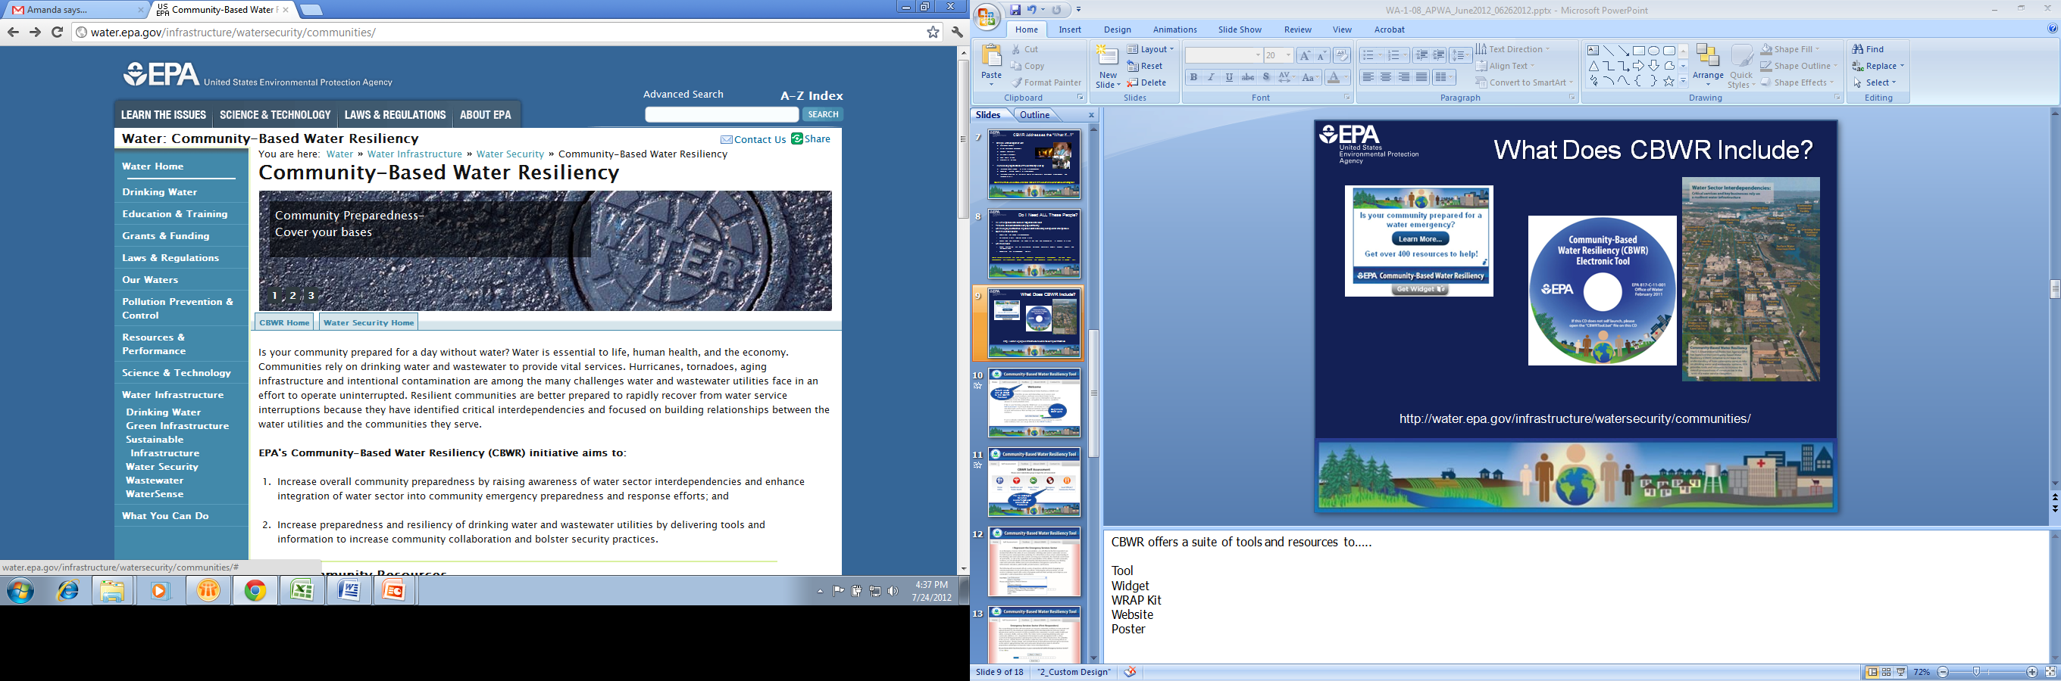
CBWR Resources
Community Water Resiliency/

Slide 40
Section 5: Train-the-Trainer

Slide 41

Train-the-Trainer
To make CBWR sustainable, communities themselves will need to champion this effort.
You will learn how to:
    Identify communities to champion CBWR efforts
    Target different stakeholder groups within a community
    Identify champions within a community to lead effort

Slide 42
What Communities Can Benefit from CBWR?
Communities that could benefit by implementing a CBWR program:
    Communities actively engaged (or interested) in preparedness efforts
    Communities that have experienced a recent emergency
    Communities with strong leadership
    Communities with a strong champion

Slide 43

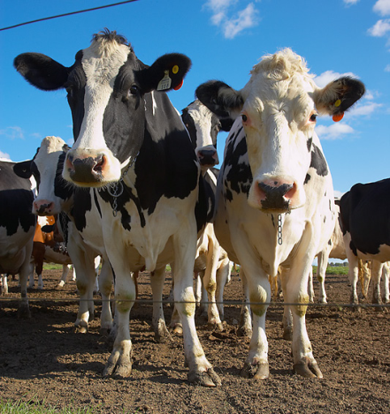
What Communities Can Benefit from CBWR? (cont.)
Additional consideration when identifying a potential CBWR community:
    Does the community have an industry that heavily relies on water service?
      Manufacturing
      Banking
      Healthcare
      Food processing
      and many more…
    Consider the impacts to the community (or region)
    due to a interruption or relocation of that industry

Slide 44
Who is a CBWR Champion?
Who should lead a CBWR program?
Drinking water and wastewater
  Utility managers
  Public affairs official
County/city emergency manager
Public health officials
Representatives from local or regional associations

Slide 45
How to get the Champion started?
Once you have identified the champion, you can help them get started by:
Illustrating the need for implementing a CBWR program in their community
Showing how they can use the WRAP Kit to host a community meeting
Assisting with the planning process, where needed
Training others to replicate process in other communities
Remember, each community is unique. The CBWR program should be adapted to meet the goals and needs of each community.

Slide 46

Where do you go from there?

