Slide 1

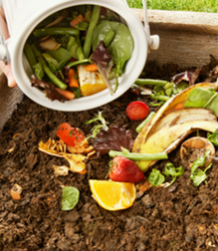
Building local resilience through community composting
Heather Williams & Bob Horowitz
CalRecycle

Slide 2
CalRecycle’s vision is to inspire and challenge Californians to achieve the highest waste reduction, recycling and reuse goals in the nation.
CalRecycle administers a range of programs:
Organics management
Food-scrap composting
Beverage container
Electronic-waste recycling
Used tires
Used motor oil
Carpet
Paint
Mattresses
Rigid plastic containers
Newsprint
Construction and demolition debris
Medical sharps waste
Household hazardous waste

Slide 3
CA
Organics Policy Drivers
Integrated Waste Management Act: AB 939 (1989)
Defined composting as recycling. All cities and counties must divert half of all solid waste away from landfills.
Mandatory Commercial Recycling (2011)
Statewide goal of 75% recycling, composting, source reduction
Mandatory Commercial Organics Recycling (2014)
Businesses generating specified amounts of organic waste must arrange for recycling services
  Green Material Used as Alternative Daily Cover (2014)
  Green materials used to cover landfill face at the end of the day no longer counts as diversion after Jan. 1, 2020.
  Short-Lived Climate Pollutants (SLCP): Organic Waste Methane Emissions Reductions, (2015)
  Reduce man made methane emissions 40% by 2030.
  Reduce organic materials going to landfills by 75% by 2025.
  Rescue 20% of currently disposed edible food for human consumption by 2025.
Must double existing organics infrastructure to attain these goals.

Slide 4
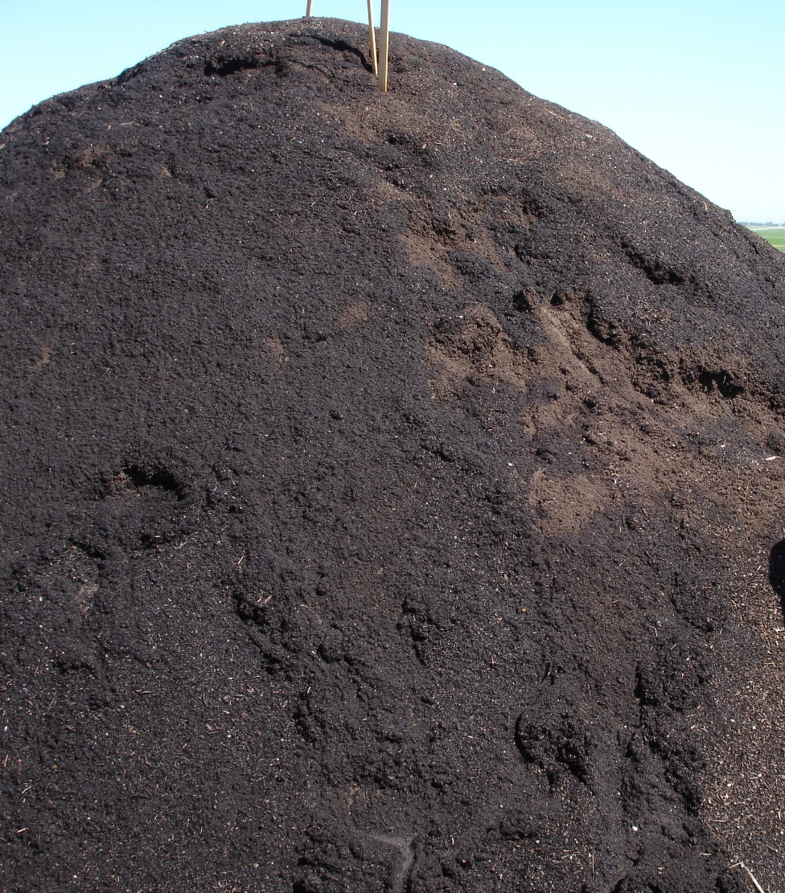
What is compost?
The odor free product of the biological-chemical breakdown of organic material
Sanitized by the early high-heat stage (PFRP): pest & pathogens controlled
Can be tilled into the soil or used as a top dressing
Source of organic matter, carbon, primary, secondary and trace nutrients
Not feedstock, a finished product

Slide 5
New Research out of
UC Davis
Tracked soil carbon changes throughout surface and subsoil layers in an agricultural system.
Gains in Soil Organic Carbon over the 19-year period translated to a rate of .66% increase in soil Carbon per year, exceeding the target of the 4-per-1000 initiative
Substantial increases in soil Carbon are achievable even in semi-arid climates.
Soil Organic Carbon losses observed in plots with winter cover crops and no compost application.
Supports importance of recording soil Carbon data on deep soil profile.
Tautges, et al., (2019)
Notes:
Received Feb 11, 2019, Accepted June 24, 2019
Tautges NE, Chiartas JL, Gaudin ACM, O’Geen AT, Herrera I, Scow KM. Deep soil inventories reveal that impacts of cover crops and compost on soil carbon sequestration differ in surface and subsurface soils. Glob Change Biol. 2019;00:1–14. https ://doi.org/10.1111/gcb.14762

Slide 6
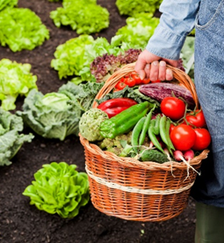
Benefits of compost use
Improve water holding capacity of soil.
Improve soil structure – increase porosity and lower bulk density
Increase moisture infiltration and permeability of heavy soils – reducing erosion and runoff.
Buffer soil pH and improve nutrient-holding capacity.
Supply beneficial microorganisms to the soil - improving nutrient uptake and suppressing certain soil-borne diseases.
A food source for beneficial microbes already in the soil.
Provide macro- and micro-nutrients

Slide 7
Environmental Justice
CalRecycle is working to increase protection of public health and safety, and the environment, within disadvantaged communities, while minimizing or mitigating the impacts of solid waste infrastructure on disadvantaged communities.
Notes:
EJ definition: The fair treatment of people of all races, cultures, and in-comes regarding the development, adoption, implementation, and enforcement of environmental laws, regulations, and policies.

Slide 8
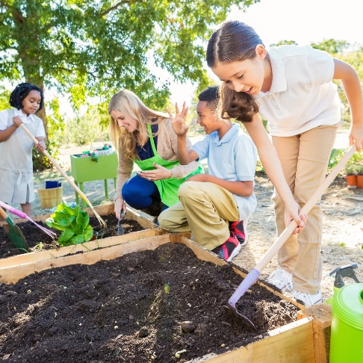
Community Composting
Provides convenient organic waste diversion opportunities within a community.
Keeps community resources within the community.
Provides environmental education opportunities to the surrounding community.
Results in local knowledge of composting and the benefits of compost use.
Can be located at community gardens, schools, farms, universities, libraries, parks and other green spaces.
Engages those served in correctly sorting organic waste.
Encourages local collaboration on efforts to protect the climate.

Slide 9

Site permitting: Excluded sites
Does not need solid waste permit, might need other types of permits
  Less than 100 cubic yards/750 sq. ft of materials on site at any time
  Vermicomposting
  Agricultural exemption
  Check in with your Local Enforcement Agency for assistance and guidance
  LEA is usually city or county environmental health department
  You cannot create a nuisance (odors, varmints)
CA Code of Regulations
(Title 17, Div. 7, Ch. 3.1, Article 2)

Slide 10

Community Composting for Green Spaces Grant Program
The program is currently in development and will provide funding from the Greenhouse Gas Reduction Fund (GGRF) to assist community groups statewide with composting.
This program is part of California Climate Investments, a statewide program that puts billions of Cap-and-Trade dollars to work reducing greenhouse gas emissions, strengthening the economy and improving public health and the environment— particularly in disadvantaged communities. The Cap-and-Trade program also creates a financial incentive for industries to invest in clean technologies and develop innovative ways to reduce pollution. At least 35 percent of these investments are made in disadvantaged and low-income communities. For more information, visit California Climate Investments.

Slide 11
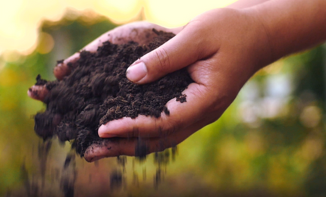
Goals of this New Program
Promote community-based solutions to reduce food and green waste and increase organic material diversion.
Grow community composting programs statewide.
Build strong working relationships with established community groups to increase the capacity and sustainability of groups.
Identify success factors for community composting programs and provide models for effective and sustainable community composting operations.

Slide 12
Grant structure
CalRecycle will select one grantee to implement the program statewide.
The grantee will identify community groups that have access to a site appropriate for community composting and are interested in managing a community composting site.
Projects located in and serving disadvantaged communities will have priority.
The grantee will work with community groups to plan and develop selected community composting project sites.

Slide 13
Program Timeline
Dec 2019 | Criteria and RFA released
Jan 2019 | Post Notice of Funds Available, application, and related instructions and documents
Jan/Feb 2020 | Question and Answer Period
Feb 2020 | Applications due
Mar 2020 | Conduct application evaluation/review process
Apr 2020 | Grant Award
May 2020 | Grant Agreement distributed and executed
Apr 1, 2022 | Grant term ends

Slide 14
Community engagement
Grantee will solicit, evaluate and select individual project sites statewide.
Grantee will coordinate with groups representing project sites to identify and address the unique needs of each community throughout creation and implementation of a project site plan.
Grantee will provide education on composting fundamentals, equipment, techniques, data collection and best management practices to managers of each project site.

Slide 15
Eligible project sites
Must be operated by a community group with the capacity and desire to operate a composting site.
Must demonstrate group is authorized to access and use the site for the entire grant term.
After the requirements have been met applications will be ranked.
Rank 1 - Applications from Disadvantaged communities
as identified by CalEnviroScreen.
Rank 2 - Applications from Low-Income communities and buffer zones of Disadvantaged communities.
Rank 3 – Applications from interested community groups throughout the state.
Must be publicly accessible.

Slide 16
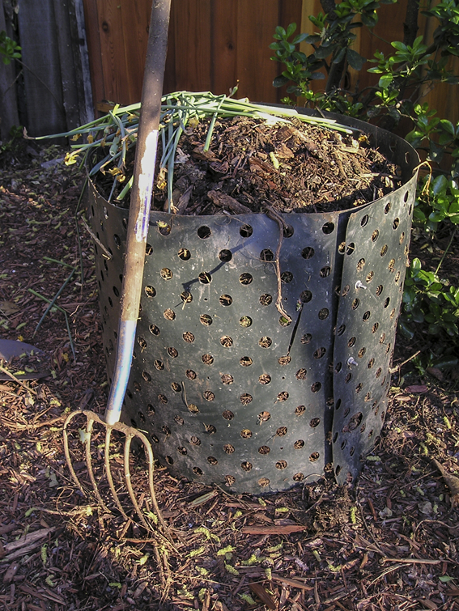
Eligible expenses
Potential eligible expenses for project sites include, but are not limited to:
Tools
Fencing
Bulking material
Containers
Signage
Trees
Staff training
Community outreach
Soil/Compost testing

Slide 17
Stakeholder
Input
Environmental education
Food waste composting
Composting tools and equipment
Staff to manage and support composting operations
Guidance on permitting and regulatory requirements

Slide 18
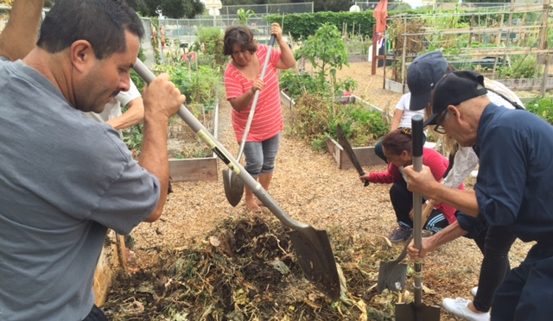
Expected Co-Benefits of Grant Program
Build and empower the community
Support gardens
Improve local soils
Enhance local food security
Promote creation of green spaces
Lead to greener neighborhoods
Increase local use of compost and carbon sequestration

Slide 19
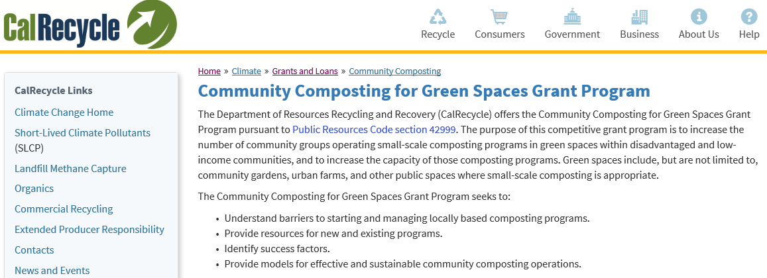
Visit the Community Composting for Green Spaces Grant Program webpage for more information. https://www.calrecycle.ca.gov/climate/grantsloans/communitycomposting/

Slide 20

Thank you for your time.
Heather Williams
Heather.Williams@calrecycle.ca.gov
916-341-6815

