Slide 1

Converting Waste to Energy with Gasification Technology in California
California Bioresources Alliance Symposium 11/14/2019
Meredith Roberts, Director of External Relations | mroberts@sierraenergy.com
sierraenergy.com

Slide 2
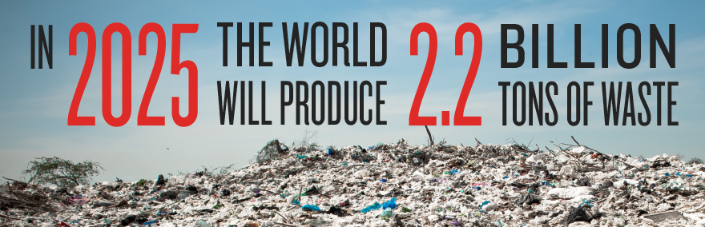
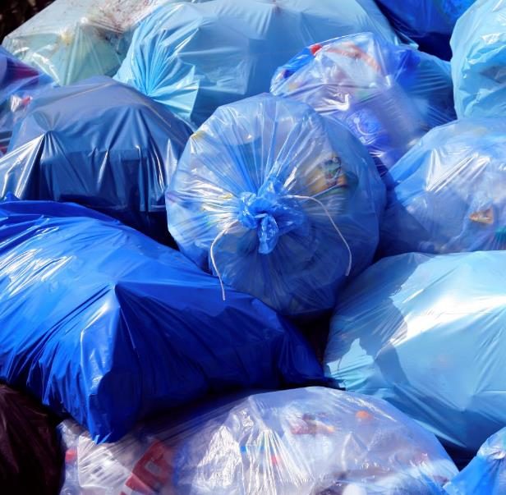
Our Waste
U.S. generates 250 million tons of waste annually and 100 million tons are landfilled (U.S. EPA)
California sends over 28 million metric tons of waste to landfills annually.
Methane is up to 84x more polluting than CO_{2 .}
Data from World Bank

Slide 3
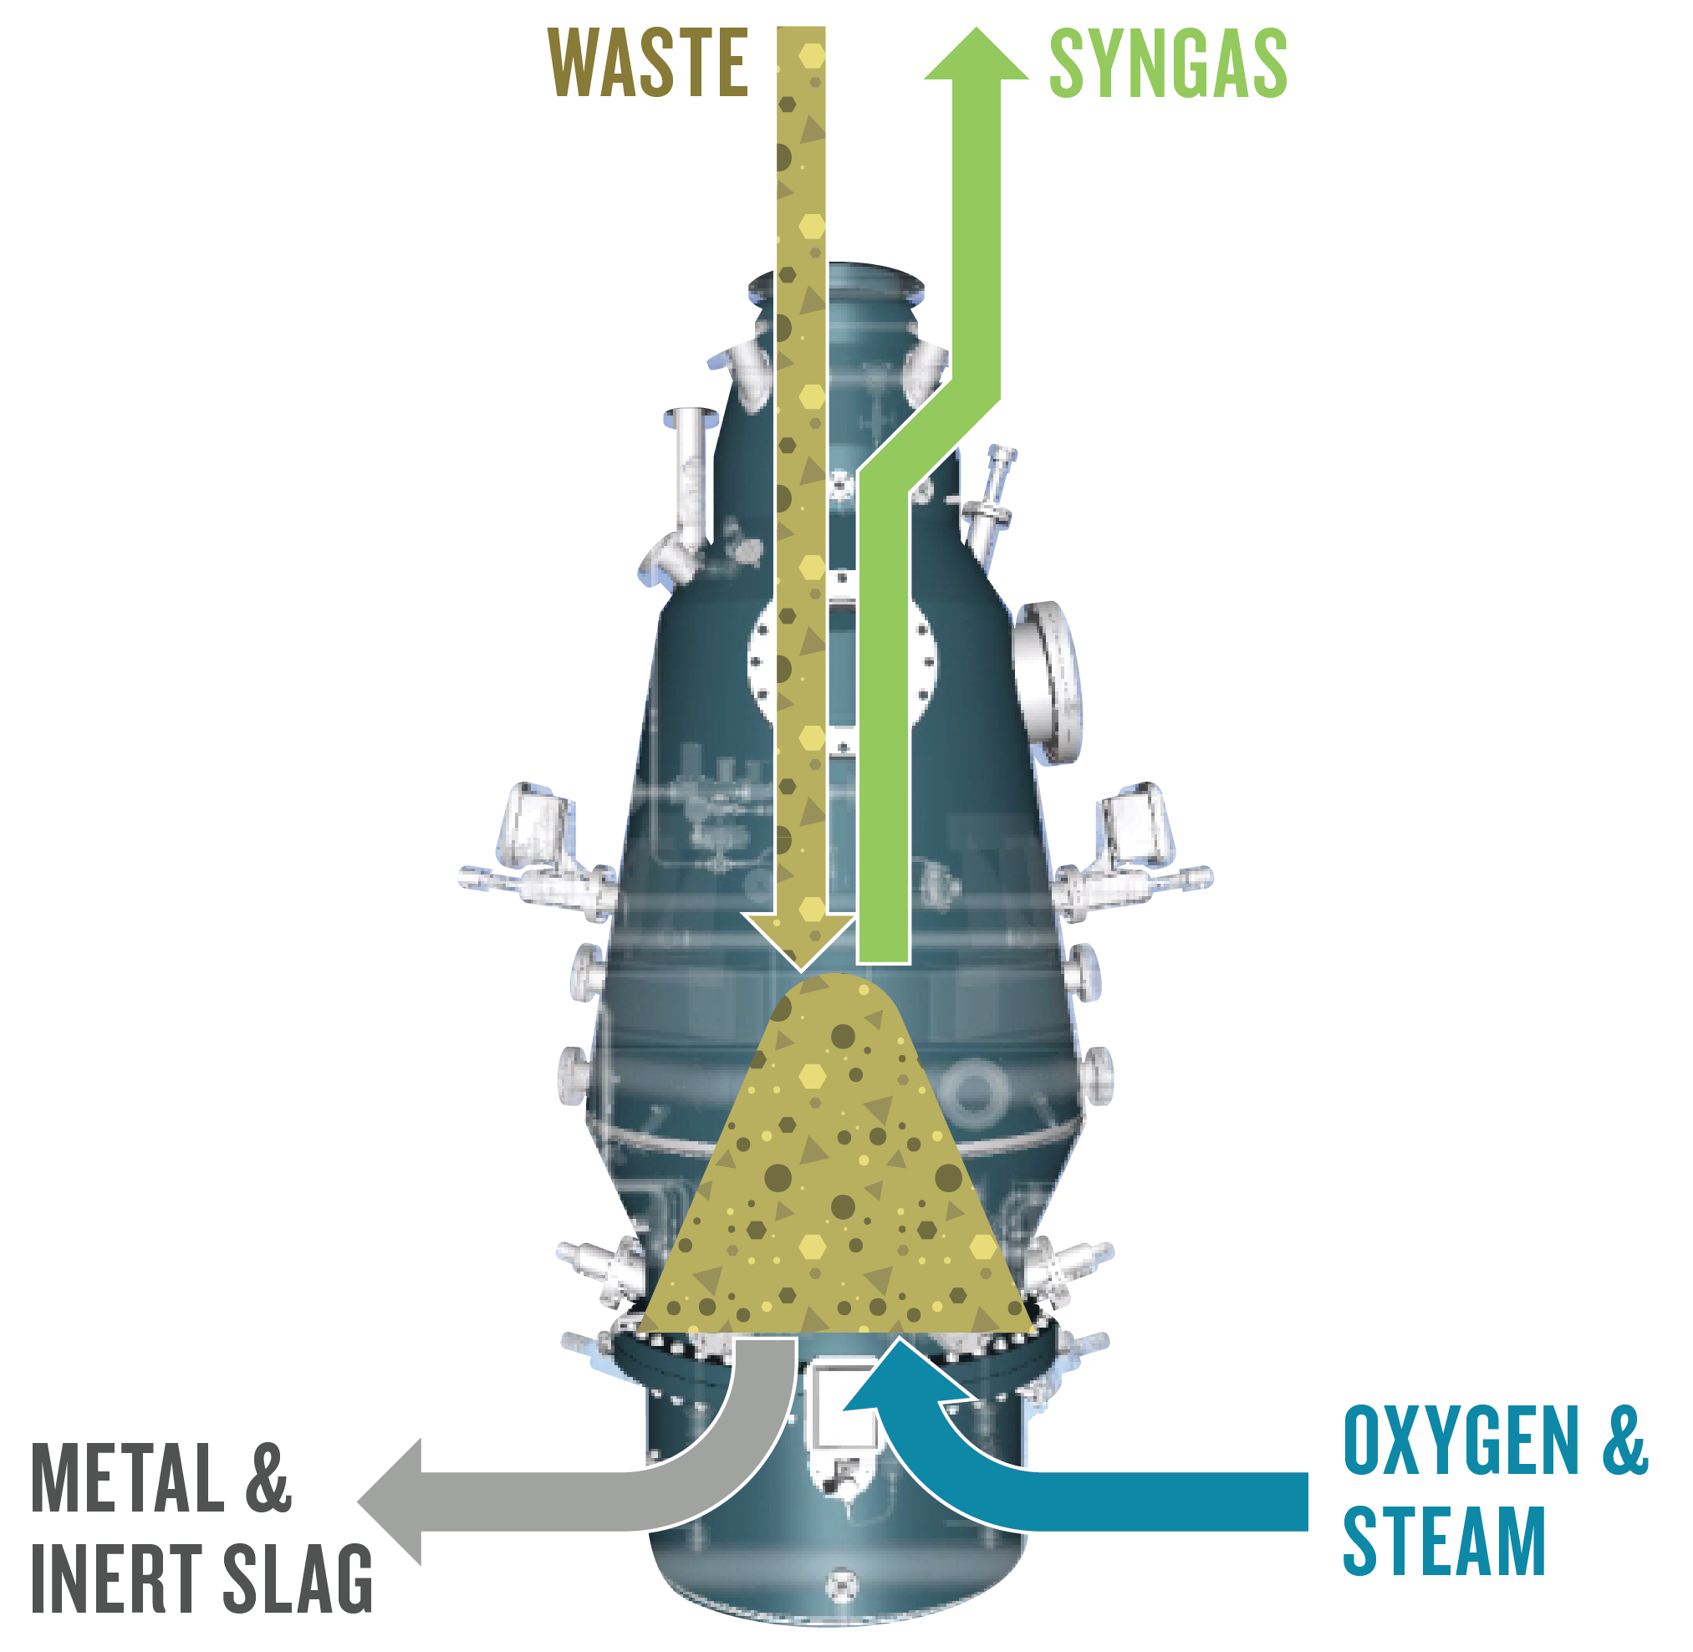
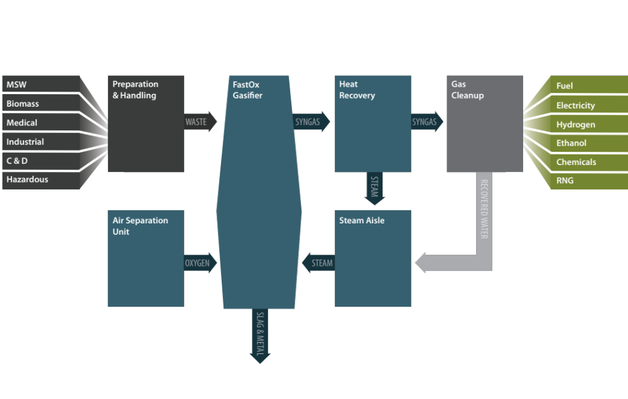
FastOx® Gasification
Unit that converts solid feed material to syngas
Based on blast furnace technology – no moving parts in high temperature zones
Reaches 4,000°F via oxygen and steam injection

Slide 4
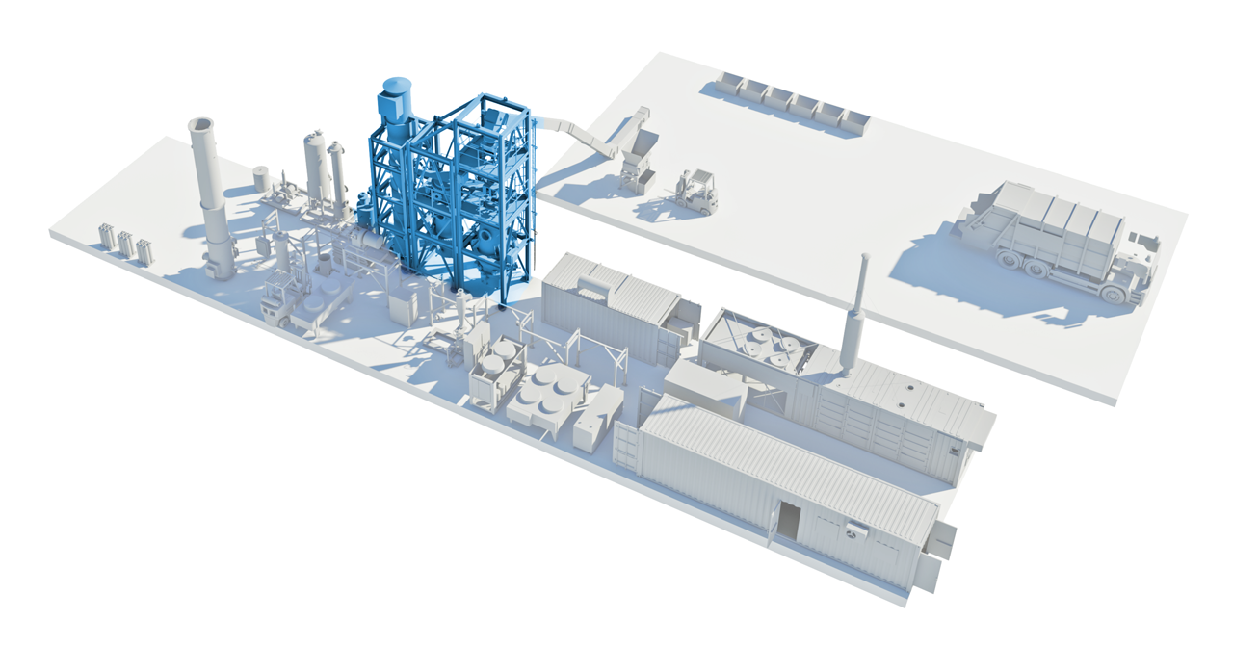
FastOx® Gasification Plant Configuration
4
Gasification
5
Gas Cleaning
1
Feedstock Preparation
2
Utilities Isle
6
End Product Isle
Sierra’s core technology is the
Gasifier, Polisher, Recuperator, and
the Controls that run them (GPRC).
3
Controls

Slide 5
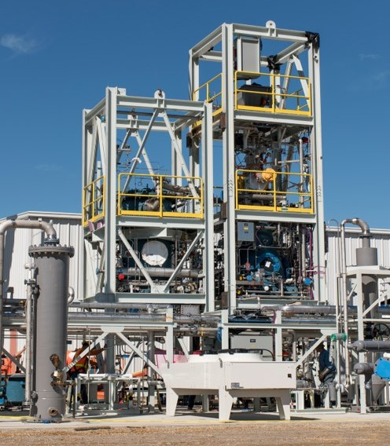
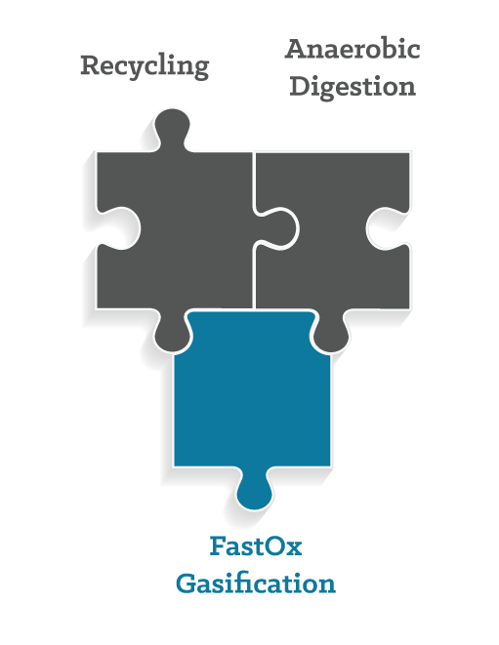
FastOx® Gasification Benefits
No process emissions
Handles complex waste
All outputs are salable
Minimal waste processing
Low maintenance
Scalable
Low parasitic load

Slide 6
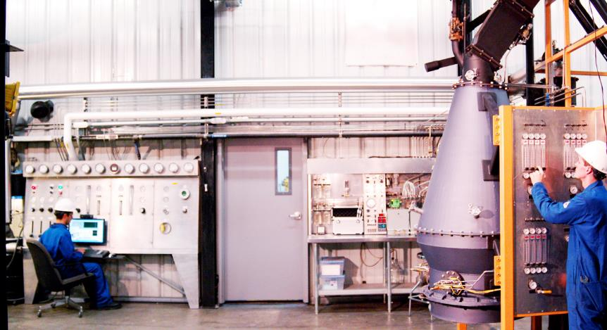
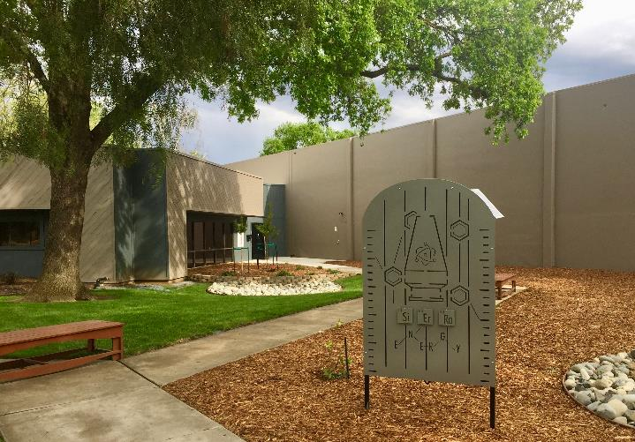
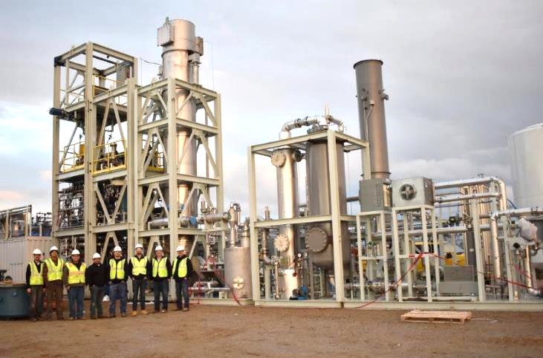
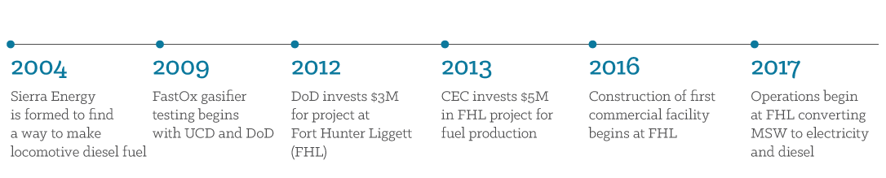
Sierra Energy Background

Slide 7


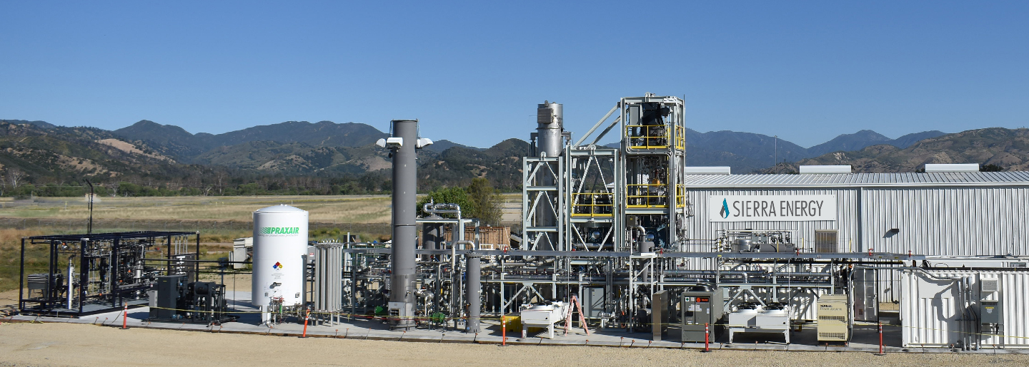


Fort Hunter Liggett Demonstration Project
Objectives
Design, develop, and demonstrate the effectiveness and economic feasibility of a
commercial scale waste to renewable energy plant.
Verify that this process is a beneficial way to achieve energy resiliency and security.

Slide 8
Fort Hunter Liggett Permitting
Topic | Agency | Requirement | Date Obtained
Air permit – Authority to Construct (ATC) | Monterey Bay Unified Air Pollution Control District | Permit to Procure and install equipment per the Air Board’s requirement | 5-Feb-2015 and updated 9-Jun-2017 and 1-Feb-2018 and 5-Dec-2018
Air Permit – Permit to Operate | Monterey Bay Unified Air Pollution Control District | Permit to operate the system / plant continuously | In progress
Solid Waste Permit Exemption | Monterey County DoH | Ensure system / plant meets all state and local requirements | 1-Mar-2016
Water | FHL Dept. of Public Works (DPW) | Ensure backflow preventers meet all state and local requirements | 12-Jul-2017
Waste Water (Discharge to FHL) | CCRWQCB | Confirmation that system does not require FHL to obtain new permit | 8-Apr-2015
CEQA / NEPA | CEC (CCRWQCB, MBARD and FHL DPW) | Project needs to be CEQA compliant given the funding sources requirement | 1-Jun-2015
Cal/OSHA | Cal/OSHA | Confirmation that the system does not trigger PSM (Process Safety Management) | 24-Jan-2018
SPCC | FHL DPW | Double-wall tanks and concrete tertiary spill containment areas | Coordinated with FHL DPW
Pressure Vessels | Cal/OSHA Pressure Vessel Division and FHL DPW | Meets CA Dept. of Industrial Relations requirements | 7-Jun-2016 – 9-Mar-2017
Boiler | Cal/OSHA Pressure Vessel Division | Permit to operate steam boiler | 29-Jun-2017
Fire | FHL Fire Department | Inspections to confirm equipment, and layout meets FHL FD, California and Federal requirements | 4-Apr-2017
Structural | FHL DPW | Meets CA requirements | 27-Apr-2016 – 24-Feb-2017

Slide 9

Global Interest in FastOx® Technology
Data Source: Sierra Energy online calculator. Most recent 1,200 calculator
runs during 2nd half of 2017. Map by Freepik.

Slide 10
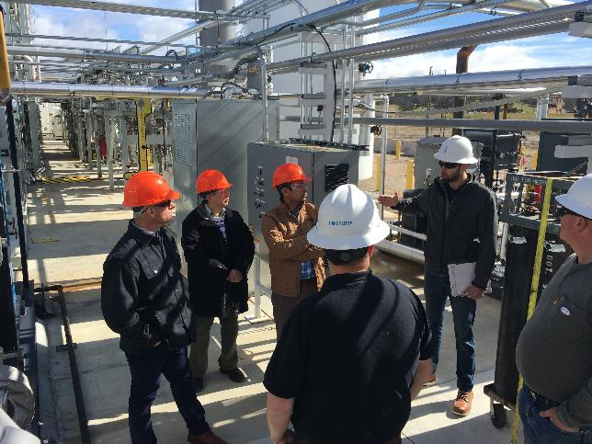
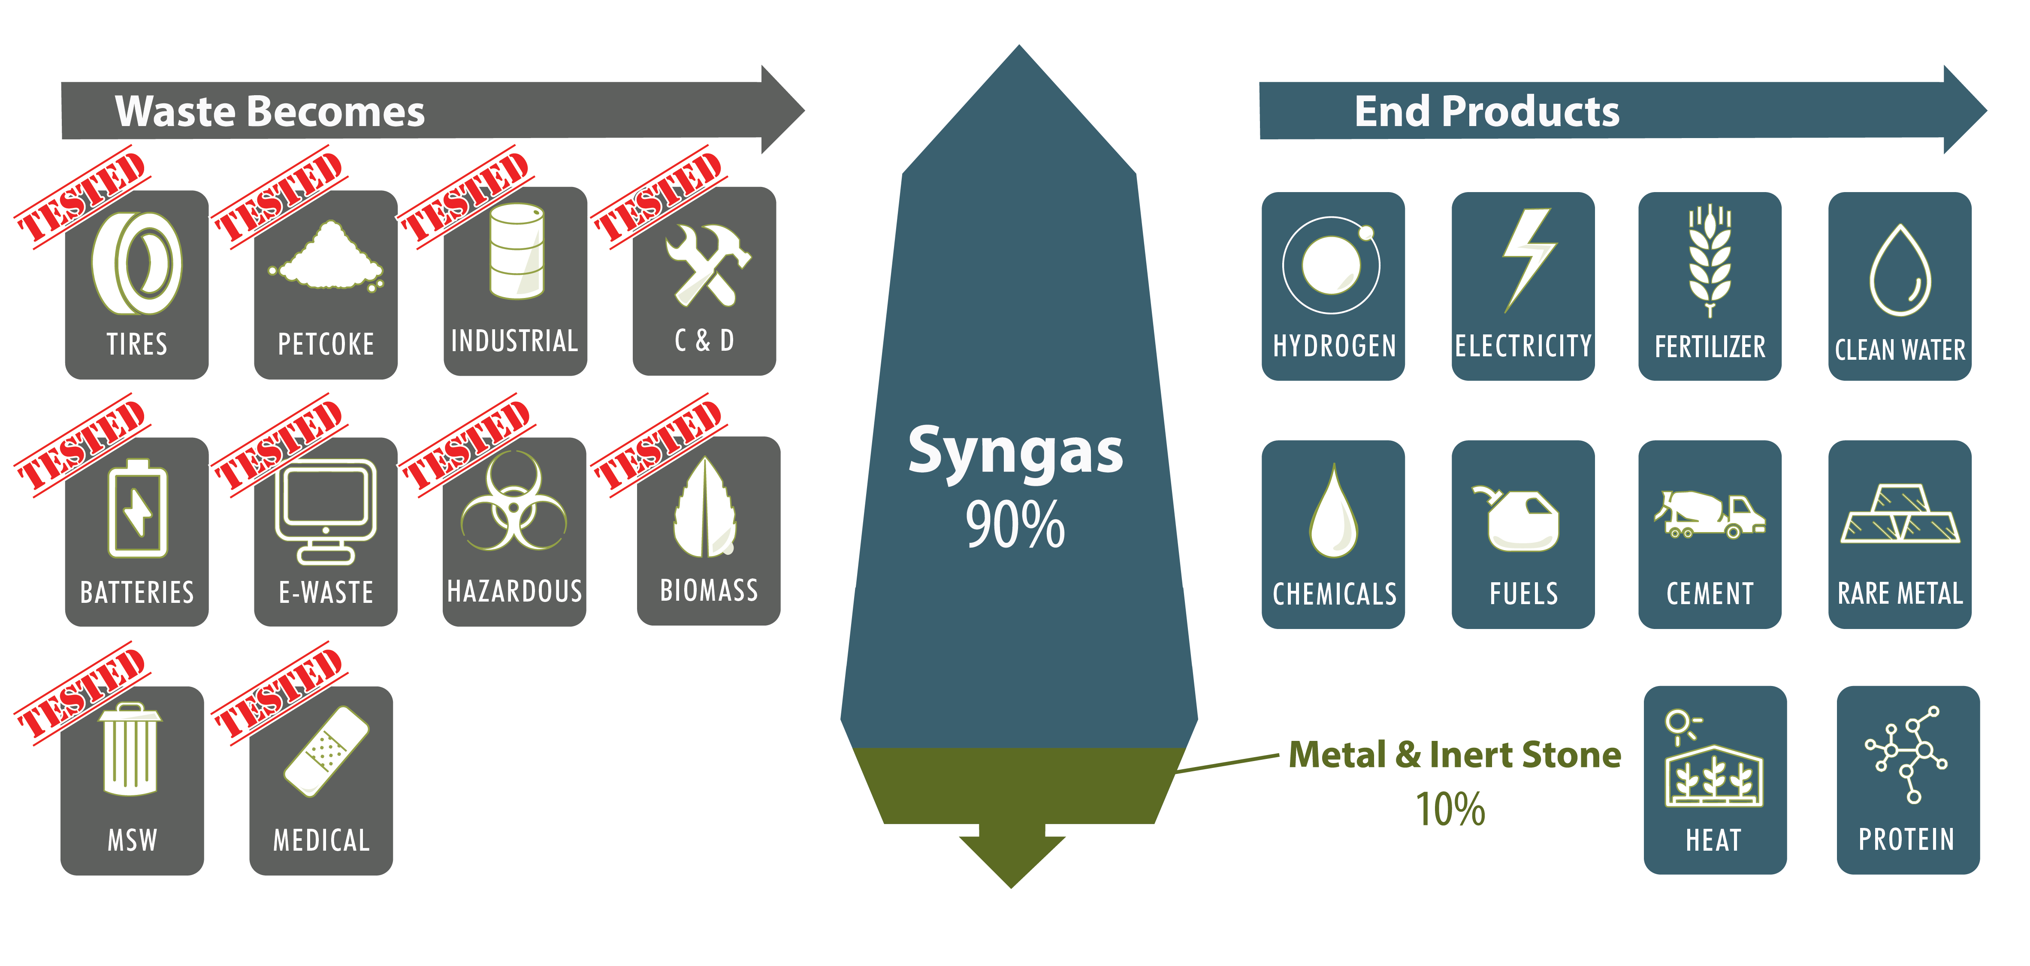
Outreach and Research
Research and Program Areas:
Academic – student and research collaborations
Institutions – national labs and other industry research entities
Defense – federal installation and research
SERP R&D facility at Davis
Team of researchers from Idaho National Laboratory

Slide 11
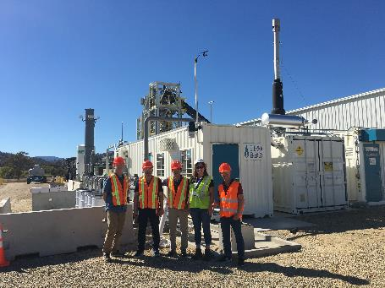
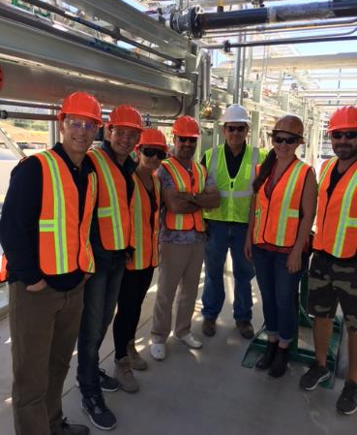
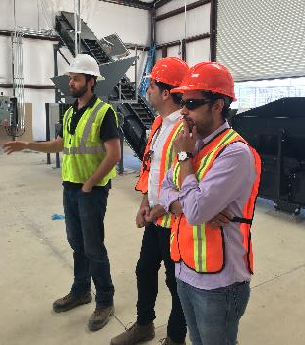
Commercialization Pathway
Sierra Energy is looking to partner with project developers all over the world
Sierra is not building to own and operate
Sierra will license technology to partners and providing engineering support
Ideal as an add-on to existing recycling and waste diversion sites
Global visitors to FHL plant:
Thailand, Poland, Turkey, Vietnam, Mexico, Trinidad and Tobago, Argentina.

Slide 12
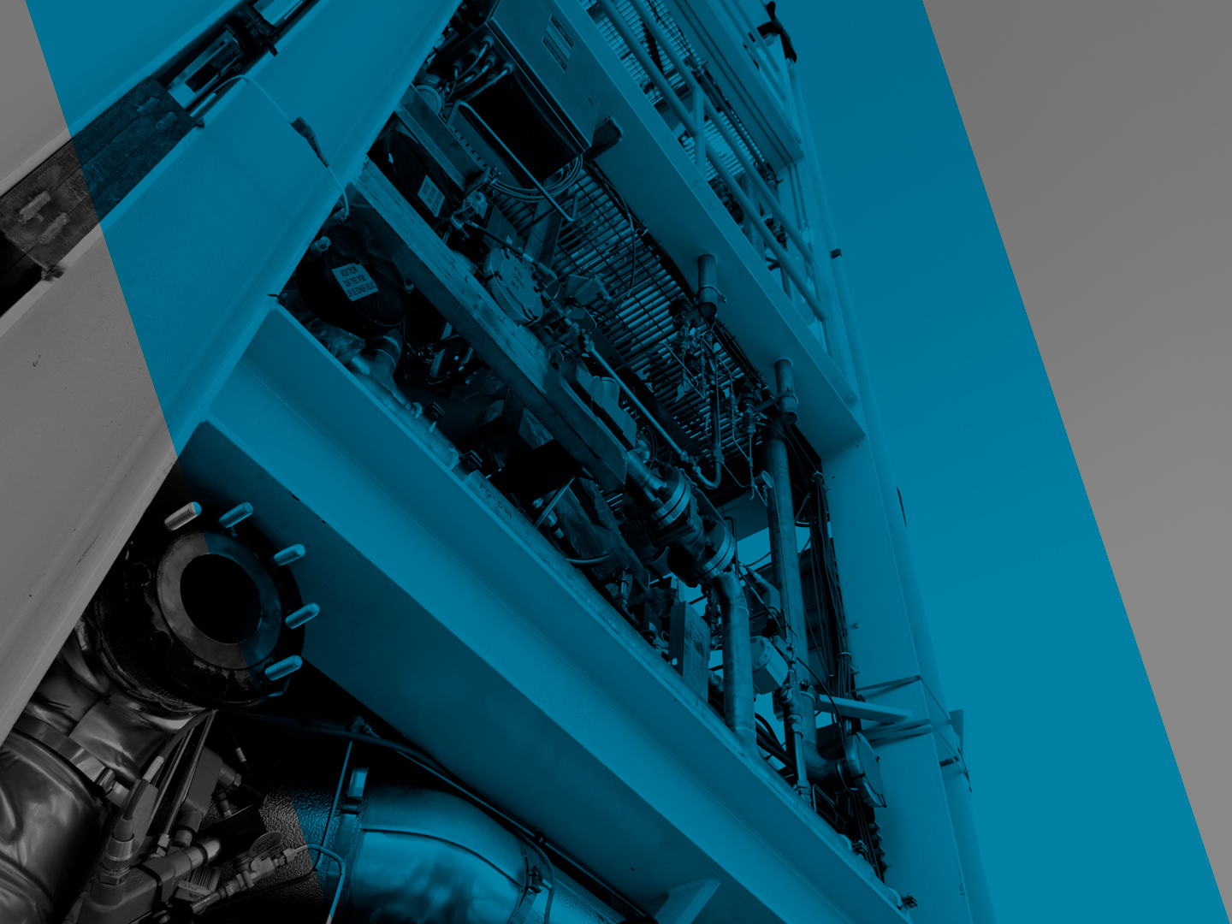
Thank You
The information provided is confidential and proprietary and constitutes Sierra Energy’s trade secrets; it may not be disclosed to any third parties without Sierra Energy’s express written permission. The information is based on estimates and assumptions that may prove to be incorrect; actual results may differ significantly. Sierra Energy makes no warranty, guarantee, or representation, either express or implied, as to the adequacy, accuracy, sufficiency, completeness, or freedom from defects of any information provided. Sierra Energy shall not have any liability whatsoever, or be liable for damages of whatever kind or for any costs, expenses, risks, or liabilities, as a result of the receipt or use of, or reliance on, any of the provided information.
Sierra Energy │ 1222 Research Park Drive, Davis, CA 95618 │ (530) 759-9827 │ info@sierraenergy.com

Slide 13










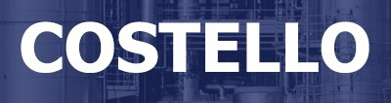




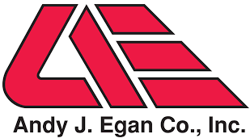


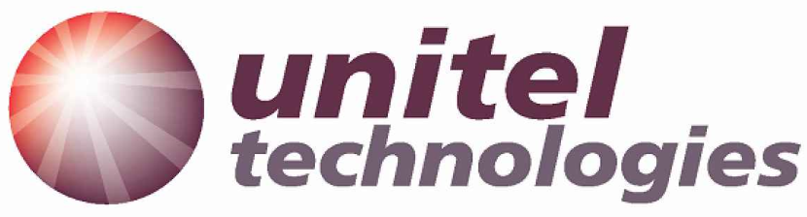








FastOx® Technology Collaborators
KAISER
STEEL

Slide 14
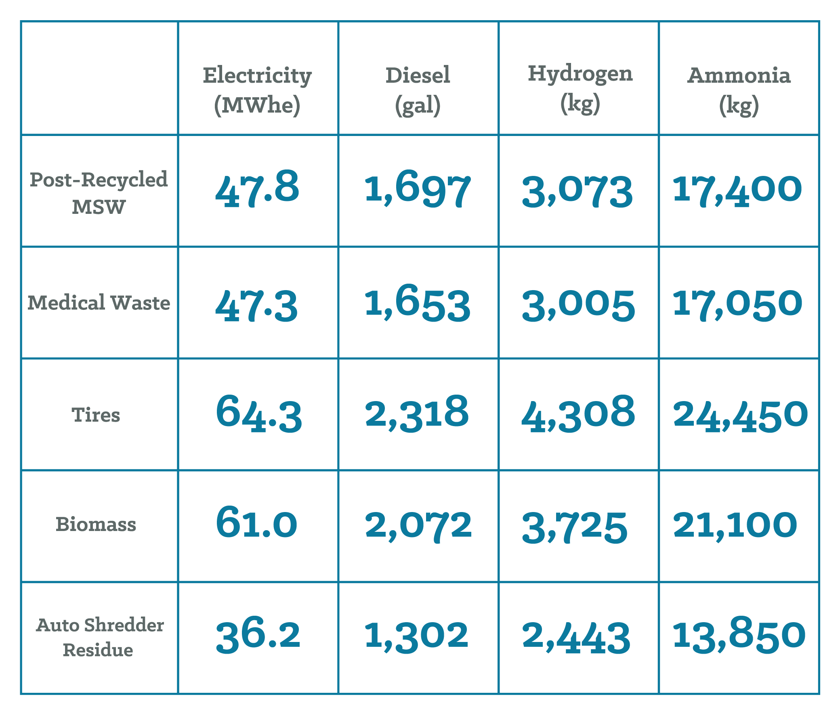
FastOx® Gasification Yield Table
Output per Day | 50 tpd Feedstock Input

