Slide 1
Introduction to clean water act
Water Quality Standards for tribes
Office of Science and Technology
Office of Water
U.S. EPA
Notes:
My goal is to introduce Water Quality Standards assuming the people in my audience are currently or will be working with tribes in the WQS program, but are new to it, or new to some parts of it. I’m assuming I’m starting from the beginning, like a 101 level. I’m not going to get into a lot of detail or into case specific situations.
I have included some blank slides where I and my colleagues can answer questions from the chat boxes every 10-15 minutes at natural break points. We can do a question or two at those points. Then we will also have time at the end for more. We can answer basic questions but if you have detailed or advanced or case specific questions, I suggest you save those for your EPA regional WQS coordinators.

Slide 2
Disclaimers
This presentation does not:
  Impose any binding requirements
  Determine the obligations of the regulated community
  Change or substitute for any statutory provision or regulation requirement
  Represent, change, or substitute for any Agency policy or guidance
  Control in any case of conflict between this discussion and statute, regulation, policy, or guidance
The views expressed in presentation are those of the author(s) and do not necessarily represent the views or policies of the U.S. Environmental Protection Agency.
Notes:
[Read the disclaimers]

Slide 3
Overview
History of the Clean Water Act
Laws, Regulations and Guidance Related to Water Quality Standards (WQS)
Water Quality Standards
  Core components of WQS:
    Designated Uses
    Water Quality Criteria
    Antidegradation
  Additional Components of WQS
Roles of Authorized Tribes, States, Territories, the Public, and the EPA
Implementing WQS
Notes:
Here is a list of topics we will cover in this presentation.

Slide 4
History of the Clean Water Act
Notes:
We will start at the legal basis for the water quality standards program, The Clean Water Act.

Slide 5
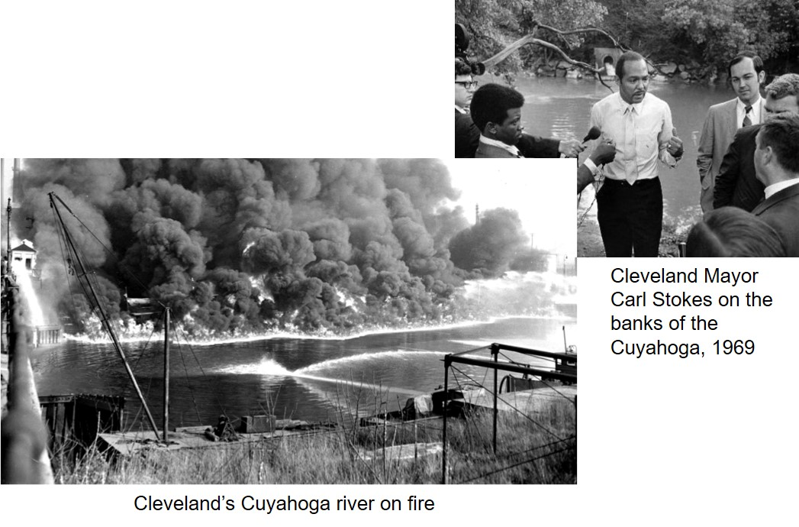
History of CWA Amendments
1948: Federal Water Pollution Control Act (FWPCA).
1972: Major set of amendments, as amended to “Clean Water Act” (CWA).
2000: The “BEACH Act” amendments established a grant program to support monitoring and advisory programs at coastal marine and Great Lakes beaches. Also required research and development of recreational criteria by EPA.
Today: The “Modern” Clean Water Act.
Notes:
Congressional statutes have mentioned water back as early as the 1800s. For example, the Rivers and Harbors Act, which focused on protecting navigation routes.
The Federal Water Pollution Control Act, which was enacted in 1948, is the root of the modern Clean Water Act, because it focused on protection for water quality, not only for navigation. In 1972, that Act was amended to add many of the key programs we are familiar with today, and we call the 1972 and subsequent versions of the statute the “Clean Water Act” or CWA for short.
The modern Clean Water Act includes some changes along the way. For example, the construction grants added in 1972 were replaced in 1987 by the Clean Water State Revolving Fund.

Slide 6
The 1972 Amendments to FWPCA:
“Clean Water Act (CWA)”
  Established the basic structure for regulating pollutants discharged into the “waters of the US.”
  Made it unlawful for any person to discharge any pollutant from a point source into navigable waters, unless a permit was obtained under its provisions.
  Funded the construction of sewage treatment plants under the construction grants program.
  Required each state and territory to adopt water quality standards for all intrastate waters and provided for EPA review and approval or disapproval.
  Provided opportunities for meaningful public engagement.
Notes:
The 1972 amendments were critical to establishing the modern Clean Water Act because they provided a robust structure and some major requirements that enhanced the legal mechanisms for protecting clean water.
At a “50,000 foot level,” some of the most major additions were that it:
-Established the basic structure for regulating pollutants discharged into the “waters of the US.”
-Made it unlawful for any person to discharge any pollutant from a point source into navigable waters, unless a permit was obtained under its provisions.
-Funded the construction of sewage treatment plants under the construction grants program. (This has subsequently been replaced for states by the clean water state revolving fund – tribes and territories can still get grants)
-Required each state to adopt water quality standards for all interstate and intrastate waters and provided for EPA review and approval or disapproval. THIS IS THE ASPECT WE WILL BE TALKING MOST ABOUT TODAY.
and
Provided opportunities for meaningful public engagement.

Slide 7
CWA Section 518
  In 1987, Congress amended the Clean Water Act in part by adding Section 518 authorizing the EPA Administrator to treat tribes in a similar manner as states (TAS) for purposes of administering certain Clean Water Act programs including:
    106 and 319 grants
    303(c) WQS and 401 water quality certification
    303(d) listings and TMDLs
    402 NPDES permits
    404 dredge and fill permits
Notes:
In 1987, Congress amended the Clean Water Act in part by adding Section 518 authorizing the EPA Administrator to treat tribes in a similar manner as states (TAS) for purposes of administering certain Clean Water Act programs, as long as the tribes can meet certain eligibility criteria.
These programs include: 303(c) water quality standards,401 water quality certifications, 303(d) impaired water listings and TMDLs, 402 NPDES permits, 404 dredge or fill permits 106 and 319 grants.
Under Clean Water Act Section 518(e) EPA can authorize tribes to establish water quality standards to protect waters under their jurisdiction.
We make use of the word “Tribes” in this presentation, recognizing that some identify themselves as “Bands,” “Nations,” “Rancherias”, “Communities,” “Pueblos,” “Colonies,” “Towns,” “Indians,” aboriginal names, and “Villages.” EPA tries to respect the tribe’s identity whenever we can, but the federal government has settled on “tribes” (and less frequently as “Indian tribal entities” or “Alaskan native entities”) as generic terms.
Note that “authorized tribe” refers to a tribe that has TAS. We’ll use this term throughout this presentation.

Slide 8
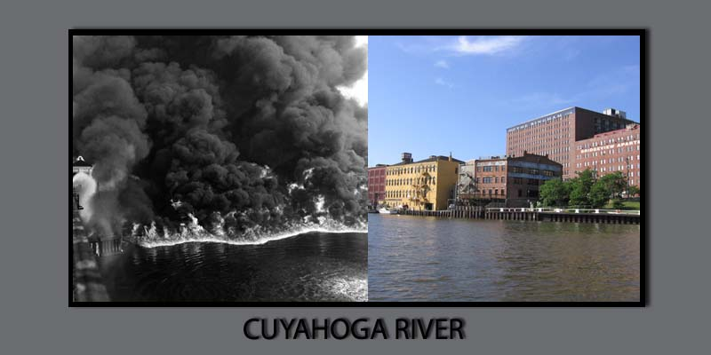
Why does the Clean Water Act matter?
Ca. 1960s
present day
Cuyahoga River water quality improvements in recent years reflect the effects of requirements of the CWA 1972 amendments.
Notes:
In less than 50 years, the CWA has had a big impact on improving and protecting our nation’s water quality, but people may not be aware of how big its impact has been.
You may be familiar with the Cuyahoga River, "the river that caught fire", located in Northeast Ohio. At one time, the Cuyahoga River was one of the most polluted rivers in the United States, and the reach from Akron to Cleveland was completely devoid of fish.
At least 13 fires were reported on the Cuyahoga River, the first occurring in 1868, and the largest in 1952, which burned for three days and was reported to cause over 1.5 million dollars in damage. Then, in 1969, a river fire captured the attention of Time Magazine, which described the Cuyahoga as the river that "oozes rather than flows". The impairment of this river helped to spur the environmental movement in the late 1960s, and is one of the reasons why we have the CWA, which is intended to help prevent the impairment of our waters.
The picture on the right shows the Cuyahoga today. What happened between the days when the river was burning and oozing and now? Well, several things - the CWA and EPA regulations implementing the Act were put into place, the federal EPA and the Ohio EPA were created. All of these, along with public involvement, brought a lot more attention to the sources of pollution to the river, and work began to remedy the problems.
The river today still faces environmental challenges, but it has been restored in many respects, it flows again, doesn’t catch fire, contains fish and other aquatic life, and attracts kayakers.
While this is an extreme case showing the benefits of the Clean Water Act, the Act and its implementing regulations can still have an effect in today’s waters. For example, having tribal water quality standards as part of tribal laws gives greater control in determining how waters are protected and in defining the goals for restoration of degraded waters. Water quality standards also are important in overall efforts to prevent or minimize communities’ exposure to pollutants and harmful substances. Because water quality standards set the foundation for what level of water quality must be met by other CWA programs, they provide particular opportunities for ensuring water quality protection in areas used by sensitive and environmentally overburdened populations.

Slide 9
Laws, Regulations and Guidance Related to cwa Water Quality Standards
Notes:
We will now talk about the basic legal framework of how the Clean Water Act gets implemented through EPA programs, specifically the WQS regulation. What people may not know is that the passing of a law like the Clean Water Act is just the beginning of addressing problems like water pollution from the federal level.

Slide 10
Working Toward CWA Goals:
It’s a Hierarchy
Statute
Regulations
Guidance and Policy
The Clean Water Act (CWA) is a statute.
  Statutes are passed by Congress.
  Statutes are laws that impose requirements or “musts.”
The CWA gave EPA the authority to promulgate regulations.
  These are substantive rules (or “musts”) to implement the statute.
  This presentation will mention several of EPA’s regulations under the CWA, including WQS (40 CFR 131), NPDES (40 CFR 122), and TMDL (40 CFR 130.7).
EPA publishes guidance to assist states and authorized tribes
  Guidance does not have the force of law.
Notes:
The Clean Water Act is a law, or a statute, passed by Congress, that imposes requirements. It is the umbrella – everything that EPA requires in its regulations under the Clean Water Act must derive from the Law.
A statute or Law is enacted by Congress (the legislative branch). It’s a “must”. Statutes are typically signed by the President, but in some cases (such as the Clean Water Act amendments of 1972), if the President vetoes a statute, Congress has been able to get enough votes to override the veto for it to become a law.
Regulations under the Clean Water Act are promulgated by EPA (an executive branch agency). They are also “musts,” and they implement the law. This presentation will go over many different regulations written and administered by EPA that are designed to implement the Clean Water Act. We will start by talking about Water Quality Standards (or WQS), and will also talk about National Pollutant Discharge Elimination System (or NPDES) permits and total maximum daily loads (TMDL) as well as other implementation programs.
To develop and promulgate regulations, agencies use a process called “notice and comment rulemaking” which is itself governed by law (the Administrative Procedures Act). These regulations provide detail on the Clean Water Act requirements, but often EPA also publishes guidance and policy documents that provide more detail to assist states and authorized tribes in implementation. EPA’s guidance and policy are different. They are the EPA’s recommendations on how to implement regulations. They do not, and should not, create a “binding norm,” and cannot limit the Agency’s action in a particular instance. Guidance and policy are not basis for disapproval of water quality standards. EPA can’t use guidance as “proxy rulemaking.” Guidance and policy are a “should”, not a “must”. Examples of guidance and policy in water quality standards are in the Water Quality Standards Handbook.
To summarize, laws are the overarching framework of requirements, regulations are more specific requirements that “flesh out” the laws, and guidance and policy are recommendations to help facilitate the implementation of laws and regulations. Guidance and/or policy are made by EPA to help states and authorized tribes follow the regulations and/or law.
Let’s look more closely at each of these elements in the hierarchy, starting with the basics of the Clean Water Act.

Slide 11
Law: Clean Water act
Objective: “restore and maintain the chemical, physical and biological integrity of the Nation’s waters.” (CWA 101(a))
Interim goal: “wherever attainable…water quality which provides for the protection and propagation of fish, shellfish and wildlife and provides for recreation in and on the water.” (CWA 101(a)(2))
Notes:
In the Clean Water Act (CWA), Congress tells us that the objective of this Act is to restore and maintain the chemical, physical, and biological integrity of the Nation's waters. That’s a great objective, and ultimately what water quality standards are all about, but it’s a little hard to wrap a water quality management program around that broad-brush objective.
Fortunately, the CWA Section 101 (a) (2) provided some more nuance to that, and established that “it is the national goal that wherever attainable, an interim goal of water quality which provides for the protection and propagation of fish, shellfish, and wildlife and provides for recreation in and on the water be achieved by July 1, 1983.”
You will hear these phrases and these section numbers many times in your work in the WQS program, so if you haven’t memorized them already, I promise you will eventually!
EPA’s WQS regulation provides further detail on what the Clean Water Act interim goal means, and how authorized tribes’ WQS programs aim for the interim goal and ultimately to the main objective of restoration and maintenance of the integrity of the nation’s waters.
We will get more into EPA’s Water Quality Standards regulation shortly, as it is at the core of the implementing regulations for the Act.

Slide 12
waters under cwa jurisdiction
“Waters of the United States” (WOTUS)
The U.S. EPA and the Army recently signed the Navigable Waters Protection Rule, which when effective will define WOTUS as:
The territorial seas and traditional navigable waters,
Perennial and intermittent tributaries to those waters,
Certain lakes, ponds, and impoundments, and
Wetlands adjacent to jurisdictional waters
The final rule also details 12 categories of exclusions, features that are not “waters of the United States,” such as features that only contain water in direct response to rainfall (e.g., ephemeral features); groundwater; many ditches; prior converted cropland; and waste treatment systems.
States and tribes have discretion to adopt state/tribal rules to protect groundwater, and any non-WOTUS, if they choose. Such waters would not be regulated under the Clean Water Act.
Notes:
Before we get more into how the CWA and its implementation programs protect water quality, we need to know, what waters are we talking about when we talk about waters protected under the Clean Water Act? And beyond that what impacts on waters are we talking about?
The jurisdiction of the CWA is for "waters of the United States.,“ or as the Act refers to them, “navigable waters.” This definition encompasses a broad range of waters, including rivers, streams, seasonally flowing streams, lakes, natural ponds, wetlands, and marine waters. Marine waters include estuaries (such as bays), salt marshes, and lagoons and near-shore coastal waters. This slide shows a very broad brush overview, but keep in mind that this is a controversial topic so we won’t go into any more detail today.
The definition of "waters of the United States" does not include ground water. Some tribes may have water quality standards for ground water, but such standards do not fall within the scope of the federally mandated water quality standards program. The Safe Drinking Water Act provides protections for underground sources of drinking water.
Important to keep in mind: EPA recognizes that a change in jurisdiction resulting from this rule may change the scope of application of the CWA regulatory programs to a particular water, but the longstanding approach that the agencies have taken to implementing and enforcing those programs would remain the same. EPA-approved water quality standards are applicable for CWA purposes only for those waters that are waters of the United States. Tribes can continue to adopt WQS for waters that are that not considered WOTUS, with the understanding that EPA would not have an official approval role under CWA Section 303(c).
EPA is the permitting authority for Indian Country under the CWA. If a CWA Section 402 permit is not currently required for a discharge to a water, it is unlikely that this final rule will create a requirement for a new CWA permit. If a Section 402 permit is currently required for a discharge to a water that is no longer jurisdictional under this final rule, that permit may no longer be required; it may still be required if the non-jurisdictional feature conveys a discharge of pollutants from a point source to a water of the United States; or it may still be required but the conditions associated with the permit may need to be modified, subject to applicable anti-backsliding permit requirements.

Slide 13
KEY CWA Sections
The following are key sections that outline a portion of the major implementation programs. The first number of the section indicates the title of the Act in which that section is located.
CWA 101 - Goals and Policy
CWA 301 - Technology Based Effluent Limits
CWA 302 - Water Quality Based Effluent Limits
CWA 303 - Water Quality Standards and Implementation
CWA 319 - Nonpoint Source Management
CWA 401 - State/Tribal Certification
CWA 402 - Point Source Permitting (NPDES)
CWA 502 - Definitions: Navigable, Pollutant…
CWA 510 - State/Tribal Authority
CWA 518 - Indian Tribes
Notes:
Here are some key sections of the CWA that outline some of (but not all) the major implementation programs. The first number of the section indicates the title of the Act in which that section is located, so "Section 303" is part of Title 3 of the Act.
Section 101 outlines the major goals as we saw a couple of slides ago.
Section 502 has definitions that apply throughout the Act.
Section 303 outlines the requirements for water quality standards, and provides the basis for EPA’s WQS regulation at 40 CFR part 131
Section 402 outlines the requirements for point source permitting under National Pollutant Discharge Elimination System (NPDES), and 301 and 302 are related to developing effluent limits for such permits.
Section 319 talks about management for nonpoint source pollution, that is pollution not managed under Clean Water Act permits. It tasks states and authorized tribes to develop management plans and EPA to award grants for that management. The Clean Water Act does not provide direct regulatory authority over nonpoint sources of pollution.
Sections 401, 510 and 518 talk about roles of states and of tribes, which are somewhat different.

Slide 14
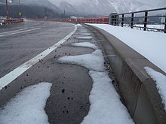
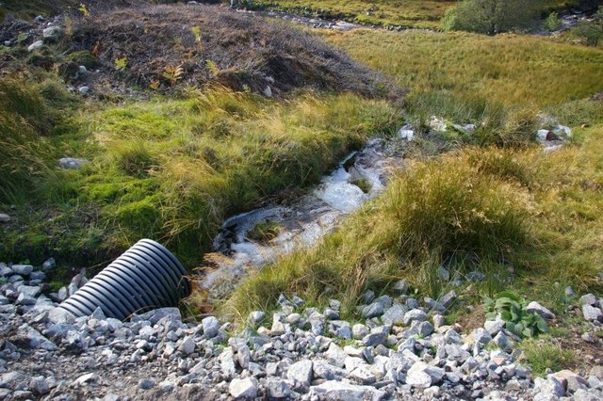
What activities are regulated under cwa?
‘Point source’ – regulated under CWA
  Defined at CWA 502(14) “any discernable, confined and discrete conveyance including…any pipe, ditch, channel…[etc] from which pollutants are or may be discharged.”
  These discharges generally must be regulated in a manner consistent with state/tribal WQS. For example, discharges of point source pollutants regulated under the National Pollutant Discharge Elimination System (NPDES) must be permitted and permit limits must be derived from and comply with WQS.
‘Nonpoint source’ – not regulated under CWA
  Any source of water pollution that does not meet the definition at CWA 502(14).
  Polluted runoff from rain or snowmelt carrying natural and anthropogenic pollutants to waters. Examples include runoff from agricultural lands, stream erosion, and atmospheric deposition.
This Photo by Unknown Author is licensed under CC BY-SA
This Photo by Unknown Author is licensed under CC BY-SA
Notes:
The Clean Water Act provides for regulation of activities related to “point source discharges.” The Clean Water Act defines a point source as “any discernible, confined and discrete conveyance, including but not limited to any pipe, ditch, channel, tunnel, conduit, well, discrete fissure, container, rolling stock, concentrated animal feeding operation, or vessel or other floating craft, from which pollutants are or may be discharged.”
Some examples of activities that have point source discharges that can affect water quality, and where water quality standards can drive decisions are NPDES permits to discharge pollutants from a point source into Waters of the U.S. This type of discharge, and the NPDES permitting process for it, are discussed in Section 402 of the Clean Water Act. Remember, point source discharges include discharges from publicly owned treatment works, or “POTWs” for short, industrial wastewater, stormwater runoff through a storm sewer system, and concentrated animal feeding operations (or CAFOs). Permits for operations that may result in discharge of dredged or fill material to Waters of the U.S., and the permitting process for it, are discussed in Section 404 of the Clean Water Act. Permits or licenses for Federal facilities that may result in discharge to Waters of the U.S. and the certification process for it are discussed in Section 401 of the Clean Water Act.
Non-point source pollution is any source of water pollution that does not meet the legal definition of “point source” in Clean Water Act Section 402. Essentially, non-point source pollution is something that does not come out of a discrete conveyance like a pipe, channel, etc.
Non-point source pollution often cannot be tied to a single source. It occurs when rainfall, snowmelt, or irrigation runs over land or through the ground, picks up pollutants, and deposits them into rivers, lakes, or the ocean. It is well documented that these pollutants can have harmful effects on drinking water supplies, recreation, fisheries, and wildlife. Though the relative impact from a few non-point sources might be small, the cumulative impact from many non-point sources degrades water quality.
The Act does not regulate non-point sources of pollution. But to address non-point sources, the 1987 amendments to the Clean Water Act established the Section 319 Non-Point Source Management Program.

Slide 15
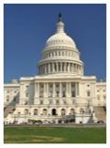
CWA’s Two Approaches to Maintain and Protect Water Quality
Water Quality-based Approach
Goal: Meet water quality standards (WQS) in the receiving water.
Focuses on: meeting limits based on what is needed to achieve water quality standards that apply to the ambient receiving water and are derived on a case by case basis.
Calculate water quality-based effluent limits (WQBELs) derived from WQS which are applied to the water body.
Technology-based Approach
Goal: Achieve a specific level of end-of-pipe performance.
Focuses on: meeting limits derived from levels that EPA expects each type of industrial & municipal discharger to achieve for specific pollutants based on the performance of treatment and control technologies.
Calculate technology-based effluent limits (TBELs) derived from federal effluent guidelines established in regulation.
Notes:
The CWA outlines 2 different but complementary types of protection, technology-based and water quality-based.
The technology-based approach focuses on what each type of discharger can achieve for specific pollutants based on the performance of treatment and control technologies and does not look at the impacts of those pollutants on receiving waters. Permit writers calculate “technology based effluent limits” (or “TBELS”) for dischargers.
TBELs are derived from effluent guidelines that serve as national standards for wastewater discharges to surface waters and publicly owned treatment works (municipal sewage treatment plants). These federal effluent guidelines are for regulating different types of industries and provide the performance standards they must meet. To calculate the tech-based limits, you can look up those numbers in the CFR. You can think of TBELs as intended to level the playing field across the country, so that the same end of pipe limits are expected across the same industrial groups, and you won’t end up with some states allowing less stringency and becoming de facto “pollution havens.”
The water quality based approach focuses on meeting limits based on what is needed to achieve WQS that apply to the ambient receiving water and are derived on a case by case basis. Under the water quality approach, we calculate water quality based effluent limits, or WQBELs, for discharge permits. WQBELs are derived from WQS which are applied to the waterbody.
But the boiled down version for these two approaches is that for permitting discharges of pollutants to waters of the US, you need to meet the more stringent of the tech based or water quality based approach. Permit writers calculate what limits would be placed on a facility to meet each of these, ultimately the more stringent of the two ends up being the one that the permittee needs to meet (though they are both technically in the permit.)
Under the Clean Water Act, the EPA issues the permits for discharges to waters in Indian country. That is because no tribes have TAS to administer the NPDES program at this point in time.
For the rest of this presentation, we’ll be focusing on the water quality based approach, but I wanted to make sure that you were aware that the CWA set up this two-approach system.

Slide 16
Questions?

Slide 17
CWA Water Quality Standards
Notes:
Now that we’ve talked about the Clean Water Act, which provides the statutory basis for water quality standards, let’s talk about what water quality standards are.

Slide 18
CWA 303: basis for water quality standards
WQS define the water quality goals for a waterbody.
WQS provide a regulatory basis for many actions, e.g.,
  Reporting on water quality conditions and status.
  Developing water quality-based effluent limits in National Pollutant Discharge Elimination System (NPDES) permits for point sources.
  Setting targets for Total Maximum Daily Loads (TMDLs).
An important function of WQS is to provide a regulatory basis for the water quality management activities authorized under the CWA.
Notes:
The Clean Water Act sets out expectations for Water Quality Standards in Section 303. Water quality standards are the goals for a waterbody. They describe: “where we want to get to”; “what we are going to manage our programs to attain”; “what we want our water quality to be”; and the “level of protection” we want for a given waterbody.
Probably the most important function of water quality standards is to provide a regulatory basis for the many water quality management actions in the Clean Water Act, for example reporting on water quality conditions through assessment and listing, or developing water quality based effluent limits in NPDES permits. Water quality standards drive management action beyond just installing available pollution control technologies in facilities that discharge pollutants. That alone is not always good enough to meet the goals of the Clean Water Act.

Slide 19
Regulation:
Water Quality Standards
Water quality standards (WQS) are the core of water management programs.
Authorized tribes adopt WQS to protect public health or welfare, enhance the quality of the water, and serve the purposes of the Clean Water Act including sections101(a) and 101(a)(2).
Tribal WQS establish water quality goals for a water body and provide a regulatory basis for controls.
The current federal regulation is in the Code of Federal Regulations (CFR) part 131, as well as part 132 for the Great Lakes area. The federal regulation contains procedures for developing, revising, and approving tribal-adopted WQS and for promulgation of state and tribal WQS by EPA.
EPA-approved tribal WQS can be supplemented by other tribal programs.
Notes:
Water quality standards are the core of water quality management programs and establish the water quality goals for a water body. Water quality standards provide a regulatory basis for controls which may require effluent limits more stringent than the technology based effluent limits.
Authorized tribes, states, and territories adopt WQS to protect public health or welfare, enhance the quality of the water, and serve the purposes of the Clean Water Act including sections101(a) and 101(a)(2).
Water quality standards establish water quality goals for a water body and provide a regulatory basis for controls.
The current federal regulation implementing the water quality standards requirements was published on October 2015 in the Federal Register, and it is codified in Title 40 of the Code of Federal Regulations (or CFR), Part 131. The Part 131 and 132 regulations contain the requirements and procedures for developing, revising, and approving tribal and state-adopted water quality standards and for promulgation of tribal and state standards by EPA.
For any who are curious about the history, the Water Quality Standards program was created by the Water Quality Act of 1965 and was expanded by the 1972 amendments to the Clean Water Act (or the ‘modern’ Clean Water Act). The first federal Water Quality Standards regulation was published in 1983. EPA most recently amended the regulation in 2015.
While tribes, states, and territories are in the driver’s seat as far as adopting their own WQS, EPA has an oversight function, because EPA has authority to approve or disapprove WQS. Note that since 2000, any new or revised water quality standards must be approved by EPA to be effective for Clean Water Act purposes.
Authorized tribes, states, and territories have the discretion to go above and beyond the EPA regulatory requirements, and EPA-approved tribal water quality standards can be supplemented by other tribal programs.
Note that where the EPA’s WQS regulations say “state”, the definition of state at 40 CFR (Code of Federal Regulations) 131.3 includes authorized tribes (i.e. tribes with TAS) and territories.

Slide 20
WQS in Indian Country
Federally Recognized Tribes
574
300+
64
45
With Reservations
With TAS for WQS
With EPA-Approved WQS
Notes:
As of February 2020, 64 tribes have TAS for WQS. The most running any EPA regulatory program.
[Please check EPA website for any updates to this number. Website: https://www.epa.gov/wqs-tech/epa-actions-tribal-water-quality-standards-and-contacts]
45 of those tribes now have EPA-approved tribal WQS; most of the rest are in the process of developing WQS.
Several more tribes are currently going through the TAS submission/approval process.
Before EPA set up the TAS process, EPA promulgated federal WQS for the Colville Reservation which is not included in the above totals. The Colville, incidentally, just received TAS approval and is now developing its own tribal WQS for EPA to approve.
So, while progress is being made, there is still a gap in CWA coverage for tribal lands.

Slide 21
components of WQS
WQS consist of 3 core components:
  Designated uses (sometimes known as “beneficial uses”),
  Criteria to protect those uses, and
  Antidegradation requirements.
Additional components: general policies (e.g., low flow provisions, mixing zone policies) (40 CFR 131.13), WQS variances (40 CFR 131.14), compliance schedule authorizing provisions (40 CFR 131.15).
Notes:
Now that we know the regulatory framework for water quality standards, what do water quality standards look like?
Water quality standards consist of 3 core components, which tribal WQS must contain..
These three components are created with the 101(a) and 101(a)(2) Clean Water Act goals in mind to:
-“restore and maintain the chemical, physical, and biological integrity of the Nation's waters,” and;
-“wherever attainable, achieve a level of water quality that provide for the protection and propagation of fish, shellfish, and wildlife, and for recreation in and on the water”.
First, we need to define the goals for the water body, otherwise we wouldn’t know what levels of a pollutant would be protective. Authorized tribes do this by designating uses.
Second, we need to define how to protect the designated uses by describing limits for pollutants that would prevent attainment of those uses. Authorized tribes do this by assigning criteria to protect the designated uses.
Third, authorized tribes have structures for additional protections for existing water quality and high water quality, under the antidegradation requirements.
Every authorized tribe with water quality standards has these 3 required components. They may choose to include additional components as well. While these additional components are not required to be included in WQS, to the extent that they are included, EPA has authority to approve or disapprove just as for the core components.

Slide 22
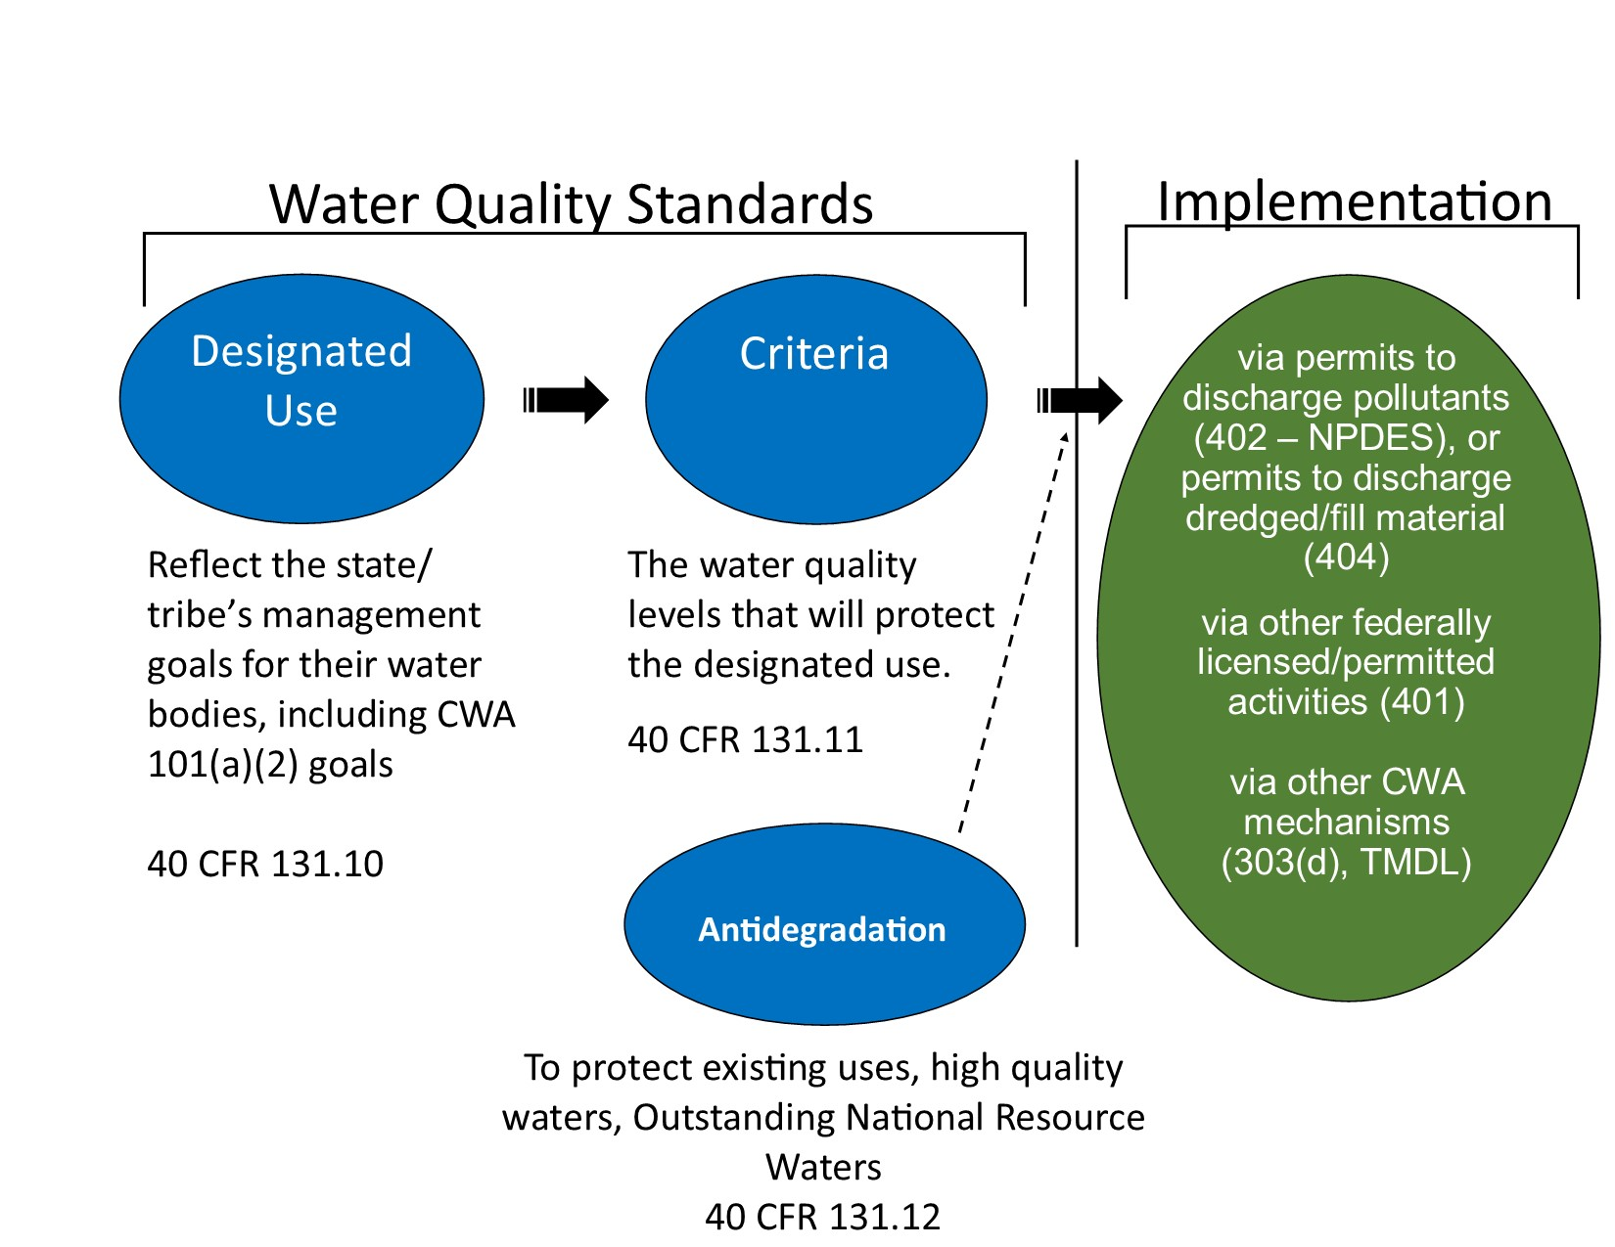
Water Quality Standards Schematic
Notes:
Here is a schematic of the three main components of water quality standards and how they work together and then get implemented through other Clean Water Act programs.
Let’s start on the left-hand side with water quality standards. An authorized tribe’s water quality standards are made up of three basic components: designated uses, criteria, and antidegradation regulations, all of which will be discussed in detail in the next few slides.
After the vertical line we have Implementation of these standards, through on the ground programs.
A permit limit is a limitation on the pollutants that can be discharged into water body. It is set by the National Pollutant Discharge Elimination System (or NPDES) permitting authority.
Permit limits must derive from and comply with water quality standards.
Permit writers need to look at the criteria to ensure permit limits will comply with water quality standards.
Once the permit with pollutant limits is issued, it is enforceable with fines and penalties on the discharger.
Two other ways water quality standards come into play is through Section 401 certification of federally licensed/permitted activities., and through Total Maximum Daily Loads, or TMDLs.
Authorized tribes may also have their own specific mechanisms to enforce water quality standards in addition to the NPDES and TMDL implementation tools.
That’s the basic system of how water quality standards fit in with programs that implement them.

Slide 23
Designated Uses
(40 CFR 131.10)
Designated uses are those uses specified in an authorized tribes’ water quality standards regulations for each water body or segment, whether or not they are being attained.
They describe the water quality goals or desired condition for a specific water body, and the functions and/or activities that are supported by a level of water quality, e.g.,
They also serve as tools to communicate water quality goals to the public.
Notes:
The first component of the Water Quality Standards program is designated uses. Designated uses describe the desired condition of a waterbody and can be aspirational. They don’t need to be attained right now, they could be a goal for the future.
Note that designated uses should be considered a tool to help communicate a state’s/tribe’s water quality goals to the public. Designated uses are typically narrative and can be described in ways that people can easily visualize.

Slide 24
What does the cwa say About Uses?
CWA 303 (c)(2)(a): water quality standards shall serve the purposes of the [Act] and “shall be established taking into consideration their use and value for public water supplies, propagation of fish and wildlife, recreational purposes, and agricultural, industrial, and other purposes, and…navigation.”
CWA 101(a)(2) sets a national goal that, “wherever attainable…water quality which provides for the protection and propagation of fish, shellfish and wildlife, and…recreation in and on the water…”
  “Uses specified in section 101(a)(2) of the Act” -
    Protection and propagation of fish, shellfish and wildlife
    Recreation in and on the water
  “Non-101(a)(2) uses”: Any uses not unrelated to the protection and propagation of fish, shellfish, wildlife or recreation in and on the water (40 CFR 131.3(q).
The WQS regulations at 40 CFR Part 131 interpret the CWA to effectively establish a “rebuttable presumption” that CWA 101 (a)(2) uses are attainable and must be designated. If a state or tribe disagrees, they may demonstrate that such uses are not attainable through a Use Attainability Analysis (UAA)
States and tribes are not required to designate non 101(a)(2) uses but their use and value must be considered.
Notes:
Clean Water Act 303(c)(2)(A) says that states and authorized tribes must establish uses for their waters taking into consideration their use and value for:
-propagation of fish and wildlife, recreational purposes
- public drinking water supplies; and
-agricultural, industrial, cooling, and other purposes, including navigation.
Section 101(a)(2) of the Clean Water Act specifies – “it is a national goal” and “water quality provides for” “Protection and propagation of fish, shellfish, and wildlife…and recreation in and on the water”. They are commonly expressed as the “fishable/swimmable” goals of the Clean Water Act, or the “uses specified in Section 101(a)(2) of the Act”.
The phrase “protection and propagation of fish, shellfish, and wildlife” is often shorthanded to “aquatic life. This includes protection of aquatic life directly as well as protection of human health when consuming aquatic life (EPA has made this statement publicly in a variety of places, most recently in the preamble to the Part 131. revisions in 2015).
The phrase “recreation in and on the water” is often shorthanded to “primary contact recreation”.
Note that Congress put a higher bar for those uses specified in CWA section 101(a)(2) than any other uses mentioned in CWA 303(c) by “provided for” (i.e., designated) unless demonstrated to be unattainable, effectively creating a rebuttable presumption. Non 101(a)(2) uses, on the other hand, do not have to be designated but must at least be considered.
It is important to note here that use designations aren’t automatic. The state or authorized tribe has to specifically designate their designated uses to express their goals; if they don’t designate a use, there is no ‘default’.
You cannot designate a water of the U.S. for waste transport or assimilation. That is specifically prohibited by Clean Water Act.

Slide 25
Designated Uses-Tribal Roles
(40 CFR 131.10)
Authorized tribes must specifically identify designated uses to express their goals.
  There are no federal “default” designated uses.
Authorized tribes have discretion in designating uses and how to articulate them as long as the system established allows protection of waters consistent with the CWA and regulations. Authorized tribes can designate multiple uses for each water body.
Authorized tribes must take into account downstream protection when designating uses.
Notes:
Authorized tribes must specifically identify designated uses to express their goals. There are no federal defaults to automatically apply if an authorized tribe fails to do so.
Authorized tribes have the discretion in designating uses. They do not need to be constrained by the wording or the use categories articulated in the Clean Water Act, but can come up with their own categories of uses. Not all authorized tribes have the same designated use categories. For example, some may say “recreation” or “water contact recreation” or “whole body contact recreation” while others may say “Class 1 waters” or “Class A waters”.
Authorized tribes can and usually do designated multiple uses for each water.
Because waters are connected, EPA’s Water Quality Standards regulations (and NPDES regulations) also require consideration of downstream protection.

Slide 26
Examples of designated use APPROACHES
Tribe A | Tribe B
Specifically designates multiple uses to each water. | Designates a “class” that contains multiple different uses.
For example, one water body designated for: Warm water aquatic life use, Public water supply use, Agricultural use, and Primary contact recreation use Cultural and traditional use | For example, designations may be: Class A(1): Aquatic biota, wildlife and aquatic habitat use Cultural and Traditional use Swimming and other primary contact recreation use Boating, fishing and other recreation use Class A(2) Includes Class A(1) + Public Water Supply Class B - Includes Class A(1), Class A(2), + irrigation of crops and other agricultural uses
Notes:
Creation of a use classification system is the authorized tribe’s choice. EPA has no specific recommended way of classifying waters. The basic water uses mentioned in the Clean Water Act should, however, be reflected in the tribal use classification systems.
This slide shows a couple of examples of approaches an authorized tribe may take to designate uses. There are different ways that authorized tribes can designate their waters; they can either use a designation system where they specifically designate multiple uses to each water (as in example Tribe A on this slide; or they can use a classification system where they designate a class but that class contains multiple different uses (as in example Tribe B on this slide).
Authorized tribes have the discretion in designating uses. They do not need to be constrained by the wording or the use categories articulated in the Clean Water Act, but can come up with their own categories of uses. Not all authorized tribes have the same designated use categories. For example, some may say “recreation” or “water contact recreation” or “whole body contact recreation” while others may say “Class 1 waters” or “Class A waters”.
In addition to the 101(a)(2) protection and propagation / recreation goals, some tribes have also included unique designated uses in their approved WQS. For example, the Lac du Flambeau Band of Lake Superior Chippewa Indians (R5) depend on the waters for traditional fishing, hunting and gathering activities, as well as ceremonial and cultural practices… …therefore, the tribe’s WQS include protection of wildlife and fish and aquatic life uses, ceremonial and recreational uses, which supports the 101(a)(2) requirements of the Act.
In addition, they also have a unique designated use for the protection of wild rice, which is an important food source for the tribe.
Another tribe with unique designated uses is the Miccosukee Tribe, which includes the uses of frogging and air boating in their water quality standards.

Slide 27
Revising Designated Uses
Sometimes states and authorized tribes may wish to revise their designated uses and associated criteria because the designated uses are not attainable.
Except in certain circumstances, designated uses can be revised to reflect:
  More specific desired condition (e.g., aquatic life use to cold water- or warm water-aquatic life use).
  Clearer articulation of the attainable use (e.g. primary vs secondary contact recreation use).
Revising designated uses can lead to more effective criteria, permits, TMDLs.
For all designated use revisions, the CWA and regulations generally require the evaluation of the use and value for that use. However Congress established more prescriptive requirements for uses related to CWA 101(a)(2) uses.
  For CWA 101(a)(2) uses, revisions must be accompanied by a UAA (a “structured scientific assessment of the physical, chemical, biological and economic factors affecting attainment of the use.”)
Notes:
Sometimes states and authorized tribes may wish to revise their designated uses and associated criteria because the designated uses are not attainable. While there are certain circumstances where a use cannot be removed, Clean Water Act Section 101(a)(2) allows for circumstances where a designated use may not be attainable in a water body, and therefore the use may be removed.
Designated uses can be revised to reflect:
A more specific desired condition (for example: revising a more general aquatic life use to a cold water- or warm water-aquatic life use),
Or a clearer articulation of the attainable use (for example: a primary versus secondary-contact recreation use).
Revising designated uses can lead to more effective criteria, permits, and TMDLs.
The rationale needed depends on the use an authorized tribe wishes to revise. For all designated use revisions, the CWA and regulations generally require the evaluation of the use and value for that use. However, Congress established more prescriptive requirements for uses related to 101(a)(2) uses (i.e., a Use Attainability Analysis or UAA). A UAA is a “structured scientific assessment of the physical, chemical, biological and economic factors affecting the attainment of the use.”
We will talk about those requirements next.

Slide 28
Questions?
Notes:
We have finished covering designated uses, so I will pause for questions.

Slide 29
Water Quality Criteria
40 CFR 131.11
Criteria are the water quality levels that will protect the designated use.
Definition (40 CFR 131.3(b)): “Elements of State water quality standards, expressed as constituent concentrations, levels or narrative statements, representing water quality that supports a particular designated use. When criteria are met, water quality will generally protect the designated use.”
Notes:
The second core component of the Water Quality Standards program is water quality criteria. Water quality criteria are limits on a particular pollutant or limits on a condition of a water body designed to protect and support a designated use. 40 CFR 131.3 says that when criteria are met, water quality will generally protect the designated use. So, when appropriate criteria are selected for a particular waterbody, and when water quality in that waterbody meets all the criteria, the designated use should be protected.
Authorized tribes adopt water quality criteria as part of their water quality standards. They consider which criteria are needed to protect the designated use and then incorporate these criteria into their water quality standards.

Slide 30
CWA requirements for criteria
CWA 303(c)(1): “States/Tribes shall adopt criteria to protect designated uses into their WQS.”
CWA 303(c)(2)(b): “States/Tribes shall adopt criteria for “priority pollutants” (a list of “toxic pollutants” from a Congressional committee report referenced in CWA 307(a)).
Notes:
The Clean Water Act requirements for criteria are in two different places.
Clean Water Act section 303(c)(1) requires states and authorized tribes to adopt criteria to protect designated uses into their water quality standards. That’s the general requirement.
There’s also a more specific requirement for a specific list of over 100 pollutants, that states and authorized tribes shall adopt criteria for those pollutants into their water quality standards. These are called ‘priority pollutants” or “toxic pollutants,” and the list was generated based on litigation that resulted in a list. The list is based on legal and policy decisions and contains many legacy pollutants, such as DDT.

Slide 31
WQS regulatory requirements for criteria
WQS regulation at 40 CFR 131.11: “States/Tribes must adopt those water quality criteria to that protect the designated use.”
  Criteria must be based on sound scientific rationale.
    EPA produces national water quality criteria recommendations under CWA 304(a) (these are recommendations, not Federal rules).
    Factors such as technological feasibility, social and economic costs, and the benefits of achieving criteria levels are not considered in criteria development.
    Criteria may be revised as new scientific data or methodologies are developed.
  Criteria must contain sufficient parameters or constituents to protect the designated use.
  For waters with multiple use designations, the criteria shall support the most sensitive use.
    EPA encourages states and tribes to reach out to the local communities to learn how they use particular water bodies. This information will help make more informed decisions on how to support the most sensitive use.
Notes:
The Water Quality Standards regulation gives more details to implement the Clean Water Act requirements that pertain to criteria.
Criteria must be based on sound scientific rationale.
EPA produces national water quality criteria recommendations under Section 304(a) of the Act. These criteria recommendations are often used as the basis for tribal water quality standards. However, the regulation allows the authorized tribes to develop its own criteria or make site-specific modifications to EPA's recommendations. The 304(a) criteria are scientific recommendations and are not Federal rules.
States/authorized tribes may not consider other factors, such as technological feasibility, social and economic costs, and the benefits of achieving criteria levels, in criteria development.
Criteria may be revised from time to time as new scientific data or methodologies are developed.
Criteria must contain sufficient parameters to protect the designated use. This means, make sure that the parameters relevant to the designated uses of the water are considered. For example, if the use is ‘human recreation’ but the only criteria are for nitrogen and phosphorus, you’re missing something…you need bacteria criteria to help protect people recreating in the water from getting gastrointestinal illnesses.
For waters with multiple use designations, the criteria shall support the most sensitive use. Most waters have more than one use. Criteria for a parameter can depend on the use – for example, aquatic life are less sensitive to something like Dieldrin (a pesticide) than humans (if humans eat fish from the water and consume the water). So, if you have both aquatic life and shellfish harvesting uses, you want to implement the criterion which would protect both uses. It’s not always that one particular use is the most sensitive. It could be that aquatic life is more sensitive to one pollutant while human health is more sensitive to another. EPA encourages authorized tribes, states, and territories to reach out to the local communities and learn how they use the water body. This information will help you to make more informed decisions that support the most sensitive use.

Slide 32
Two Forms of Criteria
Numeric – 40 CFR 131.11(b) provides that states/tribes should establish numeric values based on:
EPA’s 304(a) national recommended water quality criteria,
  Recommendations developed by EPA based on the latest scientific knowledge, issued periodically as guidance to states/tribes for use in developing their own criteria.
  NOTE: EPA typically uses these as basis for promulgation if necessary.
304(a) recommendations modified to reflect site-specific conditions, or
Other scientifically defensible methods.
Narrative – states/tribes should establish narrative criteria
Where numeric criteria cannot be established, and
To supplement numeric criteria.
Both numeric and narrative forms of criteria provide a regulatory basis for implementation and management actions like NPDES permit limits.
Notes:
EPA’s WQS regulation allows for both numeric and narrative criteria. While states and authorized tribes will often use EPA’s 304(a) criteria recommendations when adopting state/tribal WQS, it is important to recognize that the regulations provide multiple options for establishing criteria.
40 CFR 131.11(b) states that authorized tribes should establish numeric values based on:
EPA’s 304(a) national recommended water quality criteria.
304 criteria are recommendations developed by EPA based on the latest scientific knowledge, issued periodically as guidance to states/tribes for use in developing their own criteria. Note that the number 304a indicates the section of the Clean Water Act that directed EPA to develop these recommendations.
NOTE: EPA will use these as basis for promulgation if necessary.
Authorized tribes can also modify 304(a) recommendations modified to reflect site-specific conditions, or they can use other scientifically defensible methods.
The Water Quality Standards regulations also allow for narrative criteria:
Where numeric criteria cannot be established, or
To supplement numeric criteria.
Both forms of criteria provide a regulatory basis for implementation and management actions like NPDES permit limits, water quality assessments and TMDL development.

Slide 33
Narrative Criteria
Example:
“Surface waters shall be free from substances attributable to wastewater discharges or other pollutant sources that cause injury to, or are toxic to, or produce adverse physiological responses in humans, animals, or plants.”
Note: For CWA 307(a) toxics, a state/tribe must provide a method of translating a narrative criterion into something numeric from which a permit writer can derive effluent limits (40 CFR 131.11(a)(2)).
Notes:
Folks are generally familiar with numeric criteria, but let’s look for a moment at an example of narrative criteria so you’ll know what I’m referring to.
Narrative criteria exist in all WQS regulations and often include the term "free from,” like this example. Another common example is “no toxics in toxic amounts.”
Narrative criteria provide a qualitative benchmark for assessing water quality. They are useful as indicators of water quality when a numeric criterion is either not available or cannot be applied; for example, when particular pollutants or water conditions cannot be precisely measured.
EPA’s view is that effective tribal water quality standards should include both numeric and narrative criteria. The use of both ensures that a water is fully protected for both chemical specific effects and the synergistic effects of mixtures of chemicals or other less measurable pollutants (e.g., floatable debris, objectionable deposits). AND when there are no numeric criteria or 304a recommendations for a particular pollutant that may be present.

Slide 34
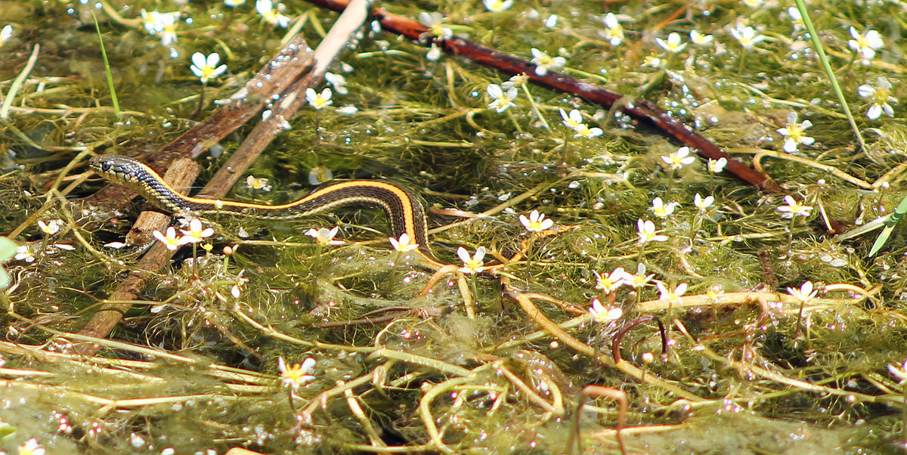
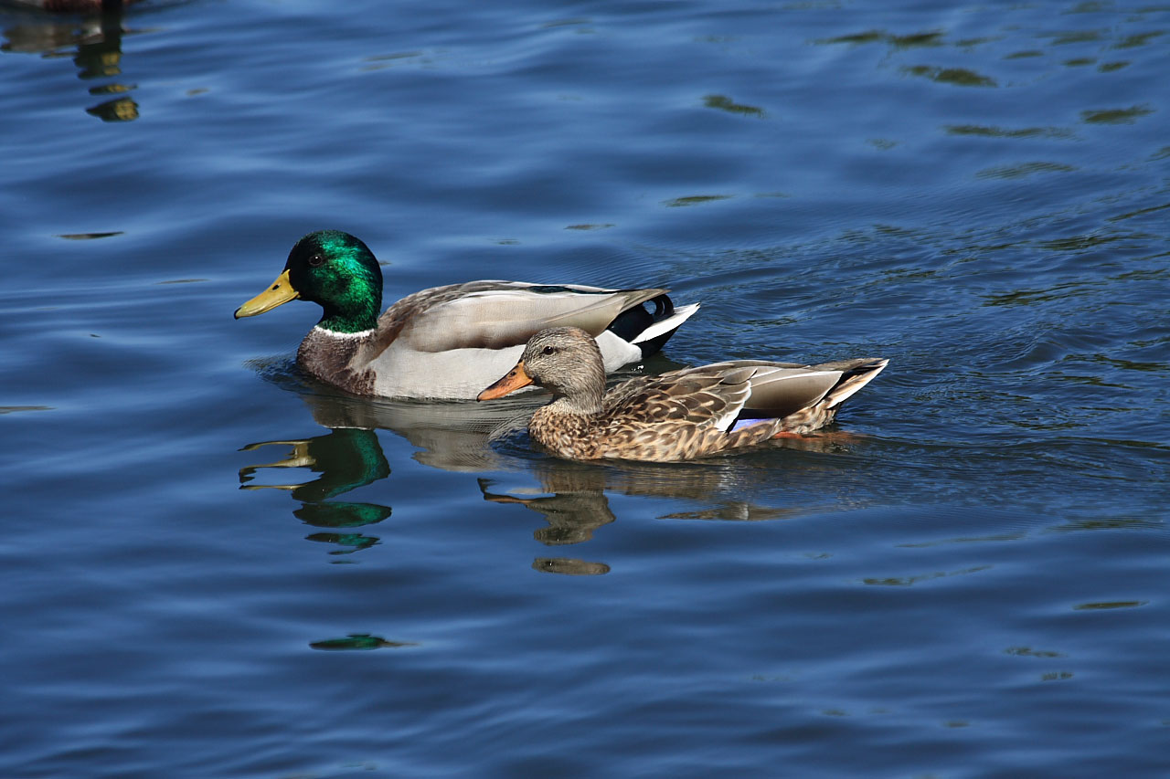
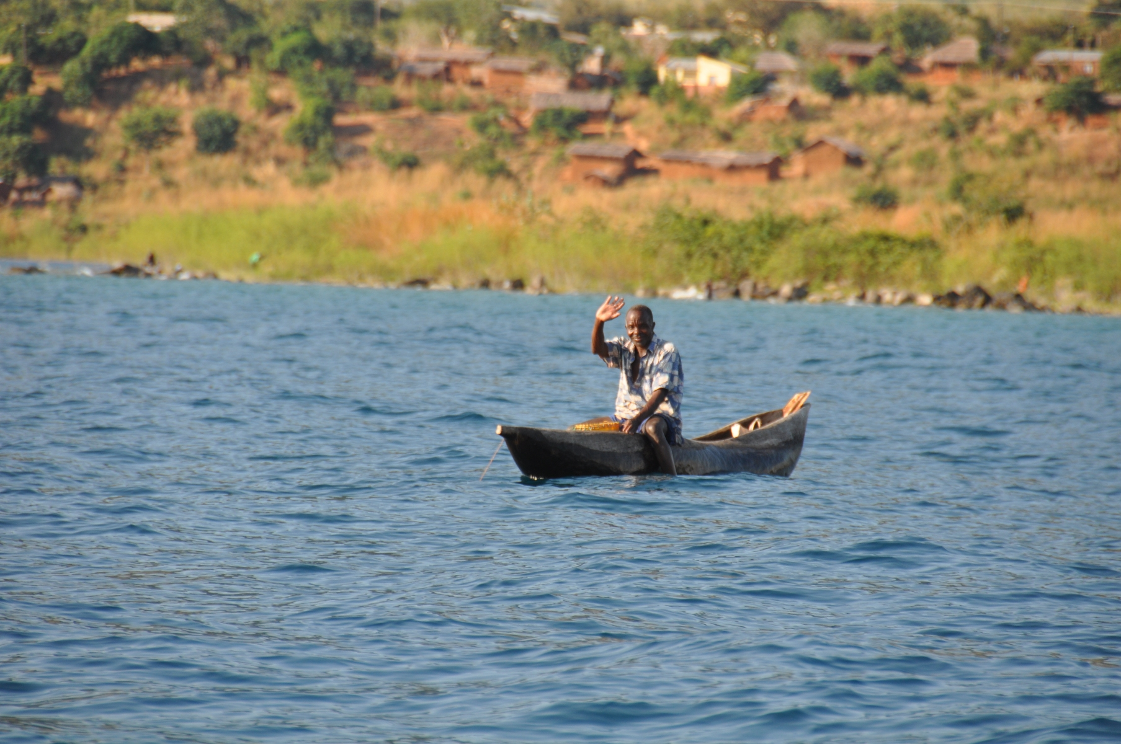
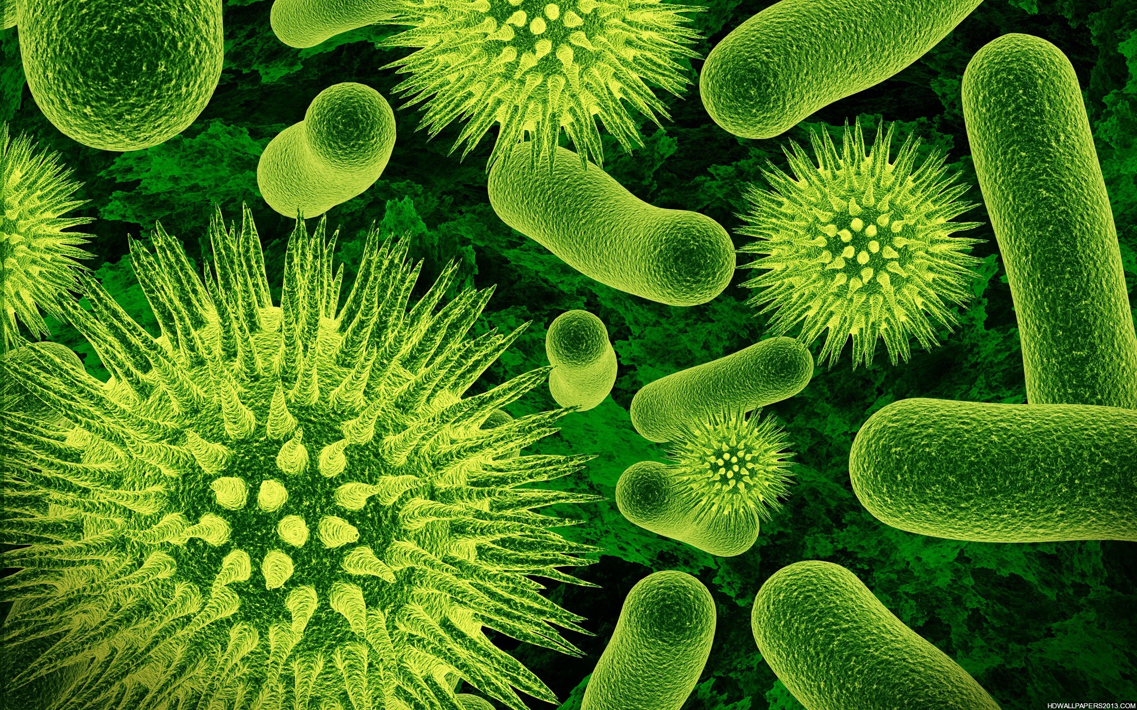
Types of Criteria
Aquatic life
Biological
Human health
Recreational
Nutrient
Other (e.g., hydrologic, sediment)
This Photo by Unknown Author is licensed under CC BY-SA
This Photo by Unknown Author is licensed under CC BY-NC-ND
This Photo by Unknown Author is licensed under CC BY-SA
Notes:
EPA’s water quality recommendations under Clean Water Act Section 304(a) include the various types of water quality criteria. Each type has a different protective focus:
Aquatic life criteria protect aquatic life from specific chemical pollutants in the water column. In addition to typical surface waters, EPA recommendations are largely applicable to wetlands, but some may need adjustments, for example, because of natural factors such as pH.
Biological criteria describe the desired biological condition of a water (using for example, a fish index, macroinvertebrate index or diatom index)
Human health criteria protect humans from specific chemical pollutants in both water and fish tissue.
Recreational criteria protect humans for uses like primary contact recreation or swimming
Nutrient criteria protect aquatic life and source water for public water supplies and/or recreation.
Other types of criteria may also be included in state WQS

Slide 35
Types of criteria
Different types of water quality criteria are complementary. There is no one type of criteria that will guarantee protection of all designated uses.
Ideally all types of water quality criteria are considered when setting standards and evaluating the condition of a waterbody.
Different types of water quality criteria collectively provide a valuable tool for setting standards and making water quality management decisions that help protect the broad diversity of life affected by water pollutants.
Notes:
Because of their different protective focuses, these different types of water quality criteria are complementary.
Since there is no single number that will guarantee protection of all forms of life, ideally all categories of water quality criteria are considered when setting standards and evaluating the condition of a waterbody. If any criterion is exceeded, there may be a potential risk to some portion of the intricate web of human, animal, and plant life connected with a waterbody.
The different types of water quality criteria collectively provide a valuable tool for setting standards and making water quality management decisions that help protect the broad diversity of life affected by water pollutants.

Slide 36
Aquatic Life Criteria
Aquatic life criteria protect aquatic life from specific pollutants in the water column.
In addition to typical surface waters, EPA recommendations are largely applicable to wetlands, but some may need adjustments, for example because of natural factors such as pH.
An aquatic life criterion typically contains three components:
  Magnitude (or concentration) – how much of a parameter
  Duration – period of time over which the instream concentration is averaged
  Frequency – how often the magnitude can be exceeded
    Example: “To protect the Aquatic Life Use from acute toxicity in saltwater, dissolved Zinc shall not exceed 90 micrograms per liter as a one hour average more than once every three years.”
Notes:
Let's take a look at aquatic life criteria. Aquatic life criteria are designed to protect all aquatic organisms, including both animals and plants.
In addition to typical surface waters, EPA recommendations are largely applicable to wetlands, but some may need adjustments, for example, because of natural factors such as pH.
Each aquatic life criterion refers to a particular concentration of a particular parameter in ambient water. An aquatic life criterion typically contains three components:
a concentration or magnitude (how much of the parameter),
a period of time (or duration) over which the instream concentration is averaged (for how long), and
a frequency indicating how often the average concentration can be exceeded (how often).
An example for Zinc in saltwater is included on this slide.

Slide 37
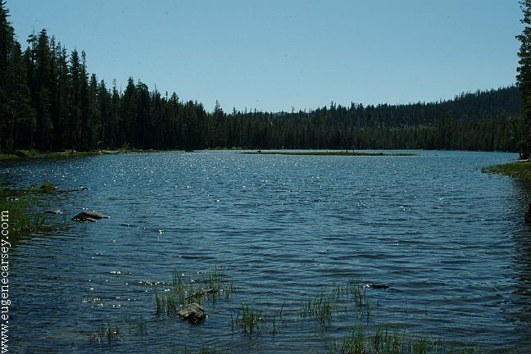
Aquatic Life Criteria
Aquatic life criteria usually include:
  An acute value to protect against short exposure periods,
  A chronic value to protect against long term exposure, and
  Separate saltwater values and freshwater values to account for different effects depending on salinity.
    Example: Dissolved Zinc Aquatic Life Criteria
    For all of the below, concentrations shall not exceed the specified number as a 1 hour average (for acute) or a 4 day average (chronic) more than once every 3 years.
    Saltwater acute: 90 ug/L as a 1-hour average
    Saltwater chronic: 81 ug/L as a 4 day average
    Freshwater acute: 120 ug/L as a 1-hour average
    Freshwater chronic: 120 ug/L as a 4 day average
Haven Lake
Notes:
An aquatic life criterion would contain something like a 4-day average, designed to protect against chronic (extended) exposure to lower concentrations, and a 1-hour average, designed to protect against acute (short) exposures to higher concentrations.
So, where data allow, there can in fact be four separate aquatic life criteria for a particular chemical: saltwater acute and chronic, and freshwater acute and chronic.
There are cases where we don’t have one or the other (for example, a chemical that is highly bioaccumulative probably doesn’t need an acute value as the chronic endpoint is far more sensitive
In some cases, the aquatic life criteria developed by EPA may actually be more stringent than necessary or not protective enough for any particular waterbody. This depends on such factors as whether the species at the site are more or less sensitive than those used to calculate the national criteria, and on whether the particular physical and chemical characteristics of the site alter the biological availability or toxicity of the chemical. In such cases, a site-specific criterion can be developed based on toxicity data for a more appropriate species water conditions at the site. That’s another topic for another day!

Slide 38
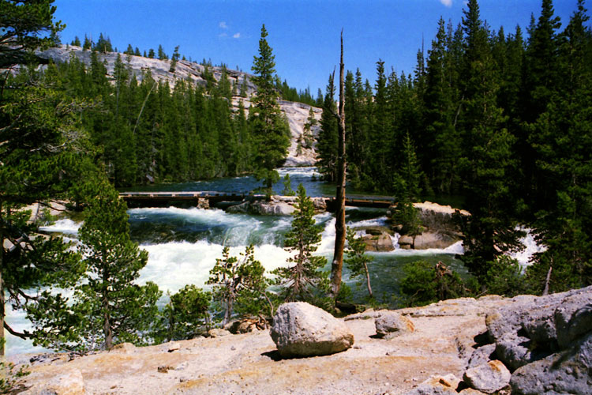
Biological Criteria
(or ‘biocriteria’)
Biological criteria protect aquatic life uses by describing the desired biological condition of surface waters for a specific aquatic life designated use.
Examples:
  Narrative: “Waters shall be free from substances in concentrations or combinations that would adversely alter the structure and function of aquatic communities, as defined by the reference condition.”
  Numeric: Class I: Cool Water Aquatic Life,
      Taxa Richness: 5
      EPT Index: 3
Notes:
Biological criteria are based on the premise that the structure and function of an aquatic biological community within a specific type of waterbody provide critical information about the quality of surface waters.
Biological criteria are threshold levels or guidelines that describe the desired biological integrity of aquatic communities of surface waters.
For example, biological criteria may refer to relatively simple indices such as the number of different species present in a given area or the number of individuals of a given species, or to more complex properties, such as the complexity of food webs or the efficiency of nutrient cycling in the waterbody.
Biological criteria can help identify water quality degradation that cannot be identified by chemical or physical test procedures alone. Followed by a stressor identification evaluation, biological criteria can initiate the process to identify and address the cause(s) of water quality degradation.
Biological criteria are developed by the tribe to reflect local conditions and the designated use classification system of the tribe. The biological criteria must protect the designated use of the waterbody and the propagation of wildlife, fish, and shellfish. Different criteria are developed for different designated uses.
Biological criteria may be numeric or narrative expressions that describe the desired biological integrity of aquatic communities inhabiting waters of a given use category. Narrative biological criteria are general statements of attainable or attained conditions of biological integrity and water quality for a given use designation. Numeric criteria are specific quantitative indicators of that condition. You can see examples of both narrative and numeric criteria on the slide.

Slide 39
Human Health Criteria
Human health criteria are developed to protect humans from specific pollutants in both water and fish tissue that humans might ingest.
Calculated to protect from effects of pollutants from ingestion of aquatic organisms in the water (“org only”) and for ingestion of water and organisms (“water + org”).
Expressed as a pollutant concentration based on:
  Toxicological Assessment
  Exposure Scenario
Notes:
Most WQS also adopt “human health criteria” which focus on protecting humans over their lifetime from chronic exposure to pollutants. This is about protecting people not just from developing an acute immediate illness following swimming, but from things like developing cancer from lifetime exposure to a carcinogenic chemical in water. A human health criterion is the highest concentration of a pollutant in water that is not expected to pose a significant risk to human health. (Exceeding a criterion does not necessarily mean there is or will be an environmental effect - only that there is the potential for one.)
EPA publishes human health criteria recommendations for the effects of pollutants from ingestion of aquatic organisms (“org only”) and for ingestion of water and the organisms (“water + org”).
Human health criteria are designed to protect human health under average conditions of exposure and
do not take into account local water quality conditions, and
do not take into account potential reactions between the chemical of concern and other chemicals that could increase or reduce the toxicity of the chemical of concern.

Slide 40
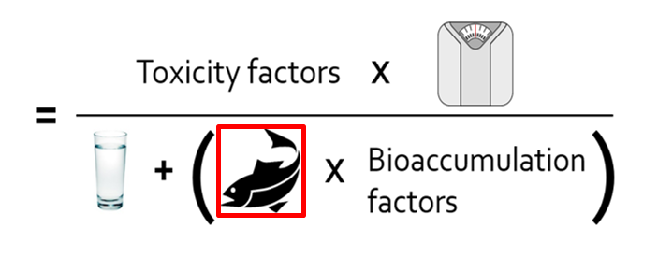
Human Health Criteria
Notes:
This is a simplified version of the equation used to develop protective human health criteria. The toxicity factors will depend on whether the pollutant is carcinogenic or not, but generally, human health criteria factor in average adult weight, water intake, fish consumption, and bioaccumulation of the pollutant. All of these factors can vary and can be varied in criteria derivation, depending on the situations of an individual tribe and its members.
To determine how much of a pollutant to allow in water where the pollutant can accumulate in fish that are caught, the tribe needs to know how much people typically eat per day, commonly referred to as the Fish Consumption Rate, or FCR. (Refers to the red box).

Slide 41
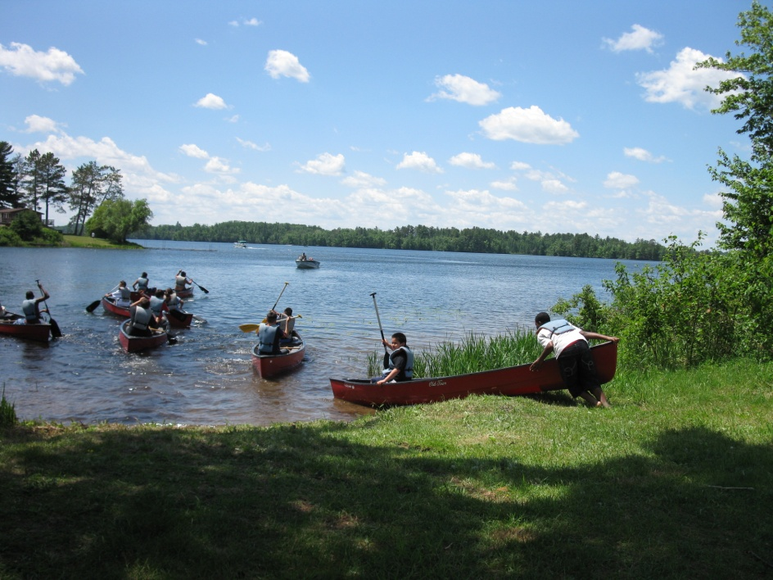
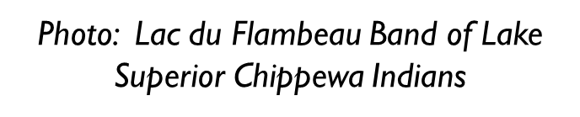
Human Health Criteria (cont.)
Fish Consumption Rate
In EPA’s recommended criteria
  National default for general population: 22 grams per day
  Default for subsistence fishers: 142 grams per day
Tribal Subsistence Fishing
  Oregon state WQS: 175 grams per day
  Spokane Tribe of Indians WQS: 865 grams per day
Notes:
Through various scientific studies, EPA has found that the average person in the U.S. eats 22 grams of fish per day. So in developing EPA’s national recommended criteria, EPA assumes that the national default rate for the general population is 22 grams per day, while the default for subsistence fishers is 142 grams per day.
Authorize tribes developing their own WQS can specify the representative fish consumption rate used in their human health criteria development.
The Spokane Tribe, when setting their own CWA-effective WQS, used a FCR of 865 grams per day based upon anthropological data. The Tribe’s estimates of the FCRs for traditional subsistence lifestyle were based on (1) open peer-reviewed literature, (2) ethnographic documents and reports concerning traditional lifestyles and practices, and (3) confirmatory statements from tribally-recognized cultural experts whose expertise derives from their traditional environmental knowledge.

Slide 42
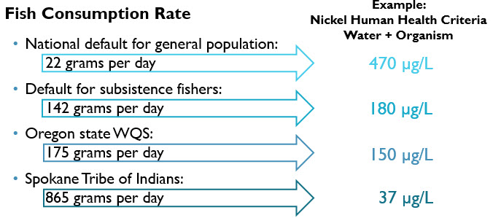
Human Health Criteria (Example)
Notes:
This slide demonstrates how much just varying the FCR can affect the ultimately-derived protective Water Quality Criteria.

Slide 43
Recreational Criteria
Recreational criteria protect recreational designated uses (activities including swimming, bathing, surfing, etc.).
Designed to protect people from illnesses (including gastrointestinal, skin, eye, ear, etc. effects) due to exposure to fecal contamination in water, and kidney and liver damage due to exposure to certain cyanotoxins.
For fecal contamination, EPA has published criteria recommendations based on epidemiological studies involving swimmers, looking at an association between water quality and illness.
Notes:
Tribes adopt recreational criteria to protect humans from illness or organ damage during recreational activities in water, such as swimming, surfing, kayaking, or ceremonial activities.
Recreational criteria are designed to protect people from illnesses (including gastrointestinal, skin, eye, ear, etc. effects) due to exposure to fecal contamination in water, and kidney and liver damage due to exposure to certain cyanotoxins.
For fecal contamination, EPA has published criteria recommendations based on epidemiological studies involving swimmers, looking at an association between water quality and illness.

Slide 44
Recreational Criteria
  Examples
Fecal contamination:
  Criteria expressed in terms of fecal indicator bacteria, for example: “A 30 day geometric mean of 30 colony forming units (cfu) enterococci /100 mL water, not to be exceeded, and a statistical threshold value of 110 cfu/100 mL for marine waters may not be exceeded in more than 10% of samples in a 30 day interval.
Cyanotoxins:
  Criteria expressed in terms of specific toxins, for example: “The concentration of total microcystins shall not exceed 8 µg/L in more than three ten-day periods per recreational season, for more than one recreational season, over a 5-year period.”
Notes:
Examples of two different types of recreational criteria are shown here. I won’t read them for you, but you can see that much like aquatic life criteria, there are elements of magnitude or concentration, and time (duration and frequency)

Slide 45
Nutrient Criteria
Nutrient criteria are numeric limits of total nitrogen and total phosphorus that protect designated uses (aquatic life, recreational, and public water supply) from the effects of eutrophication.
Nutrient criteria are developed for different water body types using field data of nutrient concentrations (the stressors) and different ecological effects symptomatic of eutrophication (the responses).
Notes:
Much of the water quality degradation around the country has been linked to nutrient over-enrichment. For example, hypoxia in the Gulf of Mexico, harmful algal blooms and fisheries degradation in the Chesapeake Bay.
Authorized tribes adopt nutrient criteria to protect both aquatic life and human uses of water. Nutrient criteria are numeric limits of total nitrogen and total phosphorus that protect designated uses (aquatic life, recreational, and public water supply) from the effects of eutrophication.
Nutrient criteria are developed for different water body types using field data of nutrient concentrations (the stressors) and different ecological effects symptomatic of eutrophication (the responses).

Slide 46
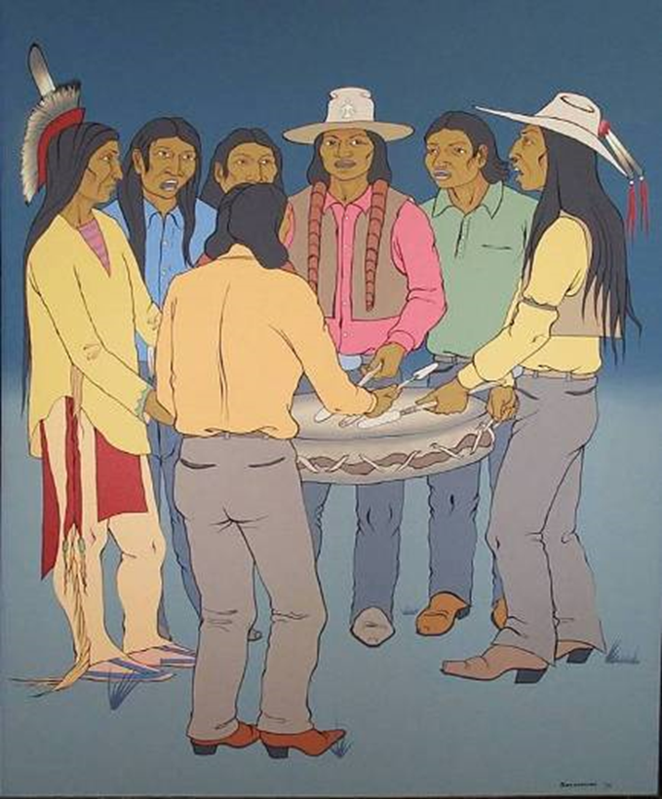
Water Quality Criteria: Individual and Specific – But Complementary!
  Each criterion has a specific focus and designated use application
  There are usually multiple criteria for each designated use
  Criteria work together to ensure that uses are protected
  The most protective criterion is the one you have to meet
Notes:
Remember that a single waterbody may have many uses, and that each use will have several different criteria. This sometimes results in different numeric criteria for the exact same parameter. For example, a lake that’s a drinking water source might have one concentration requirement for nitrate to protect drinking water, and another – much lower – concentration for nitrate because the lake also supports aquatic life. When there are two separate values for the same numeric criterion, the most protective criteria for the most sensitive use is the one you have to meet. That ensures that all the designated uses are supported.

Slide 47
Questions?
Notes:
Now that we’ve introduced criteria, I will pause for questions.

Slide 48
Antidegradation
40 CFR 131.12
Policy:
    40 CFR 131.12 (a): The State shall develop and adopt a statewide antidegradation policy.
    Antidegradation adds additional protections for waters of the U.S. above and beyond designated uses and criteria. The antidegradation policy provides the goals and framework of protection.
Implementation Methods:
    40 CFR 131.12(b): The State shall develop methods for implementing the antidegradation policy that are, at a minimum, consistent with the State's policy and with paragraph (a) of this section. The State shall provide an opportunity for public involvement during the development and any subsequent revisions of the implementation methods, and shall make the methods available to the public.
    The antidegradation implementation method describes how the state/tribe will implement the policy.
Notes:
Antidegradation is the third core element of WQS, and it’s in section 131.12 of the regulation. The purpose of antidegradation is to provide a framework to implement the CWA requirements to “maintain” the chemical, physical and biological integrity of the nation’s waters.
Section 131.12 describes that states and authorized tribes shall develop and adopt an antidegradation policy that is legally binding. That policy provides additional protections for waters of the US beyond designated uses and criteria. The regulation also requires that they shall also develop antidegradation implementation methods. those may or may not be legally binding but must be available to the public and subject to public involvement.
The line between antidegradation policy and implementation methods isn’t always clear. At a minimum, to be consistent with the Federal Regulation, the elements specified 40 CFR 131.12(a) must be addressed in legally binding language somewhere in state/tribal regulations.

Slide 49
Antidegradation Requirements
40 CFR 131.12 (a): Policy
Authorized tribes must develop and adopt a statewide antidegradation policy that includes:
    Protection for existing uses for all waters of the U.S.;
    Protection for high quality waters (water quality that exceeds the levels necessary to support protection and propagation of fish, shellfish and wildlife and recreation in and on the waters);
            Identification of High Quality Waters
            Analysis of Alternatives
    Protection for Outstanding National Resource Waters (ONRWs) identified by the state/tribe; and
    Compliance with CWA 316 in regard to thermal discharges.
Notes:
Let’s talk about the policy first, and then after that we will talk about the implementation methods.
States and authorized tribes must develop and adopt a statewide antidegradation policy that includes 4 elements:
Protection for existing uses for all waters of the U.S.;
2. Protection for high quality waters (water quality that exceeds the levels necessary to support protection and propagation of fish, shellfish and wildlife and recreation in and on the waters);
Protection for Outstanding National Resource Waters (ONRWs) identified by the state/tribe; and
Compliance with CWA 316 in regard to thermal discharges.

Slide 50
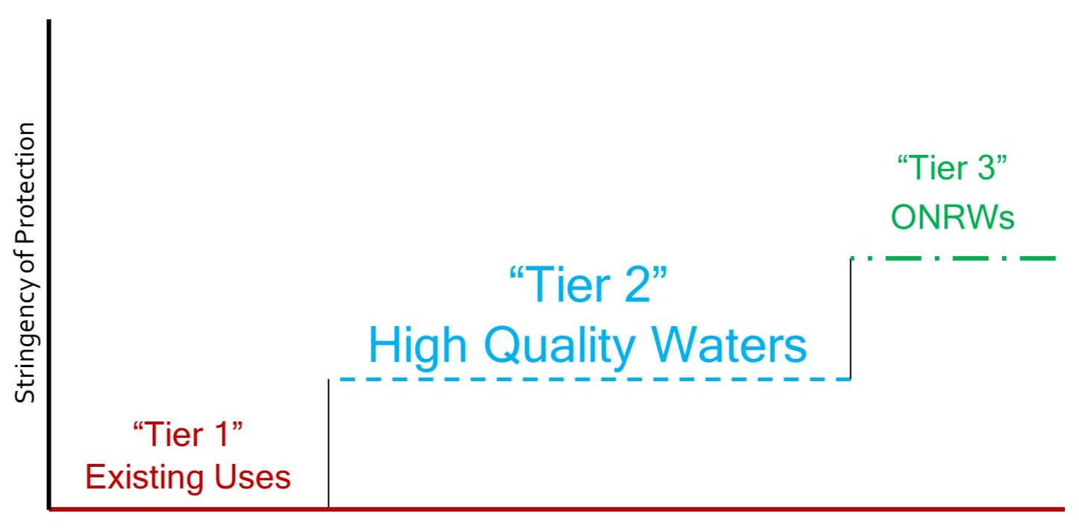
The 3 “Tiers” of Protection
Notes:
People often refer to antidegradation as having three “tiers” of protection, like stairsteps. All waters have at least Tier 1 protection, while some waters have Tier 2 or Tier 3 protection as well. The higher the number, the more stringent the protection.
I will now explain what protection each of the 3 tiers includes.

Slide 51
“Tier 1” Protection: Existing Uses
40 CFR 131.12 (a)(1): “Existing instream water uses and the level of water quality necessary to protect the existing uses shall be maintained and protected.”
This protection applies to all waters of the U.S.
Notes:
Tier 1 protection requires the maintenance and protection of existing uses
40 CFR 131.3(e) defines existing uses as: “those uses actually attained in the water body on or after November 28, 1975, whether or not they are included in the water quality standards.”
Tier 1 protection applies to all waters of the U.S. This means that waters receiving Tier 2 or 3 protection receive Tier 1 protection in addition to either Tier 2 or Tier 3 protection.

Slide 52
“Tier 2” Protection: High Quality Waters
  What is Tier 2 Protection?
    40 CFR 131.12(a)(2): Maintenance and protection of high quality waters: waters where water quality is better than necessary to support CWA 101(a)(2) uses (protection and propagation of fish, shellfish and wildlife and recreation in and on the water.)
    High water quality shall be maintained and protected UNLESS:
        Use of the assimilative capacity is necessary to accommodate important economic or social development in the area in which the waters are located.
        If this is the case, in order to allow that lowering there must be a Tier 2 Review, including analysis of alternatives, a socio-economic analysis, and public participation, to demonstrate these circumstances are met.
Notes:
The regulation language for Tier 2 protection can be found at 40 CFR 131.12 (a)(2). As it is somewhat complex, the slide summarizes the main points here. Along with defining which waters will be protected and how, the regulation also lays out the requirements of a Tier 2 review.
Essentially, a Tier 2 review is a decision-making process for what to do with high water quality where it exists, that is, water quality better than necessary to support CWA 101a2 uses. The regulation says that high water quality shall be maintained and protected, UNLESS a finding is made that
Use of the assimilative capacity is necessary to accommodate important economic or social development in the area in which the waters are located. And,
If this is the case, in order to allow that lowering, there must be a Tier 2 Review, including public participation, to demonstrate these circumstances are met.

Slide 53
“Tier 3” Protection: Outstanding National Resource Waters (ONRWs)
40 CFR 131.12 (a)(3) “Where high quality waters constitute an outstanding National resource, such as waters of National and State parks and wildlife refuges and waters of exceptional recreational or ecological significance, that water quality shall be maintained and protected.”
An authorized tribe can identify any water body as an ONRW.
ONRWs typically include: waters that are viewed as pristine, highly valued waters (important to recreation or tourism), and/or waters of exceptional ecological significance (important, unique or sensitive ecologically).
This is the most stringent protection. No degradation is allowed, except on a short term or temporary basis (weeks or months, not years).
Some states have created a “Tier 2.5” category as a slightly less restrictive protection.
Notes:
Tier 3 protection is for “outstanding national resource waters” or ONRWs. States and authorized tribes must ensure that the water quality of such waters is maintained and protected.
It’s important to note that although the regulation provides some suggestions as to types of waters that could be considered for Tier 3 protection, it is up to the state or tribe to identify their Tier 3 waters themselves. EPA does not identify Tier 3 waters for states or tribes.
A state or tribe can classify any water body as an ONRW. These often include:
Waters that are viewed as pristine
Highly valued waters: important to recreation or tourism; or
Water of exceptional ecological significance: important, unique, or sensitive ecologically
It is important to note that a waterbody does not have to be pristine or a high quality water in order for a state or tribe to identify the water as an ONRW. For example, a water could be of exceptional ecological significance but not yet be of sufficient water quality, thus warranting stringent protection to help maintain and restore the water body.
Tier 3 protection is the most protective of all three tiers of antidegradation protection because it does not allow any degradation. However, some states and tribes choose to allow an exception for temporary or short term degradation, to which EPA has established national policy that such temporary degradation can only be consistent with the regulations if it occurs for weeks or months, not years. This could allow for activities such as restoration projects that will ultimately restore and/or protect water quality but will cause disruption in the short term.
Some states have created a “Tier 2.5” or “Tier 2 ½” category to provide more restrictive protection than Tier 2, without the “no degradation” restriction of Tier 3. This looks different in different states, and is at their discretion since it is not described in EPA’s national regulation. When reviewing such provisions, EPA would act based on whether such provisions and decisions are consistent with Tier 2 requirements at 40 CFR 131.12(a)(2).

Slide 54
Antidegradation Requirements
40 CFR 131.12 (b): Implementation Methods
States/tribes must develop implementation methods that describe how the policy will be applied.
    Must be consistent with and address all components of the state’s/tribe’s policy and EPA’s regulation.
        3 Tiers of Protection, Components of Tier 2 review, CWA 316 Compliance
    Must be publicly available.
    State/tribe must provide an opportunity for public involvement during development and revisions of implementation methods.
In addition:
    May provide additional details that explain how the state’s/tribe’s policy will be implemented.
    Can be adopted as WQS provisions (binding), incorporated by reference (binding), or written as guidance documents (non-binding).
Notes:
We just talked about the basic elements that an authorized tribe’s policy must address. What about those implementation methods?
Authorized tribes must develop implementation methods that describe how the policy will be applied
The methods must be consistent with and address all components of the tribes’ policy and EPA’s regulation
3 Tiers of Protection, the Components of Tier 2 review, and CWA §316 Compliance for thermal discharges
The methods must be publicly available
The tribe must provide an opportunity for public involvement during development and revisions of implementation methods. (Note that doesn’t mean necessarily a public hearing, but there should be documentation of what the public involvement was)
In addition:
Methods may provide additional details that explain how the state’s/tribes’ policy will be implemented
The methods can be adopted as WQS provisions (binding), incorporated by reference (binding), or written as guidance documents (non-binding)
While this may seem like a lot to address, EPA has developed a model tribal WQS template (which we’ll describe in more detail later in the presentation) that is accessible on our website and provides template language that can be readily incorporated and modified as a tribe is developing or revising its WQS regulations.

Slide 55
Additional components of WQS
(40 CFR 131.13-131.15)
Authorized tribes may adopt additional policies affecting the application and implementation of water quality standards in addition to WQS such as:
  Mixing zone policies (40 CFR 131.13)
  Low flow policies (40 CFR 131.13)
  WQS variance policies (includes WQS variance policies, procedures and authorizing provisions) (40 CFR 131.14)
    More information on WQS variances can be found at: https://www.epa.gov/wqs-tech/water-quality-standards-variances (40 CFR 131.13)
  Provisions authorizing use of compliance schedules for WQBELs in NPDES permits (40 CFR 131.15)
If these additional policies are legally binding provisions, then they are considered new or revised WQS and are subject to EPA review and approval.
Notes:
Sections 131.13-131.15 of the WQS regulation allow authorized tribes to adopt additional policies affecting the application and implementation of WQS such as mixing zone policies, low flow policies ,WQS variance policies, WQS variances themselves, and provisions authorizing the use of compliance schedules for WQBELs in NPDES permits.
These policies are not required elements in authorized tribal WQS, but if they are included, they are subject to EPA review and approval as WQS.
Again, use of EPA’s model tribal WQS template provides language for tribes to consider when deciding whether or not to adopt language regarding mixing zone policies and WQS variance policies.

Slide 56
Questions?
Notes:
We have now covered the 3 core components of water quality standards and mentioned the additional policies that can also be included in state or tribal standards. I’ll pause here for any questions.

Slide 57
Role: Authorized Tribes, states, territories
Authorized tribes, states, and territories have the primary authority to adopt, review and revise WQS and implementation procedures (CWA 303(c)). They must:
  submit their WQS to EPA for review and approval or disapproval after adoption into their state or tribe’s regulations,
  review their WQS triennially, and
  conduct a public hearing to involve the public.
They may adopt standards more stringent than recommended by EPA (CWA 510).
Tribes may choose to seek responsibility for administering the WQS program. Applicant tribes must meet four criteria specified in the Clean Water Act Section 518 in order to receive “Treatment in a Similar Manner as a State” (TAS) for the program
Notes:
States, authorized Tribes, and territories do the “heavy lifting” in the WQS program: They determine the designated uses, adopt the protective criteria and the uses, adopt antidegradation and implementation procedures. When a Tribe adopts new or revised water quality standards, it is required under section 303(c) of the Clean Water Act to submit the standards to EPA for review, and then EPA either approves or disapproves. At least once every 3 years, they must hold public hearings for the purposes of reviewing applicable water quality standards, and modify and/or adopt new and/or revised standards, where appropriate. This is often called the triennial review.
The responsibility for water quality standards is given to the States by statute (CWA section 303(c)) and they have no option but to participate in the program. Indian Tribes, however, may or may not assume responsibility for administering the standards program at their option.

Slide 58
Benefits of TAS under the CWA 303 (c) (Water Quality Standards) program
Authorizes the tribe to administer the water quality standards program under the Clean Water Act
Demonstrates tribal self-governance
Ensures waters are fishable and swimmable for everyone, including tribal members and non-members
Once established and approved by EPA, the tribes’ water quality standards would serve as a basis for limits in permits for discharges into reservation waters e.g., National Pollutant Discharge Elimination System (NPDES) permits. Such limits are then enforceable under the CWA.
Notes:
Work with your regional EPA office to learn more about applying for TAS for WQS.
Additional considerations:
A few tribes have chosen to seek TAS for a portion of the waters within their reservation (rather than all waters) if boundary issues are still being worked through. Tribes are also able to submit supplemental TAS applications (following the same regulatory requirements to submit as TAS application) if they decide to include additional waters at a later date as tribal lands are expanded (e.g., putting additional lands into trust).

Slide 59
Benefits of TAS under the CWA §401 Water Quality Certification Program
Provides Tribes with mechanism to require conditions for discharges to reservation waters
With approved TAS for WQS and 401, Tribes review proposed federal permits and licenses for activities that may result in a discharge to determine whether discharges comply with WQS and other Tribal laws
Tribes either certify that discharges comply, certify with conditions, deny certification, or waive certification
Notes:
Tribes who apply for TAS under the WQS program often apply for TAS under the 401 program within the same TAS application. TAS may then be given for both programs, consistent with EPA’s WQS regulations.

Slide 60
tribal WQS submittals to EPA for review under cwa 303(C)
Must include the new or revised WQS provisions that have been adopted
Must include supporting information regarding those provisions
  For example, if an authorized tribe is revising a use specified in CWA 101(a)(2) to require less stringent criteria, the authorized tribe would need to submit a UAA.
Must include certification that the standards were duly adopted according to state or tribal law
  This certification must be provided either by the tribe’s Attorney General or appropriate legal authority within the authorized tribe. This is often called “Attorney General Certification” or “AG Cert”).
Must include evidence of public participation
  EPA regulations require notifying state and local governments and affected parties, seeking public comments, holding a public hearing, and publishing a responsiveness summary.
Notes:
After being adopted into a tribe’s regulations, an authorized Tribe will submit its standards to EPA for review under CWA 303(c).
An authorized tribe’s submittal must include:
the new or revised WQS provisions presented for review – could be uses, criteria, and antidegradation for all waters of the tribe all at once, or just a few specific changes, or WQS for a specific basin in the state. Whatever it is, it should be clear what the new or revised WQS are – so you’d want to show state regulation numbers to reference, and if it’s a revision, a redline strikeout version can help with comparison.
supporting information regarding those provisions – for example, if a designated use is being revised to something less than 101(a)(2) use, you would need to submit a UAA. The UAA itself isn’t something that the EPA would ‘act on’ to approve or disapprove, but the EPA would evaluate the UAA as it shows the basis for the use change that EPA does need to action.
certification that the standards were duly adopted according to state or tribal law (often called “Attorney General Certification” or “AG Cert”
evidence of public participation. EPA’s regulation at 40 CFR 131.20(b), as revised in 2015, makes clear that states and authorized tribes must conduct a public hearing on all new and revised WQS consistent with 40 CFR 25.5, regardless of whether the revisions are connected to a triennial review or not.
In order words, authorized tribes must comply with EPA’s public participation requirements when administering WQS programs under the CWA. This means that tribes must hold well-publicized public hearings consistent with 40 CFR 25.5 when adopting their initial water quality standards, among other things. Tribes should work with their EPA regional offices to ensure they are addressing public participation requirements.

Slide 61
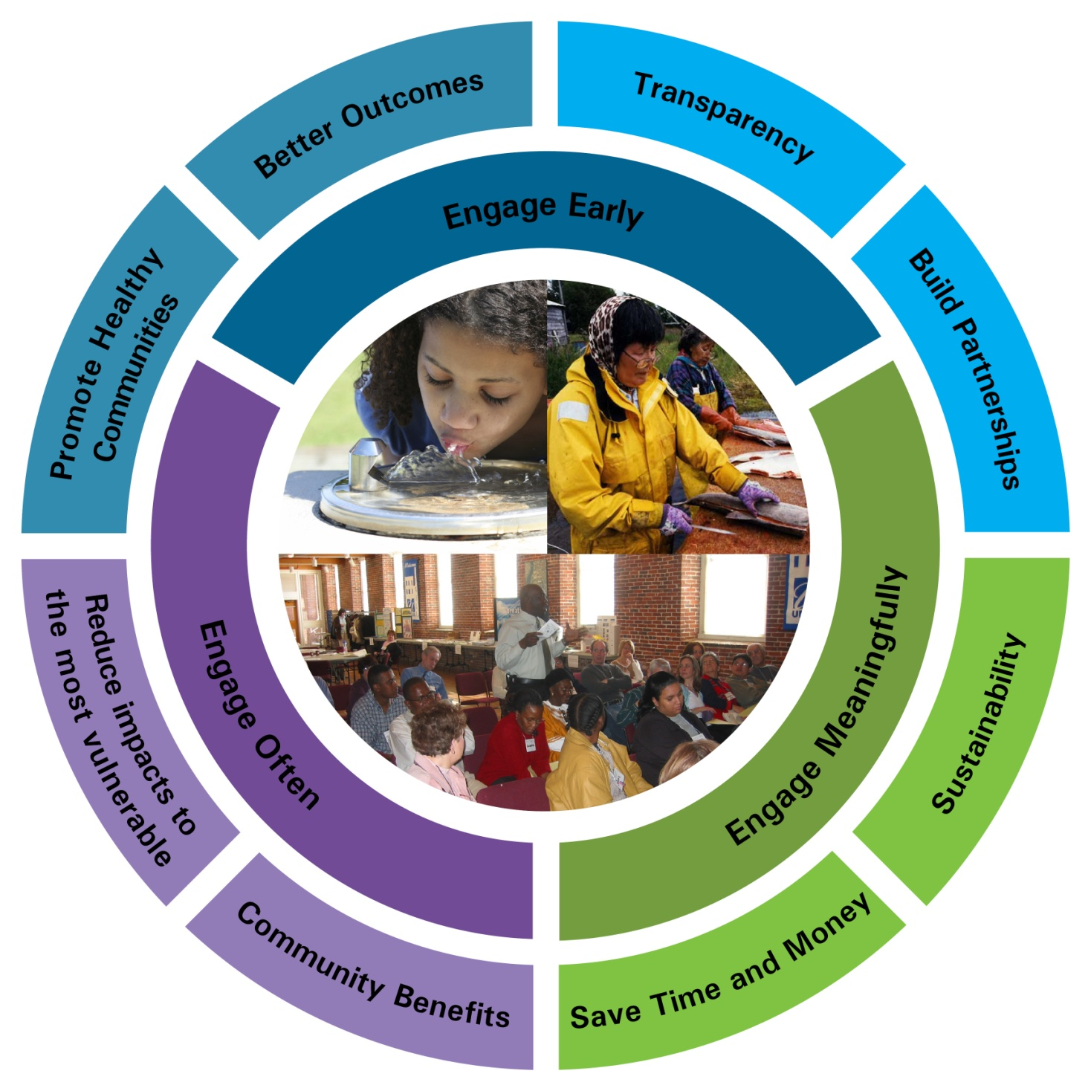
Role: Community / public Involvement
EPA encourages authorized tribes to reach out to the local communities and learn how they use their water body and to keep those communities informed. By engaging early and often, WQS decisions will best reflect the variables and needs of a local community which will benefit the public and implementing agency.
Community members should be engaged meaningfully throughout the decision-making process through public meetings, webinars, and public hearings as necessary.
Each community has unique considerations, and outreach should be tailored to meet those needs. Considerations when engaging the local community might include: language, age, rural/urban population, community work schedules, income and education levels, literacy rates, and community demographics.
Notes:
Any revision or review of a WQS must be subject to a public hearing. But, it’s not limited to that.
EPA encourages authorized tribes, states, and territories to reach out to the local communities and learn how they use their water body and to keep those communities informed of any WQS issues that could impact that water body. By engaging early and often, WQS decisions will best reflect the variables and needs of a local community which will benefit the public and implementing agency alike (see outermost circle of figure).
Community members should be engaged meaningfully throughout the decision-making process through public meetings, webinars, and public hearings as necessary. Keep in mind that each community has unique considerations, and outreach should be tailored to meet those needs. Considerations to keep in mind when engaging the local community might include language, age, rural population vs. urban population, community work schedules (for purposes of planning public hearings, for example), income and education levels, illiteracy rates, and similar demographics.

Slide 62
WQS Tools for tribes
  Streamlined TAS Application
      Provides interested tribes with a template that includes simple explanations and organization of relevant language to address eligibility requirements for TAS approval for CWA Section 303(c) WQS and CWA Section 401 certification.
  Model WQS Template
      Facilitates drafting of WQS. EPA expects that tribes will be able to incorporate the template language and tables directly into their draft WQS after tribes have made changes to the text and/or tables in coordination with the appropriate EPA Regional Office.
  Human Health Criteria Calculator
      This calculator generates a customized numeric HHC table based upon a selected fish consumption rate and cancer risk level. The calculator generates a table and footnotes to include in draft WQS.
  Website: https://www.epa.gov/wqs-tech/water-quality-standards-tools-tribes
Notes:
EPA has developed tools to assist tribes with TAS applications and WQS development. On the featured website, you can find:
A streamlined TAS application that outlines the requirements for eligibility and identifies places where applicants can refer to previously-approved TAS applications.
A model WQS template that provides example language that tribes can use as a possible starting point for developing WQS.
A Human Health Criteria calculator that produces a table of numeric criteria using specified fish consumption rates and cancer risk levels.
We strongly recommend that tribes work with regional EPA offices if they are interested in starting the TAS and CWA WQS process.

Slide 63
Role: EPA
Facilitate development of regulations and policies that guide EPA’s review of submitted WQS.
Coordinate with and provide technical assistance to authorized tribes.
Develop and publish CWA 304(a) criteria recommendations (based on latest science).
Approve/disapprove WQS submitted by authorized tribes. CWA requires EPA to approve within 60 or disapprove within 90 days. (CWA 303(c)).
    If EPA approves as consistent with the CWA and WQS regulation, the new/revised WQS becomes effective for CWA purposes.
    If EPA disapproves, the tribe has the chance to revise. Consistent with the CWA, if the tribe does not adopt specified changes within 90 days, the EPA Administrator must promptly propose and promulgate replacement WQS.
Notes:
EPA serves several roles for water quality standards.
For one, it facilitates development of regulations and policies that guide EPA’s review of submitted WQS
EPA also coordinates with and provide technical assistance to authorized Tribes
EPA develops and publishes national CWA 304(a) criteria recommendations (based on latest science)
EPA has delegated authority to approve or disapprove tribal WQS under CWA 303(c). The Act sets out a statutory timeframe for action: 60 days to approve or 90 days to disapprove. WQS do not become legally binding, or useable, for CWA purposes until EPA approves them. Once EPA approves, they become effective for CWA purposes.
EPA’s basis for review and approval or disapproval is whether the submitted WQS are consistent with the CWA and/or federal WQS regulation. Note that while EPA reviews Tribal standards to ensure that they meet the minimum requirements and the intent of the Clean Water Act, EPA does not have the authority to disapprove a Tribe’s standards on the grounds that the standards are too stringent. Section 510 recognizes a Tribe's authority to adopt standards that are more stringent than those required by the Act.
If EPA disapproves, EPA provides a an opportunity for the tribes to revise their WQS. As specified in the CWA, If a tribe does not adopt specified changes within 90 days, the EPA Administrator must promptly propose and promulgate replacement WQS.

Slide 64



Implementing WQS
An authorized tribe has adopted WQS into their regulations and EPA has approved them under CWA 303(c). Now what?
WQS:
Theory, Plans, Process
Implementation: Permits to discharge or waterbody assessment program
This Photo by Unknown Author is licensed under CC BY-NC
This Photo by Unknown Author is licensed under CC BY-SA
Notes:
One way to think about the difference between WQS and Implementation is that WQS are the theoretical basis for lots of implementation programs. Think of WQS as the theory, plans, process. Then implemented through permits to discharge (as the slide shows), or other programs like assessment and 303(d) listing of impaired waters. Implementation is where the rubber meets the road for water quality protection.

Slide 65
Water Quality Standards Schematic
Notes:
What that boils down to is, you set up your tribal WQS in order to provide the basis for your other CWA programs to work off of. Permits to discharge pollutants (via NPDES) or to discharge dredged or fill material (via section 404 permits) need to be structured in order to attain WQS. And, when you assess whether a water is impaired or not attaining its WQS, you will assess the water based on your WQs. If you end up developing a TMDL as a means to help restore water quality, you will use the WQS to set the target of the TMDL.
Hopefully you have a sense now of why WQS are important as a base for all the other implementation programs.
Before we end I will mention a few “tools” that you may be familiar with or may be hearing about in your future, tools that can help to achieve WQS. We know that many waters are impaired or aren’t attaining their WQS in the short term, but under the CWA framework, we need to work towards achieving the WQS, adjusting where needed and restoring where needed.

Slide 66
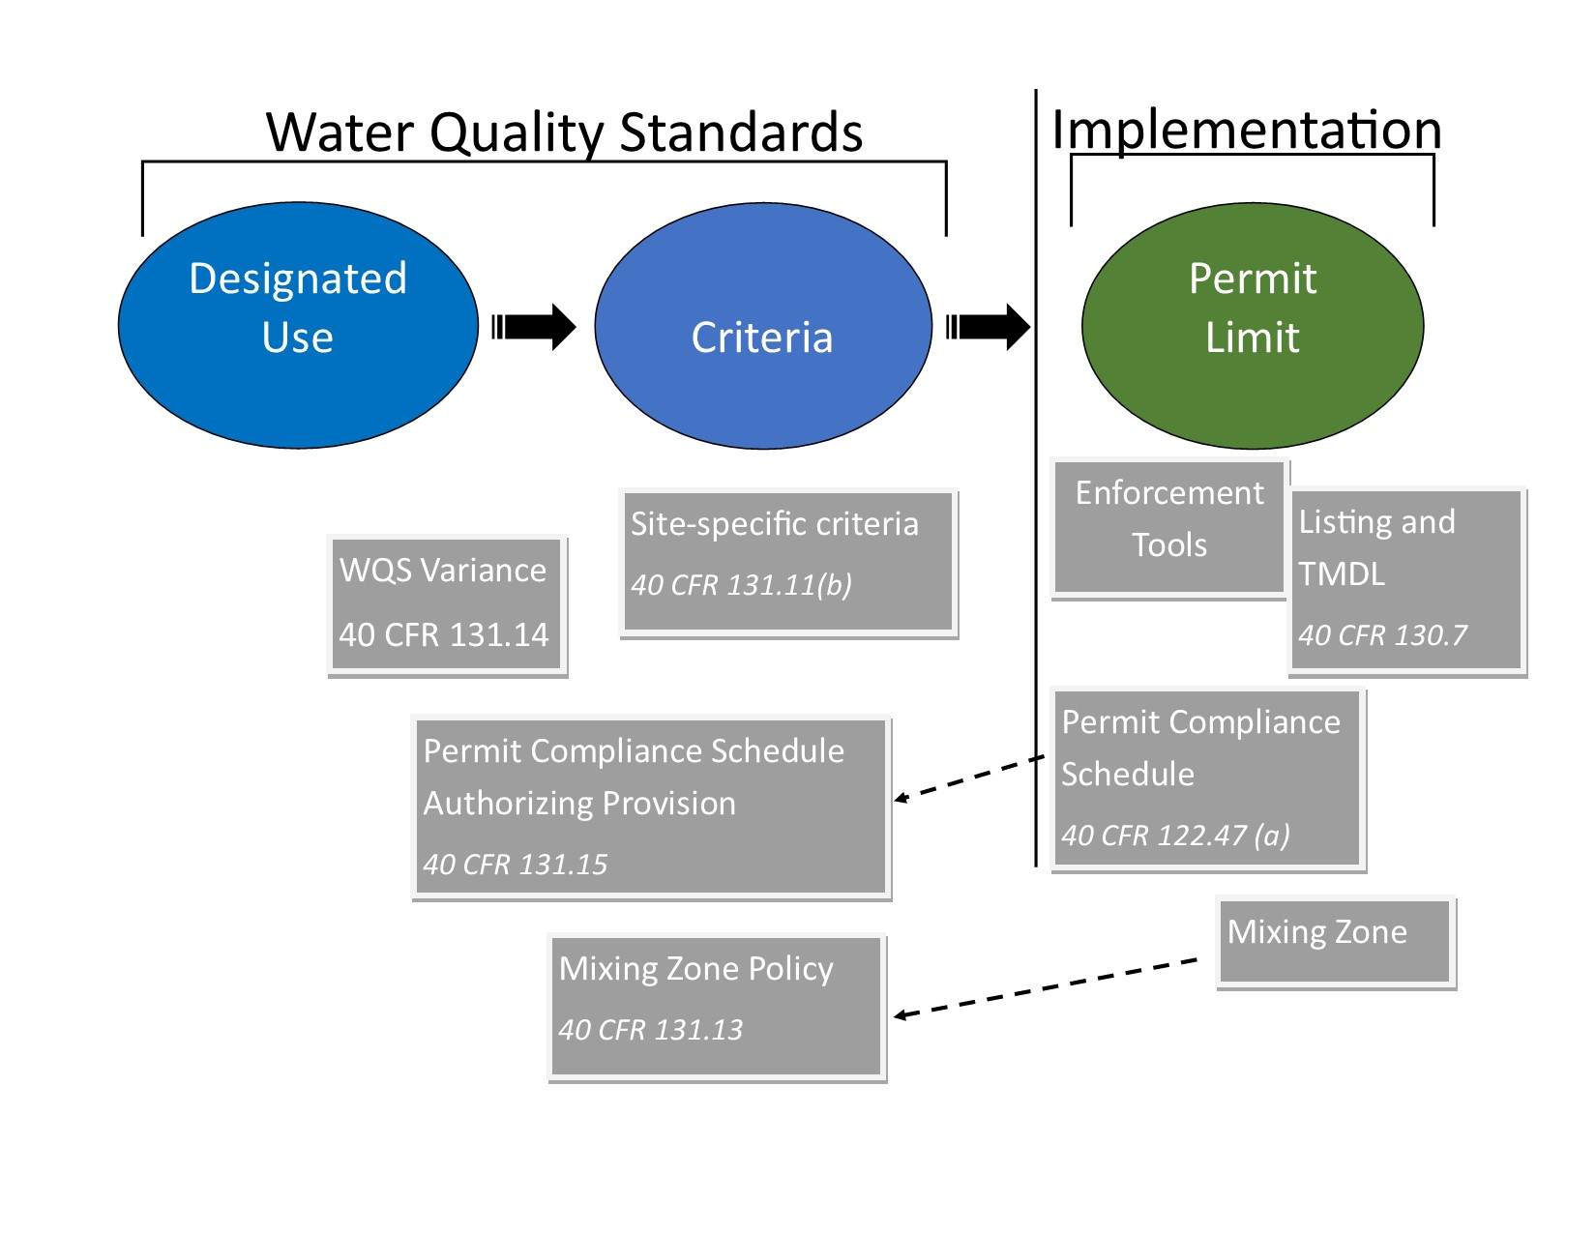
A Variety of Tools To Help Meet WQS
Notes:
Here are a variety of tools that you may encounter, some relating to the WQS themselves, and some relating to implementation programs (simplified in this diagram as ‘permit limit’)
In the realm of water quality standards, shown at left, we have variances and site specific criteria, I’m going to tell you a little about these now.

Slide 67
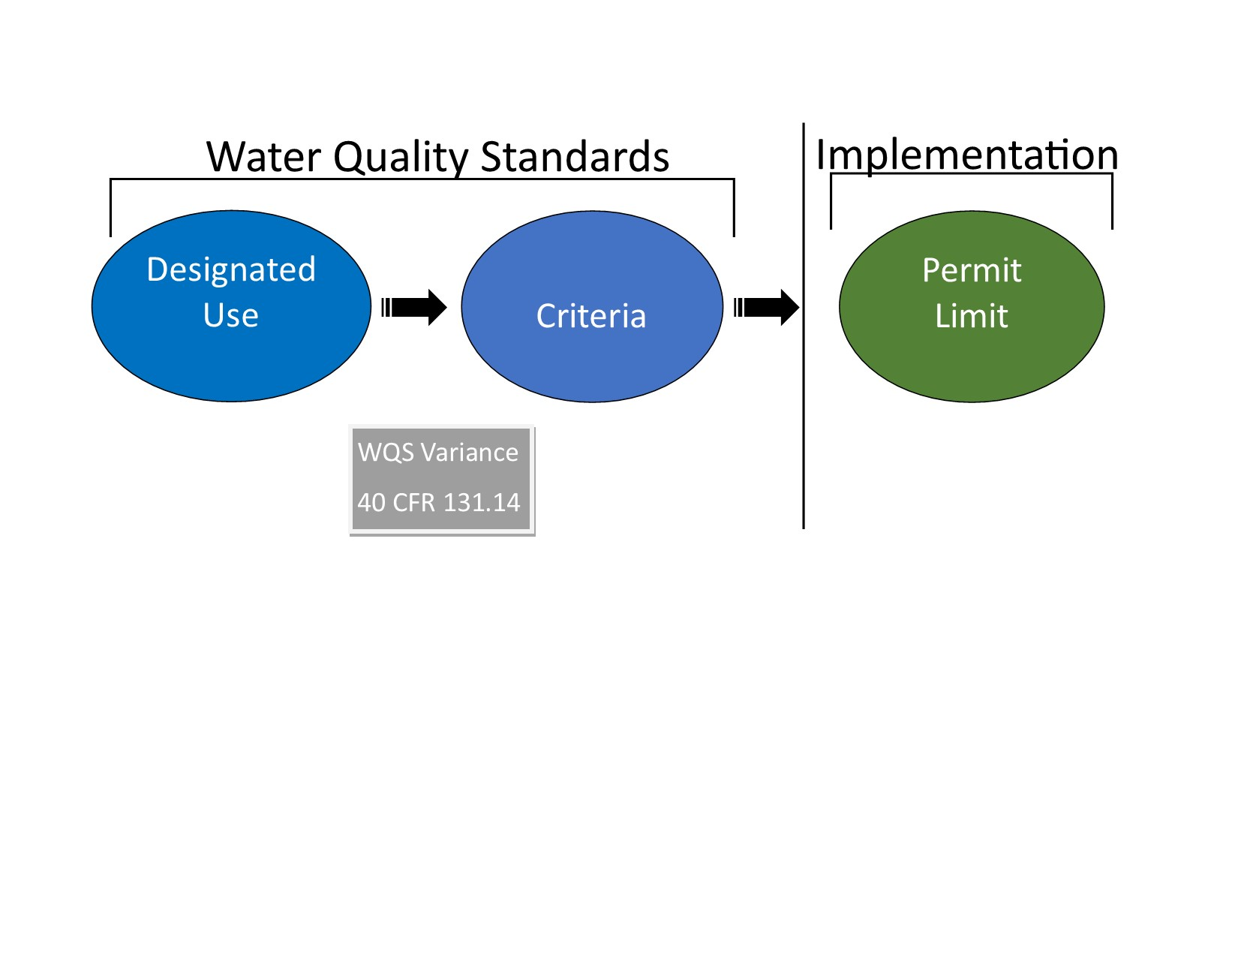
WQS Variance
Time-limited designated use and criterion for a specific pollutant(s) or water quality parameter(s) that reflect the highest attainable condition during the term of the WQS variance (40 CFR131.14).
Notes:
A WQS variance is a time-limited designated use and criterion for a specific pollutant(s) or water quality parameter(s) that reflects the highest attainable condition during the term of the WQS variance. Unlike use revisions, WQS variances do not change the underlying designated use, and they only apply for the dischargers, waterbodies, and pollutant or water quality parameter identified within the WQS variance and only for the length of time specified in the WQS variance.
WQS variances are a useful tool for when there is uncertainty around whether the standards can be attained, but you know you could make incremental improvements. They allow time to implement actions, assess the impact of those actions, and then adapt those actions in order to effectively improve water quality.
A regulatory mechanism that ensures incremental water quality improvements when the designated use and criterion are not currently attainable.

Slide 68
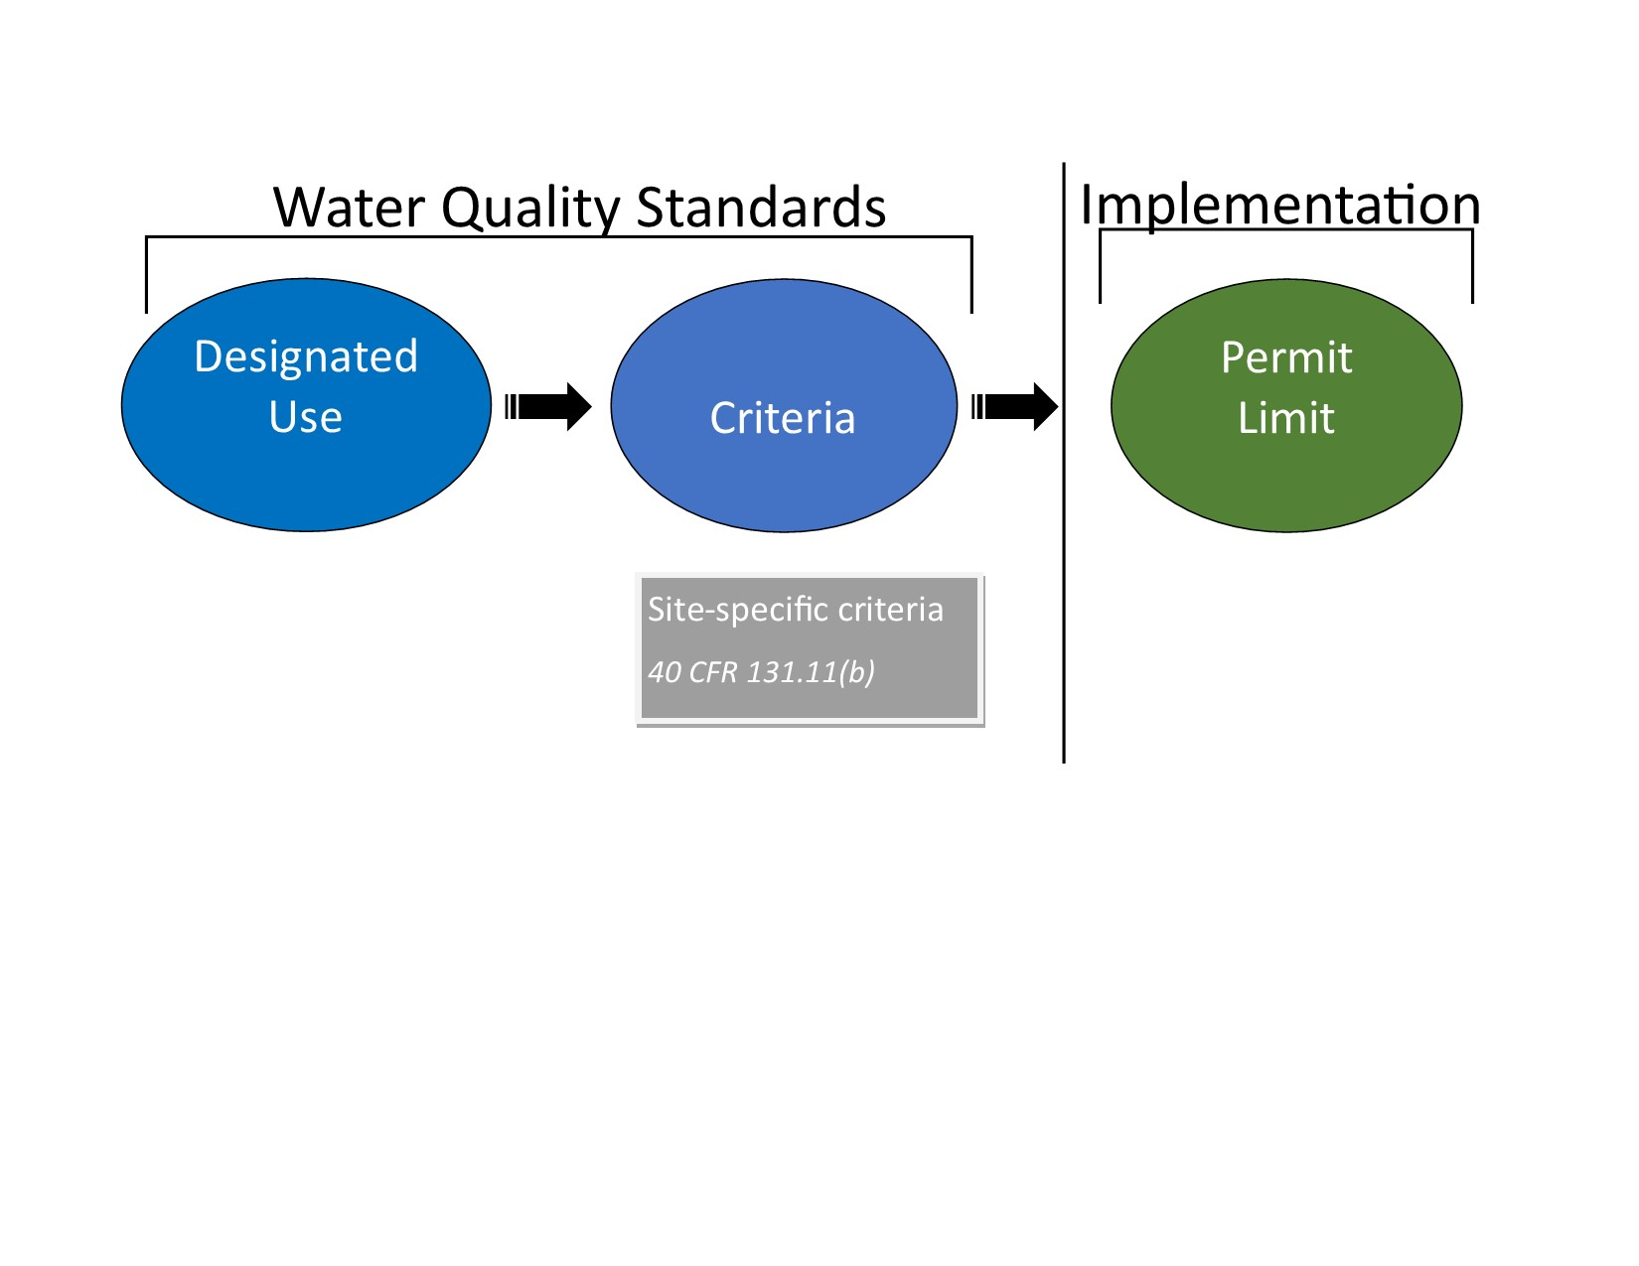
Site Specific Criteria
Best used when you have additional scientific information that more accurately expresses a level/concentration for a water quality parameter to protect the designated use.
Under Section 131.11(b)(1) of the regulations, States and Tribes may adopt numeric criteria based on:
  Published CWA 304(a) guidance;
  CWA 304(a) guidance modified to reflect site specific conditions; or,
  Other scientifically defensible methods.
Notes:
Site specific criteria are another tool for meeting WQS. If you are having trouble meeting the WQS in a water body, it is possible that you might not have the right criteria to protect the use. Site specific criteria are best used when you have additional scientific information that can more accurately express a level for a water quality parameter to protect the designated use based on the water body’s specific physical, chemical, and biological characteristics.
Under Section 131.11(b)(1) of the regulations, Tribes may adopt numeric criteria based on:
Published CWA Section 304(a) guidance;
Section 304(a) guidance modified to reflect site specific conditions; or,
Other scientifically defensible methods

Slide 69
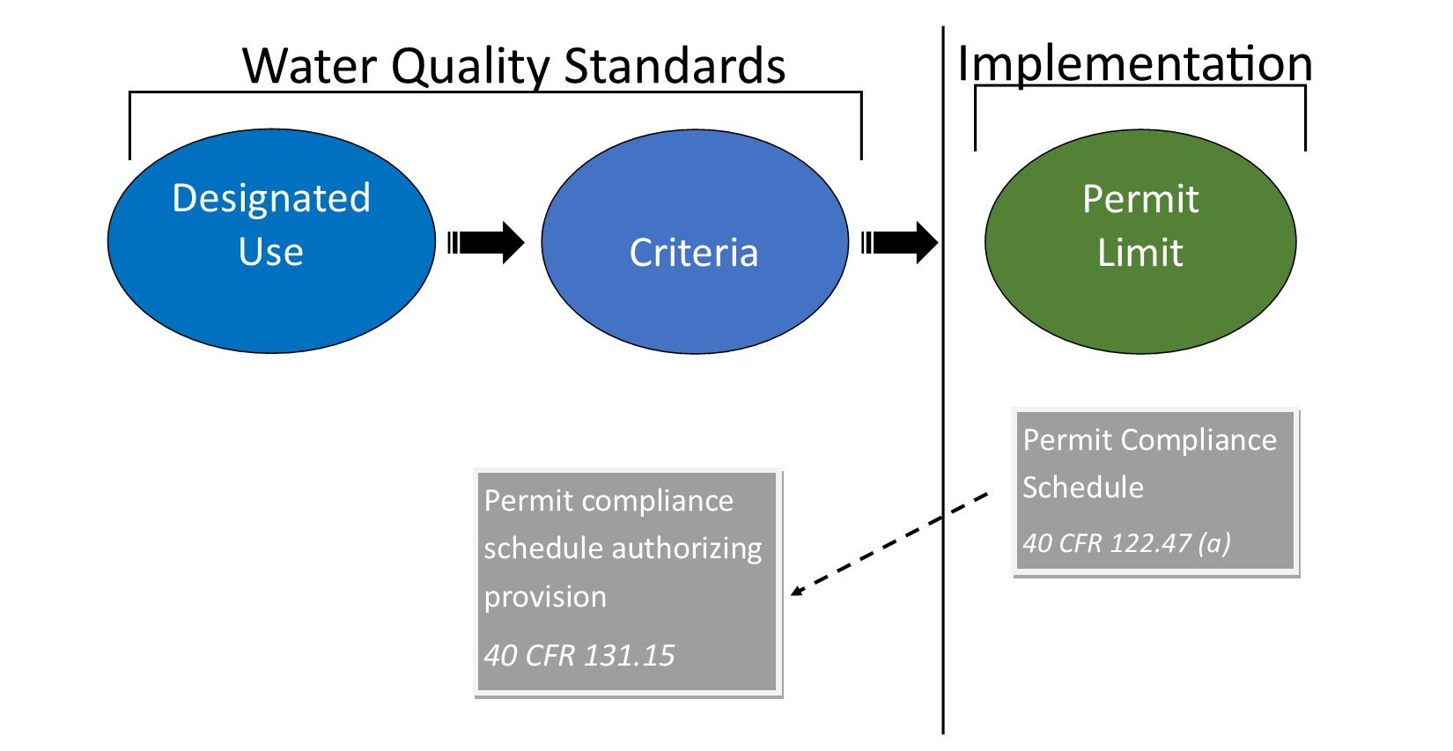
Permit Compliance Schedule
A tool that allows additional time to take specific actions to meet an NPDES WQBEL.
If a permittee cannot immediately comply with the permit WQBEL upon effective date of permit, the permit may include, where appropriate, a schedule of compliance granting time to a NPDES permittee to meet new or revised WQS “as soon as possible.”
Notes:
Another tool that “lives” in NPDES permits is NPDES permit compliance schedules.
If an authorized tribe has authorized the use of NPDES permit compliance schedules in its WQS via an authorizing provision (see this indicated on the left in the diagram), NPDES permits discharging to waters in the tribe may include permit compliance schedules as needed. This would be when a permittee cannot immediately comply with the permit’s water quality-based effluent limits upon the effective date of the permit. If that is the case, where appropriate, the permit can include a schedule of compliance that grants time to the permittee to take additional actions needed to meet the limits (such as adding treatment or expansion). The regulation requires that the water quality effluent limits be met “as soon as possible.”

Slide 70
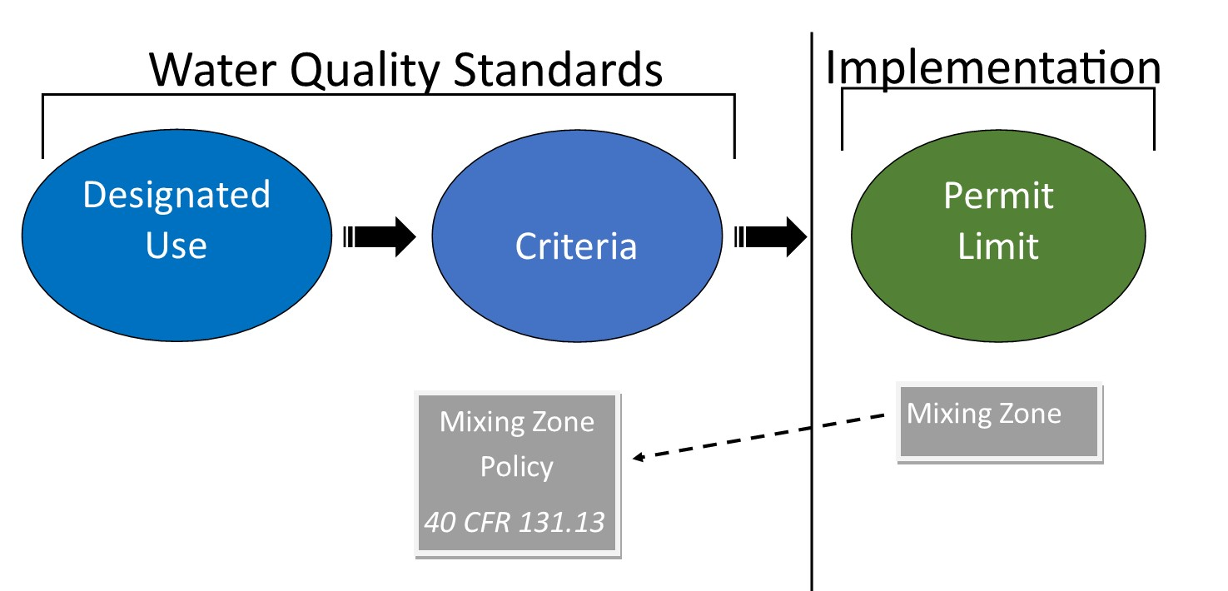
Mixing Zone
A tool that allows for dilution of a discharge before criteria must be met.
A mixing zone is a limited area or volume of water where initial dilution of a discharge takes place and where certain numeric water quality criteria may be exceeded.
Rationale: Sometimes organisms can be exposed to pollutant concentrations above a criterion magnitude for a short duration without interfering with the designated use of a waterbody as a whole.
Notes:
Now I’ll mention some tools for achieving standards that “live” in the realm of implementation programs.
An NPDES permit may in some circumstances include a “mixing zone,” which is a provision allowing an initial zone of dilution around the outfall in which criteria can be exceeded, but the WQS of the water body as a whole will be met. The rationale for allowing this in some permits is that sometimes organisms can be exposed to pollutant concentrations above a criterion magnitude for a short duration without interfering with the designated use of the waterbody as a whole.
The “mixing zone” provision itself is contained in the actual NPDES permit, as you see on the right in the diagram, but the tribe’s WQS would contain a policy about mixing zones, as you see on the left. That policy would outline details such as descriptions of circumstances under which mixing zones would or would not be allowed.

Slide 71
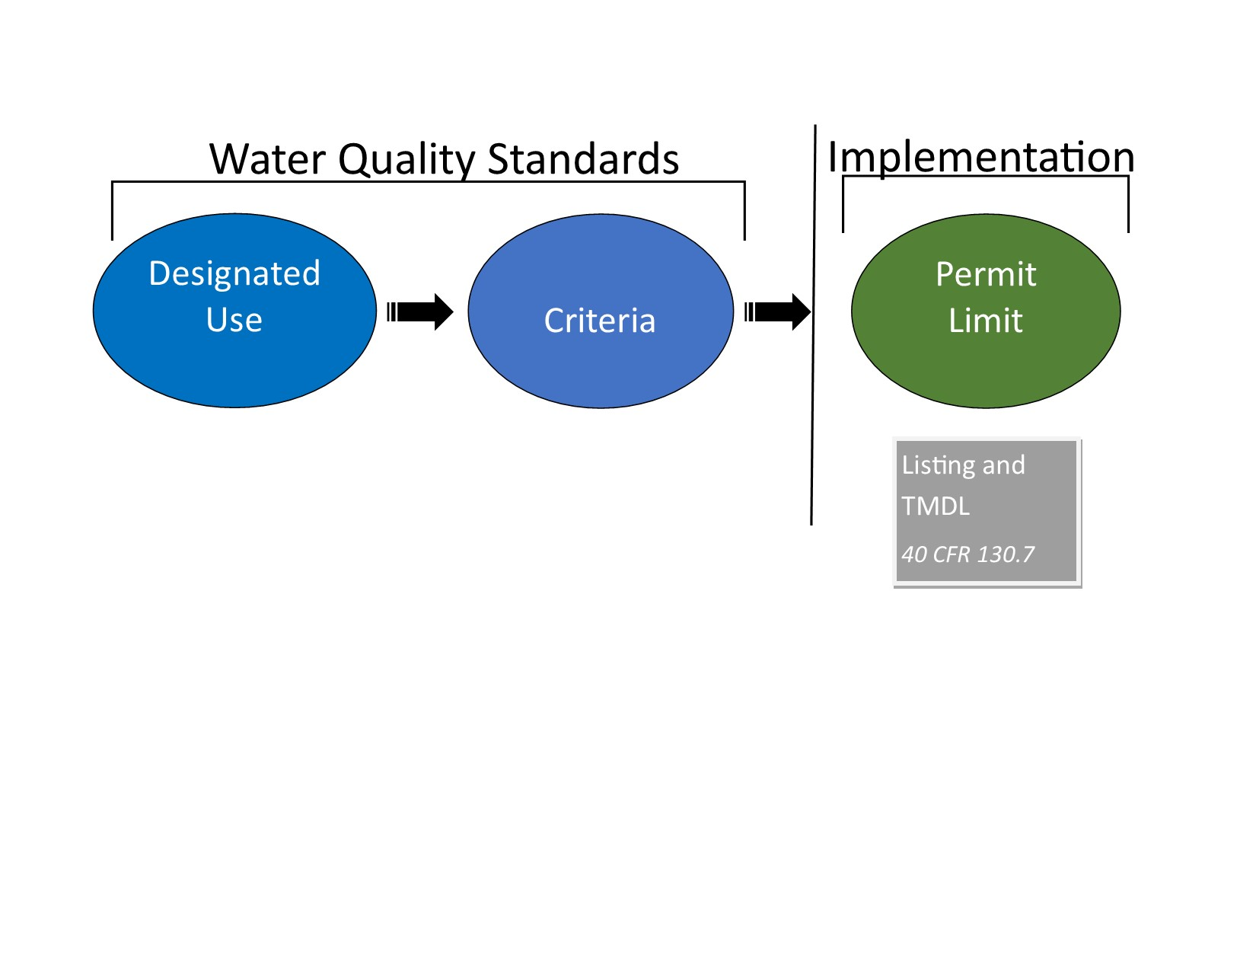
Total Maximum Daily Load (TMDL)
A tool to calculate needed source reductions (point sources and nonpoint sources) to meet WQS.
A TMDL is a calculation of the maximum amount of a pollutant that a water body can receive and still meet water quality standards, and an allocation of that amount to the pollutant’s sources (wasteload allocations for point sources and load allocations for nonpoint sources).
  Every 2 years states/tribes develop a list of waters that are not meeting applicable WQS and need a TMDL.
Notes:
A Total Maximum Daily Load (TMDL) is another tool to help achieve WQS.
States are required to assess the quality of their waters every two years, and part of this assessment includes making a list of waters that are not meeting their water quality standards. This is called the “CWA 303(d) list.” Waters that get put on this list are in queue to have a Total Maximum Daily Load, which is a plan for how to get the water to meet its WQS.
A TMDL is a calculation of the maximum amount of a pollutant that a water body can receive and still meet water quality standards, and an allocation of that amount to the pollutant’s sources (waste load allocations for point sources and load allocations for nonpoint sources). A TMDL would be developed for a water not meeting its standards, with the goal being that once actions are taken to reduce the relevant loads, the water would then meet its WQS.

Slide 72
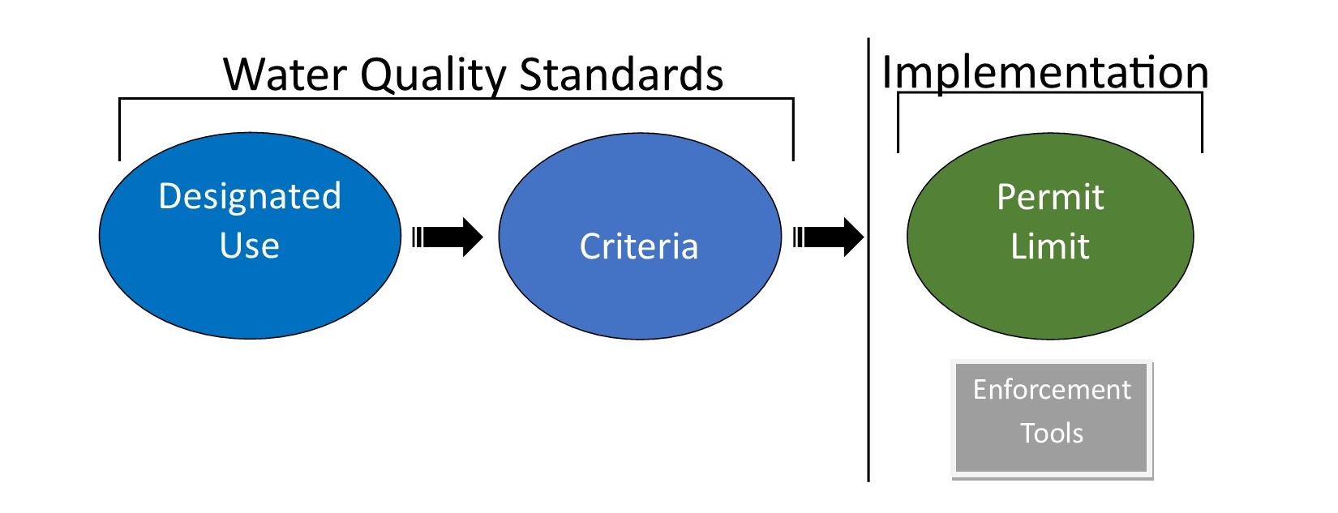
Enforcement Tools
Requirements outside of WQS to take specific actions.
Enforcement tools support implementation of NPDES permit limits and the underlying WQS.
  For example, administrative orders and civil judicial consent decrees contain enforceable corrective actions and deadlines to return to compliance.
Notes:
Enforcement actions are established outside the permitting and WQS development framework to resolve violations and support implementation of permits. Enforcement actions are intended to return a facility to compliance with the permit limit, and consequently, the underlying WQS.

Slide 73
Grants
CWA Section 106 program: for developing, maintaining, and expanding water quality programs. These programs are designed to control, prevent, and eliminate water pollution as well as to educate tribal members and the general public.
CWA Section 319 program: grants and technical assistance to support tribal environmental programs in assessing and managing their nonpoint source pollution problems and threats.
Notes:
There is no special funding just for WQS, but developing TAS applications and developing WQS are allowable uses of Clean Water Act Section 106 and 319 grant programs.
There are also grant funds available under EPA’s General Assistance Program for Tribes (GAP grants) offered through the Regional offices. The GAP grants do not come from the Clean Water Act but rather cover all environmental programs administered by EPA.

Slide 74
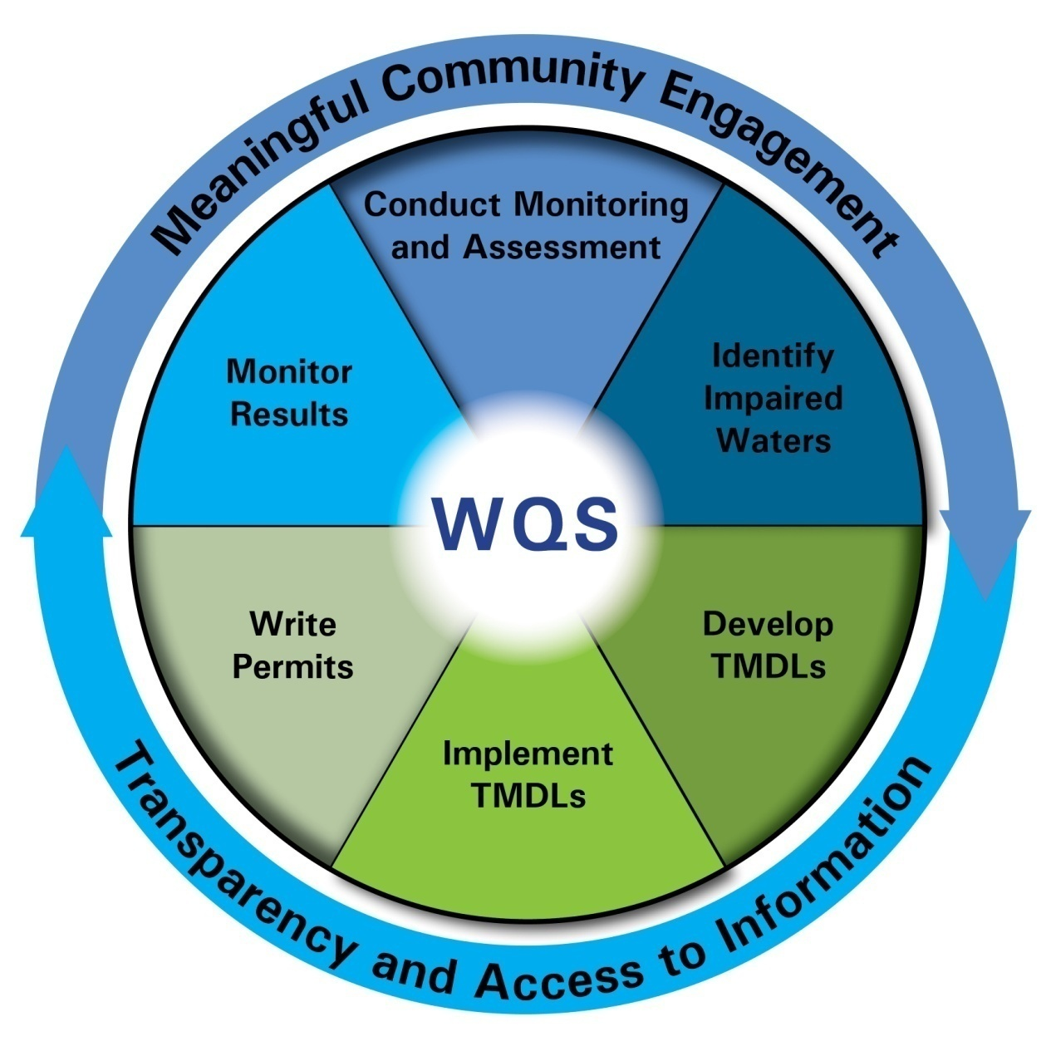
Water Quality Based Approach
Notes:
As you can see by now, WQS provide the basis for many other CWA programs, and we can think of this as the ““Water Quality Based Approach.”
The activities described in this slide (the pie slices) are a sampling of the implementation tools that rely on Water Quality Standards (WQS) to define the water quality goal that needs to be achieved. WQS is the base or “target” for the implementation programs, which is why it is at the center of the wheel.
The water quality-based approach emphasizes the overall quality of water within a water body and provides an mechanism through which the amount of pollution entering a water body is controlled based on the intrinsic conditions of that body and the standards set to protect it.
The Water Quality Based approach is a cyclic process which starts at the center with establishing water quality standards and then either goes to “conduct monitoring and assessment” or “write permits.” For example, if you start with “write permits” at the 7pm wedge, which are written to comply with the underlying WQS, then the state or authorized tribe will monitor the effluent to see if it is meeting its permit limits and monitor the ambient water to track the water body’s health. Based on how these assessments compare to the water quality standards (the water quality goal of the water body), a waterbody may be listed as impaired. If a water is listed as impaired, it is then slated to receive a Total Maximum Daily Load (or TMDL). That TMDL is implemented through integration into permits, and the cycle begins over again.
Beyond public involvement in the development of water quality standards, the implementation of water quality standards also provides opportunities for meaningful community engagement at the tribal, state, and local levels. The arrows on the outside of the “pie slices” in the diagram refer to this. For instance, the community surrounding a water body can monitor the water quality and provide data and information to their tribe.
I hope that you now have a good sense for what WQS are, how they are implemented, and the roles of various entities in WQS.

Slide 75
Thank you!
Questions?
Notes:
Thank you for your attention. I will now take questions.

