Slide 1
AWIA workshop
Module 1: awia Section 2013 requirements, Certification, & awia Section 2018 basics
Name, Organization
Date
Notes:
Main Presenter
Hi everyone,
My name is _____and I’m here today to conduct Module 1 of our 3 module training on America’s Water Infrastructure Act. In Module 1, we will give an overview of section 2013, which requires certain community water systems (CWS) to conduct or update risk and resilience assessments and emergency response plans. We will also cover the process by which a CWS can certify to EPA that they have completed their RRA and ERP. Finally, we will review Section 2018 of AWIA, which is related to spill notifications.

Slide 2
Workshop Training Modules
Module 1: AWIA Section 2013 Requirements, Certification Process,
and AWIA Section 2018 Basics
Module 2: AWIA Risk and Resilience Assessments: Malevolent Acts, Natural Hazards, and the Small Systems Checklist
Module 3: Emergency Response Plan Template and Guidance
2
Notes:
Here is the training outline for the next few days.​
​
Today we will cover the first Module which provides and overview of AWIA Section 2013 and background, how to certify RRAs and ERPs, and AWIA Section 2018.
​
Then Module 2 will cover the risk and resilience assessment requirements and the tools that EPA has developed to assist you in conducting your AWIA-compliant risk and resilience assessment.​
​
The next module, Module 3, will cover the emergency response plan requirements and the emergency response plan guidance and template that was developed to assist community water systems in developing/updating an AWIA-compliant emergency response plan. ​
​

Slide 3
Poll 1
What best describes your organization?
3
Notes:
Let’s start with our first poll of the day. We would like to know, what best describes your organization?
It is water utility; consultant; state, tribal, or agency representative; or other?
Answer:
Open ended, no correct answer. Comment on the response.
As we mentioned before, we will be broadcasting a mix of polls and quiz questions throughout the day to keep you all engaged. Please make sure you respond to the questions.

Slide 4
Learning Objectives
Participants will:
Learn the history, requirements, and deadlines of AWIA Section 2013.
Know how to certify to EPA that they have completed the risk and resilience assessment and emergency response plan.
Learn about the new AWIA Section 2018 release notification requirements and accessing chemical inventory data.
4
Notes:
Main Presenter
We have 3 main goals for today:
Understand the history, requirements, and deadlines of Section 2013
Review the 3 methods by which you can certify to EPA that you have completed your AWIA compliant RRA and ERP
Learn about the new chemical spill release notification requirements and accessing chemical inventory data (AWIA Section 2018)

Slide 5
AWIA SECTION 2013 (A-F)
Amendment to Safe Drinking Water Act Section 1433
5
Notes:
Let’s get to it. First we will discuss AWIA Section 2013 sections a-f. which replaces the Safe Drinking Water Act Section 1433.

Slide 6



Purpose
History – Replaces 2002 Bioterrorism Act
RRA and ERP completion help utilities to address hazards in your community
Examples of utility emergencies
Who does it apply to?
Funding
6
Notes:
This purpose of this training is to ensure that you are aware of the AWIA of 2018 updates to SDWA Section 1433, which was added by the Public Health Security and Bioterrorism Preparedness and Response Act of 2002.
AWIA Section 2013 expands the risk types addressed in a public water system's assessment to include risks of natural hazards and malevolent acts. In addition, community water systems are required to evaluate the resilience of their current physical infrastructure and their management practices, including financial capacity to respond to these risks. Based on the assessment, community water systems must also develop emergency response plans that address the risks and resilience issues that systems may face.
We will also review the common types of emergencies faced by utilities in your region.
The risk assessment and emergency response plan certification requirements only apply to community drinking water systems serving 3,300 or more people.
We will also discuss the funding available to date.

Slide 7
Bioterrorism Act of 2002
Vulnerability
Assessment &
Emergency
Response Plan
Public Health Security and Bioterrorism Response Act was signed into law by President Bush on June 12, 2002.
  Added SDWA Section 1433.
Initial requirement for community water systems to conduct a vulnerability assessment by set deadlines (submit a copy to EPA) and develop an emergency response plan (certify completion to EPA).
  Assessment of system to terrorist attack or other intentional acts designed to disrupt the water system.
Required EPA to develop stringent measures to protect the information found in or derived from the Vulnerability Assessments.
Required EPA to provide technical assistance to certain community water systems.
EPA is the primary agency responsible for enforcing Section 1433.
7
Notes:
Prior to AWIA, the Bioterrorism Act of 2002, which added Section 1433 to the SDWA, required water systems to assess their vulnerabilities to terrorist or other intentional acts and, based on the assessment, prepare emergency response plans.
The statute required community water systems to conduct a vulnerability assessment by set deadlines and submit a copy to EPA as well as develop an emergency response plan and certify completion to EPA, but did not require them to periodically update their risk assessments or emergency response plans.
The vulnerability assessments were meant to identify risks associated with terrorist attacks or other intentional acts designed to disrupt the water system.
This also required that EPA protect the information in those vulnerability assessments submitted by water systems.
EPA also provided technical assistance to certain community water systems based on these assessments.
EPA was named as the primary agency responsible for enforcing this section of SDWA.
*If anyone asks about getting their Vulnerability Assessments returned to them: this process has been delayed by COVID-19. We are currently working on reducing our backlog but it will be several more weeks before we can get through them all (10/22/2020).

Slide 8
America’s Water Infrastructure Act of 2018: Section 2013
Risk & Resilience
Assessment &
Emergency
Response Plan
Amends SDWA Section 1433.
Initial risk and resilience assessment and emergency response plan completion and certification by set deadlines, based on utility service size.
  Includes malevolent acts and natural hazards.
Utility must re-certify every 5 years.
Requires EPA to provide guidance to systems serving populations of 3,300 or less.
EPA is the primary agency responsible for enforcing Section 1433.
8
Notes:
AWIA Amends the SDWA Section 1433 and requires not only an initial risk assessment and emergency response plan, but the new requirement includes re-certification every 5 years.
Also, it includes malevolent acts and natural hazards, while the bioterrorism act only included intentional malevolent acts.
EPA will also provide guidance to very small systems who are not required to comply with the certification requirements.
EPA directly enforces Section 1433, like the bioterrorism act.
*Please note that AWIA in a large law with multiple sections. We will be spending most of our time on AWIA Section 2013. Because of this, I may say “AWIA requirements” as shorthand instead of saying Section 2013 over and over – please note that by “AWIA requirements” I am talking about Section 2013 of AWIA, specifically. At the end of Module 1 I will spend some time talking about AWIA Section 2018, but for the rest of this workshop (all 3 modules), I will be talking about Section 2013.

Slide 9
Risk & Resilience Assessment Requirements
Each community water system serving a population greater than 3,300 persons shall assess the risks to, and resilience of, its system. Such an assessment shall include:
The risk to the system from malevolent acts and natural hazards;
Pipes/conveyances, source water, water collection/intake, pretreatment, treatment, storage and distribution, electronic, computer, or other automated systems (including security);
Monitoring practices;
Financial infrastructure;
Use, storage or handling of chemicals;
Operation and maintenance; and
May include capital and operational needs for risk management.
Risk &
Resilience
Assessment
9
Notes:
Now that we’ve talked about AWIA Section 2013 and the similarities and differences with the Bioterrorism Act which it replaced, let’s talk about the 2 big AWIA section 2013 requirements, starting with the RRA.
The requirements of what needs to be included in your RRA are listed on the slide. We will go over this in much more detail in Module 2 of this workshop.
Summary of steps to take for RRAs:
develop or update the RRA, according to these 10 requirements on the slide
certify to EPA that you’ve done this by the deadline
maintain records of it at your facility for 5 years
review and update, if needed, and recertify every 5 years

Slide 10
Emergency Response Plan Requirements
Prepare or revise an ERP that incorporates findings from the risk assessment and include:
  Strategies and resources to improve resilience, including physical security and cybersecurity (Resilience Strategies);
  Plans, procedures, and equipment for responding to a malevolent act or natural hazard (Emergency Plans & Procedures);
  Actions, procedures, and equipment to lessen the impact of a malevolent act or natural hazard, including alternative source water, relocation of intakes and flood protection barriers (Mitigation); and
  Strategies to detect malevolent acts or natural hazards (Detection Strategies).
The law also requires you to coordinate with your local emergency planning committees (LEPCs).
Emergency
Response Plan
10
Notes:
The requirements of what needs to be included in your ERP are listed on the slide. We will go over this in much more detail in Module 3 of this workshop.
Summary of steps to take for ERPs:
develop or update, if you already have one, an ERP based on the information that you put together in your RRA
certify to EPA that you’ve done this by the deadline (6 months after you certify your RRA)
maintain records of it at your facility for 5 years, just like the RRAs
Review, update, and recertify ERPs every 5 years, just like the RRAs

Slide 11

Who Do the AWIA Requirements Apply To?
Are you a community (drinking) water system serving a population over 3,300?
If yes, you must comply with AWIA risk and resilience assessment and emergency response plan requirements.
11
Notes:
Who does the new AWIA requirements apply to?
If you are a drinking water system that serves a population greater than 3,300 and you are considered a community water system, then this applies to you.
If you are a wholesale utility, this also applies to you.
Please note, AWIA of 2018 requirements apply to drinking water systems, not wastewater systems. If you’re a combined system you only have to address the drinking water part.

Slide 12
Poll 2
What is your utility service size?
12
Notes:
Question: What is your utility service size?
[wait for responses and comment on the distribution]
If you are a drinking water system that serves a population greater than 3,300 and you are considered a community water system, then this applies to you.
If you are a wholesale utility, this also applies to you. Include the population that you sell water to when determining the population served by your utility.
If you responded, I don’t know, you should reach out to dwresilience@epa.gov to confirm your population service size.

Slide 13
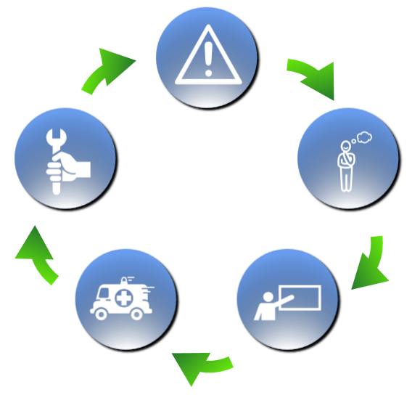
Water Resilience Framework
ASSESS
RECOVER
PLAN
RESPOND
TRAIN
13
Notes:
I’d like to take a moment to describe how the AWIA required RRAs and ERPs fit within a larger, water resilience framework. Lots of utilities ask how to start building resilience. Here is a basic framework with steps to help you along the way. We recommend that you start with:
Assessing risks: To prepare for emergencies, we must understand utilities’ threats and vulnerabilities. The risks that are most relevant to your utility will determine the planning steps you take. (examples here include creating an AWIA compliant risk and resilience assessments)
Planning for an emergency: this involves developing and updating emergency response plans, initiating mitigation projects, and taking other key actions to reduce the impact of a future disaster. (examples here include developing an AWIA compliant Emergency Response Plan)
Training: this can involve training staff on emergency response protocols and conducting exercises to practice coordination at the local, state, and national levels. (examples here include participating in tabletop or Full-scale exercises)
Emergency response: when a disaster occurs (whether that be routine, such as water main breaks, or natural disasters, such as hurricanes or earthquakes), you must have the right tools available to respond. Our Response On the Go App is one tool that can help you with responding to an emergency.
Recovery: having resources available to restore service as quickly as possible. Our FedFUNDs tool can help you find federal funding for the recovery phase.
If you are not sure where to start, check out the tools EPA has developed to assist in each of these steps of becoming more resilient.

Slide 14
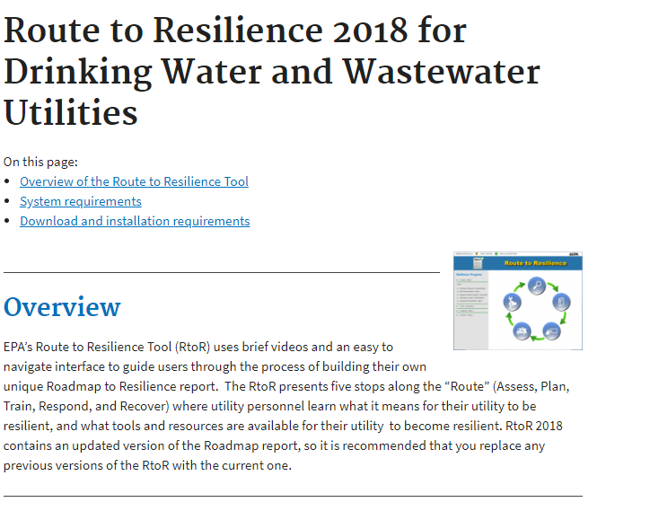
Route to Resilience Tool
https://www.epa.gov/waterresilience/route-resilience-2018-drinking-water-and-wastewater-utilities
14
Notes:
Our Route to Resilience Tool a voluntary resource you can use to help your utility walk through the 5 steps of the Water Resiliency Framework. This is a side note- it is not directly related to AWIA; I am sharing this resource with you to put the RRAs and ERPs required by AWIA into a larger framework for resiliency that your utility may want to use. Download the Route to Resilience Tool to get started.
EPA’s Route to Resilience Tool (RtoR) uses brief videos and an easy to navigate interface to guide users through the process of building their own unique Roadmap to Resilience report. The RtoR presents five stops along the “Route” (Assess, Plan, Train, Respond, and Recover) where utility personnel learn what it means for their utility to be resilient, and what tools and resources are available for their utility to become resilient.

Slide 15
All Hazards Resilience
Region 4 Natural Hazards
  Flooding
  Hurricane
Malevolent Acts
  Cyber intrusion
  Contamination
  Vandalism
  Active Shooter
All hazard resilience resources are available at: https://www.epa.gov/waterresilience/technical-support-products-and-services-list
15
Notes:
As we prepare for this training, we want you to start thinking of the types of natural hazards and malevolent acts that you might be faced with and need to plan for at your utility.
Both RRAs and ERPs required that you look at natural hazards and malevolent acts.
Some examples of natural hazards that may affect you all in Region 4 include:
Flooding
Hurricane
Malevolent Acts
Cyber intrusion – very important issue to consider nowadays
Contamination – accidental or purposeful
Vandalism – of water system’s property
Active Shooter scenario
While you are working through your RRAs and ERPs, please note that the water security division has many technical support products that may help you get information on security and resilience for water systems that face these types of threats. Note that taking mitigation steps is NOT required by AWIA, just creating the RRA and ERPs are required. Here are links to resources we currently have available to help you will these threats.

Slide 16
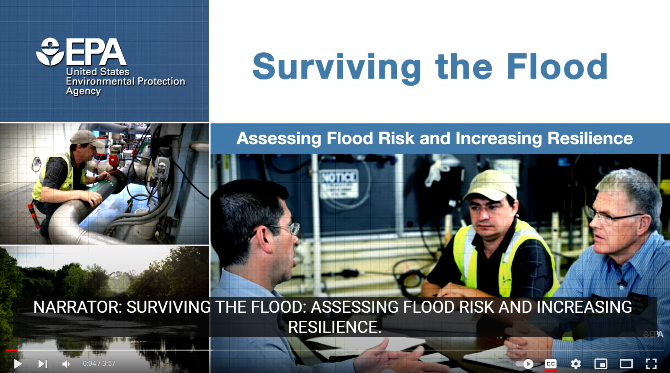
All Hazards Resilience: Flood Resilience Guide
https://www.youtube.com/watch?v=r25J-DJH2NQ&feature=emb_logo
16
Notes:
Now I’m going to share this video as an example of one of tools that EPA has developed to support utilities in planning to mitigate against the threat of flooding. EPA has other guides to address drought, power outages, earthquakes and other hazards your utility might face.
NOTE TO PRESENTER: Include tool video specific to event that can occur in this region and change text above to go along with it.
The EPA also has several resources to deal with other natural disasters including:
Options:
Earthquake Resilience Guide https://www.youtube.com/watch?v=U_098V40t6E&feature=youtu.be
Flood Resilience Guide https://www.youtube.com/watch?v=r25J-DJH2NQ&feature=emb_logo
Power Resilience Guide https://www.youtube.com/watch?v=zFGEnNsFnok&feature=emb_logo

Slide 17
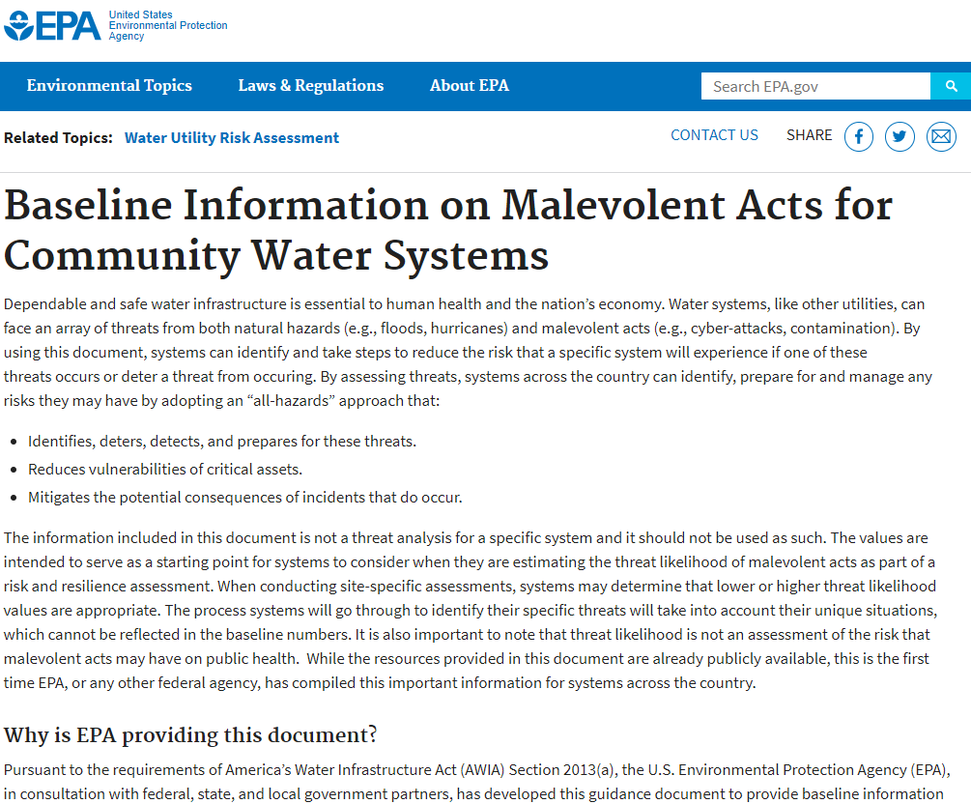
Baseline Information on Malevolent Acts for Community Water Systems
17
Notes:
We just talked about the earthquake resilience guide that can provide you with information on natural hazards. Here is an example of a resource that EPA has developed to support utilities in identifying malevolent acts that could occur at a community water system.

Slide 18
What Types of Funding Are Available?
Currently the grant funding that is stated in the law has not been appropriated by Congress.
What is available for use?
  Drinking Water State Revolving Fund program can be used to conduct a risk assessment since it addresses resilience of the system and the risk assessment may yield a project that the utility may want to invest in to improve the overall system resilience.
  States may also choose to dedicate some of their set-aside funds towards RRA or ERP development. Each state will manage this differently. Please check with your state to see if they have set aside funds for this function specifically and how you may access this assistance.
18
Notes:
The grant funding that’s stated in the law has not yet been appropriated by Congress.
What federal funds are available for use? Water systems can access funding through the drinking water state revolving fund program. These funds can be used to conduct a risk assessment since it addresses resilience of the system and the risk assessment may yield a project that the utility may want to invest in to improve the overall system resilience.
States may also choose to dedicate some of their set-aside funds towards RRA or ERP development. Each state will manage this differently. Please check with your state.
Are there any state primacy agency representatives in the audience? If so, can you speak to how you are managing DWSRF funding for RRAs in your state? Feel free to type into the chat box or raise your hand and we can unmute your microphone.

Slide 19
Enforcement
SDWA Section 1414 is an enforcement provision EPA may invoke to address an owner/operator of a public water system's noncompliance with an "applicable requirement" under the Act.
Section 1414(i) defines "applicable requirement" broadly and it expressly includes Section 1433. If a CWS fails to comply with a requirement under Section 1433 (e.g., fails to certify they have conducted a risk and resilience assessment or ERP by the statutory deadline), then EPA may exercise its enforcement discretion by initiating an action under Section 1414.
Under Section 1414, EPA may bring an action to require compliance and may also seek a civil penalty of not more than $57,317* per day of violation. (*This number is adjusted annually for inflation. See 40 CFR 19.4.)
EPA’s main goal is returning the system to compliance and protecting public health.
19
Notes:
READ THE SLIDE DIRECTLY – START WITH THE ORANGE TEXT
EPA’s main goal is returning the system to compliance and protecting public health.
Section 1414 is an enforcement provision EPA can invoke to address a public water system's noncompliance with the Act.
Section 1414(i) defines "applicable requirement" broadly and it expressly includes Section 1433. If a CWS fails to comply with a requirement under Section 1433 (e.g., fails to certify they have conducted a risk and resilience assessment or ERP by the statutory deadline), then EPA may exercise its enforcement discretion by initiating an action under Section 1414.
Under Section 1414, EPA can bring an action to
1) require compliance and
2) may also seek a civil penalty of not more than $57,317* per day of violation. (*This number is adjusted annually for inflation. See 40 CFR 19.4.)

Slide 20
Module 1 Quiz 1
Yes or No. Your utility serves a population size of 4,000. Are you required to certify completion of your risk and resilience assessment?
20
Notes:
Question: Yes or no. Your utility serves a population size of 4,000. Are you required to certify completion of your risk assessment?
Answer: Yes. All community drinking water systems that serve over 3,300 people are required to certify that they have completed a risk assessment, and then 6 months later, an emergency response plan.

Slide 21
Module 1 Quiz 2
Yes or No. Your utility is a combined water system. Does your AWIA-compliant risk and resilience assessment have to cover both the drinking water and wastewater side of the operation?
21
Notes:
Question: Yes or No. Your utility is a combined water system. Does your AWIA-compliant risk assessment have to cover both the drinking water and wastewater side of the operation?
Answer: No. AWIA of 2018 requirements only apply to drinking water, not wastewater.

Slide 22
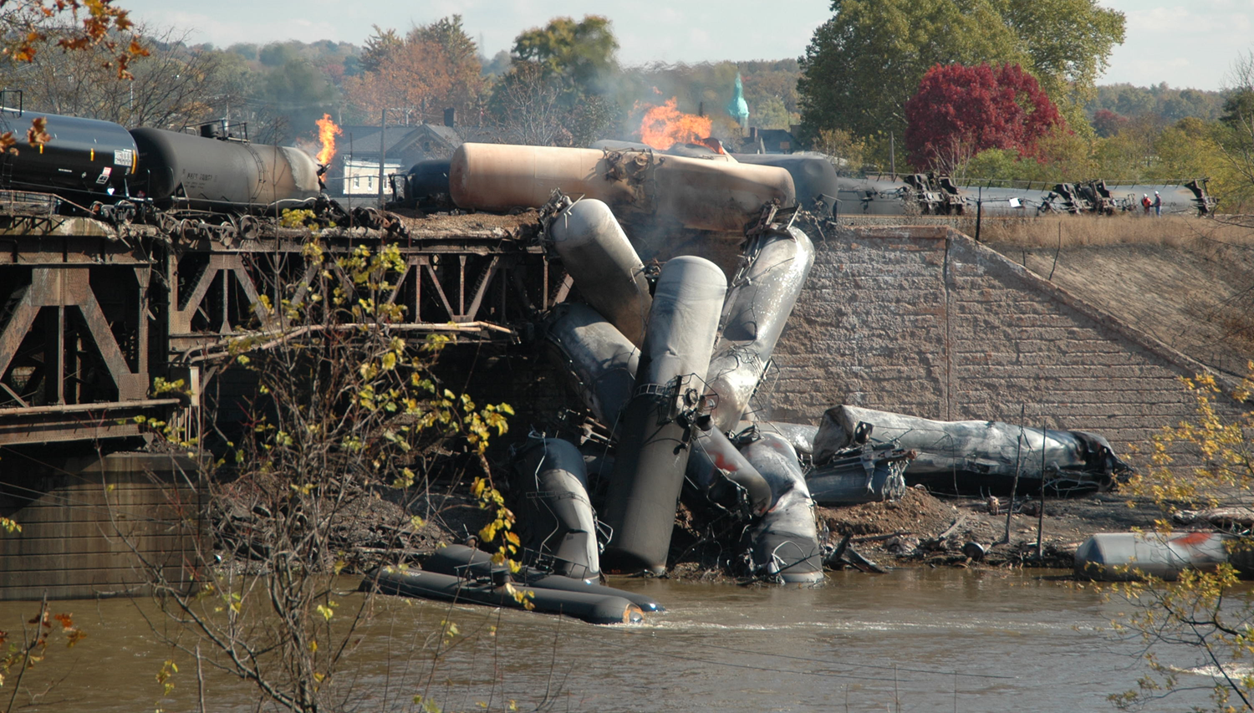
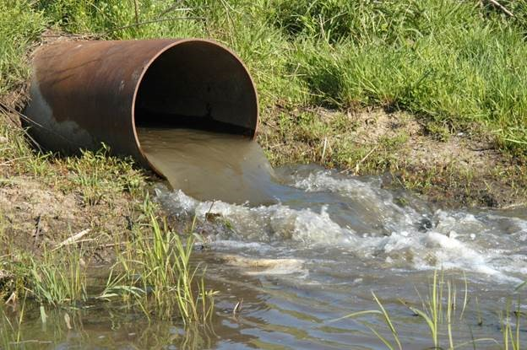

Questions?
22
Notes:
Any questions on basic concepts of resilience, EPA resources, and RRA/ERP requirements?

Slide 23
Certify Your Risk Assessment/Emergency Response Plan
23
Notes:
Now I’ll walk through how to certify your risk assessment and emergency response plan.

Slide 24

Risk and Resilience Assessment Certification Deadlines
  Population
  served
  ≥100,000
  Population
  served
  50,000-99,999
  Population
  served
  3,301-49,999
March 31,
2020
December 31,
2020
June 30,
2021
Effective Date of System Size: U.S. EPA is using the SDWIS database from 4th quarter of 2018 to determine the population size served by each utility and the corresponding deadline.
24
Notes:
This slide shows the certification deadline for your risk assessment based on the population served by your utility.
For utilities serving a population of greater than or equal to 100,000, the deadline has already passed.
For utilities serving a population of 50,000 to 99,999, you must certify your risk assessment no later than December 31, 2020.
For utilities serving a population of 3,301 to 49,999, you must certify your risk assessment no later than June 30, 2021.
Note that population served size is being determined using the Safe Drinking Water Information System (SDWIS) date from the fourth quarter of 2018.

Slide 25

Emergency Response Plan
Certification Deadlines
Certify Emergency Response Plan no later than 6 months after certification of the risk and resilience assessment.
25
Notes:
The emergency response plan certification is due no later than 6 months after certifying the risk assessment. So, if your utility certifies earlier than the deadline, the six months starts from the date of submission, not the deadline dates. For example, if my utility serves a population of 75,000, and I certify completion of my risk assessment on July 31, 2020, then the certification of the emergency response plan is due no later than January 31, 2021.

Slide 26


Additional Requirements
You must recertify RRAs and ERPs to EPA every 5 years.
RRA and ERP retention time = 5 years.
The law does not stipulate who the certifying official must be, only that they must be from the water utility.
26
Notes:
Community water systems must review and update, if necessary, and then recertify RRAs and ERPs every 5 years. You must also maintain a copy of their risk assessment and emergency response plans for 5 years after the date it was certified. You will not submit a copy of either document to EPA.
Who is qualified to certify a risk assessment or emergency response plan?
The law does not stipulate who the certifying official must be, but they must be from the water utility. Thus, each water utility decides who the certifying official for the risk and resilience assessment and emergency response plan will be. Please pick one person just to reduce the chance that you’d submit a duplication. A duplicated submission for the same PWSID isn’t necessarily bad, but EPA may reach out to you to clarify who the correct certification official is so that we have the correct email on file in case we need to contact the utility.
[If helpful:]
The law states that Each community water system described in paragraph (1) shall review the assessment of such system conducted under such paragraph at least once every 5 years after the applicable deadline for submission of its certification under subparagraph (A) to determine whether such assessment should be revised. Upon completion of such a review, the community water system shall submit to the Administrator a certification that the system has reviewed its assessment and, if applicable, revised such assessment. ``(4) Contents of certifications.--A certification required under paragraph (3) shall contain only-- ``(A) information that identifies the community water system submitting the certification; ``(B) the date of the certification; and ``(C) a statement that the community water system has conducted, reviewed, or revised the assessment, as applicable.”

Slide 27


Three Ways To Certify RRAs and ERPs
Electronic Submission (preferred method)
Email
Regular Mail
Note: Do NOT send EPA your RRA or ERP, only submit your certification form to EPA
27
Notes:
There are three ways to certify completion of your risk assessment and emergency response plan. These include the secure online electronic submission, which is our preferred method, and the easiest to complete. If you use the electronic submission platform you will also receive reminders before your next 5-year RRA and ERP submission is due and a confirmation of your submission for your records.
Email and regular mail submission is also available using designated certification forms. You will not get a confirmation email from EPA by using these methods nor 5 year reminder emails, however.
Note: Do NOT send in your actual risk assessment or ERP; EPA only needs the certification form saying that you completed it, please keep the actual plan on file at your utility. These plans often contain sensitive information (e.g. drinking water intake locations) so it should stay in a safe location at your utility.

Slide 28
Email Submission
Complete the Risk and Resilience Assessment Certification Statement or Emergency Response Plan Certification Statement fillable pdf provided online at epa.gov/waterresilience. The document allows for an electronic signature.
Email statement to awiaservicedesk@epa.gov
28
Notes:
While the online certification platform is the preferred method for submission, your utility may also email to certify.
Complete and sign the fillable PDF certification document on EPA's website and email it.
The pdf allows for an electronic signature so no need to print it out and scan it.

Slide 29
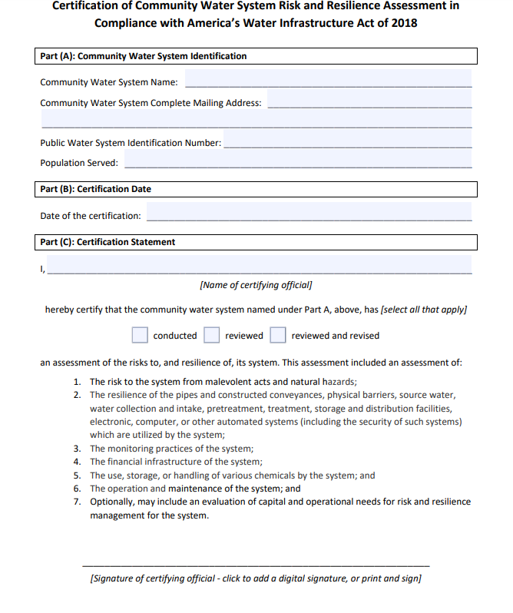
Certification Statement
29
Notes:
Here is the form. Please double check the email address and PWSID you provide to mitigate errors.

Slide 30
Mail Submission
Complete the Risk and Resilience Assessment Certification Statement or Emergency Response Plan Certification Statement fillable pdf provided online at epa.gov/waterresilience.
Mail statement to the following address:
U.S. EPA Data Process Center
ATTN: AWIA
C/O CGI Federal
12601 Fair Lakes Circle
Fairfax, VA 22033
30
Notes:
Alternatively, you may complete the fillable PDF, print it out, and send it to this address. There won’t be a way to confirm that we’ve received your certification. But you could get a preferred tracking number to make sure it was delivered to that address.

Slide 31
Module 1 Quiz 3
True or False. CWSs should not send the actual RRA and ERP documents to EPA; they should only submit a certification statement.
31
Notes:
Question: True or False. Community water systems should not send the actual Risk and Resilience Assessment and the Emergency Response Plan documents to EPA; they should only submit a certification statement to EPA that these documents have been completed in accordance with AWIA Section 2013.
Answer: True. Risk and Resilience Assessments may contain sensitive utility information (e.g. intake locations, etc.) so we do not want you to send them to EPA, just send the certification saying that it has been completed to EPA by the applicable deadline based on the size of your system. Please keep the RRA on file at your utility in a secure location.

Slide 32
Poll 3
Do you manage utilities with multiple PWSID numbers?
32
Notes:
Poll 4: Do you manage utilities with multiple PWSID numbers?
This is a poll, there is no correct answer.
You need to certify each PWSID number, AWIA compliance tracking is done by PWSID. In the electronic certification system you can add multiple individual systems under your username, but you need to certify for each one individually. For example if you oversee 5 PWSID numbers, you will need to submit 5 different forms.

Slide 33
AWIA Section 2013
Frequently asked questions
33
Notes:
Pick and choose FAQs to review depending on how we are doing on time. If we don’t have time to review FAQs, mention that the FAQ document is on our website and include it in GoToWebinar resources.
I will go over some questions that are sometimes confusing or overlooked. While I’m going over them, please feel free to type in any questions you have and I’ll answer those at the end of these FAQs.

Slide 34
AWIA Section 2013 FAQs Question 1
Q. Do I need to send a copy of the RRA or ERP?
A. No, you only need to certify that you have completed them in accordance with the legal requirements.
Q. I must do this for the state I live in, does that count?
A. No, it does not. We understand that certain states also require this, but this is a law that was passed by the Federal government and requires all systems that meet the requirements to certify. EPA is trying to work with those states to try to get their deadlines to line up with the ones laid out by AWIA.
34
Notes:
Read slide
Q: Do I need to send a copy of the RRA or ERP?
A: No, please don’t. Just submit the certification statements.
Q: some states require this, can I use that?
A: That’s normally in response to the ERP. This is sort of a half and half answer. Your state required plan likely requires some of the AWIA requirements but possibly not all. E.g. previous vulnerability assessments (from bioterrorism act of 2002) don’t cover natural hazards nor financial infrastructure or monitoring systems. Just make sure it meets all the requirements of AWIA section 2013 and that it is updated with any information that’s been added since the plan was originally created.
We have resources available to guide you through the process and make sure that you meet all the requirements of the law, if you’d like to use it. We will be reviewing those tools in detail in Module 2 and 3.

Slide 35
AWIA Section 2013 FAQs Question 2
Q. I have multiple PWSIDs. Can my risk assessment cover multiple systems? What about my certification?
A. How you do your risk assessment and ERP is up to you. If you want to do one risk assessment for multiple PWSIDs, that works or if you want to do them separate that works too. When you certify you must certify each PWSID individually in order to comply.
Q. How soon can I submit a certification?
A. You can submit your certification as soon as possible.
35
Notes:
Read slide
Q. I have multiple PWSIDs. Can my risk assessment cover multiple systems? What about my certification?
A: We reviewed this question in our recent poll. In summary, you can make the plan however you want, it can be a big assessment or separate assessments, but you must submit a certification for each PWSID.
Q. How soon can I submit a certification?
A: You can submit your certification at any time , just make sure it’s in before the deadline.

Slide 36
AWIA Section 2013 FAQs Question 3
Q. How does AWIA impact Transient Non-Community Water Systems and Non-Transient Non-Community Water Systems?
A. Section 2013 of AWIA only applies to Community Water Systems, public water systems that supply water to the same population year-round.
Non-Transient Non-Community Water System: public water systems that regularly supply water to at least 25 of the same people for at least 6 months per year (e.g., schools, factories, office buildings, and hospitals which have their own water systems).
Transient Non-Community Water Systems: public water systems that provide water in a place where people do not remain for long periods of time (e.g., gas station, campground).
For more information about CWSs, visit https://www.epa.gov/dwreginfo/information-about-public-water-systems
36
Notes:
Under the safe drinking water act there are 3 types of public water systems:
Community Water Systems
Transient Non-Community Water Systems
And Non-transient non-community Water Systems
AWIA only applies to community water systems, which is defined as a public water system that supplies water to the same population year-round.
Q: Sometimes we get asked about how AWIA 2013 applies to
1)Transient Non-Community Water Systems (a public water system that provides water in a place like a gas station or campground where people do not remain for long periods of time) OR
2)Non-Transient Non-Community Water Systems (a public water system that regularly supplies water to at least 25 of the same people at least six months per year. Some examples are schools, factories, office buildings, and hospitals which have their own water systems).
Short answer is that AWIA doesn’t apply to them. AWIA only applies to Community Drinking Water Systems (CWS) that serve over 3,300. CWS is defined as a public water system that supplies water to the same population year-round.
Please visit this website for more information about public water systems if you’re trying to figure out which category your utility belongs to.

Slide 37
AWIA Section 2013 FAQs Question 4
Q. Is there guidance for very small systems (serving under 3,300)?
A. The law explicitly directs us on guidance for the smaller systems. Please see the language below.
“(e) Guidance To Small Public Water Systems.—The Administrator shall provide guidance and technical assistance to community water systems serving a population of less than 3,300 persons on how to conduct resilience assessments, prepare emergency response plans, and address threats from malevolent acts and natural hazards that threaten to disrupt the provision of safe drinking water or significantly affect the public health or significantly affect the safety or supply of drinking water provided to communities and individuals.”
37
Notes:
Q. Is there guidance for very small systems (serving under 3,300)?
EPA is required by law to provide guidance for systems that serve under 3,300 that aren’t required to comply with AWIA. This guidance will be available in 2021, we are purposefully putting this out at a later date so that it’s less likely to be confused with compliance resources, like the small systems checklist, VSAT, and ERP guidance and template.

Slide 38
AWIA Section 2013 FAQs Question 5
Q. I have a new system that is coming online after the deadline for its estimated population size. When is the initial risk assessment deadline for the new facility?
A. Your utility will follow the deadline required by the system size in the next period.
Q. Who is qualified to certify a risk assessment or emergency response plan?
A. Any designated utility employee.
38
Notes:
Read slide
Q: what do I do if a new facility comes online after the compliance deadline?
A: Your utility will follow the deadline required by the system size in the next period.
Q: Who can certify?
A: The certifying official doesn’t need to hold a specific rank in a water utility or anything like that, but they do need to be from the utility. This question often comes up when a contractor is helping a water system create an RRA or ERP – contractors cannot certify, a utility representative needs to submit the certification.

Slide 39
AWIA Section 2013 FAQs Question 6
Q. What specifically is meant by “financial infrastructure” under the risk and resilience assessment (RRA) component requirements?
  A. We interpret financial infrastructure to mean utility billing and payment and financial account management systems, including those operated by a third party on behalf of a utility. It does not include measures of financial stability such as bond rating or asset/debt ratios.
Q. Will EPA be providing directive on or mandatory components specific to the cybersecurity part of the ERP requirements?
  A. No, there are no mandatory components beyond what the law states. However, EPA does provide training on cyber incident response planning.
39
Notes:
Read slide
We will be going over the RRA and ERP in more detail in the next 2 so you’ll find out more about the requirements if you attend those modules, but here’s a look at some of the RRA and ERP FAQs.
Q: What specifically is meant by “financial infrastructure” under the risk resilience assessment (RRA) component requirements?
A: billing, payment, and financial account management systems, including those operated by a 3rd party.
Q: Will EPA be providing directive on or mandatory components specific to the cybersecurity part of the ERP requirements?
A: There are no mandatory components beyond what the law states (one of the required components of the ERP says you must include “strategies and resources to improve the resilience of the system, including the physical security and cybersecurity of the system”). However, EPA does provide training on cyber incident response planning- check out our website if you’re interested in that.

Slide 40
AWIA Section 2013 FAQs Question 7
Q. Will the repeated (every 5 years) due dates for updated RRAs and ERPs be based on 5 years from the previous submittal date/certification to EPA (which will vary for all systems), or be based on 5 years from the initial due dates cited in the Act (i.e., all first round RRA renewals will be due March 31, 2025)?
A. The 5-year date will be based on the deadlines established in the law for tracking purposes. For example, for CWSs serving more than 100,000, the risk and resilience assessment was due March 31, 2020 and the ERP was due September 30, 2020. The next compliance deadlines for these systems are 5 years later (March 31, 2025 and September 30, 2025), no matter the date when the RRA or ERP certification was submitted.
40
Notes:
Read slide
Q: will the 5-year cycle certification due dates be based on the date you previously submitted or 5 years from the initial due dates in the Act?
A: it’s not based on an initial certification date, you don’t have to remember the date you originally submitted your RRA 5 years later. The next 5 year cycle deadline will be based on the dates specified in the law.

Slide 41
Third Party Standards
EPA does not require water systems to use any designated standards, methods, or tools to conduct the RRA or to prepare the ERP required under AWIA Section 2013.
Water systems may use any standards, methods, or tools that aid the water system in meeting the requirements of AWIA Sections 2013(a) and (b).
Regardless of the use of any standard, method, or tool, the water system is responsible for ensuring that its risk and resilience assessment and ERP fully address all AWIA requirements.
41
Notes:
There are third party standards out there to help with risk assessments and ERPs. You can use any standard you want. We’re going to you about the tools EPA has created to help you comply during this workshop, but you can use whatever method works for you, as long as it complies with all of the AWIA requirements.
Are there any questions that came up in the chat box?

Slide 42
AWIA Section 2018
Background
42
Notes:
We are at the last topic of Module 1, so stay with me for just a little longer
During this presentation, we’re going to switch gears a bit and leave Section 2013 and discuss Section 2018 of America’s Water Infrastructure Act. Please note that Section 2018 does not require water utilities do anything; we are taking some time to talk about Section 2018, however, because this is information that can be useful and beneficial for water utilities. Section 2018 doesn't require the utility to do anything but it does require other regulated parties in your community to do things that could benefit your water utility.

Slide 43
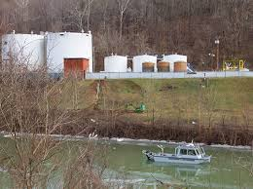
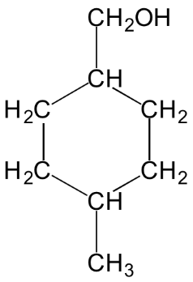
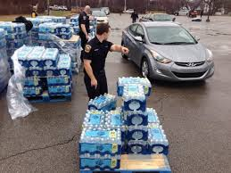
AWIA Section 2018: Source Water
Amends the Emergency Planning and Community Right-to-Know Act (EPCRA).
Intended to mitigate risk of source water contamination.
Motivated by several recent source water contamination incidents, such as the MCHM spill into the Elk River in Charleston, WV in 2014.
  “Do Not Use” order in place for 10 days.
  369 individuals sought medical care at hospital emergency departments.
  Financial cost of incident was more than $72 million.
43
Notes:
Let’s start with some background information. Signed into law in October 2018, AWIA is a sweeping law aimed at improving the resilience of community drinking water systems and is in effect as we speak today. There are many sections of AWIA. We’ve been talking about Section 2013 this entire time. Now we’re going to look at another section of AWIA that may be of interest to this group, Section 2018: source water.
Section 2018 focuses on spills/releases, whether they be intentional or accidental, and the potential contamination that could be caused to a community water system.
While most provisions in AWIA that affect the “water sector” amend the Safe Drinking Water Act (SDWA), Section 2018 is different in that it amends the Emergency Planning and Community Right to Know Act, or EPCRA ( will be using that acronym because it’s long).
The purpose of these revisions is to mitigate the risk of acute contamination to sources of drinking water, specifically the threat of spills or releases into sources of drinking water.
The Section 2018 provisions were motivated by several spills that occurred within the past several years that impacted drinking water supplies.
The most notable being the spill of 10,000 gallons of MCHM (4-methylcyclohexane methanol) into the Elk River, the drinking water source for Charleston, West Virginia, in 2014. When that contaminated water passed through the treatment plant and into Charleston’s drinking water distribution system, it caused significant public health and economic consequences.

Slide 44
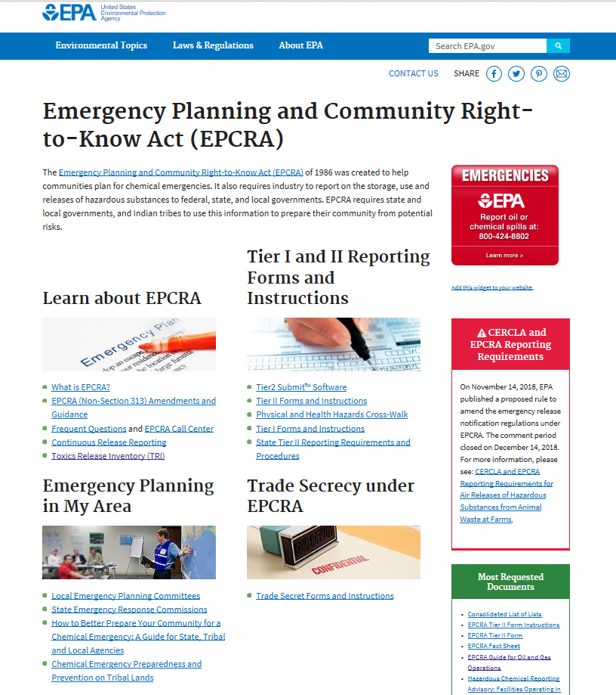
Overview of EPCRA
EPCRA was created to help communities plan for chemical emergencies.
EPCRA regulates facilities that store or handle hazardous chemicals above threshold planning quantities.
EPCRA administration and oversight:
  U.S. EPA Office of Emergency Management
  State Emergency Response Commissions (SERCs)
  Local Emergency Planning Committees (LEPCs)
44
Notes:
EPCRA was signed into law in 1986. It was created to help communities plan for chemical emergencies and address concerns of environmental safety hazards posed by the storing and handling toxic chemicals. Concerns were triggered by the accidental release of a hazardous chemical (methylisocyanate) in Bhopal, India in 1984, which killed or severely injured more than 2,000 people.
The community regulated by EPCRA are the facilities that produce, use or store hazardous chemicals in quantities above a specified threshold. EPCRA is administered by USEPA’s Office of Emergency Management and implemented by State Emergency Response Commissions (SERCs) or TERCs (tribes) and Local Emergency Planning Committees. For those of you who are not familiar with SERCs/TERCs, the governor of each state has designated a SERC that implements EPCRA procedures in that state. Their role is to do the following:
Establish procedures for receiving and processing request for information collected under EPCRA
Review local emergency response plans
Designate local emergency planning districts as well as appoint the LEPCs for each district and supervise the activities of the LEPCs
Optional info note: while this is a federal regulation, EPA does not have enforcement authority over the SERCs and LEPCs.
If someone asks where to get threshold quantities, direct them to: EPCRA Sections 311-312 EPA website: https://www.epa.gov/epcra/epcra-sections-311-312

Slide 45
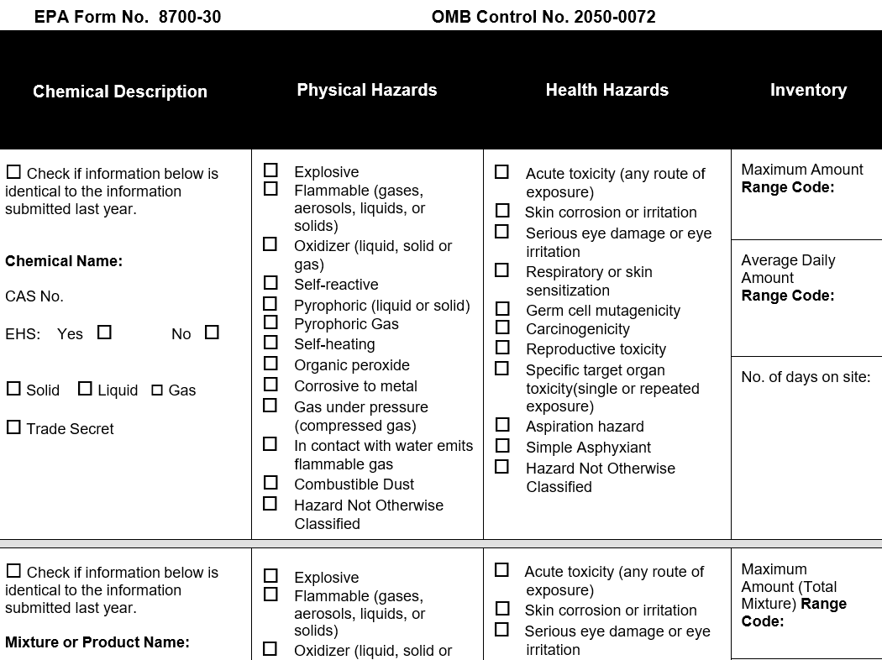
Key Provisions of EPCRA
https://www.epa.gov/epcra/epcra-tier-ii-emergency-and-hazardous-chemical-inventory-form
Sec 301-303: Emergency Planning
Sec 304: Emergency Notification
Sec 311-312: Chemical Inventories
Sec 313: Toxic Release Inventory
Sec 322: Trade Secrets
45
Notes:
The specific sections of EPCRA amended through Section 2018 of AWIA are the two shown in bold: Section 304, Emergency Notifications, and Section 312, Chemical Inventories. We will talk about those in more detail later.
Just note that there are other sections of EPCRA and we are just focusing on the ones that were amended under section 2018 of AWIA.
[background information to mention if presenter wants to]
Several other key sections of EPCRA include:
Sec 301-303: Emergency Planning, requires local emergency planning committees (LEPCs) to prepare chemical emergency response plans and update them annually.
Section 311: requires facilities handling or storing OSHA hazardous chemicals to submit material safety data sheet (MSDS) (or safety data sheet (SDS)) to the SERC, LEPC, and local fire department.
Sec 313. requires facilities to submit an annual report of releases of designated toxic chemicals. Certain facilities that meet specific criteria must submit a toxic chemical release form annually for each of the TRI chemicals manufactured, processed or used above threshold quantities.
And Sec 322. allows facilities to withhold the identity of proprietary substances in their annual Tier 2 reports, if their trade secret request is approved by USEPA. (The request for this exemption must be made every year. Very small percentage of records. Is not applicable to Sec 304.)

Slide 46
AWIA Section 2018(a)
Amendments to the Emergency Planning and Community Right-to-Know Act (EPCRA) Section 304 (42 U.S.C. 11004)
46
Notes:
Now that we have some background on EPCRA, let’s talk about EPCRA Section 304 first and the amendments required under AWIA Section 2018

Slide 47
EPCRA Section 304: Emergency Notification
Section 304 requirements cover approximately 355 Extremely Hazardous Substances (EHSs) and over 700 hazardous substances subject to the Comprehensive Environmental Response, Compensation and Liability Act (CERCLA, a.k.a. Superfund). Some chemicals are common on both lists.
Requires facilities to immediately (within 15 minutes) notify the LEPC and SERC (or TERC) if there is a release into the environment of a hazardous substance that is equal to or exceeds minimum reportable quantities set in regulation.
  Report should be via phone call, radio or in-person.
  CERCLA releases also require notification to the National Response Center (NRC).
Emergency notification requirements for transportation incidents can be met by calling 911.
47
Notes:
First, what is EPCRA Section 304?
Section 304 requirements cover approximately 355 Extremely Hazardous Substances (EHSs) and over 700 hazardous substances subject to the Comprehensive Environmental Response, Compensation and Liability Act (CERCLA, also known as Superfund)
Note that there are some chemicals that are common on both lists (optional information: there is a list out there called “The List of Lists” which helps facilities keep track of what chemicals are on each list, which overlap, and the requirements. This is not an official document and the only official list is what is codified in regulations)
Section 304 requires facilities to immediately (within 15 minutes) notify the LEPC and SERC (or TERC) if there is a release into the environment of a hazardous substance above quantities set in regulation.
Report should be done over phone, radio, or in-person.
For CERCLA releases you also must notify the National Response Center (NRC).
Emergency notification requirements for transportation incidents can be met by calling 911

Slide 48
EPCRA Section 304: Emergency Notification Continued
The emergency notification needs to include:
  The chemical name or identity of any substance involved.
  An indication of whether the substance is on the EHS list.
  An estimate of the quantity released into the environment.
  The time and duration of the release.
  The medium or media into which the release occurred.
  Any known or anticipated acute or chronic health risks associated with the emergency and advice regarding medical attention necessary for exposed individuals.
  Proper precautions to take, including evacuation.
  The name and telephone number of a contact person for further information.
48
Notes:
The emergency notification from the facility to the SERC/TERC and LEPC needs to include:
Chemical name
Whether the substance is on the Extremely Hazardous Substance list
How much was released
Time and duration of the release.
The medium into which the release occurred.
Known or anticipated health risks and advice on the medical attention needed for those exposed.
Proper precautions to take, e.g. evacuation.
The name and telephone number of a contact person for further information.

Slide 49
EPCRA Section 304: Emergency Notification Continued 2
As soon as practicable, a written follow-up notice must be provided to the SERC (or TERC) and LEPC. The written notice shall provide updates to the information provided in the original notification, as well as additional information with respect to:
    Actions taken to respond to and contain the release;
    Any known or anticipated acute or chronic health risks; and
    Where appropriate, advice regarding medical attention necessary for exposed individuals.
49
Notes:
And then, as soon as practicable, a written follow-up notice must be provided to the SERC (or TERC) and LEPC. The written notice shall provide any updates that there have been to all the information we listed on the previous slide, as well as additional information on:
Actions taken to respond to and contain the release;
Health risks; and
Where appropriate, advice regarding medical attention necessary for those exposed
In summary, section 304 requires an initial notification and a written follow up after a spill.
Optional extra info: Failure of a person in specifically in charge of a facility with knowledge of a reportable release who fails to comply with the EPCRA Section 304 immediate notification requirements, or submits information that he or she knows is false or misleading, may result in criminal penalties, per offense, of up to $25,000 and prison sentences of up to two years (or up to $50,000 and five years for second and subsequent convictions). This is specific to that facility only.

Slide 50
Section 2018 (a): Amends Emergency Notification
Amends EPCRA Section 304 (42 U.S. Code 11004) to add subsection (e) Addressing Source Water Used for Drinking Water:
(e)(1) Applicable State Agency Notification
(e)(2) Community Water System Notification
50
Notes:
Now, how is section 304 amended under AWIA Section 2018? You will find that these amendments are beneficial to the water sector.

Slide 51



SERC (or TERC) Notification Requirements
A State or Tribal Emergency Response Commission (SERC or TERC) shall:
  Promptly notify the applicable State agency (i.e., the drinking water primacy agency) of any reportable release of an EPCRA extremely hazardous substance (Appendices A and B of 40 CFR Part 355) or a CERCLA hazardous substance (40 CFR Part 302.4(a)).
51
Notes:
The amended Section 304 now requires SERCs/TERC, once they get that initial notification from a facility, to notify the agency in the state that is responsible for the implementing the Safe Drinking Water Act (i.e., drinking water primacy agency) of a release of an EPCRA Extremely Hazardous Substance or a CERCLA Hazardous Substance. This includes both the initial, “prompt” notification as well as follow-up reporting.
Before, the facility notified the SERC or TERC and legal requirements stopped there. Now there’s another step, the SERCs and TERCs must forward on that notification to the drinking water primacy agency.
CERCLA: Comprehensive Environmental Response, Compensation, and Liability Act, known also as Superfund.
EHSs are the same in both appendices - Appendix A in alphabetically and Appendix B by CAS number

Slide 52
SERC (or TERC) Notification Requirements Continued
A State or Tribal Emergency Response Commission (SERC or TERC) shall provide the primacy agency with the following information (same information provided by the facility with the release):
  The chemical name or identity of any substance involved.
  An indication of whether the substance is on the EHS list.
  An estimate of the quantity released into the environment.
  The time and duration of the release.
  The medium or media into which the release occurred.
  Any known or anticipated acute or chronic health risks associated with the emergency and advice regarding medical attention necessary for exposed individuals.
  Proper precautions to take, including evacuation.
  The name and telephone number of a contact person.
52
Notes:
Once again, the same information that was provided by the facility to the SERC needs to be provided to the drinking water primacy agency

Slide 53

SERC (or TERC) Notification Requirements Continued 2
As soon as practicable, the SERC (or TERC) shall provide the drinking water primacy agency a written follow-up notice (same information provided by the facility with the release):
  The written notice shall provide updates to the information provided in the original notification, as well as additional information with respect to:
    Actions taken to respond to and contain the release;
    Any known or anticipated acute or chronic health risks; and
    Where appropriate, advice regarding medical attention necessary for exposed individuals.
53
Notes:
And the written follow up notice requires the same information as well.
As soon as practicable, the SERC (or TERC) shall provide the drinking water primacy agency a written follow-up notice (same information provided by the facility with the release):
The written notice shall provide updates to the information provided in the original notification, as well as additional information with respect to:
Actions taken to respond to and contain the release;
Any known or anticipated acute or chronic health risks; and
Where appropriate, advice regarding medical attention necessary for exposed individuals.

Slide 54

Primacy Agency Notification Requirements Notice to Community Water Systems
The drinking water primacy agency receiving notice from a SERC (or TERC) shall:
Promptly forward the initial notice and all information provided to any community water systems whose source waters are affected by the release.
Forward the written follow-up emergency notice provided to the affected community water systems.
54
Notes:
Then the drinking water primacy agency receiving notice from a SERC (or TERC) shall then:
Promptly forward the initial notice, and all information provided, to any community water systems whose source waters are affected by the release.
Then also forward the written follow-up emergency notice provided to the affected community water systems.
Note that the requirement is to notify community water systems (25 connections supplying water to the same population year-round), not all public water systems. Not required to notify Non-transient Non-community Water Systems (supplies water to the same people at least six months per year, such as schools, hospitals, office buildings with their own water system); or Transient Non-Community Water System (e.g., gas stations, rest stops, campgrounds)

Slide 55


Direct Notification:
Notice to Community Water Systems
If a state does not have a drinking water primacy agency, the SERC (or TERC) shall provide the required notices and information to the community water systems affected by the release.
55
Notes:
If a state does not have a drinking water primacy agency (Wyoming, Washington DC, and several tribal nations do NOT have state primacy agencies):
The SERC (or TERC) shall provide the required notices directly to the affected community water systems.

Slide 56
Visual of Amended
Notification Requirements
Release Occurs and Facility Provides all Information Required Under EPCRA 304(b)(2) and 304(c)
EPCRA 304(b)(2)
304(c)
EPCRA 304(b)(2)
304(c)
SERC & TERC
State Drinking Water Primacy Agency
Community Water System(s) whose source water is affected
Promptly notify of reported release(s)
Promptly notify of reported release(s)
EPCRA 304(b)(2)
304(c)
If no State Drinking Water Primacy Agency, directly notify Community Water System
56
Notes:
This visual provides all of the requirements of the amendments to EPCRA Section 304 (e)(1) and (2) in one place.
Starting with the orange bucket, that is the original EPCRA Section 304 requirement.
Now onto the amendments in the green boxes. The diagram visually describes how the amended Section 304 requires SERCs to notify the drinking water primacy agency of a release of an EPCRA Extremely Hazardous Substance or a CERCLA Hazardous Substance. This includes both the initial, “prompt” notification as well as follow-up reporting. Then the State drinking water primacy agency is required to provide all information about the release received from the SERC/TERC to any/all community water systems whose source water is affected by the release. If there is no applicable State agency, the SERC is responsible for directly notifying affected community water systems (the route along the bottom).

Slide 57
AWIA Section 2018(b)
Amendments to the Emergency Planning and Community Right-to-Know Act (EPCRA) Section 312(e) (42 U.S.C. 11022(e))
57
Notes:
That was EPCRA Section 304 and the amendments to it under AWIA Section 2018.
Now let’s move onto EPCRA Section 312 and the amendments required to it under AWIA Section 2018.

Slide 58
EPCRA Section 311-312:
Chemical Inventories
Under Occupational Safety and Health Administration (OSHA) regulations, employers must maintain a safety data sheet (SDS) for any hazardous chemicals stored or used in the workplace. Approximately 500,000 products are required to have SDSs.
EPCRA Section 311 requires facilities that have SDSs for chemicals held above certain threshold quantities to submit either copies of their SDSs or a list of these chemicals to the SERC or TERC, LEPC, and local fire department.
58
Notes:
OSHA regulations require facilities to have a safety data sheet (SDS) (it used to be called a material safety data sheet (MSDS) but they’ve recently changed it to SDS) for hazardous chemicals they store or use. Around 500,000 products are required to have safety data sheets.
EPCRA Section 311 requires facilities that handle or store OSHA hazardous chemicals to submit a safety data sheet to the SERC/TERC, LEPC, and local fire department.
Optional extra info: Facilities that start using a hazardous chemical or increase the quantity to exceed the thresholds must submit SDSs or a list of SDSs chemicals within three months after they become covered. Facilities must provide a revised SDS to update the original SDS or list if significant new information is discovered about the hazardous chemical.

Slide 59
EPCRA Section 311-312:
Chemical Inventories Continued
EPCRA Section 312 requires those facilities handling or storing the OSHA hazardous chemicals above certain threshold quantities to submit an annual (by March 1) emergency and hazardous chemical inventory form to the SERC or TERC, LEPC and local fire department.
Inventory forms include:
  The chemical name or the common name as indicated on the SDS;
  An estimate (in ranges) of the maximum amount of the chemical present at any time during the preceding calendar year and the average daily amount;
  A brief description of the manner of storage of the chemical;
  The location of the chemical at the facility; and
  An indication of whether the owner elects to withhold location information from disclosure to the public.
59
Notes:
Sec 312 requires facilities handling or storing OSHA hazardous chemicals to submit an annual chemical inventory (which includes chemical identity, quantities, and locations in facilities) to the SERC, LEPC, and local fire department. Annual inventory is usually due by March 1st of every year.
Listed on this slide is the information that the inventory must include: chemical name, estimated amount, storage, location, and this last part (an indication of whether the owner elects to withhold location information from disclosure to the public) is usually due to proprietary reasons for their chemical.
Section 312 includes a two tier approach. Tier 2 is the stricter tier that requires all the information in tier one PLUS information on specific chemicals and location and storage. Tier 2 is what we’ll be talking about with the AWIA amendments.
If anyone in the class asks about Tier I versus Tier II, here is some information:
Section 312 includes a two tier approach. Tier I requires information (such as maximum amount of hazardous chemicals at the facility during the preceding year, an estimate of the average daily amount of hazardous chemicals at the facility, and the general location) be aggregated and reported by hazard categories. Tier II not only requires the information mentioned above, but also requests information on specific chemicals and specific location and storage.
Tier I is required by federal law; Tier II is federally required only upon request by the local emergency planning committee or the state emergency response commission. However, a covered facility may submit Tier II forms instead of Tier I forms. Many (most) states already require facilities to submit Tier II forms or forms created by the states under their own state legislation.

Slide 60
Section 2018(b): Amends Chemical Inventory Data Availability
Amends Emergency Planning and Community Right-to-Know Act (EPCRA) Section 312(e) to add:
(4) Availability to Community Water Systems
60
Notes:
So that’s the original section 311 and 312 or EPCRA. How did the AWIA amendments change it?
The AWIA amendments require SERCs/TERCs and LEPCs to provide community water systems with the chemical inventory data collected under Tier 2 for the system’s source water area, upon request.
Other optional info: Section 312 provides availability of Tier 2 information to:
SERCs or TERCs, LEPCs, and Fire Departments
Other State and Local Officials
The public (with some specific timelines and caveats)
Community Water Systems – NEW because of AWIA

Slide 61
Chemical Inventory Data Availability
EPCRA Sec 312(e)(4) requires SERCs (or TERCs) and LEPCs to provide affected* community water systems with chemical inventory data submitted under Tier 2 of EPCRA for their source water area, upon request from the system.
  Upon receipt of the request, the SERC or LEPC will provide the information or request the information from the facility and forward any information received to the community water system.
  * In this Section, ‘affected’ is defined as a community water system (as defined in SDWA Section 1401(15)) that receives supplies of drinking water from a source water protection area delineated under SDWA Section 1453, in which a facility that is required to prepare and submit an inventory form under EPCRA Section 312 is located.
61
Notes:
Note that the community water system must request the data, it’s not automatic.
This is a beneficial change for the water sector because in the absence of this provision, access to Tier 2 chemical inventories was subject to interpretation by SERCs/TERCs and LEPCs, and water utilities were not always successful in obtaining the data they needed without extensive measures, such as requesting data facility by facility. Or the data was provided in formats not well suited to analysis, such as scanned hard-copy records.

Slide 62
AWIA Section 2018 CONTINUED
Connection with AWIA Section 2013
62
Notes:
So that’s AWIA Section 2018. Since we discussed Section 2013 already today, I wanted to quickly mention the connections between Section 2018 and Section 2013.

Slide 63
Connection with AWIA Section 2013
Encourage water systems to join their LEPC:
  To ensure the community ERP includes any chemicals at the water system.
  To ensure access to Tier 2 data and obtain emergency release notifications under EPCRA Section 304.
  Systems are required to coordinate with their LEPC, to the extent possible, under Section 2013.
Gathering Tier 2 chemical data can inform the risk and resilience assessment required under Section 2013.
Risk to a chemical spill can be incorporated into the ERP required under Section 2013, as well as procedures for notification in chemical release incidents.
63
Notes:
It is a good idea for water systems to become members of the LEPC for several reasons:
to make sure that the community emergency response plan includes community water systems that also handle Extremely Hazardous Substances (e.g.: Chlorine).
To make it easier for your water system to obtain Tier II information easily and immediately (after 9/11 incident, many states safeguard their Tier II information according to the state homeland security procedures) and get emergency release notification under 304 that may affect your waters.
AWA requires systems to coordinate with your LEPC, to the extent possible, anyways (may as well join while you’re at it to reap the benefits listed above)
Requesting Tier 2 chemical data can help inform your risk and resilience assessment
Risk to a chemical spill can be incorporated into the ERP required under Section 2013

Slide 64
Products and Outreach for Section 2018
Amendments to EPCRA - AWIA: A guide for SERCs, TERCs, and LEPCs
Amendments to EPCRA - AWIA: A guide for CWS and State Primacy Agencies
Frequently Asked Questions about AWIA Section 2018
EPA led webinars and in-person training to community water systems, state primacy agencies, EPA emergency responders, SERCs, TERCs, and LEPCs
Resources available at: https://www.epa.gov/waterresilience/americas-water-infrastructure-act-2018-spill-notification-and-access-chemical
64
Notes:
Here are the resources that EPA has available on the subject we just went over, Section 2018.
We have a fact sheet for SERCs, TERCs and LEPCs to explain how AWIA revised EPCRA.
We also published companion fact sheet for state primacy agencies and community water systems.
A list of FAQs for Section 2018
And EPA provides webinars and in-person training to community water systems, state primacy agencies, EPA emergency responders, SERCs, TERCs and LEPCs
For more information about AWIA Section 2018, please visit our website, listed on the slide.

Slide 65
Questions? 1
65
Notes:
Any questions? I’ll do my best to answer. If not, I will follow up and get an answer or you are welcome to reach out to our subject matter experts on Section 2018 whose contact info is on the next slide.
Q: Can a contractor certify my utility’s risk assessment or emergency response plan?
A: A contractor can assist you in putting together the RRA and ERP, but it must be certified by a utility employee.
Q: When you say that RRA renewals are due after five years, is that based on five years after the initial deadline, or five years after the utility submits and certifies?
A: The 5-year date will be based on the deadlines established in the law. So for example, this year’s deadline for medium (50,000-99,999) utilities is December 31, 2020; the next deadline for renewal is December 31, 2025.
Q: Under Section 2018, is there any documentation required to be maintained about the release notification process?
A: Neither EPCRA nor AWIA contain any explicit recordkeeping requirements for facilities or for state and local implementing agencies.

Slide 66
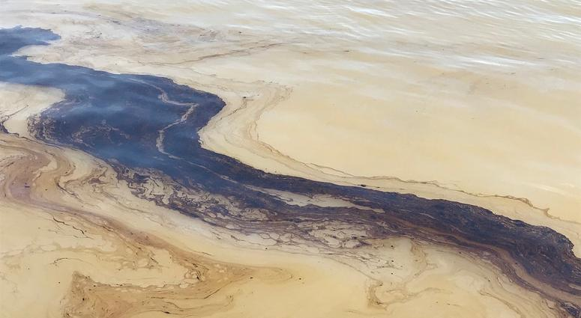
Section 2018 Contacts
Dawn Ison
Emergency Notification
ison.dawn@epa.gov
(513) 569-7686
Steve Allgeier
Chemical Inventory Availability
allgeier.steve@epa.gov
(513) 569-7131
66

Slide 67
AWIA workshop
Module 2:
AWIA Risk and Resilience Assessments
Notes:
Main presenter
Hello Everyone,
My name is ___ and I’m here today to conduct Module 2 of our 3-module training on America’s Water Infrastructure Act. In Module 2, we will be focusing on the risk and resilience assessments requirement of AWIA.
*Note: Be sure to state some very encouraging words to everyone in the class to validate their ability to conduct a risk assessment and develop/update an emergency response plan in order to motivate them to model positive learning behaviors. For example:
Some of you are already involved in asset management and others may have been involved in the development of a previous vulnerability assessment from the Bioterrorism Act of 2002 (which AWIA has now replaced). This training will help you to take that knowledge and apply it to complete the new requirement for the risk and resilience assessment under AWIA.
Let’s start with introductions. Note: Be sure to introduce support staff. Introduce yourself and the other instructor(s) and ensure that the you include the following in your introductions:
Where you work and mission of the WSD (WSD Mission: To enhance the security and resilience of the water sector by providing innovative tools and training)
College degrees
Experience with water sector
During the middle portion of today’s workshop, we will be joined by several small group breakout moderators from EPA, they will introduce themselves to you when we break out into small groups.

Slide 68
Training Modules
Module 1: AWIA Section 2013 Overview, Certification Process,
and Section 2018
Module 2: Risk and Resilience Assessments
Module 3: Emergency Response Plan Guidance and Template
Notes:
Here are the 1.5 hour modules that we are giving for our multi-module AWIA​ workshop this week. During Module 1 we gave an overview of AWIA Section 2013, including requirements the certification process, and Section 2018, for those of you who joined us.
Today, in Module 2, we’ll delve into the risk and resilience assessment requirements and the tools that EPA has developed to assist you in conducting/updating your AWIA-compliant risk and resilience assessment.​
​
Then in Module 3, a guest speaker from EPA will talk through the emergency response plan requirements and the emergency response plan guidance and template that was developed to assist community water systems in developing/updating an AWIA-compliant emergency response plan. ​

Slide 69
Learning Objectives –AWIA RRA
Participants will understand the requirements of a risk assessment and know how to use the Small Systems Risk and Resilience Assessment Checklist to either complete one for their own facility or train a utility on how to complete one.
Notes:
Main presenter
Our goal for today is to understand the requirements of a risk assessment and know how to use EPA’s Small Systems Risk and Resilience Assessment Checklist to complete a risk assessment.
AWIA does not require you to use any particular standard or method to complete your risk assessment. Whether you use the small systems checklist, or another method is completely up to your water utility, we’re just going to use the checklist today as an example of one resource that’s available to help you make an AWIA-compliant risk and resilience assessment.

Slide 70
How Does a Risk and Resilience Assessment Help Your Utility?
Information is power – utilities who identify their risks can create plans and prioritize resources around specifics.
Awareness of frequency/rate of natural hazards in your area – use data to inform the likelihood of natural hazards occurring in your area.
Evaluate potential improvements that serve multiple purposes to enhance your operations and resilience.
Notes:
Main presenter
How does a risk and resilience assessment help your utility?
You don’t know what you don’t know, so a risk assessment will help to identify those risks specific to your utility. Knowing the types of risks and potential for those risks is crucial for developing plans to prepare for those risks. For natural disasters, use data from your area to determine the likelihood of earthquakes, fires, floods, drought, etc.
Once you know all your risks, you can put measures in place to mitigate those risks and make your utility more resilient. The value of the risk assessment is to help you prioritize the projects that you will invest in at your utility to build resilience to your biggest threats.

Slide 71
AWIA Section 2013 - Risk and Resilience
Assessment Basic Requirements
Each community water system serving a population greater than 3,300 persons shall assess the risks to, and resilience of, its system. Such an assessment shall include:
The risk to the system from malevolent acts and natural hazards;
Pipes/conveyances, source water, water collection/intake, pretreatment, treatment, storage and distribution, electronic, computer, or other automated systems (including security);
Monitoring practices;
Financial infrastructure;
Use, storage or handling of chemicals;
Operation and maintenance; and
May include capital and operational needs for risk management.
Notes:
Main presenter
If you serve a population over 3,300, AWIA Section 2013 requires that you complete a risk and resilience assessment. Your risk and resilience assessment shall include:
the risk to the system from both malevolent acts (e.g. theft, contamination) and natural hazards (e.g. flood);
the resilience of the pipes and constructed conveyances, source water, water collection and intake, pretreatment, treatment, storage and distribution facilities, electronic, computer, or other automated systems (including the security of such systems); NOTE: [Ask the audience to provide] examples of ways to keep these assets safe. Be sure to mention cybersecurity; other examples include fencing, bollards, and perimeter walls; gates and facility entrances; intrusion detection sensors and alarms; access control systems (e.g., locks, card reader systems); and hardened doors, security grilles, and equipment cages
the monitoring practices of the system; NOTE: [Ask the audience to provide] examples of monitoring practices. Examples include sensors, laboratory resources, sampling capabilities, and data management equipment and systems.
the financial infrastructure of the system; NOTE: [Ask the audience to provide] examples of financial infrastructure. examples include billing, payment, and accounting systems, along with third parties used for these services.
the use, storage, or handling of various chemicals by the system; NOTE: [Ask the audience to provide] examples of storage facilities and handling practices used for chemical disinfection and treatment. Assessments under this asset category should focus on the risk of uncontrolled release of a potentially dangerous chemical like chlorine
and the operation and maintenance of the system. NOTE: [Ask the audience to provide] examples of operation and maintenance areas to include in the assessment examples include equipment, supplies, and key personnel
The assessment may include an evaluation of capital and operational needs for risk and resilience management for the system.
In addition, the risk assessment should consider and address risks at any consecutive systems that could impact the water system.

Slide 72
Risk and Resilience Assessment Certification Deadlines 2
  Population
  served
  ≥100,000
  Population
  served
  50,000-99,999
  Population
  served
  3,301-49,999
March 31,
2020
December 31,
2020
June 30,
2021
No later than 6 months after you certify your risk and resilience assessment, you must certify your emergency response plan
Utilities must recertify their risk and resilience assessments and emergency response plans every 5 years
Notes:
Main presenter
This slide is a reminder of the deadlines for RRAs for different water systems, which are based on population service size.
This slide shows the certification deadline for your risk assessment based on the population served by your utility. You can see that any community water system servicing a population greater than 3,300 must comply with AWIA Section 2013 requirements.
The deadlines for utilities serving 100,000 or more have already passed.
For utilities serving a population of 50,000 to 99,999, you must certify your risk assessment no later than December 31, 2020.
For utilities serving a population of 3,301 to 49,999, you must certify your risk assessment no later than June 30, 2021.
ERP due 6 months later.
Then, 5 years after these deadlines, you will be asked to review your risk and resilience assessment, update it if necessary, and recertify completion to EPA [Make sure to emphasize this bolded text because it comes up later in the form of a CEU quiz question]
Note that population served size is being determined using the SDWIS date from the fourth quarter of 2018.

Slide 73
Module 2 Quiz 1
CWSs must include the risk to the system from both malevolent acts and natural hazards in their risk and resilience assessment.
True or False.
Notes:
Main presenter
Question: True or False. Community Water Systems must include the risk to the system from both malevolent acts and natural hazards in their risk and resilience assessment.
Answer: True. Malevolent acts (contamination, cyber intrusion, vandalism, active shooter etc.) and natural hazards (earthquakes, fires, floods, droughts, etc.) must be addressed in the risk and resilience assessment. This is different from the Vulnerability Assessment that some of you may have done for the Bioterrorism Act of 2002, which AWIA replaces. The Bioterrorism Act only asked CWSs to consider malevolent acts, now AWIA requires both.

Slide 74
Small systems risk and resilience checklist overview
https://www.epa.gov/waterresilience/small-system-risk-and-resilience-assessment-checklist
Notes:
Main presenter
Now that you know the basic requirements of a risk and resilience assessment, how do you get started? It can take several months to complete, depending on the size of the utility, so please do not delay.
Today we are going to take a deeper look at one of the resources that EPA developed to help you comply with AWIA, the Small Systems Risk and Resilience Assessment Checklist. Some of you may have already started creating or updating your risk assessments using our VSAT tool. If so that's great. We will be talking about the small systems checklist today though, a new resource that EPA published this summer that is an alternative to using our VSAT tool. If you are familiar with EPA’s VSAT tool you'll probably see the similarities between VSAT and the checklist, they're just 2 different options for how your utility can present your risk and resilience assessment analysis in an organized way.

Slide 75
Purpose of Small Systems Checklist
A voluntary protocol for a simpler qualitative risk and resilience assessment that complies with AWIA.
Developed for water systems that lack the resources to perform a full quantitative risk assessment or that prefer filling in a physical document rather than using an e-tool.
This guidance does not address emergency response plans (ERPs), which are also required under AWIA - see the EPA ERP Template and Instructions for AWIA compliance.
Guidance does not address many other important aspects of water system security and resilience.
Notes:
Main presenter
Let’s take a deeper look at one of the resources that EPA developed to help you comply with AWIA, the Small Systems Checklist.
This guidance document came out of discussions we at EPA had with small system technical assistance providers. EPA recognizes the challenge that many small systems would face in complying with the AWIA requirement to do an assessment.
Congress did not appropriate significant funding for technical assistance for AWIA, so essentially the assessments will be based on what systems are able to do in house with the limited time and resources. This guidance is intended to provide the simplest way for water systems to comply with the requirements in AWIA.
Please note that this guidance does not cover all aspects of water system security and resilience, such as asset management, climate change, and emergency preparedness and response. It’s focused on the risk and resilience requirements in AWIA, but WSD does have many more resources available if a system would like to add to their risk assessment or emergency response plan.

Slide 76
Who Should Use Small Systems Checklist
No water system is required to use this guidance. AWIA allows the use of any method that complies with the statute.
Intended for CWSs serving between 3,301 and 50,000 people (smallest AWIA compliance size category).
For larger water systems, EPA recommends a quantitative risk assessment method (e.g., VSAT or J100).
For CWSs serving 3,300 or fewer people, the AWIA risk and resilience assessment is NOT required, but EPA plans to publish information for very small systems on risk assessments, ERPs, and related issues in 2021.
Notes:
Main presenter
AWIA does not require water systems to use any particular standard or guidance, a water system can take any approach they’d like as long as they comply with the requirements in the statute.
The small systems checklist was developed with AWIA’s smallest size category in mind, serving 3,300 – 50,000 people, as a straightforward, qualitative approach to creating a risk and resilience assessment that complies with AIWA.
For larger water systems, EPA recommends a quantitative risk assessment method like the Vulnerability Self Assessment (VSAT) tool or American Water Works Association’s J100 standard.
Systems that serve under 3,300 aren’t required to create a risk assessment but EPA is going to release guidance for these very small systems next year in case they would like to assess the risk and resilience of their system.

Slide 77
Procedure for Completing the Checklist
10 sets of tables correspond to the 10 asset categories in AWIA. In each set of tables, do the following:
Select malevolent acts and natural hazards from the tables that pose a significant risk to the asset category at the CWS.
  TIP: EPA’s Baseline Information on Malevolent Acts Relevant to Community Water Systems provides additional information and resources.
For each threat that you identify as a significant risk, briefly describe how it could impact the asset category at the CWS.
  TIP: Focus on identifying the impact of the threat to critical assets (i.e. assets that have significant economic or public health consequences).
Notes:
Main presenter
10 sets of tables correspond to the 10 asset categories in AWIA. In each set of tables, do the following:
1. Select malevolent acts and natural hazards from the tables that pose a significant risk to the asset category at the CWS.
You may write-in malevolent acts and natural hazards not listed
Consider prevalence, vulnerabilities, and significant potential consequences
NOTE: EPA’s Baseline Information on Malevolent Acts Relevant to Community Water Systems provides additional information and resources to help you with this step (a link to the baseline document is in the instructions of the small systems checklist)
2. For each threat that you identify as a significant risk, briefly describe how it could impact the asset category at the CWS
Include major assets that might be damaged or disabled, water service restrictions or loss, and public health impacts as applicable.
Focus on identifying the impact on critical assets (i.e. assets that have significant economic or public health consequences). Do not try to address the impact on every asset that exists at the water system, that would get overwhelming very quickly. We want to create focused risk and resilience assessments targeted to the assets that are most critical to the functioning of the system. [this is important, and it is a CEU quiz question, so take time to drive this point home]

Slide 78
Threats Considered in EPA Guidance
MALEVOLENT ACTS
Assault on Utility – Physical
Contamination of Source or Finished Water – Accidental*
Contamination of Source or Finished Water – Intentional
Theft or Diversion – Physical
Cyber Attack on Business Enterprise Systems
Cyber Attack on Process Control Systems
Sabotage – Physical
Other
NATURAL HAZARDS
Flood
Earthquake
Tornado
Hurricane
Ice Storm
Wildfire
Other
*Accidental contamination is not a malevolent act. It is included here due to similar potential consequences and because whether a contamination incident is intentional or accidental may not be known during initial response
Notes:
Main presenter
Here’s a list of malevolent acts and natural hazards that could negatively impact water systems that EPA suggests that water utilities consider when creating their risk and resilience assessment. You can add more.

Slide 79
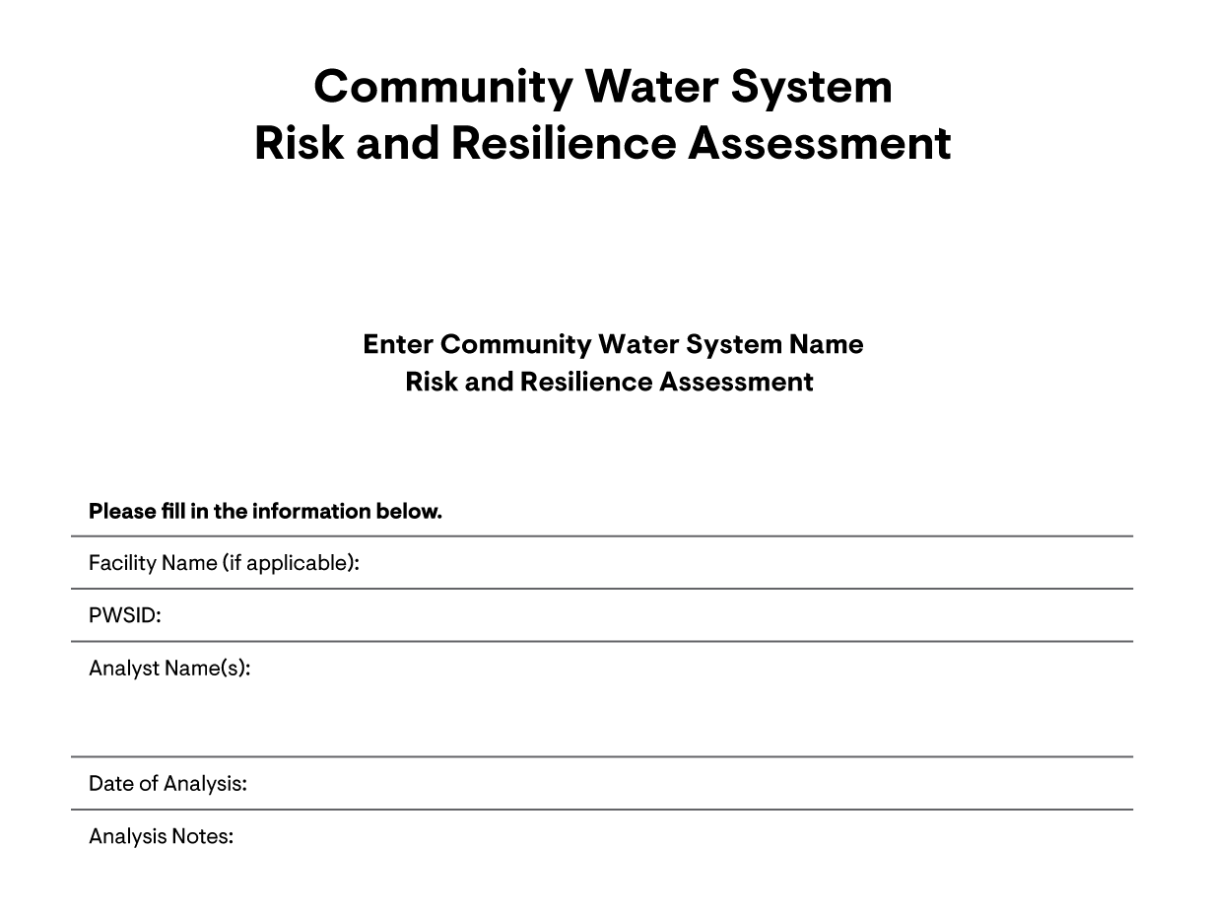
79
Notes:
Main presenter
Here’s what the checklist looks like. On the cover page you just fill out the basic information for the water system.

Slide 80
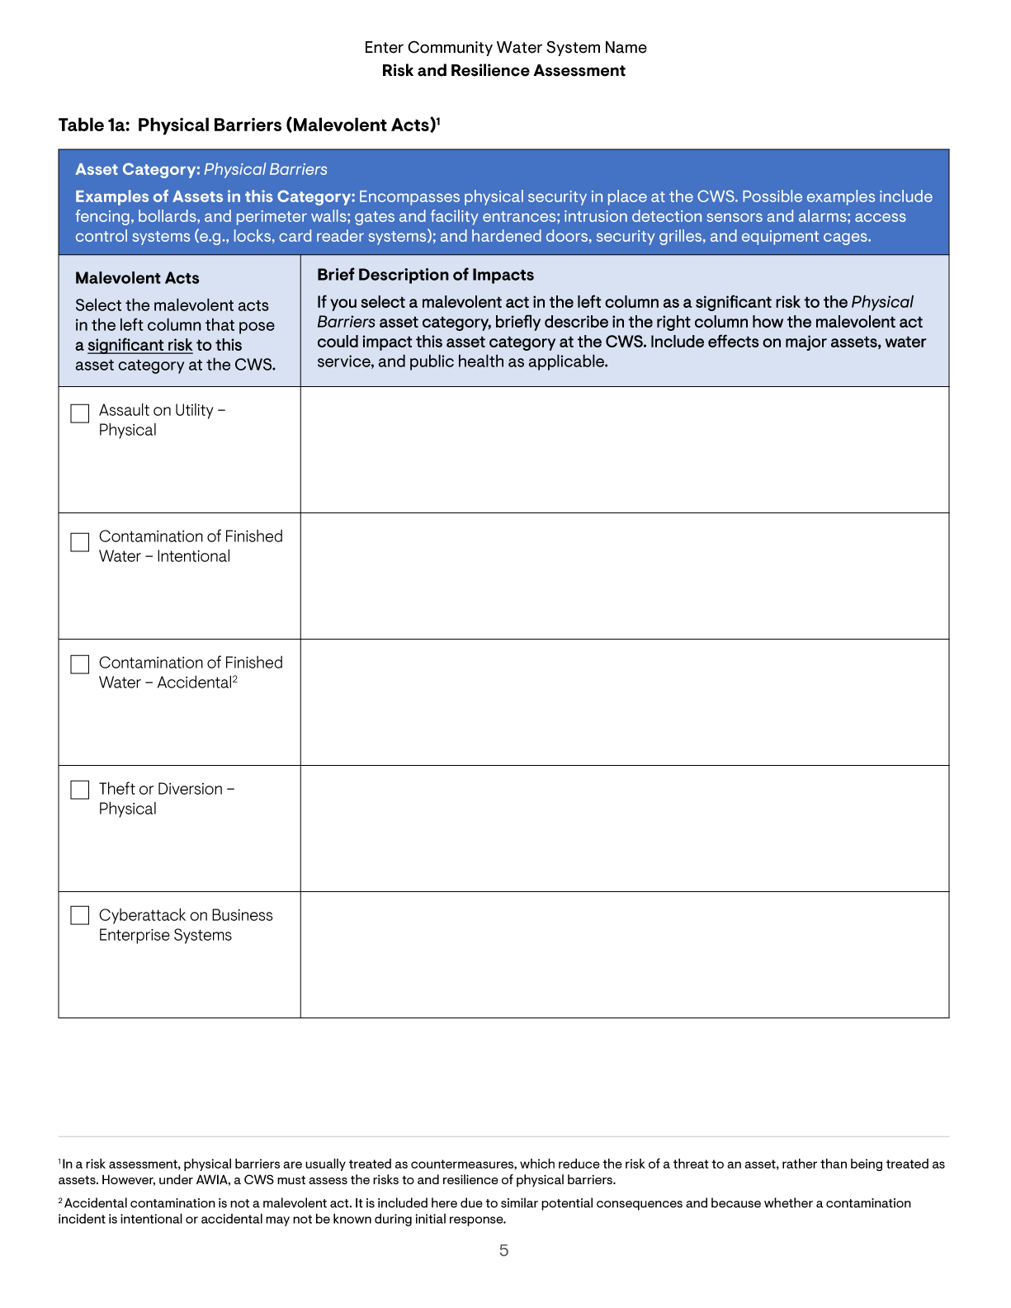
Risk and Resilience Assessment Checklist Table 1a: Physical Barriers (Malevolent Acts)
Notes:
Main presenter
And here is an example of table 1. At the top, the table states the asset category. This table is looking at physical barriers, which refers the physical security at the water system. The water system would check off any of these malevolent acts that they believe could cause significant risk to the system and then write a description of the impacts it could have on the given asset.

Slide 81
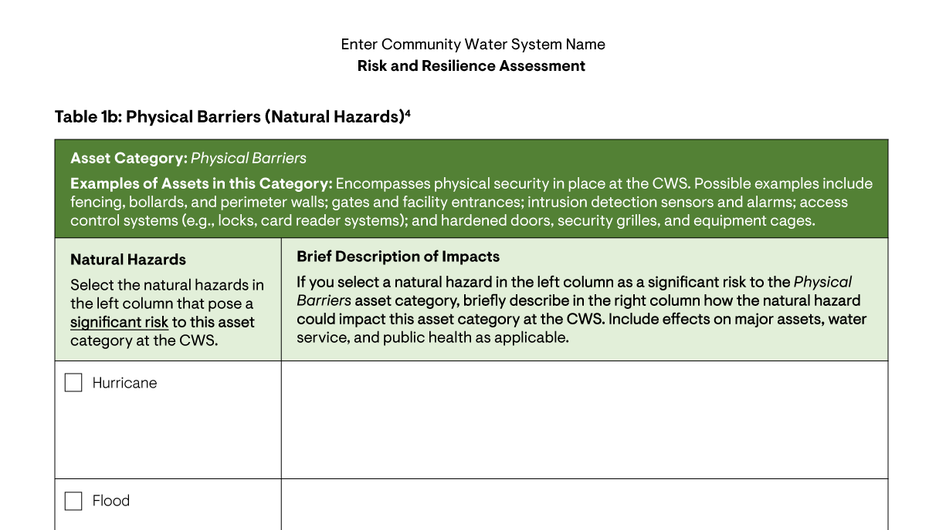
Risk and Resilience Assessment Checklist Table 1b: Physical Barriers (natural hazards)
Notes:
Main presenter
This second table follows a similar format of the first, but now it’s asking for natural hazards instead of malevolent acts.

Slide 82
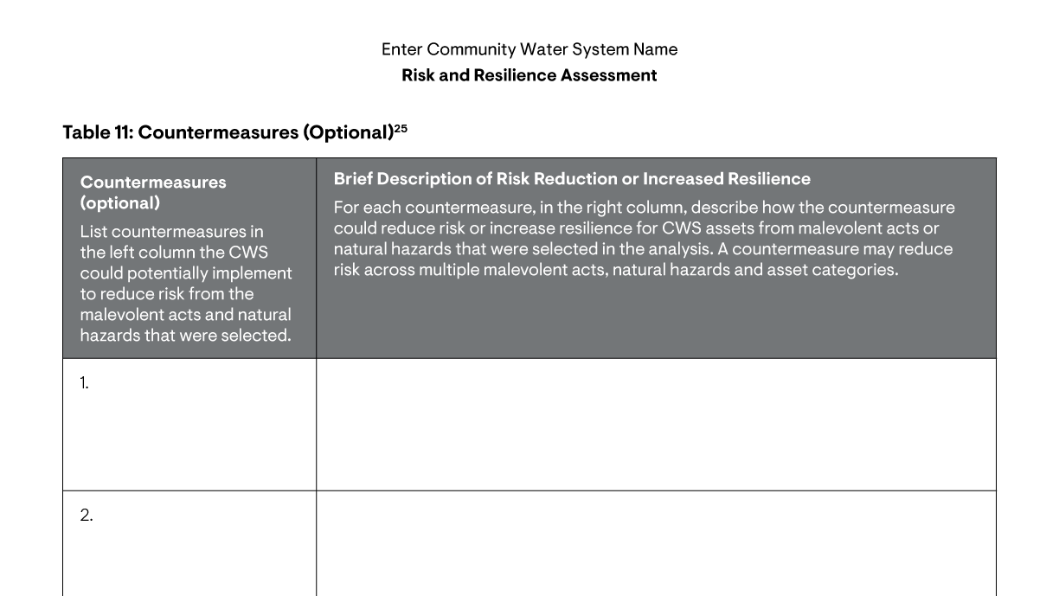
Risk and Resilience Assessment Checklist Table 11: countermeasures
Notes:
Main presenter
This table is optional. Since water systems are going through the process of identifying threats, they may want to take the next step and identify countermeasures to reduce risk while they’re at it.

Slide 83
Module 2 Quiz 2
The RRA should focus on threats to critical assets, rather than every single asset that exists at the water utility.
True or False.
Notes:
Question: True or False. The risk and resilience assessment should focus on the impact of threats on critical assets (i.e. assets that have significant economic or public health consequences); Community Water Systems should not try to address every single asset that exists at the water utility.
Answer: True. Focus on critical assets so that you don’t get overwhelmed trying to incorporate every single asset in your risk and resilience assessment.

Slide 84
Small systems risk and resilience checklist breakout groups
Notes:
Main presenter
Now we’re going to enter break out groups with moderators who will walk each group through an example water utility scenario that we created. Our webinar support will automatically place you into a breakout group.
In the meantime, we encourage you to open a blank checklist (can be found on the materials tab) and, if you’d like, use this time to start jotting notes for your own RRA. It is not possible to complete your systems RRA in a 45-minute session, but we encourage you to think through the process for your facility, while we walk through the fictitious facility example, and ask questions of the group to help you out with your own utility’s RRA.

Slide 85
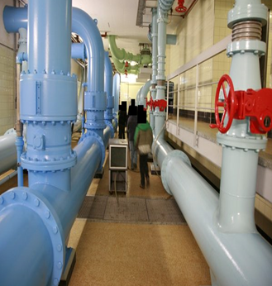
Example Scenario Utility Overview
Utility Name: Spring View Water District
Size and Location: Small utility located in the far south suburbs of Atlanta, GA that serves 35,000 people
Critical assets:
  8 pumping stations
  Supervisory control and data acquisition (SCADA) system
  Water treatment plant
  IT business and financial systems
Notes:
Break Out Group Discussion Leader 1
Instructions for leader: Once you join,
Unmute yourself on your GoToTraining panel.
Turn on your webcam in the browser.
View the chat and attendee list in your browser.
Periodically say the slide deck page number to the attendees.
Make note of attendee’s names and questions for when we rejoin the group.
Welcome to the breakout group. As a quick reminder, you will control your audio on your GoToTraining side panel. All other features will be in your browser. Please note the “Raise hand” feature on your browser is to notify organizers that you have a technical issue and not to notify me that you would like to ask a question. Instead, if you have questions for me, please feel free to unmute. Please stay muted when you aren’t asking a question.
If you experience technical issues, please:
Raise your hand in your Breakout Browser or
Chat organizers in your GoToTraining Side-panel.
One of our webinar support staff will assist you shortly.
Lastly, if you cannot see the slides in your browser, all slides are available for download in the “Materials” panel on your GoToTraining panel.
We will go through the slides for our breakout group. Please scroll through the PDF with me in your browser.
Our job as a breakout group moderator is to walk the group through the checklist to demonstrate how it works. If you have any questions that I don’t know the answer to, I will get an answer from my EPA colleagues who are technical experts on the subject and get back to you.
Let’s get started!
Both introduce yourself. Ask participants to type their name and occupation in the browser breakout group chat box so we know who is in our group.
Today we will be working through the Small Systems Risk and Resilience Checklist for the fictitious water utility Spring View Water District. Spring View Water District is a : small utility located in the far south suburbs Atlanta, GA that serves 35,000 people. Spring View Water District went through their inventory and chose their most critical assets to considerer through the checklist:
8 pumping stations
Supervisory control and data acquisition (SCADA) system (pronounced skay-duh; rhymes with cicada)
Water treatment plant
IT business and financial systems
Here’s a quick recap of what we learned in the last presentation about the checklist:
The checklist provides an organized way to present your risk and resilience assessment analysis in previously created tables.
If you walk through each part of the checklist and fill out the necessary tables, your RRA will be compliant with AWIA, since the 10 tables correspond to the categories of water systems assets that you must address under AWIA.
Each table represents an asset category. Blue tables are for malevolent acts, green tables are for natural hazards. The rows of the tables correspond to pre-written malevolent acts or natural hazards that could negatively impact that asset category. At the bottom of each table, there is an “Other(s), enter below:” column for you to add your own threats that could significantly impact your specific utility.
*Anticipated questions that breakout group leaders can be prepared to answer:
Does every table have to have something checked on it? Yes. AWIA requires that you consider each of these 10 asset categories, so pick threats to critical asset(s) in each table to fully address AWIA requirements.
And related, if they fill out one line of each table is that enough? Yes.
What does EPA say (if anything) is the “minimum” level of completeness? Fill out at least one line of each of the required tables (Tables 1a-10b)
If a difficult question comes up that you do not know how to answer, say “that’s a great question. How about we take that question back to the main group during our large group discussion.” Then, during the large group discussion, pose the question to me and the rest of the group to see if we can answer it. If I can’t answer it I will follow up with an answer later.
Please take note of questions that you are asked so we can add to this list to help out future moderators!
Tips: if you are running out of time, you don’t have to ask every breakout question. If you have too much time, try to encourage discussion by revisiting certain examples and prompting additional discussion about assets and threats that utilities could use.
*Definition: Supervisory control and data acquisition (SCADA) (pronounced skay-duh; rhymes with cicada): control system architecture comprising computers, networked data communications and graphical user interfaces for high-level process supervisory management

Slide 86
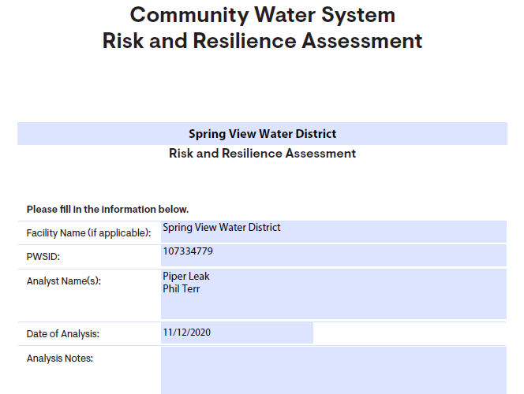
Enter Utility Information
24
Notes:
Break Out Group Discussion Leader 1
Periodically say your slide deck page number to the attendees.
Here is the first page of the template. It simply asks you to fill in some information about your water utility and the staff members from your water utility (or a consultant) who worked on putting together the RRA.

Slide 87
Threat Selection
Focus the selection of malevolent acts on those that:
Are prevalent in the United States (e.g., cyberattacks),
Can exploit vulnerabilities at the CWS (e.g., known security gaps), and
Have the potential for significant economic or public health consequences (e.g., contamination).
Focus the selection of natural hazards on those that:
Are prevalent in the area where the water system is located,
May affect vulnerable water system infrastructure, and
Have the potential for significant economic or public health consequences related to the CWS.
Notes:
Break Out Group Discussion Leader 1
Periodically say your slide deck page number to the attendees.
Now it’s time to select threats to assess throughout this RRA. The RRA is meant to help your water utility prepare for the most likely, highest impact threats. In order to identify such threats of malevolent acts, we recommend focusing on those acts that:
- we know are widespread throughout the US (e.g. cyberattacks)
- can exploit vulnerabilities (weaknesses in the system) at the CWS (e.g. known gaps in security, both cyber security and physical security)
- have the potential to create significant economic loss and/or adversely impact public health.
We recommend focusing on selecting natural hazards that:
- are prevalent in the area where the water system is.
- could affect water system infrastructure that’s vulnerable
- have the potential to cause significant economic loss and/or adversely impact public health
Using the guidelines on the slide, what are some malevolent acts and natural hazards that you think would be good to consider for Region 4?
Natural hazards e.g. Flooding, Severe Winter Storms, Ice Storms, etc.
Malevolent acts e.g. contamination, cyber intrusion, active shooter, vandalism, etc.

Slide 88
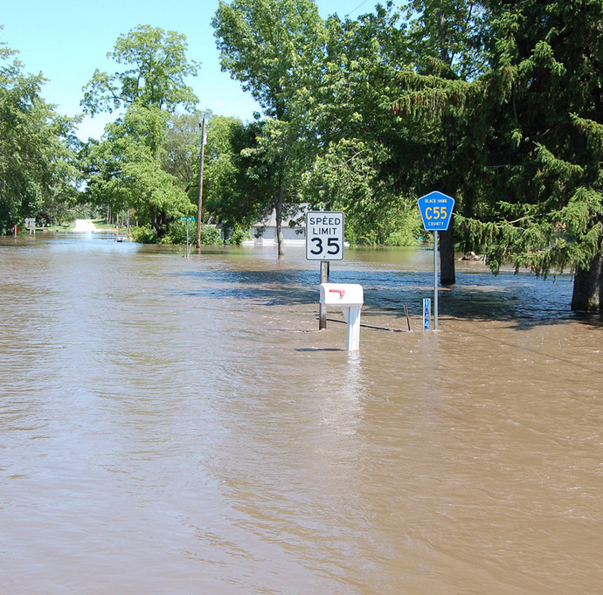
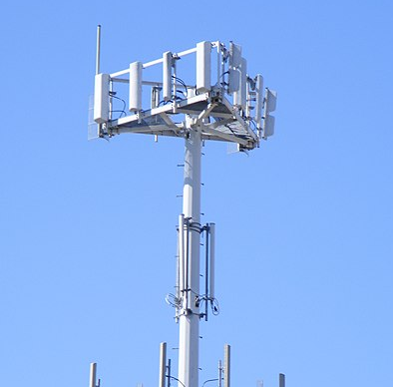

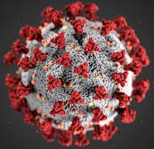
Example Scenario Threat Selection
Spring View Water District is assessing the risk and resilience of critical assets to the following malevolent acts and natural hazards:
Flooding
Cyberattack on process control systems
Cyberattack on business enterprise systems
Viral Pandemic
Notes:
Break Out Group Discussion Leader 1
Periodically say your slide deck page number to the attendees.
Here’s the malevolent acts and natural hazards we chose for this hypothetical scenario:
First we’ll look at how a 100-year flood event near Spring View Water District could impact the water system.
then we’ll look at a cyberattack on process control systems.
next we’ll look again at a cyberattack, but this time one that is targeted on business enterprise systems that coordinate the accounting, finance, and other crucial processes for operating the water system.
finally, we’ll look at how a viral pandemic could affect water system operations (a timely example)
Please note that we will be taking a limited look at these events. There are many more assets that could be considered during a cyberattack, flood, or pandemic. We recommend that you visit our website for resources that can give you a more in depth look at water security considerations related to specific events of interest to your utility when you create your RRA.
These 4 examples were chosen to illustrate how to fill out the checklist, but your utility may select a longer list of threats to consider that aren’t in our hypothetical Spring View Water District example. There are other, equally important threats that water systems in your region will want to address. Our website has resources that can help you address today’s example threats, and many additional types of natural hazards and malevolent acts, in more detail.

Slide 89
Perform Risk and Resilience Assessment 1
Hypothetical Threat: Flooding
Spring View Water District is located near the Winding River, and draws its source water from the river
The District is concerned about a 100-year flooding event
Electrical components of the utility’s online water quality monitoring equipment (not elevated) could be damaged
This could disable continuous monitoring of the finished water leaving the treatment plant
Notes:
Break Out Group Discussion Leader 2
Periodically say your slide deck page number to the attendees.
Our first hypothetical threat is the threat of a 100-year flood event. Spring View Water District is located next to the Winding River, where it draws its source water from. They are concerned that a 100-year flood could damage electrical components of their water quality monitoring equipment (which is currently on the ground and is not elevated). This could disrupt their monitoring of the finished water leaving their facility.

Slide 90
Perform Risk and Resilience Assessment 6 1
CWSs serving over 3,300 people must assess the risks to and resilience of specified assets to malevolent acts and natural hazards:
  physical barriers;
  source water;
  pipes and constructed conveyances, water collection and intake;
  pretreatment and treatment;
  storage and distribution facilities;
  electronic, computer, or other automated systems (including the security of such systems);
  monitoring practices;
  financial infrastructure;
  the use, storage, or handling of chemicals;
  operation and maintenance of the system
  *May include an evaluation of capital and operational needs for risk and resilience management
Notes:
Break Out Group Discussion Leader 2
Periodically say your slide deck page number to the attendees.
Ask the group: Which of these assets could a flood impact?
On the slide is a list of the 10 assets that water systems must consider that are stated in the law. Feel free to unmute yourselves or type your thoughts into the chat box. There can be more than one answer to this, so feel free to suggest multiple assets from the list and discuss your reasoning with the group.
Encourage participants to suggest as many assets as they can think of as a type of brainstorming session for everyone in the breakout group to come up with ideas on how the threat can impact critical assets. Be prepared to throw out suggestions of how several the above assets could be impacted by the threat in case the group is not talkative. EPA’s Incident Action Checklists may help spark ideas:
https://www.epa.gov/sites/production/files/2015-06/documents/flooding.pdf
Examples from EPA’s flooding incident action checklist:
Flood related debris could cause a blockage at an intake or unearthed water lines due to falling trees. This could fit in category 3 (pipes and constructed conveyances, water collection and intake).
The flood could cause water quality changes to source waters, including increased turbidity, increased nutrients, and other potential contaminant. This is related to category 2 (source water).
Loss of power and communication lines. This could fit in category 10 (operation and maintenance of the system).
Restricted access to the facility due to debris, flood waters and damage to roadways from washouts and sinkholes. This could affect number 10 (the operation and maintenance of the system).

Slide 91
Perform Risk and Resilience Assessment 171
Hypothetical Threat: 100-year flood
In this scenario, Spring View Water District has determined that a flood poses a significant risk to the District’s monitoring practices
The utility completes the following table in the checklist, as illustrated on the following slide:
Table 7b: Monitoring Practices (Natural Hazards)
Notes:
Break Out Group Discussion Leader 2
Periodically say your slide deck page number to the attendees.
Great discussion about how a flood could negatively impact assets at a water utility. Here is the asset that we chose to use in this example. As was mentioned earlier in the presentation, the RRA should look at threats that pose a significant risk to the system. For this example, Spring View Water District determined that a flood poses risk to their monitoring practices.
I’ve bolded the words that you will see match up to the language that is used in the small systems checklist: flood is the threat and monitoring practices is the asset impacted by that threat. Thus, we can use Table 7b of the checklist, the table for monitoring practices.

Slide 92
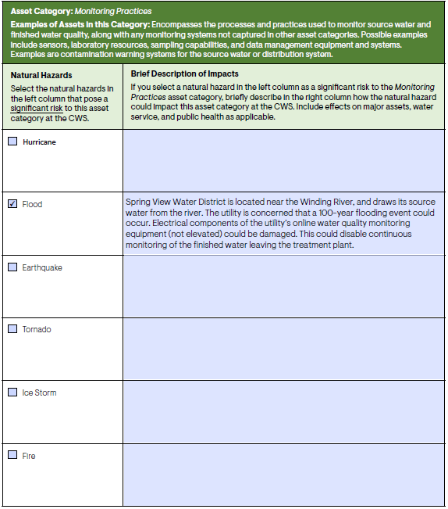
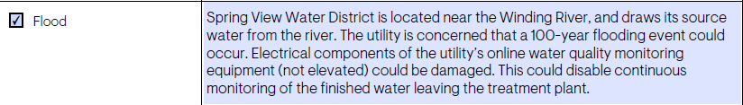
Perform Risk and Resilience Assessment
Table 7b 8
Notes:
Break Out Group Discussion Leader 2
Periodically say your slide deck page number to the attendees.
In table 7b, the district checks flood as a significant natural hazard of concern. Then they describe their concern that a 100-year flood could damage electrical components for the utility’s online water quality monitoring equipments (which is not currently elevated).
With a checked box and a written description, we have completed a qualitative assessment of the risk of a flood on monitoring practices. When your system is creating your RRA, you may want to add more than one check box and description to a given table but for the sake of our time-limited training, lets move on to some of the other required areas of the assessment.

Slide 93
Perform Risk and Resilience Assessment 195
Hypothetical Threat: Cyberattack on process control systems
Spring View Water District relies on a cellular provider to remotely operate its pumping stations.
Spring View Water District is concerned about a cell tower attack by a malicious actor. This attack could prevent remote (cellular) operation of a pumping station.
Notes:
Break Out Group Discussion Leader 1
Periodically say your slide deck page number to the attendees.
Next, Let’s look at some of the details of our hypothetical threat, a cyberattack on process control systems.
- Spring view water district relies on a cellular provider and cell towers to remotely operate its pumping stations.
- the district would like to prepare for the situation where a malicious actor attacks the cell tower and prevents remote operation of a pumping station.
Cyberattacks are an important, ever emerging concern in the modern world. They are a great choice of a threat to include in a risk assessment for all utilities.

Slide 94
Perform Risk and Resilience Assessment 10
CWSs serving over 3,300 people must assess the risks to and resilience of specified assets to malevolent acts and natural hazards:
  physical barriers;
  source water;
  pipes and constructed conveyances, water collection and intake;
  pretreatment and treatment;
  storage and distribution facilities;
  electronic, computer, or other automated systems (including the security of such systems);
  monitoring practices;
  financial infrastructure;
  the use, storage, or handling of chemicals;
  operation and maintenance of the system
  *May include an evaluation of capital and operational needs for risk and resilience management
Notes:
Break Out Group Discussion Leader 1
Periodically say your slide deck page number to the attendees.
Ask the group: Which of the assets that the risk and resilience assessments are required to consider do you think this hypothetical cyberattack on process control systems (the cell towers) could impact?
On the slide is a list of the 10 assets that water systems must consider that are stated in the law. Feel free to unmute yourselves or type your thoughts into the chat box. There can be more than one answer to this, so feel free to suggest multiple assets from the list and discuss your reasoning with the group.
*Encourage participants to suggest as many assets as they can think of as a type of brainstorming session for everyone in the breakout group to come up with ideas on how a cyberattack on process control systems can impact critical assets. Be prepared to throw out suggestions of how several the above assets could be impacted by the threat in case the group is not talkative. EPA’s Incident Action Checklists may help spark ideas:
https://www.epa.gov/waterutilityresponse/incident-action-checklists-water-utilities
https://www.epa.gov/sites/production/files/2017-11/documents/171013-incidentactionchecklist-cybersecurity_form_508c.pdf
Examples from the cybersecurity incident action checklist:
Interruption of treatment, distribution or conveyance processes from opening and closing valves, overriding alarms or disabling pumps or other equipment = pipes and constructed conveyances, water collection and intake; pretreatment and treatment; storage and distribution facilities
Loss of use of industrial control systems (e.g., SCADA system (pronounced skay-duh)) for remote monitoring of automated treatment and distribution processes = pipes and constructed conveyances, water collection and intake; pretreatment and treatment; storage and distribution facilities
Once the participants have had a chance to suggest assets, flip to the next slide to reveal the asset we will be using in this example.

Slide 95
Perform Risk and Resilience Assessment 11
Hypothetical Threat: Cyberattack on process control systems
In this scenario, Spring View Water District has determined that a cyberattack on process control systems poses a significant risk to the District’s storage and distribution facilities.
The utility completes the following table in the checklist, as illustrated on the following slide: Table 5a: Storage and Distribution Facilities (Malevolent Acts).
Notes:
Break Out Group Discussion Leader 1
Periodically say your slide deck page number to the attendees.
Those were all great suggestions. Here is the asset that we chose to use in this example. As was mentioned earlier in the presentation, the RRA should look at threats that pose a significant risk to the system. In this case, spring view water district decided that a cyberattack on their process control systems poses a significant risk to their storage and distribution facilities. I’ve bolded the words that you will see match up to the language that is used in the small systems checklist: cyberattack on process control systems is the threat, storage and distribution facilities is the asset impacted by that threat. Since storage and distribution is one of the items that AWIA requires that RRA’s address, the small systems checklist has a table that spring view water district can use (Table 5a) to look at the effect that this type of cyberattack could have on its storage and distribution facilities.

Slide 96
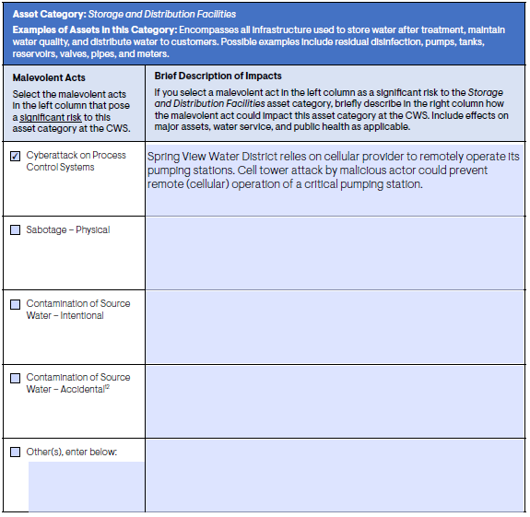
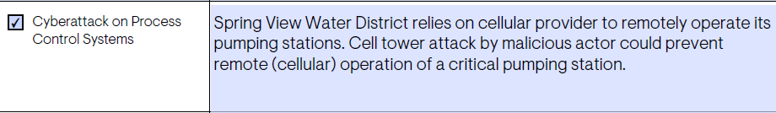
Perform Risk and Resilience Assessment Table 5a 12
Notes:
Break Out Group Discussion Leader 1
Periodically say your slide deck page number to the attendees.
Here is what it will look like when spring view water district fills out table 5a of the small systems checklist. You see that spring view water district check off cyberattack on process control systems as the type of malevolent act that they believe could significantly impact their utility. Then in the right-hand column they wrote a description of how the cyberattack could negatively impact their process control systems: if a cell tower is attacked by a malicious actor, it could prevent operation of a critical pumping station.
With a checked box and a written description, we have completed a qualitative assessment of the risk of a cyberattack on process control systems. When your system is creating your RRA, you may want to add more than one check box and description to a given table but for the sake of our time-limited training, lets move on to some of the other required areas of the assessment.

Slide 97
Perform Risk and Resilience Assessment
Hypothetical Threat: Cyberattack on business
enterprise systems
The concern is a ransomware attack that propagates through Spring View Water District’s local area network.
Could prevent Spring View Water District’s communications with customers and access to financial systems.
Utility systems connected to the network could also be impacted (e.g., laboratory equipment, work order systems).
Notes:
Break Out Group Discussion Leader 2
Periodically say your slide deck page number to the attendees.
Now we’re going to look at the effect that a different kind of cyberattack could have on spring view water district. A malicious actor could launch a ransomware attack that propagates through the district’s local area network, preventing the district from being able to communicate with their customers and access their financial systems. In addition to the negative consequences this cyberattack could have on the financial systems, utility systems that are connected to the local area network, such as lab equipment or work order systems, could also be affected.

Slide 98
Perform Risk and Resilience Assessment13
CWSs serving over 3,300 people must assess the risks to and resilience of specified assets to malevolent acts and natural hazards:
  physical barriers;
  source water;
  pipes and constructed conveyances, water collection and intake;
  pretreatment and treatment;
  storage and distribution facilities;
  electronic, computer, or other automated systems (including the security of such systems);
  monitoring practices;
  financial infrastructure;
  the use, storage, or handling of chemicals;
  operation and maintenance of the system
  *May include an evaluation of capital and operational needs for risk and resilience management
Notes:
Break Out Group Discussion Leader 2
Periodically say your slide deck page number to the attendees.
Ask the group: Which of the assets that the risk and resilience assessments are required to consider do you think this hypothetical cyberattack on business enterprise systems could impact?
Just like last time, feel free to unmute yourselves or type your thoughts into the chat box. Remember that there can be more than one correct answer to this, so feel free to suggest multiple assets and discuss your reasoning with the group.
Encourage participants to suggest as many assets as they can think of as a type of brainstorming session for everyone in the breakout group to come up with ideas on how a cyberattack can impact critical assets. Be prepared to throw out suggestions of how several the above assets could be impacted by the threat in case the group is not talkative. EPA’s Incident Action Checklists may help spark ideas:
https://www.epa.gov/waterutilityresponse/incident-action-checklists-water-utilities
https://www.epa.gov/sites/production/files/2017-11/documents/171013-incidentactionchecklist-cybersecurity_form_508c.pdf
Examples from the cybersecurity incident action checklist:
Theft of customers’ personal data such as credit card information and social security numbers stored in on-line billing systems = 6. electronic, computer, or other automated systems (including the security of such systems); 8. financial infrastructure
Defacement of the utility’s website or compromise of the email system = 6. electronic, computer, or other automated systems (including the security of such systems)

Slide 99
Perform Risk and Resilience Assessment 14
Hypothetical Threat: Cyberattack on business enterprise systems
Spring View Water District determined that a cyberattack on business enterprise systems poses a significant risk to the District’s electronic, computer, or other automated systems as well as its financial infrastructure.
The utility completes the following tables in the checklist, as illustrated on the following slides:
Table 6a: Electronic, Computer, or Other Automated Systems (including the security of such systems) (Malevolent Acts)
Table 8a: Financial Infrastructure (Malevolent Acts)
Notes:
Break Out Group Discussion Leader 2
Periodically say your slide deck page number to the attendees.
Great suggestions everyone. Here are the two asset that we chose to focus on in this example. Spring view water district decided that a cyberattack on their business and enterprise systems poses a significant risk to their electronic, computer, or other automated systems AND financial infrastructure. The small systems checklist has a tables that spring view water district can use to look at the effect that this type of cyberattack could have on these assets, Table 6a and Table 8a.

Slide 100
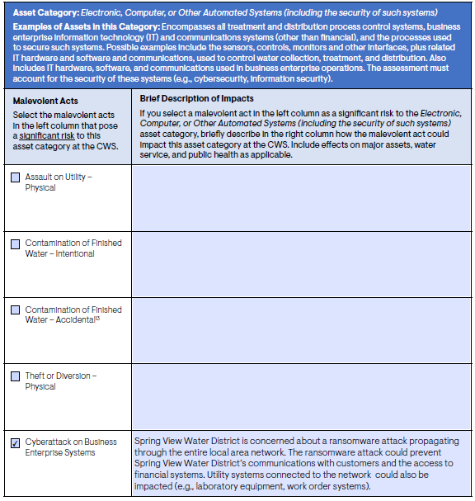
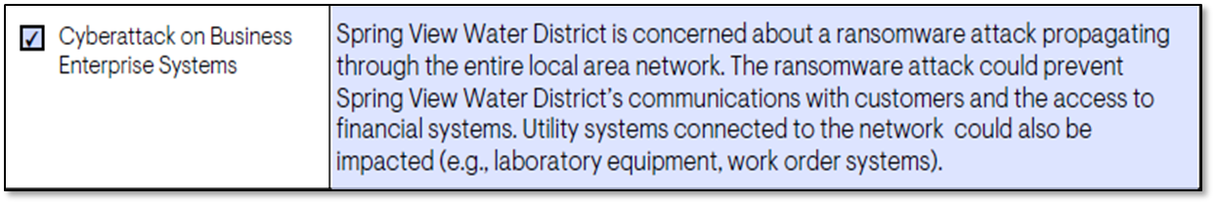
Perform Risk and Resilience Assessment
Table 6a 15
Notes:
Break Out Group Discussion Leader 2
Periodically say your slide deck page number to the attendees.
In table 6a, spring view water district checks off cyberattack on business enterprise systems and then writes a description of how a ransomware attack could impact business enterprise systems.

Slide 101
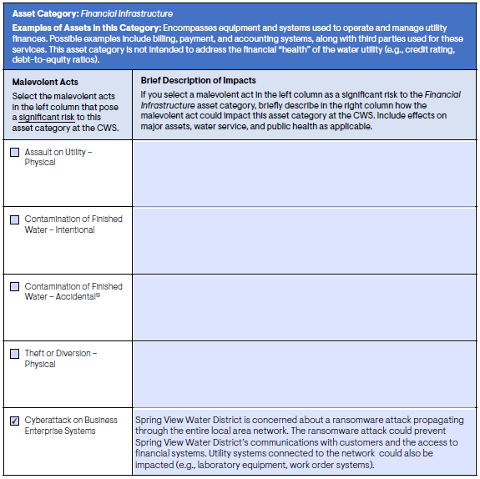
Perform Risk and Resilience Assessment
Table 8a 16
Notes:
Break Out Group Discussion Leader 2
Periodically say your slide deck page number to the attendees.
In table 8a, the district checks cyber attack on business enterprise systems. Then in the right-hand column they describe how the cyberattack will affect financial infrastructure.

Slide 102
Perform Risk and Resilience Assessment 17
Hypothetical Threat: Viral Pandemic
Spring View Water District is concerned about the effects of a viral pandemic on the utility.
The utility stores a 3-week supply of chlorine on-site. Disruptions to the supply chain during a pandemic could cause difficulties obtaining chlorine from suppliers.
Spring View Water District has 11 employees. Absenteeism during a viral pandemic could create issues with staffing and a loss of key personnel.
Notes:
Break Out Group Discussion Leader 1
Periodically say your slide deck page number to the attendees.
Now let’s look at how you would enter a threat that is not one of the pre-written suggestions in the template. Our example focuses on a threat that’s very much on all of our minds right now, a global pandemic. The water sector has learned a lot about how a pandemic could affect the ability of systems to provide clean, reliable drinking water to customers. The district has a 3 week supply of chlorine stored onsite. Disruptions to the chlorine supply chain due to the pandemic could cause problems obtaining chlorine from suppliers.
Spring view water district has 11 employees, but many of those employees may become ill and unable to work, causing shortages in available staff and the loss of personnel who play a key role in operating the water system.

Slide 103
Perform Risk and Resilience Assessment 18
CWSs serving over 3,300 people must assess the risks to and resilience of specified assets to malevolent acts and natural hazards:
  physical barriers;
  source water;
  pipes and constructed conveyances, water collection and intake;
  pretreatment and treatment;
  storage and distribution facilities;
  electronic, computer, or other automated systems (including the security of such systems);
  monitoring practices;
  financial infrastructure;
  the use, storage, or handling of chemicals;
  operation and maintenance of the system
  *May include an evaluation of capital and operational needs for risk and resilience management
Notes:
Break Out Group Discussion Leader 1
Periodically say your slide deck page number to the attendees.
Ask the group: You all know the drill at this point. Which of the assets that the risk and resilience assessments are required to consider (the 10 assets required by AWIA are listed on the screen) do you think a viral pandemic could impact?
Feel free to unmute yourselves or type your thoughts into the chat box.
Encourage participants to suggest as many assets as they can think of as a type of brainstorming session for everyone in the breakout group to come up with ideas on how a pandemic can impact critical assets. Be prepared to throw out suggestions of how several the above assets could be impacted by the threat in case the group is not talkative. EPA’s Incident Action Checklists may help spark ideas:
https://www.epa.gov/sites/production/files/2020-03/documents/pandemic_iac_final_032620_508_fillable_0.pdf
Staff shortages due to absenteeism = 10. operation and maintenance of the system
Supply chain disruptions (chemicals, materials, personal protective equipment) = 9. the use, storage, or handling of chemicals; 4. pretreatment and treatment
Field operations interruptions (repairs, meter reading, sampling) = 10. operation and maintenance of the system; 3. pipes and constructed conveyances, water collection and intake; pretreatment and treatment; 5. storage and distribution facilities

Slide 104
Perform Risk and Resilience Assessment 19
Hypothetical Threat: Viral Pandemic
In this scenario, Spring View Water District has determined that a viral pandemic poses a significant risk to the District’s operation and maintenance of the system.
The utility completes the following table in the checklist, as illustrated on the following slide:
Table 10b: The Operation and Maintenance of the System (Natural Hazards)
Notes:
Break Out Group Discussion Leader 1
Periodically say your slide deck page number to the attendees.
Good asset suggestions. Here is the asset that we chose to use in this example. Spring view water district decided that a viral pandemic poses a significant risk to the District’s operation and maintenance of the system. Operations and maintenance of the system is one of the assets that AWIA requires RRA’s to address, but the small systems checklist does not have viral pandemic as an option. No worries, though, because each table has an option for you to write your own threats. We’ll use Table 10b, which addresses system operation and maintenance, and write in the threat viral pandemic.

Slide 105
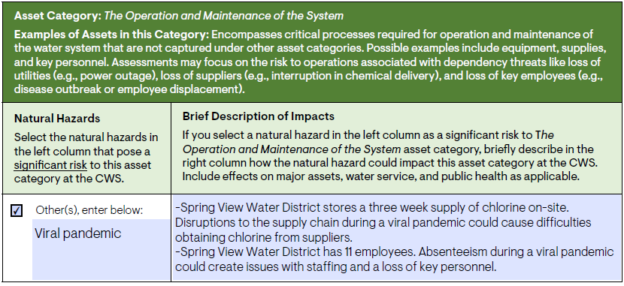
Perform Risk and Resilience Assessment
Table 10b 20
Notes:
Break Out Group Discussion Leader 1
Periodically say your slide deck page number to the attendees.
Here we use the natural hazards table, 10b, and typed in our natural hazard, viral pandemic. In the description box, the utility wrote an explanation of their concern that the pandemic could affect their ability to obtain chlorine and that absenteeism could cause loss of staff and key personnel.

Slide 106
Identify Countermeasures (Optional)
For malevolent acts, countermeasures are intended to deter, delay, detect, and respond to an attack.
For natural hazards, countermeasures are intended to prepare, respond, and recover from an event.
A single countermeasure, such as emergency response planning or power resilience, may reduce risk across multiple malevolent acts, natural hazards and asset categories.
Note: Countermeasure risk assessments are not required for AWIA-compliance.
Notes:
Break Out Group Discussion Leader 2
Periodically say your slide deck page number to the attendees.
In table 11 of the Checklist, which is optional, you can identify countermeasures the CWS could potentially implement to reduce risk from the malevolent acts and natural hazards that you selected in in this assessment.
For malevolent acts, countermeasures are intended to deter, delay, detect, and respond to an attack
For natural hazards, countermeasures are intended to prepare, respond, and recover from an event
A single countermeasure, such as emergency response planning or power resilience, may reduce risk across multiple malevolent acts, natural hazards and asset categories.

Slide 107
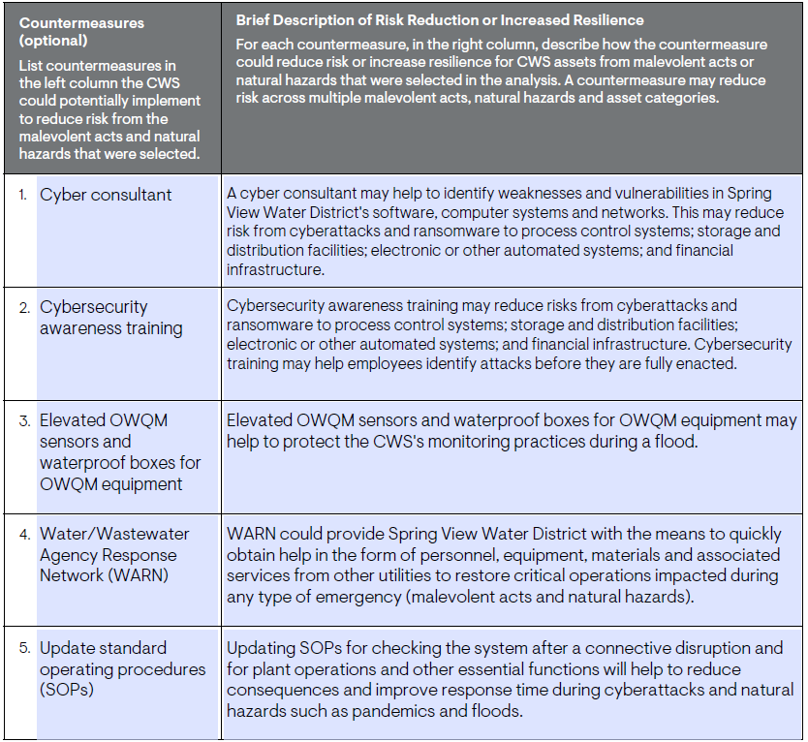
Identify Countermeasures
Table 11 (Optional)
Note: This table is optional. It also does not require a specific number of countermeasures.
Notes:
Break Out Group Discussion Leader 2
Periodically say your slide deck page number to the attendees.
Here’s table 11 of the Checklist filled out with 5 countermeasures that the district identified that they could implement to reduce risk from the malevolent acts and natural hazards that they used in their assessment:
To help with the cyber attacks, they could hire a consultant to find vulnerabilities in the districts networks that could make them vulnerable to a cyberattack.
They could also institute cybersecurity awareness trainings for their employees to help them identify attacks quicker and potentially stop them from infecting the water system’s electronic systems.
A countermeasure they listed for floods is to elevate sensors and waterproof boxes for equipment to protect monitoring practices.
The first 3 measures identified in this example are countermeasures for specific types of incidents. The 4th and 5th countermeasures identified could help Spring View Water District with a wide variety of threats. For example, Spring View Water District could join a Water Agency Response Network (WARN) in their area to be able to quickly get help from nearby utilities during an emergency. If you’re interested in joining a WARN in your area, you can find that information on our website (searching “EPA WARN” will get you to the correct webpage).
Another countermeasure that could help Spring View Water District reduce risk to many threats is included in the last row of table 11: to update their Standard Operating Procedures for checking their system.
Can anyone think of additional counter measures related to today’s examples that could go in this table? Example you can offer if no one suggests anything:
Waterproofing building access areas to increase protect the building and ensure that personnel will be able to access the building during an emergency
Please note that the table is OPTIONAL. We recommend that you fill out this table if your utility has the time and resources to do so, however, because it can help you take the next step towards making your utility more resilient. It can also help get you thinking about the information you will need to include in your emergency response plans, which you must certify to EPA 6 months after you certify your risk assessment.
Also note that table 11 doesn’t require a specific number of countermeasures, you may have fewer than five countermeasures or add more countermeasures and describe them in a separate document.

Slide 108
End of Breakout Group
We will connect you back to the main group shortly.
Be ready to engage by offering thoughts or takeaways from your breakout group to the larger group.
Notes:
Break Out Group Discussion Leader 2
We are now done with our breakout group session. Thanks for joining me in this discussion! If you have any thoughts or takeaways from this session, please keep them in mind for when we join the larger group again. You will get a notice in this browser window when the session ends, and you will automatically be sent back to the larger group in the GoToTraining window. We will wait for the other groups to finish and then we will be reconnected shortly.
In the remaining time we have, feel free to spend time taking notes on your own small systems checklist for your RRA, or feel free to take a break and come back at ___ for the large group discussion.
If you have time before the session ends:
Are there any final thoughts/questions while we wait to rejoin the session?

Slide 109
LARGE GROUP DISCUSSION
Notes:
Main presenter
Now that we’ve all spent time walking through some examples using the checklist, I hope everyone is comfortable doing the same for your own utilities. It would be great to hear what some of the takeaways were from the breakout groups. Does anybody want to share their takeaways from their breakout group discussion? If you want to speak out loud, please raise your hand and we will unmute you. If you would like to type in your question or comment, please send it in the chat box.
While giving everyone a chance to type in the chat box or prepare to unmute themselves, do any of the moderators have any key takeaways or questions that they remember from their group?
Some example takeaways:
In our breakout group, we noticed that many different types of threats can affect the same assets. Water utilities may list the same threat, for example a flood, but due to their particular circumstances they may be concerned about a flood influencing vastly different types of assets (e.g. one system may already have critical assets elevated while another doesn’t, so their top concerns of what assets a flood could impact could be different). These checklists have the potential to look very different when filled out by utilities with different circumstances.
The checklist gives a pre-created structure to your risk and resilience assessment that you can fill into present your analysis in an organized way. Hopefully this makes you feel confident that this can be done relatively easily if your utility has limited time and resources.
If you fill out each of the 10 tables that correspond to the 10 required parts of an RRA, your RRA will be compliant with AWIA.
The checklist is very customizable, allowing each of you to customize it to the needs of your utility. Each table has a section to write in threats that we didn’t include in our pre-written suggestions.
Our ultimate goal with this law is to help all water systems improve their resiliency to potential threats. The checklist is one resource that can help you through the process of qualitatively assessing risks.
You will have these slides available to you after the presentation so feel free to look back at our examples for a refresher on how to fill in the checklist.

Slide 110
Module 2 Quiz 3
Table 11: Identify Countermeasures in the Small System’s RRA Checklist is required for AWIA Section 2013 certification.
True or False.
Notes:
Question: True or False. Table 11 Identify Countermeasures in the Small System’s Risk and Resilience Assessment Checklist is required for your AWIA Section 2013 certification.
Answer: False. Table 11 is completely optional, it is not required by AWIA.

Slide 111
Recap: AWIA Risk Assessments
Initial risk and resilience assessment completion and certification due by set deadlines based on utility service size.
The risk and resilience assessment replaces the vulnerability assessment from the 2002 Bioterrorism Act.
Includes malevolent acts and natural hazards.
Small Systems Checklist is a resource designed for small systems with limited resources to create a qualitative risk assessment that complies with AWIA.
Utility must re-certify every 5 years.
Notes:
Main presenter
Here’s a summary of what we learned today. Risk and resilience assessments need to be completed and certified by set deadlines in the law, based on utility service size.
For utilities serving a population of 50,000 to 99,999, you must certify your risk assessment no later than December 31, 2020.
For utilities serving a population of 3,301 to 49,999, you must certify your risk assessment no later than June 30, 2021.
The old vulnerability assessment from the 2002 bioterrorism act is now replaced with the new risk and resilience assessment from AIWA.
AWIA Section 2013 expands the risk types addressed in a public water system's assessment to include risks of natural hazards and malevolent acts. Community water systems are required to evaluate the resilience of their current physical infrastructure and their management practices, including financial capacity to respond to these risks. Then, based on the assessment, public water systems must also develop emergency response plans that address the risks and resilience issues that systems may face.
The small systems checklist is a resource created by EPA specifically for small systems in mind that may have limited time and resources. It was designed so that if you thoroughly fill out the checklist, your RRA should comply with AWIA.
Your utility must re-certify their RRA (and ERRs, which we’ll talk about in the next module) every 5 years.

Slide 112
Questions? 2
Notes:
Cadmus (Webinar Support) facilitates questions
Questions?
Common FAQs:
What are the implications of AWIA Section 2013 for small systems less than 3,300?
[AWIA Section 2013 requires EPA to provide guidance and assistance to utilities under 3,300 on risk and resilience assessments and emergency response plans, and more guidance for these very small systems will be published in 2021. However, these utilities are not required to certify completion of either their risk and resilience assessment or their emergency response plan.]
Are transient non-community water systems or non-transient non-community water systems impacted by AWIA Section 2013?
[No, Section 2013 only applies to community water systems, which are defined as public water systems that supply water to the same population year-round.]
Who is qualified to certify a risk and resilience assessment or emergency response plan on behalf of my CWS?
[Any utility employee can be the certifying official for the risk and resilience and emergency response plan. There are no specific requirements for the official other than that they must be employed by the utility.]
Is there funding available to assist us conduct the risk and resilience assessment to comply with AWIA Section 2013?
[Currently, there is no single designated funding; however, this is considered an eligible project under EPA’s Drinking Water State Revolving Fund (DWSRF). Each state develops priority projects for funding under this DWSRF, so check with your state to see if they have funds for this.]

Slide 113
Awia workshop Module 3:
Emergency Response Plan Guidance and template
Notes:
Hi everyone. Welcome to the last module of our 3 module AWIA workshop!

Slide 114
Workshop Training Modules 1-3
Module 1: AWIA Section 2013 Overview, Certification Process,
and Section 2018
Module 2: Risk and Resilience Assessments
Module 3: Emergency Response Plan Guidance and Template
114
Notes:
As we near the end of the workshop modules, here is a recap of what we discussed on the previous modules.
​
In the first Module, we provided an overview of AWIA Section 2013 and background, how to certify RRAs and ERPs, and AWIA Section 2018.
​
Then Module 2 covered the risk and resilience assessment requirements and the tools that EPA has developed to assist you in conducting your AWIA-compliant risk and resilience assessment.​
​
Today in this Module, we will cover the emergency response plan requirements and the emergency response plan guidance and template that was developed to assist community water systems in developing/updating an AWIA-compliant emergency response plan. ​
​

Slide 115
Learning Objectives – AWIA ERP
Participants will:
Learn the background, requirements, and deadlines for Emergency Response Plans (ERPs) under AWIA Section 2013.
Understand how to utilize EPA’s Emergency Response Plan Template and Instructions to develop an AWIA-compliant ERP.
Learn about additional free emergency response tools and resources available to utilities.
115
Notes:
Main Presenter
We have 3 main goals for today:
Learn the background, requirements, and deadlines for Emergency Response Plans (ERPs) under AWIA Section 2013.
Understand how to utilize EPA’s Emergency Response Plan Template and Instructions to develop an AWIA-compliant ERP.
Learn about additional free emergency response tools and resources available to utilities.

Slide 116
Overview
Background
AWIA Section 2013-ERP’s
EPA Guidance and Template
Demonstration and Discussion
Tools and Resources
116
Notes:
So, I will first provide you with some background information on the importance of emergency response planning and
Second, discuss the AWIA requirements for ERPs
Then provide you with an overview of the guidance itself, which includes a user-friendly template that can be used to develop/update your ERP’s and accompanying instructions on how to use the template; and
From there I will use a scenario from one of the Module 2 breakout session to demonstrate and discuss creating an ERP from an incident
Finally discuss some additional tools and resources that with assist you with emergency planning and response.

Slide 117
Background
An ERP describes your utility’s strategies, resources, plans and procedures to prepare for and respond to an incident, natural or man-made, that threatens life, property or the environment.
Incidents can range from small main breaks or localized flooding to large scale hurricanes, earthquakes or system contamination, among other examples.
Notes:
So why is it important to plan for emergencies and to develop a comprehensive ERP?
Well an incident or an emergency can happen at any time as we know from recent events, and if we are not prepared, then response may be ineffective, recovery may take longer and also can be more costly in the long run.
So overall, an ERP describes your utility’s strategies, resources, plans and procedures to prepare for and respond to an incident, whether it’s a natural or man-made incident, that threatens your utility and overall mission.
Now, incidents can range from small main breaks or localized flooding to large scale hurricanes, earthquakes or system contamination, among other examples.

Slide 118
Background - continued
When an incident occurs that requires a response, you will need to activate the procedures and protocols described in your ERP. This can include:
  Implementing personnel emergency roles and responsibilities.
  Setting up your utility’s Incident Command System (ICS) structure.
  Recalling personnel on vacations and notifying external agencies such as your local emergency management agency, police, fire department and state regulatory agency.
118
Notes:
So, when an incident occurs, and you have a well-developed, tested/exercised and comprehensive ERP in place:
You will need to respond and activate the procedures and protocols described in your ERP. This can include:
Implementing personnel emergency roles and responsibilities-with personnel already knowing and trained on their specific ER roles;
It can include setting up your utility’s Incident Command System (ICS) structure or other IMS that the utility is operating under;
Recalling personnel on vacations and notifying external agencies such as your local emergency management agency, police, fire department and state regulatory agency.
At a previous workshop, one utility in the midwest indicated that during a major flooding event that came on quickly, the majority of the utilities key personnel just happened to be at conferences or on vacation, and they needed to recall people back.
Should have ~40% staff available at all times.

Slide 119
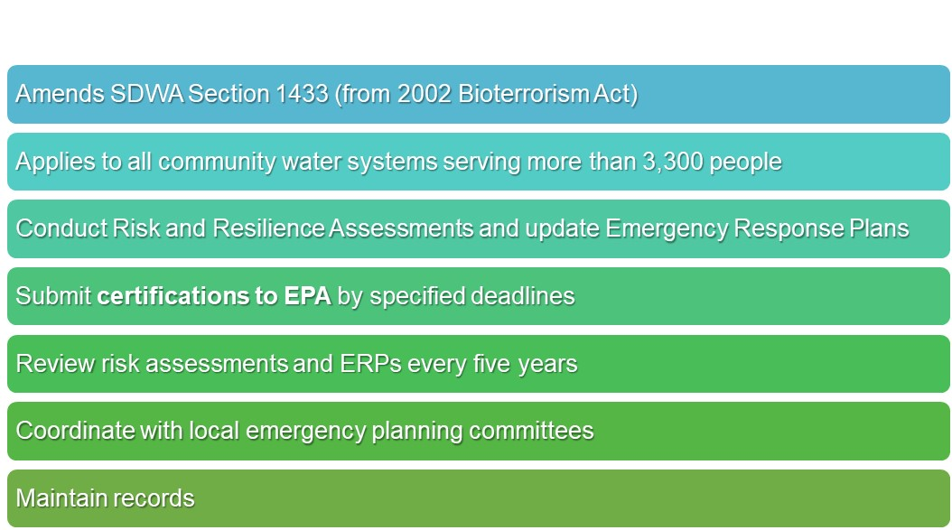
America’s Water Infrastructure Act Section 2013
119
Notes:
So just to provide an overview or big picture look at Section 2013:
It amends SDWA Section 1433 (from 2002 Bioterrorism Act)
It applies to all community water systems serving more than 3,300 people similar to the BTA
It requires that these systems conduct Risk and Resilience Assessments and update Emergency Response Plans (ERPs)
After which they must submit certifications to EPA by specified deadlines
And must continue to review risk assessments and ERPs every five years to determine if it should be revised. Upon completion of such a review, the system must submit to the EPA a certification that it has reviewed its assessment and revised it, if applicable.
Also to coordinate with the local emergency planning committees, to the extent possible, when developing the RA and ERP to gather more detailed information on regional threats and identify community-wide resources that can be included in the utility response plan, and
Finally to maintain records-risk assessment and ERP for 5 years after the due date for certification.

Slide 120
AWIA Certification Deadlines
Risk and Resilience Assessment (RRA)
  Population
  served
  ≥100,000
  Population
  served
  50,000-99,999
  Population
  served
  3,301-49,999
March 31,
2020
December 31,
2020
June 30,
2021
Emergency Response Plan (ERP)
Certify ERP no later than 6 months after certification of the RRA.
Notes:
Here are the certification deadlines for your risk and resilience assessment based on the population served by your utility.
For utilities serving a population of greater than or equal to 100,000, you must certify your risk assessment no later than March 31, 2020.
For utilities serving a population of 50,000 to 99,999, you must certify your risk assessment no later than December 31, 2020.
For utilities serving a population of 3,301 to 49,999, you must certify your risk assessment no later than June 30, 2021.
Then, no later than 6 months after certification of the RRA, CWSs must certify that they have created or updated their ERPs.

Slide 121
Module 3 Quiz 1
  My utility updated its ERP in 2017. Does this count for AWIA and can I certify my ERP is complete today?
121
Notes:
My utility updated its ERP in 2017. Does this count for AWIA and can I certify my ERP is complete today?
Yes
No
Maybe
Well it’s a good thing that you took the initiative to update your ERP, but you need to go back and make sure that it now covers all the criteria specified in AWIA. Their ERP was updated prior to AWIA so they just need to make sure that it now covers the requirements set forth in AWIA Section 2013.

Slide 122
AWIA ERP Criteria
Prepare or revise an ERP that incorporates findings from the risk assessment and include:
  Strategies and resources to improve resilience, including physical security and cybersecurity (Resilience Strategies);
  Plans, procedures and equipment for responding to a malevolent act or natural hazard (Emergency Plans & Procedures);
  Actions, procedures and equipment to lessen the impact of a malevolent act or natural hazard, including alternative source water, relocation of intakes and flood protection barriers (Mitigation); and
  Strategies to detect malevolent acts or natural hazards (Detection Strategies).
Notes:
So as for AWIA, it requires ERPs to incorporate several criteria including:
Strategies and resources to improve system resilience (Resilience Strategies)
Plans, procedures and equipment to use in the event of a malevolent act or natural hazard emergency that threatens the utilities ability to provide safe drinking water (Emergency Plans & Procedures)
Actions and procedures that can be used to reduce the impacts of malevolent acts or natural hazards (Mitigation)
and finally, strategies in place to detect malevolent acts or oncoming natural hazards that threaten the system (Detection Strategies)
You will see shortly how our new guidance is structured around these 4 criteria.
Just note that “malevolent acts and natural hazards” will hereafter be referred to as simply incidents.

Slide 123
Module 3 Poll 1
  Is your utility currently coordinating, or has it ever coordinated, with your Local Emergency Planning Committee (LEPC)?
123
Notes:
Poll Title: Poll 1: Is your utility currently coordinating, or has your utility ever coordinated in the past, with your Local Emergency Planning Committee (LEPC)?
A. Yes
B. No
C. I don’t know.
D. N/A
There is really no right answer here except to encourage them to reach out to their LEPC’s and there is a link in our ERP guidance on where they can find out more info about LEPC’s.

Slide 124
ERP Guidance TEMPLATE AND INSTRUCTIONS
124
Notes:
What I would like to do now is provide you with an overview of our new ERP guidance which includes a template and corresponding instructions for using the template.
As you will see, it is structured after the criteria specified in AWIA that all ERP’s must include.

Slide 125
ERP Guidance - Features
The ERP template and instructions assist water utilities with developing an ERP in accordance with AWIA Section 2013(b).
A single PDF document provides guidance on what information should be provided in each section of the ERP template.
  Includes useful links for additional information and guidance.
A blank ERP template in Word format is embedded in the PDF document and can be easily accessed and modified to meet your own utility’s needs.
The user-friendly template features fillable tables, checklists and charts to use as a starting point for utilities to develop their own plans.
125
Notes:
So as for features of the guidance:
It is formatted as a single PDF document that provides instructions on what information should be provided in each section of the ERP template.
It also includes useful links for additional information and guidance
The blank ERP template is in Microsoft Word format, which is embedded in the PDF document and can be easily accessed and modified to meet your own utility’s needs.
The template is very user-friendly and features fillable tables, checklists and charts to use as a starting point for utilities to develop their own plans.
Just note that although this template was designed for DW utilities, we are in the process of developing a similar one for WW utilities that will be completed later this year.
I will also show provide some examples today for what additional information can be included in an ERP for WW utilities.

Slide 126
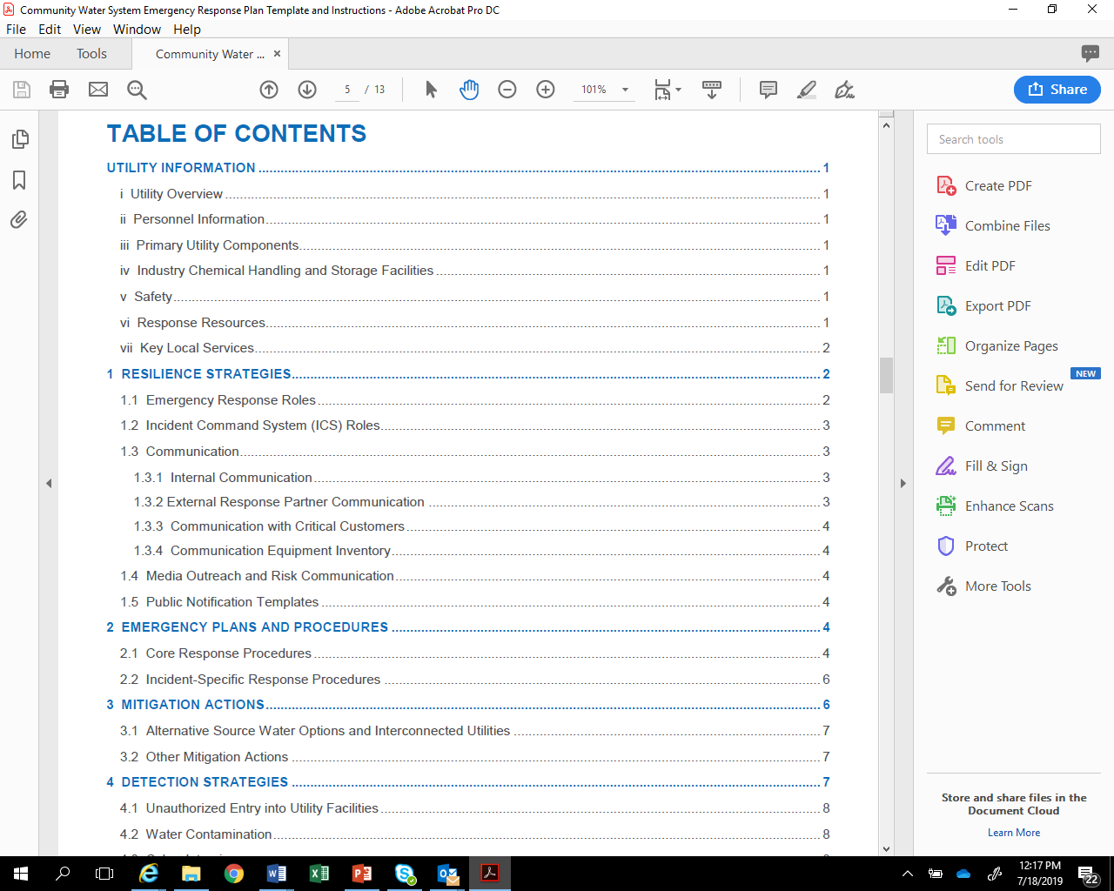
ERP Template Outline
Utility Information
Resilience Strategies
Emergency Plans and Procedures
Mitigation Actions
Detection Strategies
126
Notes:
This next slide shows the overall outline for the guidance and, as I mentioned, it is structured around the ERP criteria identified in AWIA.
This includes:
Utility Information
Resilience Strategies
Emergency Plans and Procedures
Mitigation Actions, and
Detection Strategies
I will provide more information on each of these sections in the next few slides.

Slide 127
Utility Information
During an incident, you need to have system information about your water utility readily available for your personnel, first responders, repair contractors/vendors, the media and other response partner agencies, including:
    Utility Overview
    Personnel Information
    Primary Utility Components
    Industry Chemical Handling & Storage Facilities
    Safety
    Response Resources
    Key Local Services
127
Notes:
The Utility Information section contains system related information about your water utility that is readily available for your personnel, first responders, and other response partner agencies during an incident.
This includes a:
Utility Overview: Provide basic information about your utility in the table in this section. The information required here should be readily available.
Personnel Information: Have a personnel roster available during an incident to quickly contact your employees.
Primary Utility Components: List, as appropriate, all the components necessary to maintain effective operation of your utility. This includes information on wells, intakes, treatment plants, storage/distribution systems (e.g., tanks, primary mains, pumping stations), and treatment chemical storage, as appropriate.
Industry Chemical Handling & Storage Facilities: Industry surrounding your utility can also be impacted by incidents such as accidental releases, hurricanes or earthquakes. It is important that you understand what chemicals may be released in your area during an incident and how they may impact your utility operations.
Safety: Having easy access to safety materials and important safety information and procedures will help protect utility personnel during an incident.
Response Resources: Having an accurate inventory of available resources (e.g., equipment, supplies) either maintained onsite or readily available offsite (e.g., neighboring water system) allows utility responders to know what resources are immediately available during an incident.
Key Local Services: Note the closest locations of key logistical and medical services that you or mutual aid and assistance providers may need during an incident.

Slide 128
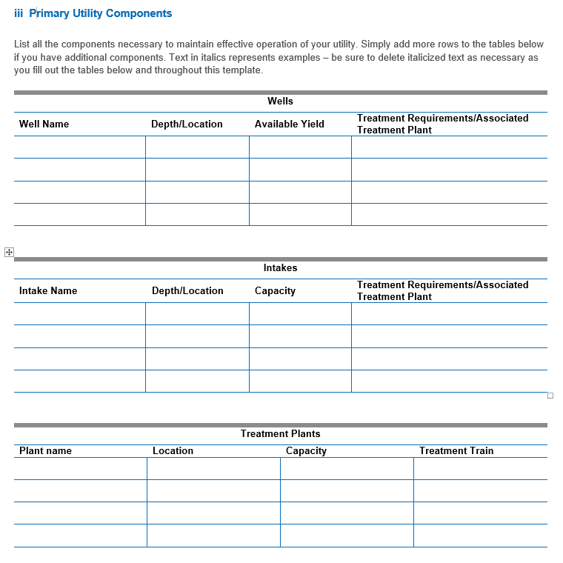
Utility Information - Template Example (1)
128
Notes:
This next slide provides an example of the fillable tables in the template for the primary utility components section.
It includes tables to enter key information for wells, intakes, treatment plants, storage and distribution system (e.g., Tanks, Primary Mains and Pumping Stations), treatment chemical storage facilities and other components as appropriate for your utility.
As you can see, the tables are very easy to fill out.
Again, the template is in Word format so if your system doesn’t have wells you can simply delete this section.

Slide 129
Resilience Strategies
This section of your ERP should contain strategies and resources to improve the resilience of your system, including:
    Emergency Response Roles
    Incident Command System (ICS) Roles
    Communication (e.g., internal, external, critical customers, equipment)
    Media Outreach & Risk Communication
    Public Notification
Resilience strategies incorporate how you will assign roles and responsibilities, how you will work with response partners and how you intend to communicate during an incident.
129
Notes:
The next section of your ERP, Resilience Strategies, should contain strategies and resources to improve the resilience of your system.
Overall, resilience strategies incorporate how you will assign roles and responsibilities, how you will work with response partners, and how you intend to communicate during an incident.
Emergency Response Roles: An effective ERP involves active participation of a variety of both utility and external response partner agency personnel, each having well-defined roles and responsibilities.
ICS Roles: Your utility should consider integrating a standardized incident management structure, such as the ICS, into your response procedures.
Communication: Communication during an incident is critical to relay information to employees, government agencies, the public, the media, and others about potential risks to health, infrastructure, and the environment.
Media Outreach: List contact information in the table provided for all media outlets that your utility may coordinate with during notification efforts. This may include newspapers, social media sites, television, and radio stations, etc.
Risk Communication: RC is a tool that helps water utilities deal with public messaging during emergencies to enhance knowledge and understanding of an incident, build trust and credibility, encourage constructive dialogue, and provide guidance on appropriate protective actions.
Public Notification: insert your templates for PNs in this portion of the ERP template, or reference where they may be found. Be sure that your templates are consistent with the regulatory requirements for public notification.

Slide 130
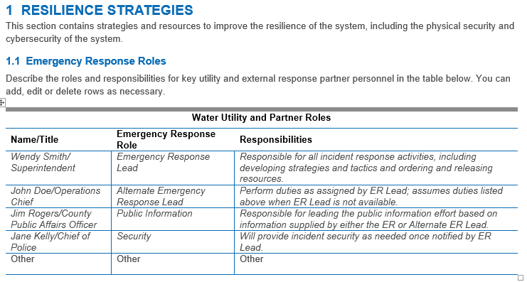
Resilience Strategies - Template Example (1)
130
Notes:
This next slide provides an example of the fillable tables in the template for Resilience Strategies, particularly for ER roles.
Here you can list the name and title of the utility or response partner personnel along with their specific role and a description of their responsibilities.
Italicized text in the table represents examples you may use as a starting point.

Slide 131
Emergency Plans & Procedures
This section of your ERP should contain plans, procedures and equipment that can be used in the event of a malevolent act or natural hazard that threatens your utility’s ability to deliver safe drinking water.
Two types of emergency response plans and procedures should be considered as part of your ERP:
    Core Response Procedures
    Incident-Specific Response Procedures (ISRPs)
131
Notes:
The next section of your ERP pertains to Emergency Plans and Procedures.
It should contain any plans, procedures, and equipment that can be used during an incident.
There are 2 types of Emergency Plans and Procedures: Core Response Procedures and Incident-Specific Response Procedures (ISRPs), which we will discuss in the next few slides.

Slide 132

Core Response Procedures
Core procedures are the “building blocks” for incident-specific procedures, since they apply across a broad variety of incidents (e.g., hurricane, earthquake, flood).
Core procedures include:
    Access
    Physical Security
    Cybersecurity
    Power Loss
    Emergency Alternate Drinking Water Supplies
    Sampling & Analysis
    Family and Utility Personnel Well Being
132
Notes:
Core procedures are the “building blocks” for incident-specific procedures since they apply across a broad variety of incidents (e.g., hurricane, earthquake, flood).
These include:
Access - A significant challenge your utility may face after a major incident is gaining access to critical facilities and other locations to assess damage and implement repairs.
Physical Security - Protecting utility facilities, equipment, and vital records is essential to restoring operations once an incident has occurred.
Cybersecurity – Your utility should consider adopting cybersecurity best practices to reduce vulnerabilities to cyber-attacks and develop, implement, and drill response and recovery procedures for cyber incidents to minimize impacts in the event of a successful attack.
Power Loss - Your utility should consider preparing for a loss of power and know what to do to respond and recover from such an incident
Emergency Drinking Water Supplies - Your ERP should consider clearly defining how your utility, along with other external response partners such as emergency management, would supply alternate drinking water to your community during both short-term (hours to days) and long-term (weeks to months) outages.
Sampling and Analysis- include pre-identified sampling sites, procedures for sample collection of both known and unknown contaminants, chain of custody, sample preservation, sample transport, as well as a list and locations of contract analytical laboratories.
Family-Your personnel are more likely to report for duty or stay on the job during an incident if they know they and their families are safe and cared for. Identify actions that could be taken before, during, and after an incident that are unique to each hazard (e.g., hurricanes, floods, earthquakes).

Slide 133
Incident Specific Response Procedures (ISRPs)
Cyberattack | Hurricane
Drought | Tornado
Earthquake | Tsunami
Extreme Cold/Winter Storms | Volcanic Activity
Extreme Heat | Wildfire
Flooding | Source Water Contamination
Harmful Algal Blooms | Distribution System Contamination
ISRPs are specialized procedures tailored to a particular type of incident and typically align with those vulnerabilities identified in your risk assessment.
They provide a quick approach for responding to a specific incident and complement actions already initiated under your ERP.
133
Notes:
An Incident Specific Response Procedure (ISRP) should be an accessible (i.e., “rip and run”) document that can be detached and taken to the field.
You may only need one or two pages to cover specific response information in these procedures since you have already addressed basic emergency response steps under your core response procedures.
EPA has developed a type of ISRPs (called Incident Action Checklists) for 12 different types of incidents listed in the table. Your system can use these or use them as a guide to create your own ISRP for areas where you are at risk.

Slide 134

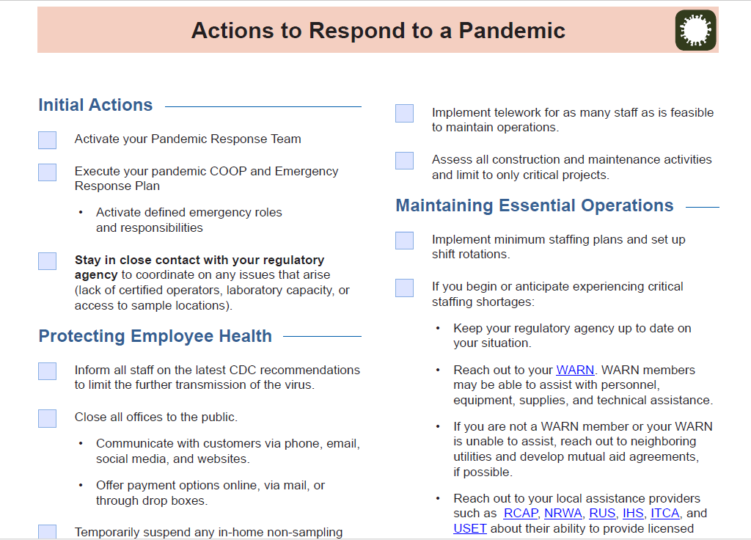
ISRPs-Template Example
https://www.epa.gov/waterutilityresponse/incident-action-checklists-water-utilities
134
Notes:
This next slide provides an example of an IAC for a Pandemic ISRP. Brand new.
Just note that this is not from the actual template but can be found at the EPA website listed at the bottom of the slide.
There are IAC for all incident-types listed in the table on the previous slide.

Slide 135
Mitigation Actions
This section of your ERP should include actions, procedures and equipment which can obviate or significantly lessen the impact of a malevolent act or natural hazard on the public health and the safety and supply of drinking water provided to your community and individuals, including:
    Development of alternative source water options.
    Relocation of water intakes.
    Construction of flood protection barriers.
These mitigation actions, procedures and equipment help your utility to better withstand and rapidly recover from incidents (e.g., flooding, earthquake), thereby increasing overall resilience.
135
Notes:
The next section of your ERP pertains to mitigation actions, or more specifically as AWIA states: actions, procedures, and equipment which can obviate and significantly lessen the impact of an incident on the public health and the safety and supply of drinking water provided to your community.
This includes:
Development of alternative source water options
Relocation of water intakes
Construction of flood protection barriers
Since these three mitigation options are specifically included in the law, you should indicate in your utility’s ERP that you considered these three specific mitigation actions, but the actions do not have to be implemented if they are not consistent with your utility’s risk profile, as defined by your risk assessment.
Remember, it is more cost-effective to mitigate the risks from natural disasters than it is to repair damage after the disaster. Examples of mitigation projects include:
Elevation of electrical panels at a lift station to prevent flooding damage
Replacement of piping with flexible joints to prevent earthquake damage
Reinforcement of water towers to prevent tornado damage
Overall, mitigation measures require financial investment by the utility; however, mitigation could prevent more costly future damage and improve the reliability of service during a disaster.

Slide 136
Mitigation Resources
Hazard Mitigation Guide: Helps utilities to coordinate with community's local mitigation planners, identify potential disaster-specific mitigation projects and fund proposed mitigation projects.
Flood Resilience Guide: Helps utilities know the local flooding threat and identifies practical mitigation options to protect critical assets. Provides worksheets, instructional videos and flood maps to help utilities through a simple 4-step process.
Drought Response and Recovery Guide: Provides worksheets, best practices, videos and key resources for responding to drought emergencies and building long-term resilience. It relays lessons learned from seven small- to medium-sized utilities nationwide that have responded to extreme drought conditions.
Earthquake Resilience Guide: Helps utilities to be more resilient to earthquakes. It contains best practices from utilities that have used mitigation measures to address the earthquake threat.
https://www.epa.gov/waterutilityresponse
136
Notes:
This next slide shows several mitigation related resources/tools that EPA has developed that utilities can use to address mitigation options for hazards they may be at risk to again as identified in your RA. This includes:
Hazard Mitigation Guide: which helps utilities to identify potential disaster-specific mitigation projects and funding proposed mitigation projects.
Flood Resilience Guide: which helps utilities understand the local flooding threat and identifies practical mitigation options to protect critical assets against flooding.
Drought Response and Recovery Guide: which provides key resources for responding to drought emergencies and building long-term resilience.
Earthquake Resilience Guide: which helps utilities to be more resilient to earthquakes.
The EPA website where you can go to find and download these products can be found at the bottom of the slide.

Slide 137
Mitigation Resources - continued
Power Resilience Guide: Helps utilities identify how to increase their resilience to power outages.
https://www.epa.gov/communitywaterresilience
Resilient Strategies Guide: Helps utilities understand how extreme weather events can impact utility operations and missions and provides examples of different actions utilities can take to prepare for potential impacts.
https://www.epa.gov/crwu/resilient-strategies-guide-water-utilities#/
137
Notes:
This next slide provides a few more EPA mitigation resources including:
Power Resilience Guide: which helps utilities identify how to increase their resilience to power outages.
And Resilient Strategies Guide: which helps utilities understand how extreme weather events can impact utility operations and provides examples of different actions utilities can take to prepare for potential impacts.
All of these products are extremely user friendly and meant specifically to be used by utility personnel.

Slide 138
Detection Strategies
This section of your ERP should contain strategies that can aid in the detection of malevolent acts or natural hazards that threaten the security or resilience of your utility.
These detection strategies can be almost no-cost (e.g., instituting a “See Something, Say Something” campaign at your utility) or require more resources (e.g., installing motion sensors and video cameras to monitor for facility break-ins or tampering) to implement.
Effective response to an emergency requires timely detection, which allows your utility to implement its ERP as soon as possible.
138
Notes:
The last section of your ERP, that is required by AWIA, pertains to Detection Strategies that can aid in the detection of incidents that threaten your utility.
They can range from no-cost strategies (like instituting a “See Something, Say Something” campaign at your utility) or ones requiring more resources to implement (like installing motion sensors and video cameras to monitor for facility break-ins or tampering).
Keep in mind that effective response to an emergency requires timely detection, which allows your utility to implement its ERP as soon as possible.

Slide 139
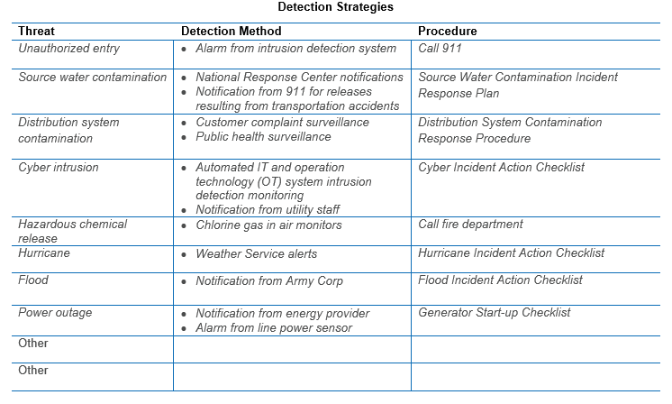
Detection Strategies - continued
Examples of effective strategies for detecting common threats include:
  Unauthorized Entry
  Water Contamination
  Cyber Intrusion
  Hazardous Chemical Release
  Natural Hazards
  Power Outages
139
Notes:
This next slide again comes from the EPA ERP template and shows some examples of effective strategies for detecting common threats including:
Unauthorized Entry: properly installed & maintained intrusion detection systems provide almost instantaneous notification of break-ins and other unauthorized access into your utility facilities, but notifications from local law enforcement officers and community watch groups are also effective.
Water Contamination: notification of source water contamination may come from many different agencies and organizations including your primacy agency, 911, LEPC, etc. Potential contamination in your distribution system can be detected through tracking of CC, PHS, PSM at access points to finished water, grab S&A, OWQM, and AMI that can alert your utility of potential backflow events or meter tampering.
Cyber Intrusion: learning about and reporting cyber threats helps all utilities be better prepared to detect and respond to this kind of malevolent act.
Hazardous Chemical Release: routine inspection of your hazardous chemical storage facilities will aid in detecting problems that could lead to an unexpected chemical release.
Natural Hazards: such as extreme weather can cause severe damage to your utility. Real-time tools such as EPA’s online On-The-Go Mobile Application can help you track severe weather and access other information for an efficient response.
Power Outages: your utility can detect impending power outages more effectively by signing up to receive notifications from your power provider for any planned maintenance activities or brown outs.

Slide 140
Discussion Question
  Small Town Utility has an extremely limited budget and minimal staff. The utility does record customer complaints in a logbook to be sure that they are followed-up with by staff. They also have a local police force that responds to 911 calls and patrols the community on a regular basis. How could Small Town Utility leverage their complaint log and the local police force into detection strategies?
140
Notes:
Discussion: The complaint log is an under-utilized resource. For example, Small Town Utility could use a map with pushpins to start tracking the locations of complaints and potentially identify clusters of complaints in certain parts of town that may be indicative of a larger infrastructure problem. Additionally, if complaints were classified by categories such as taste & odor or visual appearance, that could serve as an early warning for other problems that may be developing within the system or for a previously unknown contamination event. This could be very helpful for Small Town Utility, especially if the utility phone is answered by “whoever hears it first” which makes it hard for a single staff person to spot patterns.
Additionally, Small Town Utility could give their local police force a tour of their facilities around town and ask the patrol officers to specifically pay attention to the facilities while out on their patrols. An additional set of eyes would help Small Town Utility to detect things like vandalism or breaches sooner and may even prevent these kinds of incidents from happening once word got around town that the police regularly patrol the facilities in addition to the visits made by Small Town Utility staff.

Slide 141
Module 3 Quiz 2
  According to AWIA, which of the following needs to be included in your ERP?
141
Notes:
According to AWIA, which of the following needs to be included in your ERP?
Resilience Strategies
Emergency Plans and Procedures
Mitigation Actions
Detection Strategies
All of the above
E. All of the above needed to be included in your ERP!

Slide 142
ERP guidance Template demonstration and discussion
142
Notes:
OPTIONAL ACTIVITY. Trainers may lead an interactive ERP Guidance Template Demonstration and Discussion if they feel comfortable with the ERP template and would like to do so. Please see the Fall 2020 AWIA Workshop Module 3 recording on our website, https://www.epa.gov/waterresilience/americas-water-infrastructure-act-risk-assessments-and-emergency-response-plans#TNG, for an example of how Bria Crawford leads such a demonstration during EPA’s trainings.
Now that we’ve gone through the ERP Guidance Template and Instructions, we will have a group discussion based on the fictious water utility Spring View Water District used during the Module 2 breakout sessions. The goal of this session is to use what you learned from developing your Risk and Resilience Assessment to now develop an Emergency Response Plan.

Slide 143
Example Scenario: Utility Overview
Utility Name: Spring View Water District
Size and Location: Small utility located outside of Atlanta, GA that serves 35,000 people
Critical assets:
  8 pumping stations
  Supervisory control and data acquisition (SCADA) system
  Water treatment plant
  IT business and financial systems
Notes:
OPTIONAL ACTIVITY. Trainers may lead an interactive ERP Guidance Template Demonstration and Discussion if they feel comfortable with the ERP template and would like to do so. Please see the Fall 2020 AWIA Workshop Module 3 recording on our website, https://www.epa.gov/waterresilience/americas-water-infrastructure-act-risk-assessments-and-emergency-response-plans#TNG, for an example of how Bria Crawford leads such a demonstration during EPA’s trainings.
Those of you who attended module 2 will be familiar with our fictional water utility, Spring View Water District. For anyone new joining for us today, Spring View Water District is a small utility located outside of Los Atlanta, GA that serves 35,000 people. Here are the critical assets that Spring View Water District considered when developing their risk and resilience assessment that will also be relevant as they develop their ERP:
8 pumping stations
Supervisory control and data acquisition (SCADA) system
Water treatment plant
IT business and financial systems
*Definition: Supervisory control and data acquisition (SCADA): control system architecture comprising computers, networked data communications and graphical user interfaces for high-level process supervisory management

Slide 144
Perform Risk and Resilience Assessment 0
Hypothetical Threat: Flooding
Spring View Water District is located near the Winding River, and draws its source water from the river
The District is concerned about a 100-year flooding event
Electrical components of the utility’s online water quality monitoring equipment (not elevated) could be damaged
This could disable continuous monitoring of the finished water leaving the treatment plant
Notes:
OPTIONAL ACTIVITY. Trainers may lead an interactive ERP Guidance Template Demonstration and Discussion if they feel comfortable with the ERP template and would like to do so. Please see the Fall 2020 AWIA Workshop Module 3 recording on our website, https://www.epa.gov/waterresilience/americas-water-infrastructure-act-risk-assessments-and-emergency-response-plans#TNG, for an example of how Bria Crawford leads such a demonstration during EPA’s trainings.
Our hypothetical threat is threat of a 100-year flood event. Spring View Water District is located next to the Winding River, where it draws its source water from. They are concerned that a 100-year flood could damage electrical components of their water quality monitoring equipment (which is currently on the ground and is not elevated). This could disrupt their monitoring of the finished water leaving their facility.

Slide 145
ERP Template
https://www.epa.gov/waterutilityresponse/develop-or-update-emergency-response-plan
Notes:
OPTIONAL ACTIVITY. Trainers may lead an interactive ERP Guidance Template Demonstration and Discussion if they feel comfortable with the ERP template and would like to do so. Please see the Fall 2020 AWIA Workshop Module 3 recording on our website, https://www.epa.gov/waterresilience/americas-water-infrastructure-act-risk-assessments-and-emergency-response-plans#TNG, for an example of how Bria Crawford leads such a demonstration during EPA’s trainings.
Purpose: The purpose of this exercise is to show not only how to access and download the ERP template, but also show how user-friendly it is.
Tip: Make sure you have extracted and downloaded the template from the “ERP Template and Instructions (PDF) as a backup in case there are technical difficulties during the live demonstration of how to access and download the template.
Now we will go through the process of completing an Emergency Response Plan, from finding the guidance and downloading the template on our website to beginning the ERP template. This is meant to be a group discussion. As we walk through the template, I’ll ask for any thoughts or ideas pertaining to the template. Feel free to enter your responses in the chat area.
I will now go to our website to begin our journey. This ERP template will be used throughout the scenario:
Go to https://www.epa.gov/waterresilience
Click on “Develop emergency response plans” link under “Plan” section
Scroll to the bottom of web page and click “ERP Template and Instructions (PDF)” link
Download and save document onto computer.
Open “ERP Template and Instructions,” go to page 2 of 13
Go to page 2 of 13, click on box with Microsoft word logo saying “AWIA ERP Template”
Open file and show participants the template. Walk through the main sections of the ERP, asking the audience to help you fill out select sections of the ERP based on the hypothetical threat of a flood occuring at the fictitious water utility introduce in the last two slides, Spring View Water District. (Note: if there is a threat other than flooding that you are interested in, feel free to make up your own hypothetical malevolent act or natural hazard that could plague Spring View Water District (e.g. the affects of a cybersecurity incident, fire, pandemic, etc. on Spring View Water District).

Slide 146
Final Thoughts
146
Notes:
Here are some final thoughts on the ERP.

Slide 147

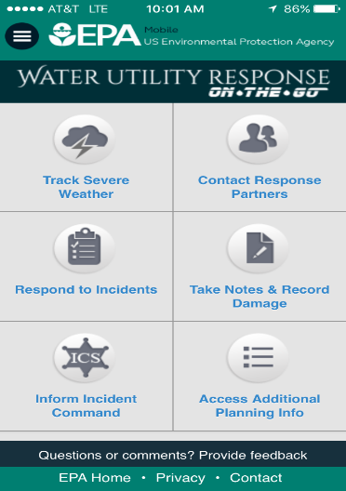
Documenting the Response
  As you respond to an incident, you should immediately begin documenting your decisions, actions and expenditures.
  This is important for justifying incident costs and potentially seeking reimbursement once the incident is resolved.
  Good incident documentation involves creating a paper trail for receipts, records, photographs and personnel timesheets.
Water Utility Response
On-The-Go!
A Mobile App for a Mobile Response
www.epa.gov/waterutilityresponse/water-utility-response-go-mobile-application-and-website
Notes:
OK, now for some final thoughts on ERP’s:
As you respond to an incident, you should make sure to document all your decisions, actions and expenditures.
This is important for justifying incident costs and potentially seeking reimbursement once the incident is resolved.
Good incident documentation involves creating a paper trail for receipts, records, photographs and personnel timesheets
This app-Water Utility on the go can help with that- (USE PHONE to Describe)

Slide 148
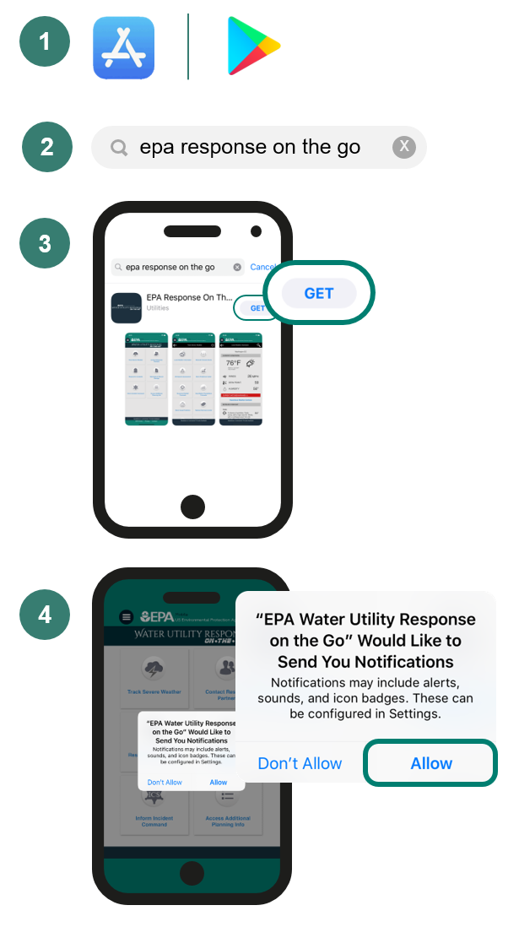
Get started by downloading the FREE Response On-The-Go App:
Navigate to the App Store or Google Play Store on your mobile device.
Search “EPA Response On-The-Go.”
Tap Install/Get; once installation is complete, open the app to begin.
Tap “Allow Notifications” when prompted. The App will now automatically notify you if severe weather is forecast for your area.
Notes:
Response OTG has been downloaded hundreds of times and EPA looks forward to continually updating and improving it so that it can serve as effective response tool for utilities.

Slide 149
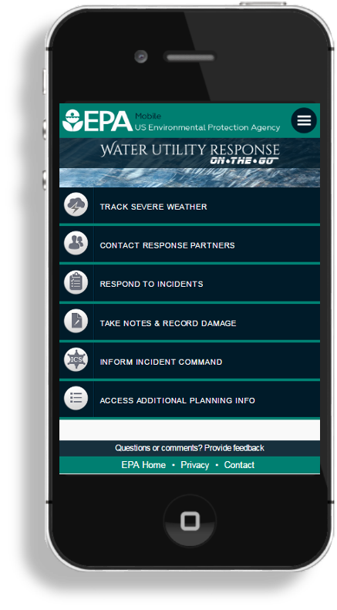
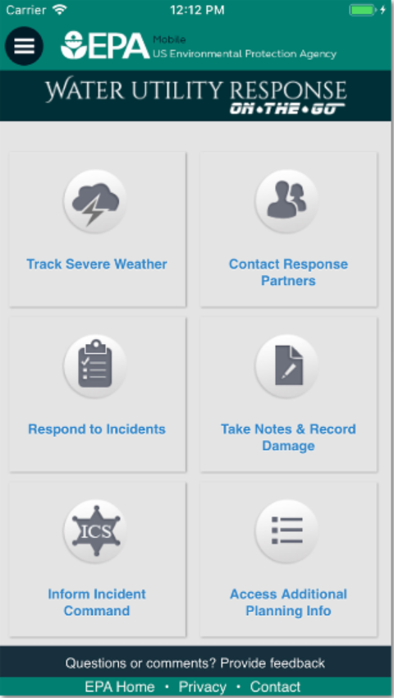
Water Utility Response On-
The-Go!
Track Severe Weather
Contact Response Partners
Respond to Incidents
Track Notes & Record Damage
Inform Incident Command
Access Additional Planning Info
Notes:
During an emergency, responders need quick access to information that will increase their situational awareness and to help them make decisions. One way Response OTG helps users do that is though it’s ability to TRACK SEVERE WEATHER
User can also CONTACT RESPONSE PARTNERS
Pull up critical emergency response partner contact information and quickly notify others during an incident.
Use ‘Respond to Incidents’ to track your response-related activities.
Users can TAKE NOTES & RECORD DAMAGE from the field
Users can access ICS information, checklists, and the Planning P from FEMA
Last feature includes additional resources from EPA

Slide 150
Final Thoughts - continued
Training:
  Once your ERP is complete, consider training your utility personnel and response partners on its contents and their individual roles and responsibilities.
  Conducting periodic trainings (e.g., seminars, workshops, tabletops, functionals) for both senior and new personnel helps ensure that your ERP procedures will be effectively implemented during actual response.
Training Tools:
  How to Develop a Multi-Year Training & Exercise (T&E) Plan: A Tool for the Water Sector
  Tabletop Exercise Tool
  Exercise Development Toolbox
  https://www.epa.gov/waterresiliencetraining
Notes:
Training: Once your ERP is complete, it is important that you train your utility personnel and response partners on its contents and their individual roles and responsibilities
Conducting periodic trainings including seminars, workshops, tabletops, functionals) helps to ensure that your ERP procedures will be effectively implemented during an actual response
Go thru resources on slide

Slide 151
Questions? 3
151
Notes:
Questions?.
Can a wastewater system use the EPA ERP guidance?
The ERP guidance is specifically designed for drinking water systems. EPA is currently in the process of developing a template for WW systems as well so stayed tuned for that guidance.
Who is qualified to certify a risk assessment or emergency response plan?
Each CWS determines who the certifying official will be for the risk and resilience assessment and emergency response plan. There are no specific requirements for the utility certifying official, however, the official must be a utility employee.
Will the repeated (every 5 years) due dates for updated RRAs and ERPs be based on 5 years from the previous submittal date/certification to EPA (which will vary for all systems), or be based on 5 years from the initial due dates cited in the Act (i.e. all first round RRA renewals will be due March 31, 2025)?
The 5-year date will be based on the deadlines established in the law for tracking purposes. For tracking and compliance purposes, compliance deadlines will be set based on the hard risk assessment submittals dates in the law. For example, CWSs 100K+ risk assessment date 3-31-20; ERP date 9-30-20. Next compliance deadlines are 5 years after (3-31-2025; 9-30-2025), no matter the date when the RA or ERP cert was submitted.
I have multiple PWSIDs. Can my risk assessment cover multiple systems? What about my certification?
How you do your risk assessment and ERP is up to you. If you want to do one risk assessment for multiple PWSIDs, that works or if you want to do them separate that works too. When you certify you must certify each PWSID individually in order to comply.
Is there funding available for conducting the risk and resilience assessment (R&RA) to meet the AWIA Section 2013 requirements?
Currently, there is not one stream of funding that is designated specifically to address the new risk assessment requirement. However, conducting a risk assessment is considered an eligible project under the EPA’s Drinking Water State Revolving Fund (DWSRF). The risk assessment may yield a project that the utility may want to invest in to improve the overall system resilience. Each state develops a list of priority projects for funding under the DWSRF, so please check with your state to see if they have set aside funds for this function specifically.

Slide 152
Thank you!
For more information or any questions about the material presented, please contact EPA at dwresilience@epa.gov.
EPA AWIA Information:
https://www.epa.gov/waterresilience/americas-water-infrastructure-act-risk-assessments-and-emergency-response-plans
152
Notes:
Thank you all for attending Module 3 of the AWIA Workshops! As a reminder in a few days, you will receive the slides, recording, and CEU quiz/evaluation via email early next week. To be eligible for CEUs you must fill out the CEU quiz/evaluation.
Thank you all again! This concludes our webinar.

