Slide 1
How to revise this presentation
This slideshow serves as a resource for members of scientific and technical assistance groups when collaborating and communicating fundamental aspects of numeric nutrient criteria development. Slides that allow for project-specific edits are marked with red text and a red box with instructions on how the slide is intended to be edited. To make edits, follow the instructions on the slide, then delete the red text and red box.

Slide 2

Overview of Numeric Nutrient Criteria Development
U.S. Environmental Protection Agency
Office of Water, Office of Science & Technology
Adapted by [Group] on [Date]
Other logo(s)

Slide 3
Disclaimers
This presentation does not:
Impose any binding requirements
Determine the obligations of the regulated community
Change or substitute for any statutory provision or regulation requirement
Represent, change, or substitute for any Agency policy or guidance
Control in any case of conflict between this discussion and statute, regulation, policy, or guidance
Notes:
Disclaimer: this presentation is for educational purposes only and does not substitute for statutes, regulations, policy, or guidance.
Materials are intended as a high-level overview. For more detailed review of concepts, see links to additional EPA resources.

Slide 4
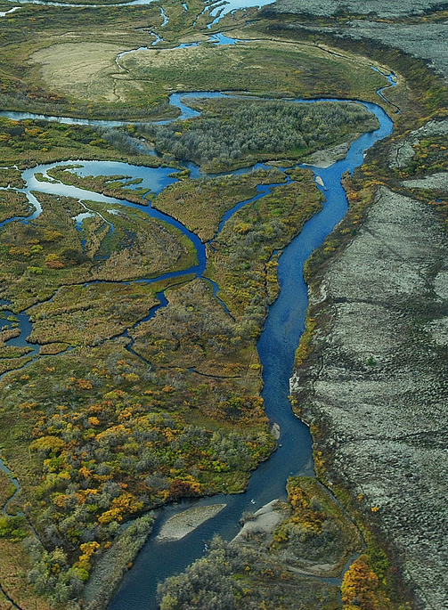

Outline
Introduction
Regulatory Process
Water Quality Standards
Nutrient Criteria 101
Other Key Concepts
Next Steps
Icons link to modules

Slide 5
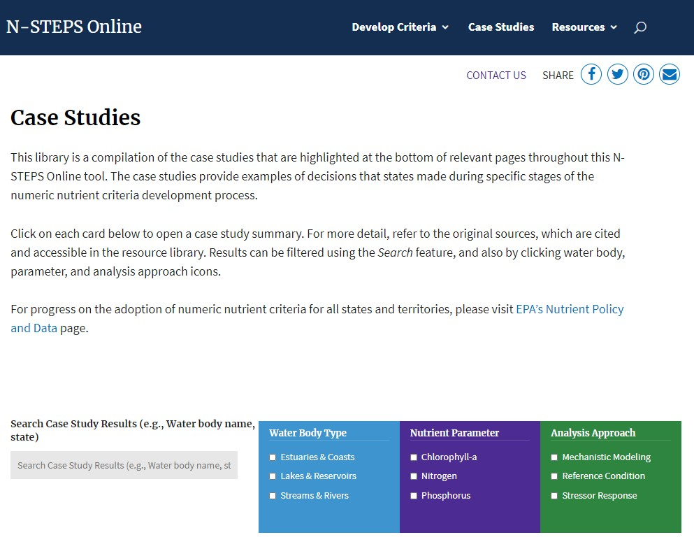
Expert Input
EDITABLE: Customize red text, then change to black and delete this box
Nutrient criteria development benefits from expert input
  E.g., Technical Assistance Groups, Scientific Advisory Committees, roundtables
In [state], these groups are called [name]
  Led by [agency] and authorized by [regulation]
Nutrient Criteria Case Studies
Notes:
States, territories, and authorized tribes frequently call on experts to help guide the candidate nutrient criteria derivation process. Advisory groups may be standing bodies or organized on an ad-hoc/as needed basis.
In this state/region, these groups are called… and have been around since... They are led by… and authorized by…
While regulatory agencies are ultimately responsible for establishing final criteria values and adopting them into law, experts can play an important role in establishing the scientific basis for criteria values. We greatly value your participation in this group!
If you’d like more information about other efforts like this one, see EPA’s case study library, filterable by type of water body, parameters, and analysis approach (linked - https://nsteps.epa.gov/case-studies/)

Slide 6
This Effort
EDITABLE: Customize red text, then change to black and delete this box
Name (e.g., Portland Area Nitrogen Criteria Advisory Group)
Scope of effort
Group charge (if applicable, e.g., this group is tasked with developing recommendations to policymakers, regulators, and funders on how to address nutrient impacts in Casco Bay)
What will be done with group’s output (if applicable)
Link to project webpage or website (if applicable)
Notes:
This group is charged with… and the output will be used to…
More information about these efforts is available at…

Slide 7
Members
EDITABLE: Customize red text, then change to black and delete this box
Member | Affiliation | Contact
Name | Organization | Email
Name | Organization | Email
Name | Organization | Email
Name | Organization | Email
Name | Organization | Email
Name | Organization | Email
Name* | Organization | Email
Name* | Organization | Email
*Support staff
Notes:
Group member names, affiliations, and contact information. Allow time for introductions if needed.

Slide 8
Anticipated Timeline
EDITABLE: Customize red text, then change to black and delete this box
January
Introductory meeting
February
Data processing and initial analysis
March
Presentation of analysis
Committee feedback & questions
April - May
Revised analysis & discussion
June - August
Draft report
Committee feedback & questions
September
Final report & recommendations
Notes:
This is the anticipated timeline for this group’s efforts…
We expect to ask for your participation in [estimated number of] meetings, and for review of draft and final reports.
Now, we’ll review some basics, including an overview of the regulatory process, water quality standards, and nutrient criteria.
Provide guidance on questions: please ask questions as we go –OR– hold questions until the end

Slide 9

Arriving at decisions
This group uses… describe process for making group decisions, e.g., consensus
To facilitate this process, we will:
  Describe tools used, e.g., “polls may be used to gauge reactions and to determine if more information is needed before making decisions”
If agreement cannot be reached… describe process for disagreement within group
EDITABLE: Customize red text, then change to black and delete this box
Notes:
Describe group decision-making process.
More information about consensus decision-making and facilitation: https://en.wikipedia.org/wiki/Consensus_decision-making

Slide 10

Regulatory Process
More information: The Basics of the Regulatory Process
Notes:
Before talking about standards, here’s a refresher on the regulatory process
For more information, see: https://www.epa.gov/laws-regulations/basics-regulatory-process

Slide 11
Roles
Who is responsible for what?
Congress passes laws or statutes
Federal agencies issue federal regulations along with guidance on how to implement them and may have oversight authority
States, territories, and authorized tribes propose and adopt their own regulations, which may be subject to federal review
  Experts lend expertise when needed
  Members of the public provide input during comment periods
Notes:
Experts like this group lend expertise to the states, territories, and authorized tribes responsible for adopting water quality standards.
Reminder – this is a basic overview. More information is available at: https://www.epa.gov/laws-regulations/basics-regulatory-process

Slide 12
Implementation
EPA and co-regulatory partners implement the Clean Water Act and adopt Water Quality Standards
Congressional Act or Statute
U.S. Code (U.S.C.)
Clean Water Act, 33 U.S.C. § 1251 et seq.
EPA Regulations
Code of Federal Regulations (CFR)
State, Territorial, or Tribal Law
Water Quality Standards
30 CFR 131
Notes:
EPA and its coregulatory partners implement the Clean Water Act
- EPA publishes recommended criteria; approves or disapproves state, territorial, and tribal Water Quality Standards; and may promulgate water quality standards in special circumstances.
- States, territories, and authorized tribes are responsible for adopting water quality standards, which become effective for CWA purposes after approval by EPA.

Slide 13
Clean Water Act
Objective: “restore and maintain the chemical, physical and biological integrity of the Nation’s waters”
Interim goal: “wherever attainable… water quality which provides for the protection and propagation of fish, shellfish and wildlife and provides for recreation in and on the water”
More information: Clean Water Act Module
Notes:
The Federal Water Pollution Control Act of 1948 was the first major U.S. law to address water pollution. Growing public awareness and concern for controlling water pollution led to sweeping amendments in 1972. As amended in 1972, the law became commonly known as the Clean Water Act (CWA).
The 1972 amendments:
Established the basic structure for regulating pollutant discharges into the waters of the United States.
Gave EPA the authority to implement pollution control programs.
Maintained existing requirements to set water quality standards for all contaminants in surface waters.
More information: https://www.epa.gov/watershedacademy/clean-water-act-module-part-1

Slide 14

Water Quality Standards
More information: Water Quality Standards Academy
Notes:
This is an overview of water quality standards, focusing on numeric nutrient criteria. For more comprehensive and detailed review, see EPA’s Water Quality Standards Academy (offers live training twice a year or self-paced online modules and resources: https://www.epa.gov/wqs-tech/water-quality-standards-academy)

Slide 15

Water Quality Standards
Water Quality Standards (WQS) are part of a connected toolbox of water quality regulatory programs
Water Quality Standards
303(d) Listing (“impaired waters”)
Restoration Planning (e.g., TMDL)
Permitting (e.g., NPDES)
Other Non-CWA Management Actions
Notes:
WQS provide a foundation that is used in other regulatory programs also established by the Clean Water Act
These include 303(d) assessment and listing (also known as impaired and threatened waters), restoration planning (e.g., Total Maximum Daily Load (TMDL) development), and permitting (e.g., National Pollutant Discharge Elimination System (NPDES)). WQS provide a starting point and foundation for the other work that regulatory partners do to control nutrients.
Other non-CWA management actions may be based on WQS, such as non-point source assessments, targeting for cleanup actions under Superfund, area-wide waste treatment plans, and others.
While some people commonly describe listed waters as “impaired,” the term is not used in Section 303(d) of the Clean Water Act, which simply refers to the requirement to list waters not meeting water quality standards.

Slide 16

Water Quality Standards (continued)
Water Quality Standards describe
the desired condition of a water body
the means by which that condition will be protected or achieved
Adopted by state, territory, or authorized tribe
Approved or disapproved (and sometimes promulgated) by EPA
Notes:
WQS are provisions of state, territorial, authorized tribal, or federal law approved by EPA that describe the desired condition of a water body and the means by which that condition will be protected or achieved.
WQS are the foundation of the water quality-based approach. They have the primary purpose of defining goals for surface waters and criteria to support those goals (see next slide). States, territories, and authorized tribes establish WQS to protect human health and aquatic life, among other things, in these waters. WQS form a legal basis for controlling pollutants entering the waters of the United States.

Slide 17
Components of Water Quality Standards
Designated Uses
Goals & expectations for water body use
Criteria
Narrative or numeric values
Anti-Degradation
Provisions that maintain existing uses
General
Policies
Policies that affect application of WQS
E.g., variances, mixing zone, and low-flow policies
Protect high quality waters and waters of exceptional recreational or ecological significance
E.g., source of drinking water; recreation; fish, shellfish, and wildlife
Protect the most sensitive designated use
Consider downstream water quality standards
Notes:
WQS consist of three core components. These include the designated uses of a water body (“goals”), criteria to protect those designated uses, and anti-degradation requirements to protect existing uses, high quality waters, and waters of exceptional significance.
States, territories, and authorized tribes also have the choice of including additional components in their water quality standards, including general policies like variances.
Factors not considered under one component of WQS may be considered under another component and at other stages in the regulatory process. For example, while economic impact and feasibility are not considered when setting criteria values, these factors may be considered when establishing and modifying waterbody designated use.

Slide 18
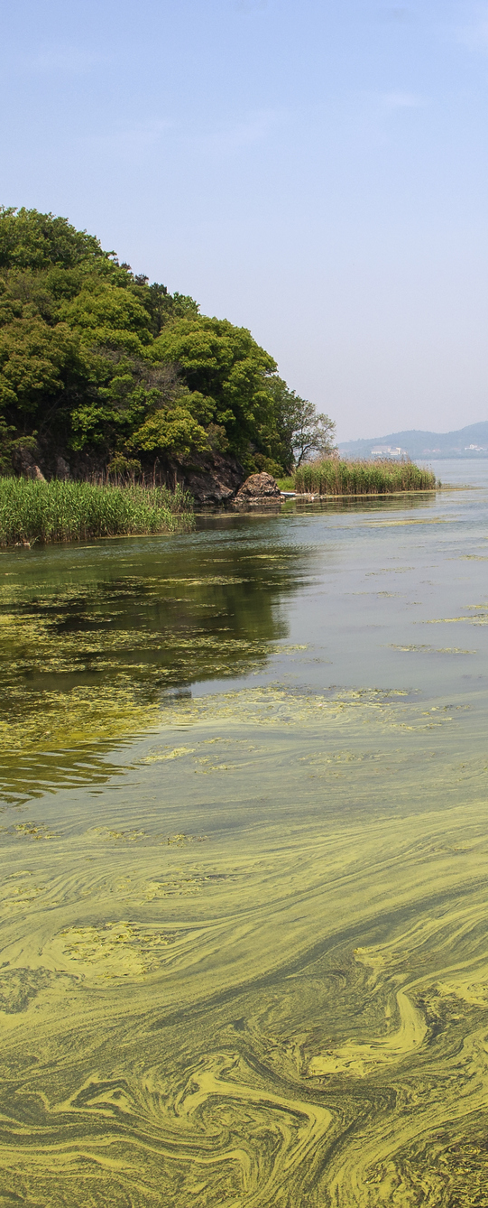
Nutrient Criteria 101
Criterion (sing.), Criteria (plural)
More information: Water Quality Criteria
Notes:
This module focuses on nutrient criteria. More information about water quality criteria in general is available in EPA’s Water Quality Standards Academy: https://www.epa.gov/wqs-tech/key-concepts-module-3-criteria

Slide 19
Types of Water Quality Criteria
Several types of criteria protect designated uses (examples below)
Typically, multiple types of criteria are applicable to a waterbody
Bacteria
(e.g.,
E. coli)
Chemical
Nutrient
Biological
Notes:
Criteria protecting ambient surface water quality can be divided up into different types. Typically, multiple types of criteria are applicable to a waterbody, depending on which uses are designated.
Examples of some common types of criteria are shown here, including criteria that…
Are based on what organisms are present or absent (biological criteria/biocriteria)
Account for how nutrients and sediments affect the designated uses of a waterbody (nutrient/sediment)
Establish allowable levels of other contaminants that may harm human and aquatic life, such as bacteria, metals, and pesticides

Slide 20
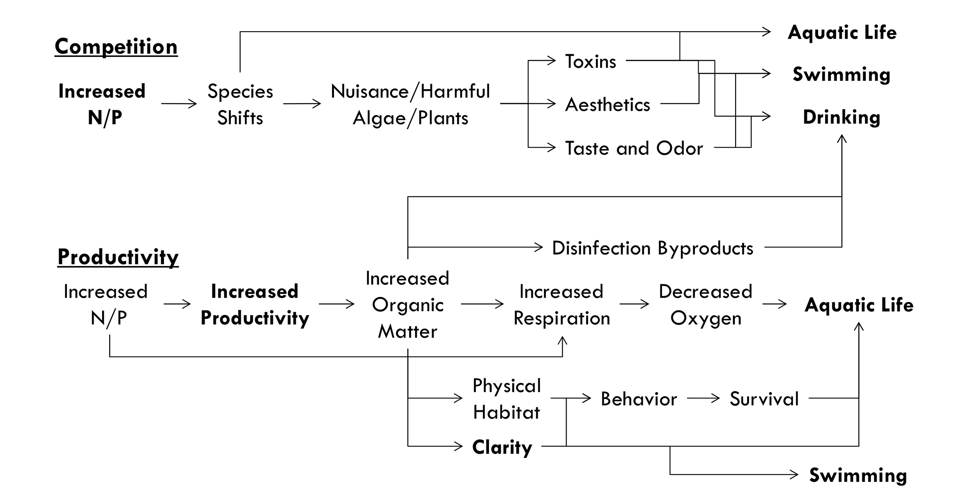
Nutrient Effects on Designated Uses
Nutrients affect waterbody function and use via many pathways
This conceptual model shows some examples
Notes:
This conceptual model shows some pathways through which nutrients can have effects on designated uses, requiring protection under the Clean Water Act.
Impacts on designated uses can occur via competition pathway, where increased N and P cause species shifts that can increase the prevalence of nuisance or harmful algae and plants, resulting in changes in aesthetics, taste, odor, or production of toxins.
Impacts can also take place via the productivity pathway, where increased nutrients increase productivity and organic matter, which can cause changes in water clarity, physical habitat, and dissolved oxygen levels.
Note: This example conceptual model is intended to illustrate some pathways by which nutrients impact designated uses, rather than a complete list of endpoints and pathways. Developing a conceptual model can help guide the criteria derivation process, which we will review next.

Slide 21

Nutrient Criteria
Nutrient Criteria identify levels (usually the concentration) of nutrients in surface waters that are protective of designated uses.
Scientific evidence supports the adoption of criteria for nitrogen (N) and phosphorus (P) in fresh and marine waters.
Notes:
Nutrient criteria limit amounts of nutrients (usually the concentration) in surface waters. Research supports the development of criteria for both nitrogen and phosphorus to prevent eutrophication.
Note: States and territories conduct many activities to control nutrient pollution including watershed prioritization, setting goals to reduce nutrient loads, and other work. However, this presentation focuses on addressing nutrient pollution using water quality standards and nutrient criteria.

Slide 22
Why Nitrogen and Phosphorus Criteria?
N and P together support plant and algal growth. For example,
Relative N and P concentrations can vary temporally and spatially within a waterbody; co-limitation is commonly observed
Controlling only P may not effectively prevent harmful algal blooms– some taxa thrive in waters with disproportionate N availability
N fixation is highly variable and does not fully offset N deficiency
Aquatic flora and fauna have different nutritional needs
Both N and P have a role in protecting downstream waters
Scientific Support for Dual Nutrient Criteria
Notes:
Traditionally, managers have focused on a single limiting nutrient. This approach is based on a paradigm that assumes primary production is N-limited in marine waters and P-limited in freshwaters.
However, evidence indicates this model is overly simplistic. N and P together support the growth of algae and aquatic plants.
EPA developed a fact sheet (linked) reviewing the evidence for dual N and P criteria for nutrients.
Some cyanobacteria tend to be more toxic (e.g., produce more microcystin, a liver toxin) in conditions where N is disproportionately available relative to P
More information about scientific support for dual nutrient criteria is available in an EPA factsheet: https://www.epa.gov/sites/default/files/documents/nandpfactsheet.pdf

Slide 23
Numeric Nutrient Criteria
Numeric values protect waters by supporting proactive and effective monitoring, planning, and permitting.
Numeric targets (“translators”) are also used to implement narrative criteria.
Numeric Criteria “Shall not exceed 0.45 mg/L total nitrogen as a seasonal (June-October) geometric mean” | Narrative Criteria “Plant nutrients shall not be present in concentrations which will produce undesirable aquatic life or a dominance of nuisance species”
More information: State Progress Towards Developing Numeric Criteria
Notes:
Establishing numeric criteria values protects waters by supporting proactive and effective control of nutrients. For example, numeric values can facilitate developing effective monitoring protocols, updating assessment lists, calculating maximum pollution loads, and writing permits.
Numeric targets (“translators”) are also used to implement narrative criteria. Numeric target values based on applicable narrative criteria statements can be developed using the same or similar analysis approaches as numeric criteria.

Slide 24



How Numeric Criteria are Expressed
Magnitude
Most often expressed as a concentration, e.g., TP: 0.067 and TN: 0.88 mg/L
Some Example Questions to Help Consider Protectiveness
Are the selected magnitude, duration, and frequency protective of the most sensitive designated use? Are values relevant to the designated use, e.g., biologically appropriate or meaningful to recreators?
Duration
E.g., Geometric annual mean, seasonal mean, 30-day rolling average, monthly average
Frequency
E.g., Never exceed, not to exceed more than 1 out of 3 years, etc.
Notes:
Numeric nutrient criteria are expressed using magnitude, duration, and frequency. Each of these elements are considered in the criteria review process when determining whether criteria are protective of designated uses and should be justified accordingly.
Magnitude (“how much”) is most often expressed as a concentration (e.g., 0.067 mg/L total phosphorus concentration and 0.88 mg/L total nitrogen concentration), but may be expressed as a load, equation, or combined criterion.
Duration (“for how long”) can be expressed as an annual or seasonal mean, a rolling average, an average over a set period of time (e.g., a calendar month), or other ways to express duration.
Frequency (“how often”) should also be expressed, such as “Never exceed”, “Not to be exceeded more than 1 out of 3 years” or other expression of frequency.

Slide 25

Deriving Nutrient Criteria

Slide 26
EPA Support for Criteria Development
EPA publishes recommended criteria, provides technical assistance for criteria development, and tracks progress towards criteria adoption
EPA’s Recommended Criteria for Nutrients
Nutrient Criteria Development Documents
Progress Towards Developing Nutrient Criteria
Notes:
EPA publishes recommended water quality criteria that states, territories, and authorized tribes can adopt or use to develop geographically relevant criteria, along with technical support documents and assistance.
EPA also tracks and reports on progress towards state, territory, and authorized tribe adoption of numeric nutrient criteria.
Web pages with more information are linked on this slide:
https://www.epa.gov/nutrient-policy-data/epas-recommended-ambient-water-quality-criteria-nutrients
https://www.epa.gov/nutrient-policy-data/nutrient-criteria-development-documents
https://www.epa.gov/nutrient-policy-data/state-progress-toward-developing-numeric-nutrient-water-quality-criteria

Slide 27
Step-by-Step: Risk Assessment Framework
The risk assessment framework is one effective way to derive nutrient criteria.
Through this process:
Determine purpose and scope
Define management goals
Outline conceptual models
Select endpoints
Analyze data
Consider multiple lines of evidence
Risk Analysis Framework
Planning
Problem Formulation
Analysis
Criteria Derivation
Notes:
EPA applies a risk assessment framework to the development of numeric nutrient criteria, similar to frameworks developed for ecological and human health risk assessments (USEPA 1998; NRC 1983).
The framework is designed to evaluate the risk of adverse effects on human and ecological health from nutrient pollution, provide an efficient process for developing criteria, and allow for easy iteration based on changing needs and scientific advancement.
The framework consists of four phases: Planning, Problem Formulation, Analysis, and Criteria Derivation.
Through this process, criteria are derived by determining the purpose and scope of criteria, defining management goals, outlining conceptual models, selecting assessment endpoints (if applicable), analyzing data, and considering multiple lines of evidence (where available).
More information about each of these steps can be found on N-STEPS Online.

Slide 28
Key Concept: Classification
EDITABLE: Insert state classification table then delete this box
Process to group or segment waters into physically and biologically similar classes of waters, such as by waterbody type and size
May also consider hydrology, chemistry, region, elevation, etc.
Statistical approaches maximize variability between groups and minimize variability within
Water Body Types
Primary Grouping: Lakes and Reservoirs
Secondary Grouping | Tertiary Grouping
Lakes | Large (≥ 250 acres) Small (> 10 acres and < 250 acres)
Reservoirs | Large (≥ 500 acres) Small (≤ 500 acres)
Notes:
One way to group or segment waterbodies is by general type, such as lakes and reservoirs, streams and rivers, and estuaries and coastal waters.
Because significant physical and biological variations exist within these subgroupings, factors such as form, hydrology, chemistry, size, ecoregion, elevation, latitude, longitude, or a variety of other factors may be used to further group waterbodies.
Classification should identify water body types that reduce the variability of key characteristics within the class (i.e., make the class members as similar as possible); and maximize the variability between classes (i.e., make the classes as different as possible). Waterbody classification reduces the variability in ambient measurements within each of the classes and improves the precision and accuracy of estimated relationships.

Slide 29
Management Goals
Narrative statements that express the desired condition of an aquatic system
Specify environmental conditions present when designated uses are supported, including resources, processes, and conditions to be protected
Developing Management Goals
Some Example Questions to Ask
What does the desired quality (e.g., sustainability, support, integrity) mean to the waterbody or system? Which resources and processes are to be protected and why? How will we know when the goal has been achieved?
Notes:
To be effective for deriving criteria, management goals should explicitly state the desired level of support and describe the resources, processes, and conditions to be protected.
Questions to ask:
- What does the desired quality (e.g., sustainability, support, integrity) mean to the particular water body or system?
- Which resources and processes are to be protected and sustained, and why?
- How will we know when the goal has been achieved? For example, management goals established to support the use of lakes as drinking water supply might include the following:
(1) To prevent algal blooms that can clog intake pipes,
(2) To prevent blue-green algae that result in release of toxic substances,
(3) To prevent algal growth that can result in taste and odor problems in finished water, and
(4) To prevent elevated nitrate concentrations to protect human health.
Note: To support the derivation of numeric criteria, management goals are usually more detailed than designated uses or narrative criteria. However, some detailed narrative criteria may already state specific management goals.
Developing clearly articulated management goals and associated water quality objectives allows for the next step in developing nutrient criteria: selecting assessment endpoints (next slide).

Slide 30
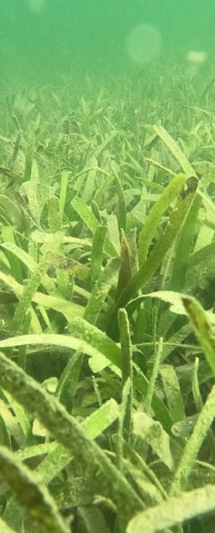
Assessment Endpoints and Measures
Identify environmental characteristics that represent desired condition
More examples are available online
Assessment Endpoints
Example Endpoints | Example Measures
Seagrass | Acreage, density, species, depth of colonization
Phytoplankton | Chl-a concentrations, species, count, biovolume
Dissolved Oxygen | Direct measure (i.e., using sensors)
Water Clarity | Secchi depth, turbidity, light attenuation
Notes:
Effective assessment endpoints should be sensitive to nutrients, relevant to ecology and management goals of the system, have available data, and be reliably and regularly measured. Endpoints are a measurable indicator of the biological community or the physical or chemical characteristics of a waterbody. Measures of the endpoint (i.e., what you measure) should be available with appropriate data type, coverage, quantity, and quality.
Notes:
Some methods (e.g., reference condition) do not require assessment endpoints.
If measurable data are not available to support the selection of an endpoint, you cannot use that endpoint for numeric criteria derivation.
Each endpoint selected to represent the management goal should have a numeric water quality target supported by information available in the literature.
More discussion of assessment endpoints is available on EPA’s website: https://nsteps.epa.gov/problem-formulation-2/assessment-endpoints/
Image: Turtlegrass (Thalassia testudinum) in Bahía de Jobos NERR. Photo by Cayla Sullivan (EPA)

Slide 31
How to Derive Numeric Nutrient Criteria
Multiple approaches can be used to analyze data and derive numeric nutrient criteria
Mechanistic Modeling
Stressor-Response
Relationship between nutrients and response measure(s), also called empirical modeling
Reference Condition
Based on data from sites or time periods that are protective of designated uses
Other Approach
Scientific literature
Other defensible approach
Mathematical model of environmental processes used to estimate system response to change
Expert judgment
Weight of evidence
Notes:
Note: While terminology for analysis approaches can vary, these are a few common approaches for nutrient criteria development.
A range of factors—including regulatory priorities, spatial scales, conceptual models, data quantity and quality, and resource constraints—should be considered in selecting the analytical approach (or combination of approaches) to use for developing numeric nutrient criteria.
After weighing approaches, the state or tribal agency selects the approach that:
- Accommodates the state regulatory constraints as well as the timeframe, resources, and technical capabilities;
- Maximizes participation of the available data in the analysis; and
- Provides rigor to and confidence in the analytical results.
Deciding to use more than one approach has the potential to corroborate analytical results and strengthen the choices made in deriving criteria.
More information about selecting an approach: https://nsteps.epa.gov/select-approach/

Slide 32
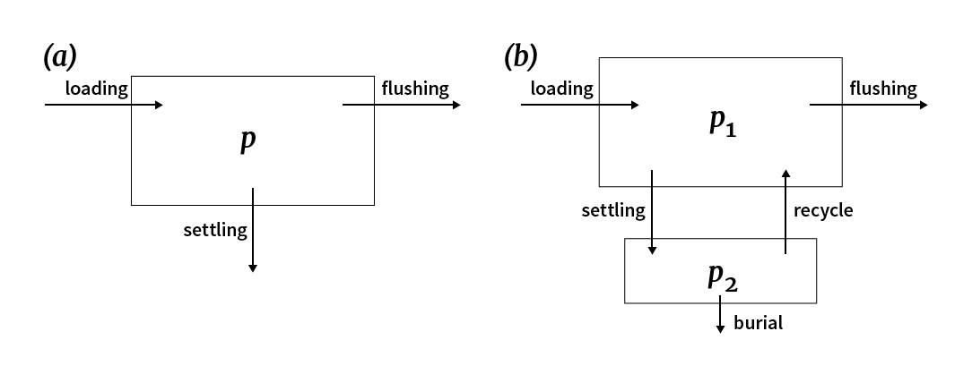
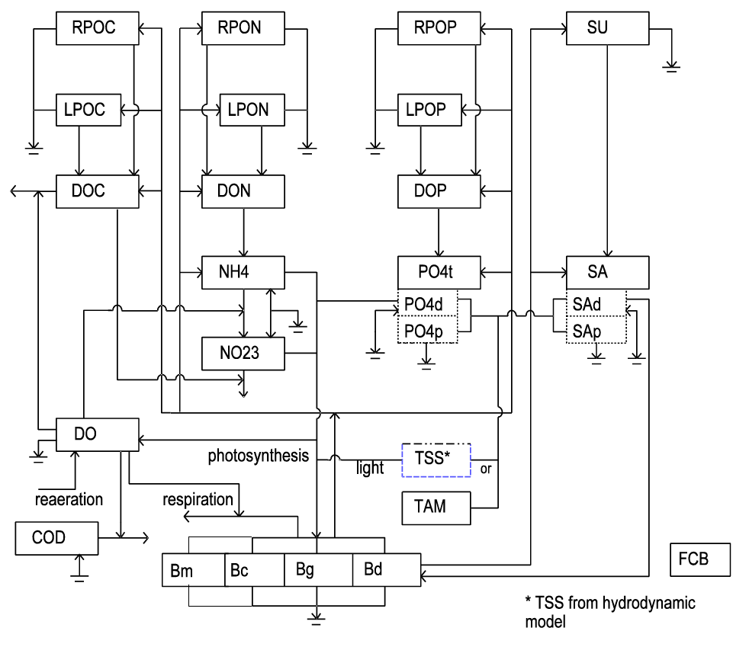
Mechanistic Modeling
Describes physical, chemical, biological processes in water, such as the transport and fate of nutrients (such as algae production)
Mechanistic Modeling
Notes:
Figure captions:
Schematic diagram of the elements of a more complex water quality model (Environmental Fluid Dynamics Code – EFDC)
Simpler water quality models can help provide additional lines of evidence for a criteria development process or to check some assumptions, e.g., this phosphorus budget model that includes cycling between sediment and water column.
Source: N-STEPS Online

Slide 33
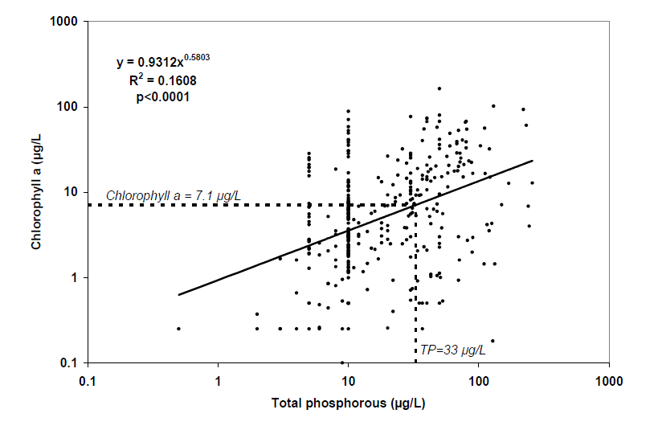
Stressor Response Modeling
Estimates the relationship between nutrient concentrations and a response measure
Stressor Response
Notes:
Figure caption:
Example of a stressor response relationship between chlorophyll a and total phosphorus.
Source: Recommended nutrient criteria for WV lakes document (2006)

Slide 34
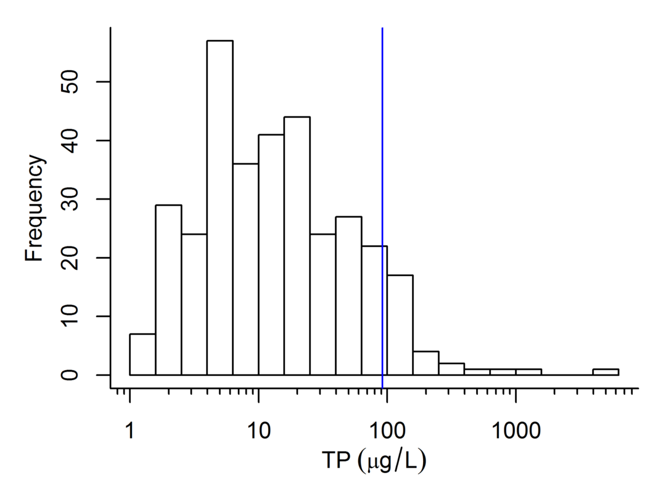
Reference Condition
Used to derive criteria based on conditions present in sites or time periods supporting designated uses
Reference Condition
Notes:
Parametric and nonparametric statistical approaches can be used to estimate a percentile of a nutrient concentration distribution. In both approaches, repeated samples at individual sites may need to be treated differently than individual samples collected at different sites.
Selection of the percentile value to use as the basis for establishing nutrient criteria is a critical decision and the rationale should be well documented. More information is available at: https://nsteps.epa.gov/reference-condition/reference-condition-computation/
Figure caption: Example log-normal distribution of phosphorus concentrations for streams. Source: N-STEPS Online.

Slide 35
How to Evaluate Evidence
Methods
Outcomes
Data suitability and quality
Strength of relationship
Confounding variables
Uncertainty
Data Considerations
Reproducible, transparent, and defensible
Meets regulatory requirements
  Sound scientific rationale
  Sufficient parameters or constituents to protect the designated use
  Protects the most sensitive use
Quantifying and Documenting Protection of the Designated Use
Notes:
How to evaluate methods when establishing numeric criteria values:
Data suitability: Are there the right types of data to develop nutrient criteria? Are there enough samples in the right place at the right time?
Data quality: How were data collected, handled, processed, measured, generated, or stored?
Strength of relationship: Likelihood of false positives or false negatives? Appropriate tests of model performance?
Confounding variables: Are important covariates measured? Could they explain relationships between nutrients and assessment endpoints?
How much uncertainty is involved? What are the descriptive statistics (e.g., measures of central tendency, percentiles, measures of variation) or the estimated parameters of the statistical distribution(s) or model(s), including the statistical confidence of those statistics and estimates?
Criteria are also evaluated according to their outcome:
Are criteria values reproducible, transparent, and defensible?
Do they meet regulatory requirements, i.e., use of sound scientific rationale, protect the most sensitive designated use
More information on both of these topics is available on N-STEPS Online.

Slide 36
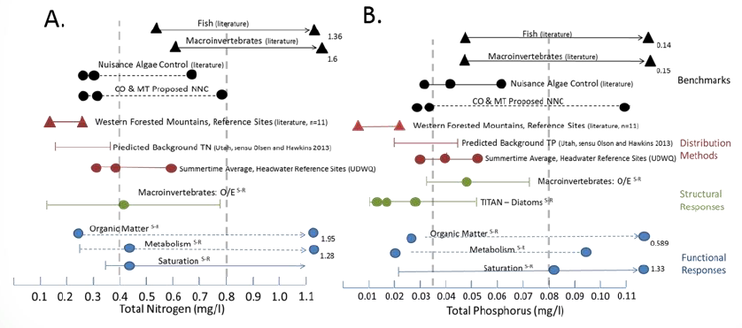
Example: Weight-of-Evidence Approach
One way to
assemble,
evaluate, and
integrate
evidence
transparently
Supported by
EPA methods
documents
Notes:
The weight-of-evidence approach is a process in which evidence is assembled, evaluated, and integrated to make a technical inference in an assessment.
Depending on a group's charge, experts may be asked to suggest criteria ranges or specific values for criteria based on the weight of evidence. However, the relevant regulatory authorities (states, territories, authorized tribes) will make final selection and adopt chosen criteria.
More information about applying weight-of-evidence approaches to nutrient criteria will be available from EPA’s Office of Research and Development in the coming year (anticipated Fall 2023), helping states, territories, and tribes maximize the use of all available evidence, further strengthening criteria transparency and defensibility
Sources:
US EPA. 2023. Application of Weight-of-Evidence Approaches to Nutrient Criteria Development. US EPA Office of Research and Development, RTP, NC. Oral presentation.
Utah Department of Environmental Quality. 2019. Technical Support Document: Utah’s Nutrient Strategy, p. 7 (ES-4). https://documents.deq.utah.gov/water-quality/standards-technical-services/DWQ-2019-006461.pdf [Graphic]

Slide 37
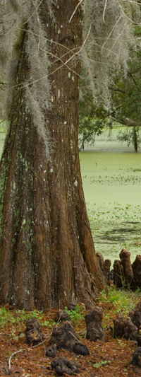
Water Quality Standards Review
States, territories, and authorized tribes submit adopted water quality standards to the relevant EPA Regional Office for review
Standards are only considered applicable for Clean Water Act purposes once approved by EPA
Water Quality Standards Review
Notes:
See link for more information about the Water Quality Standards review process.

Slide 38
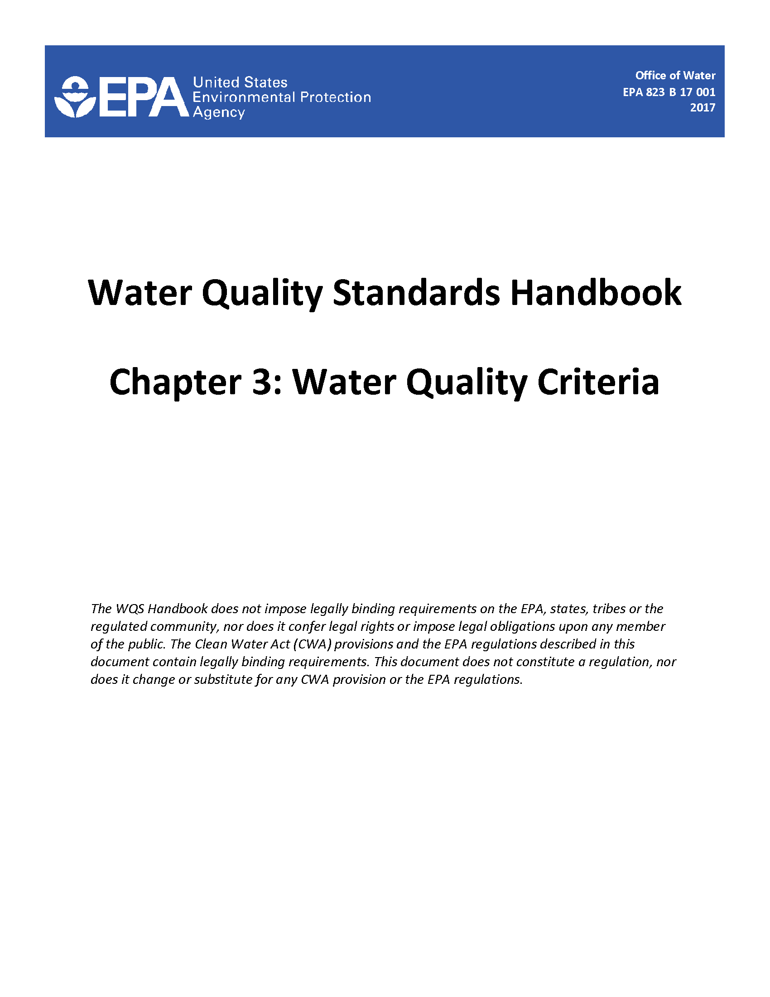

More Resources
U.S. EPA Nutrient Scientific Technical Exchange Partnership & Support (N-STEPS) Online
Water Quality Standards Handbook
Water Quality Standards Academy

Slide 39
Review
What is the objective of the Clean Water Act? Its interim goal?
What is the scope of our effort?
How will my input be used?
Any concepts need review?
Questions about this process?
Notes:
Review of this presentation’s concepts:
What is the objective of the Clean Water Act? “restore and maintain the chemical, physical and biological integrity of the Nation’s waters”
What is its interim goal? “wherever attainable… water quality which provides for the protection and propagation of fish, shellfish and wildlife and provides for recreation in and on the water”
Review of process:
What is the scope of effort?
How will participant input be used?
Additional review (optional):
What are the three parts of water quality standards? Designated uses, water quality criteria, and antidegradation policies, plus other general policies, such as variances and mixing zones
How do we evaluate candidate water quality criteria? (See “How to Evaluate Evidence” slides)
Methods (data suitability, data quality, strength of relationship, confounding variables, uncertainty)
Outcomes (sound scientific rationale, meets regulatory requirements, is reproducible, transparent, and defensible)

Slide 40
Next Steps
Next meeting date
Important milestones
Action items
Notes:
Review:
Next meeting date
Important milestones
Action items for group and/or “homework” for individual participants

