Slide 1
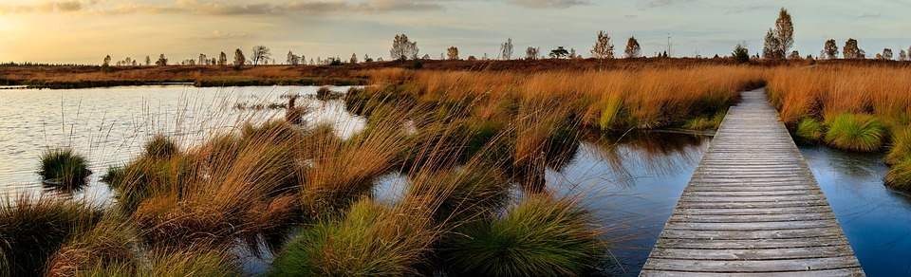



Southeast New England Program: Public Forum 2023
Forum 2023
June 13, 2023
8:30a – 4:30p
Bristol Community College

Slide 2

Adam Reilly
SNEP Communications Coordinator,
EPA Region 1
Forum 2023

Slide 3
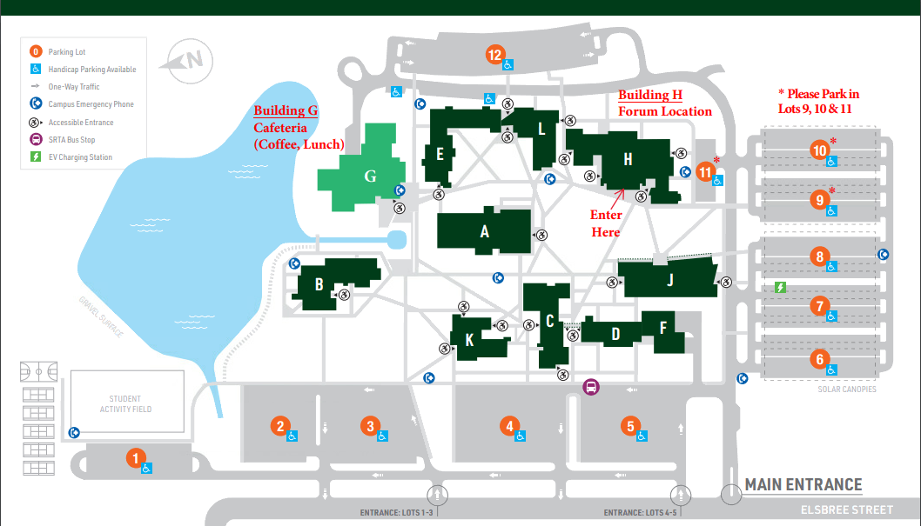
Forum 2023

Slide 4
Poster Presentations
Rick Bishop, Friends of Bass River
Eric Andrade, Groundwork Southcoast
Edward Tanner, Town of Bristol
Susan Inglis, Commercial Fisheries Research Foundation
Tim Pac, Terra Systems, Inc.
Paul Dombrowski, ISOTEC Remediation Technologies
Karen Scott, Town of Glocester, RI
Ryan Kopp, RI Stormwater Innovation Center
Owen Placido, Kristen Hemphill, and Alissa Cox, URI
Matthew Dowling, Town of Charlestown, RI
Leah Hill, Town of Nantucket
Heather Stoffel, URI/GSO
Kelly Reed, Community MusicWorks
Alexie Rudman and Brian Baumgaertel, MASSTC
Laura Ludwig, Center for Coastal Studies
Maryann Dugan, NEIWPCC
Forum 2023

Slide 5
Agenda
9:30 – 9:40 | Opening Remarks, Regional Administrator David Cash, USEPA
9:40 – 10:00 | Keynote, Dr. Christopher Obropta, Rutgers University
10:00 – 10:45 | SNEP Overview and Program Partner Introduction
10:45 – 11:00 | Break
11:00 – 12:00 | Session 1: Regional Resources and Blind Spots
12:00 – 12:50 | Lunch
1:00 – 2:00 | Session 2: Opportunities for Improvement
2:00 – 2:15 | Break
2:15 – 3:15 | Session 3: Looking Towards the Future
3:15 – 3:20 | Break
3:20 – 4:00 | Report Out, Next Steps, and Group Discussion
Forum 2023

Slide 6
Dr. David Cash
Administrator, EPA Region 1
Forum 2023

Slide 7
Engaging Diverse Communities in Green Infrastructure Planning, Design, and
Construction Partnerships
Presented at Southeast New England Program Public Forum at Bristol Community College, Fall River, MA
Christopher C. Obropta, Ph.D., P.E.
Rutgers Cooperative Extension
Water Resources Program
obropta@envsci.rutgers.edu
June 14, 2023

Slide 8
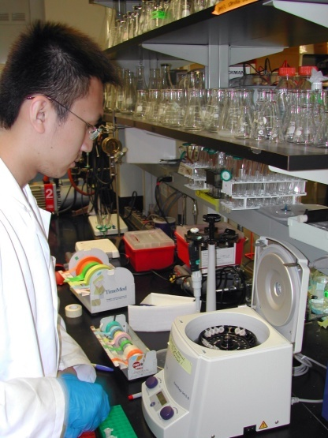
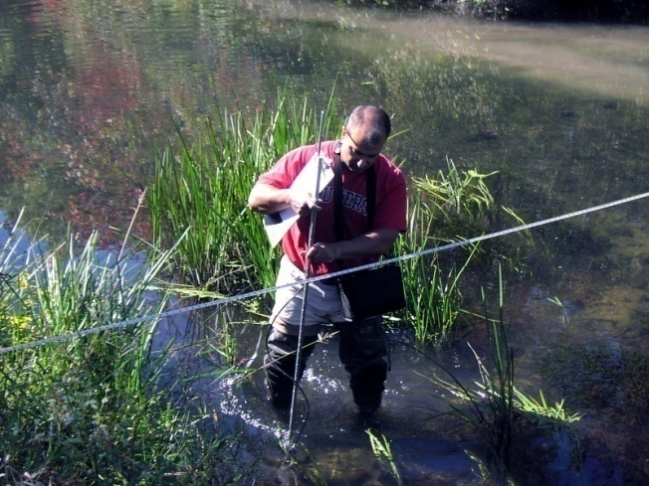
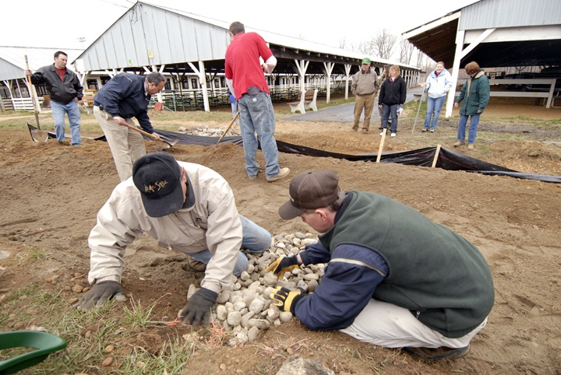
Rutgers Cooperative Extension
Rutgers Cooperative Extension (RCE) helps the diverse population of New Jersey adapt to a rapidly changing society and improves their lives through an educational process that uses science-based knowledge.

Slide 9

The RCE Water Resources Program
Our mission is to identify and address water resources issues by engaging and empowering communities to employ practical science-based solutions to help create a more equitable and sustainable New Jersey.
Notes:
As you may know, the Water Resources Program is a specialty program in the Rutgers Cooperative Extension.

Slide 10
The RCE Water Resources Program created a
Community-Based Green Infrastructure Initiative
Notes:
We created a community-based green infrastructure initiative for the state of NJ. Since there are currently no regulatory drivers for cities to implement green infrastructure, community engagement was created to move green infrastructure forward.

Slide 11
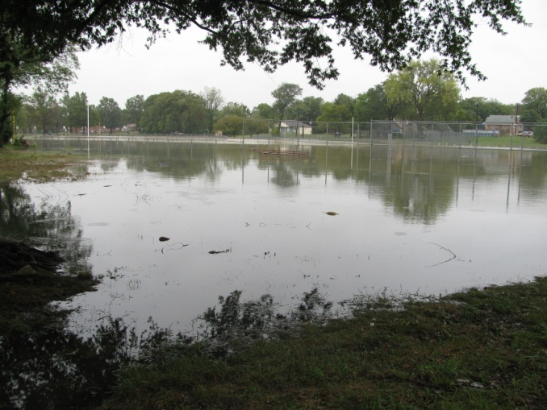
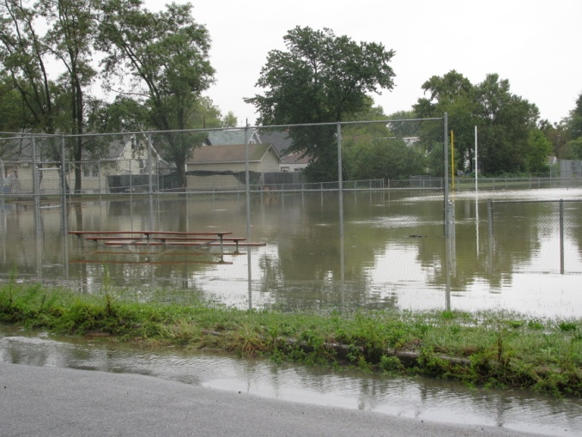
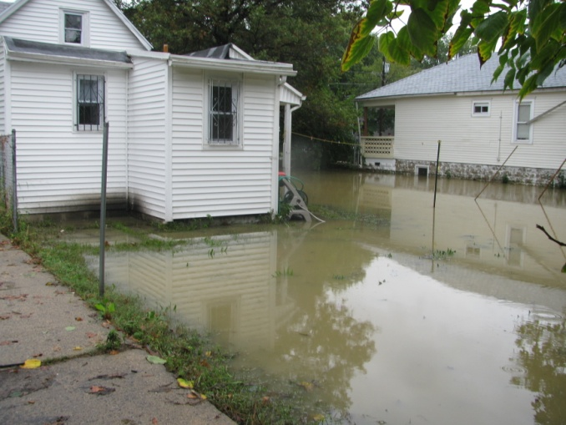
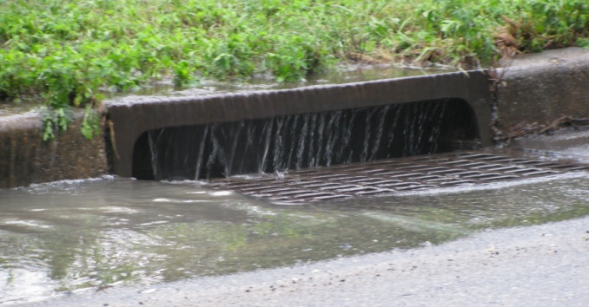
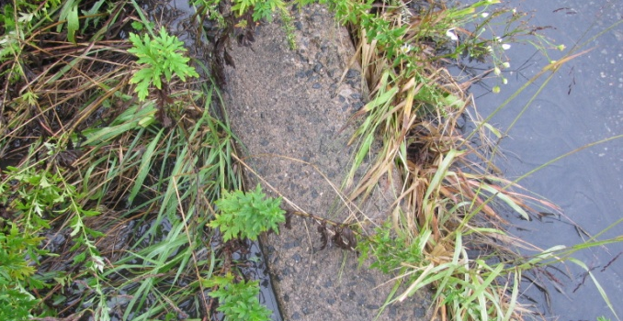
Localized Flooding in Camden
Capacity of existing infrastructure & topography
Sewage water and public health hazard
Existing conditions/needs vary by neighborhood
Notes:
Prior to this effort, we had done some green infrastructure work in the South Bronx for Sustainable South Bronx and for the City of Newark. Our real efforts began in Camden. Camden is the poorest city in the nation. According to figures from the U.S. Census Bureau, nearly 32,000 Camden residents live below the poverty line. For a family of four, the poverty line is an annual household income of about $22,000

Slide 12
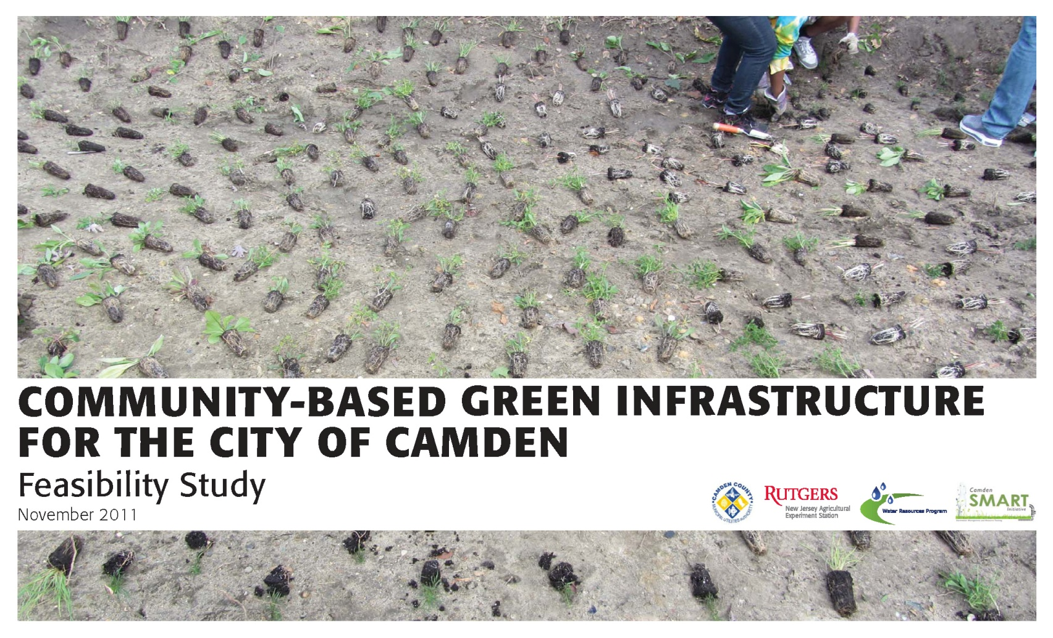
Notes:
We set out to complete a green infrastructure feasibility study in Camden but ended up doing so much more.

Slide 13
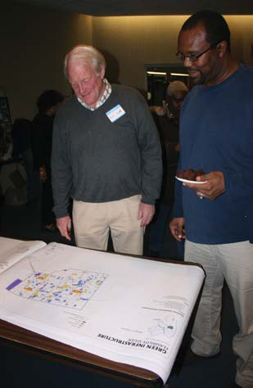
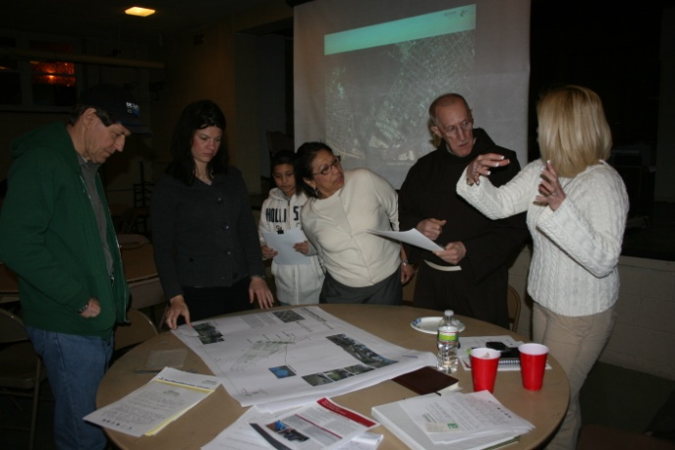
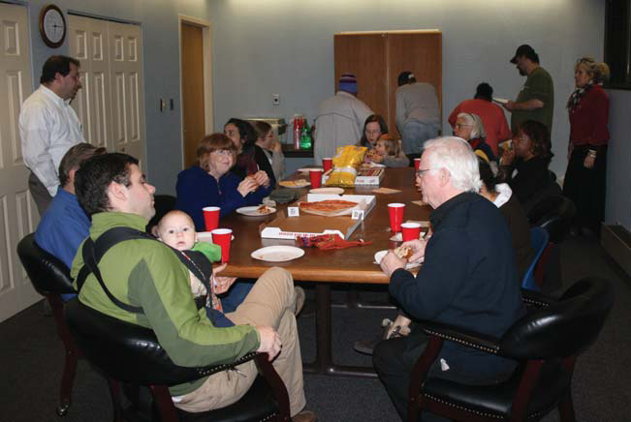
Community Meetings
Five meetings across the City
Residents completed short surveys and sketched on neighborhood maps to identify existing areas of flooding and potential areas for Green Infrastructure
Notes:
We attended community meetings and got input from local residents.

Slide 14
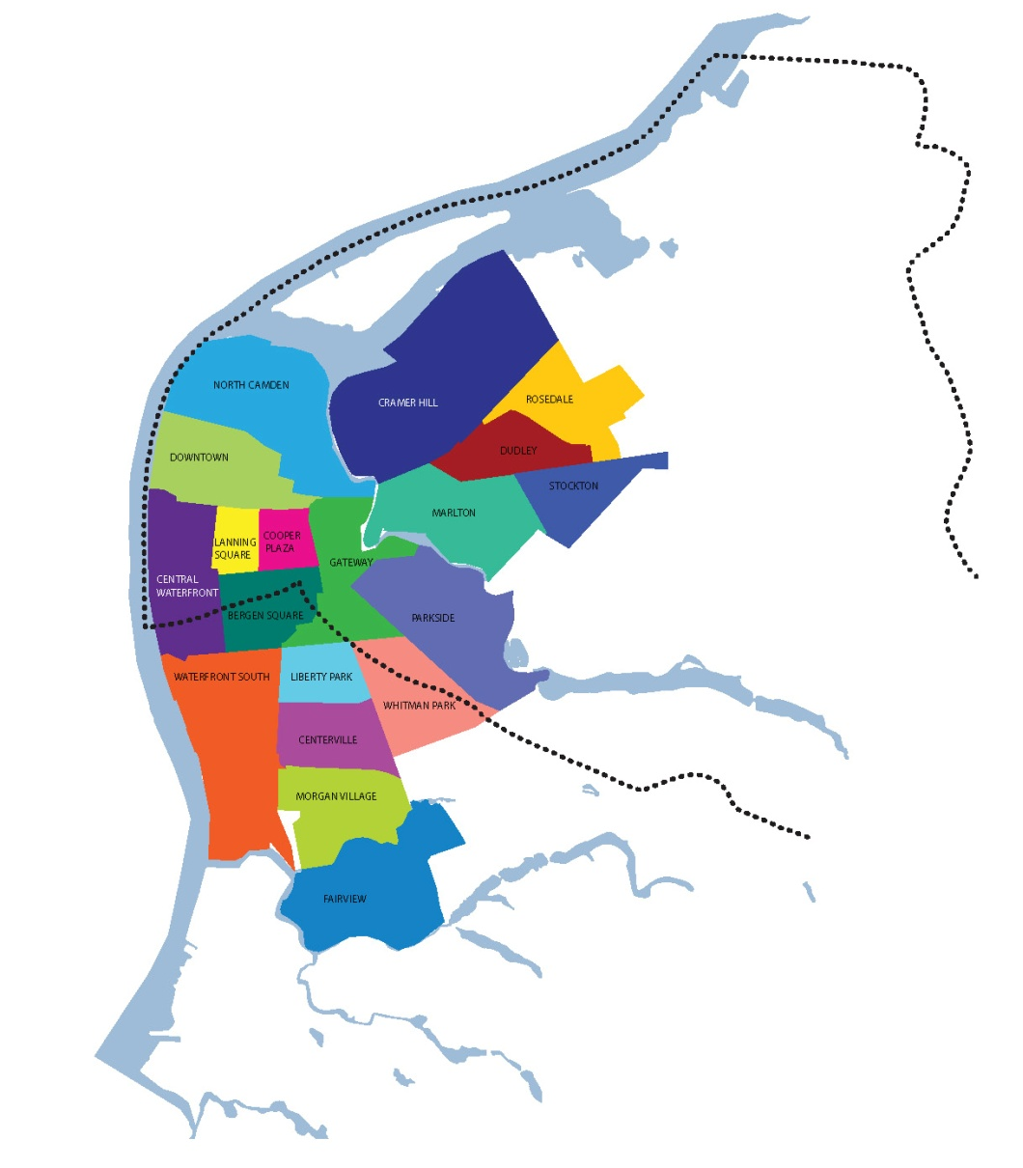
City-Wide Mapping
Geographic Information Systems (GIS)
20 Neighborhood Maps
Map information includes:
  Churches
  Schools
  Parks
  Community Meeting Input
Notes:
We did city-wide mapping of green infrastructure opportunities in all 20 neighborhoods.

Slide 15
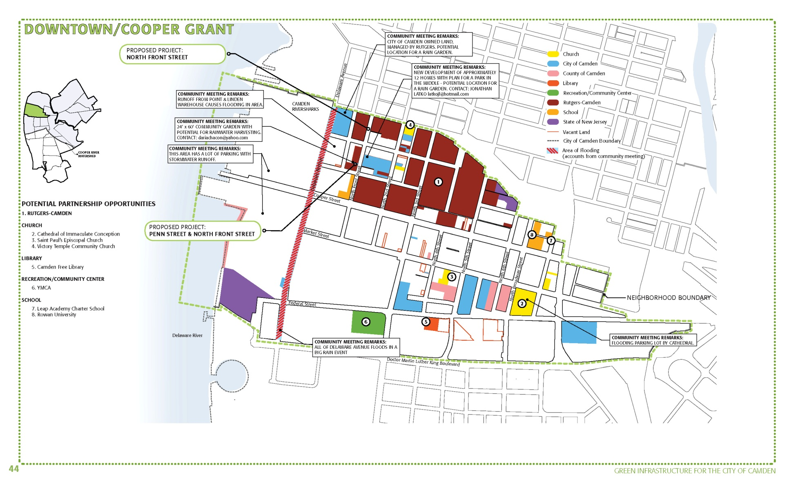
Neighborhood Maps
Notes:
We completed neighborhood maps of green infrastructure opportunities.

Slide 16
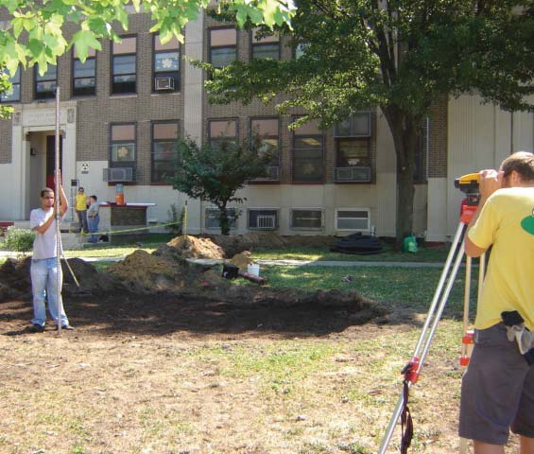
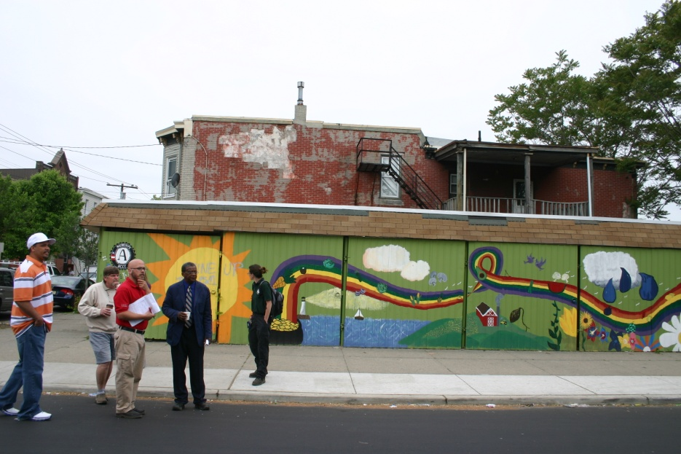
Site Visits and City Tours
Conducted multiple visits and tours to individual neighborhoods
Met with community Leaders
Photographed and measured green infrastructure opportunity sites
Notes:
We visited each potential site and met with local leaders.

Slide 17
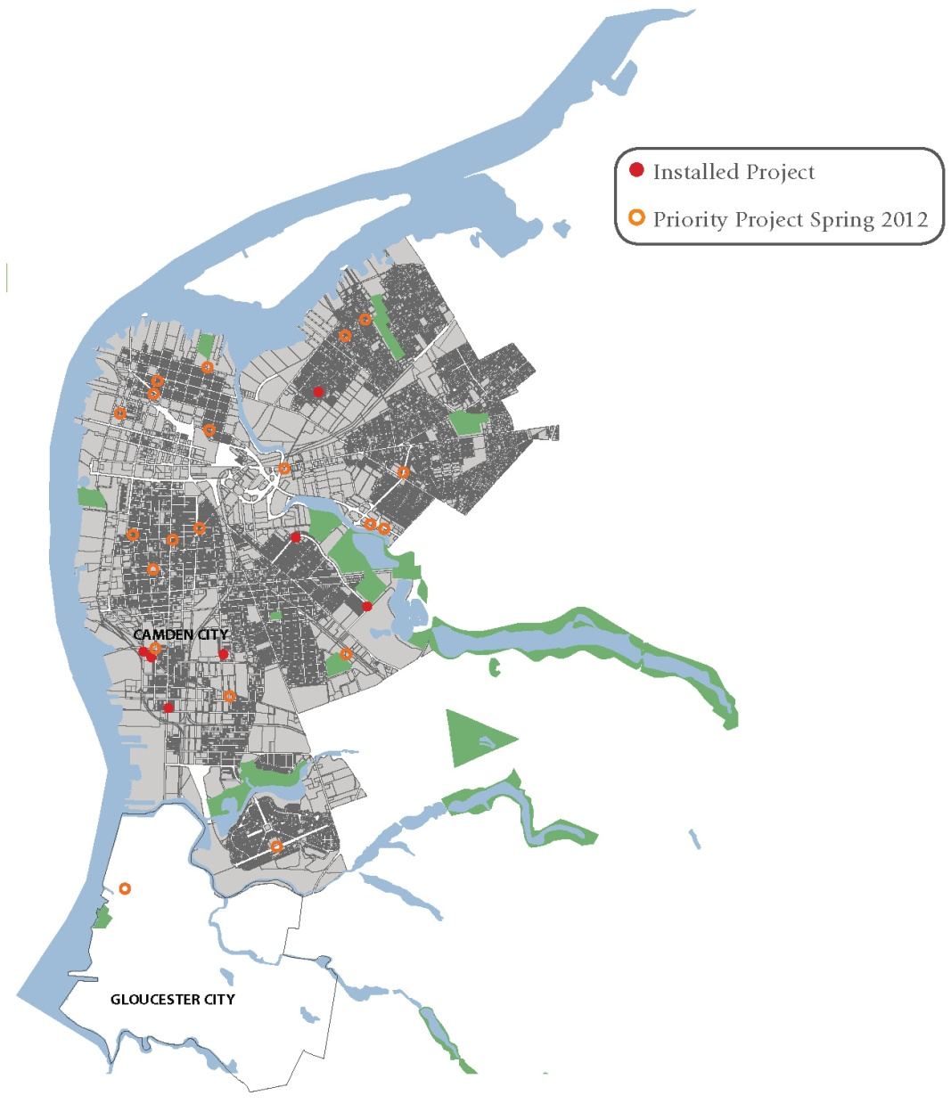
Conceptual Designs
Identified 40 green infrastructure demonstration projects and programs
Projects proposed in all of Camden’s neighborhoods
Selected 13 Priority sites
  Feasible project
  Ready partnership
  High visibility
  Grant funds available
Notes:
We prepared concept designs for 40 projects and identify priority sites.

Slide 18
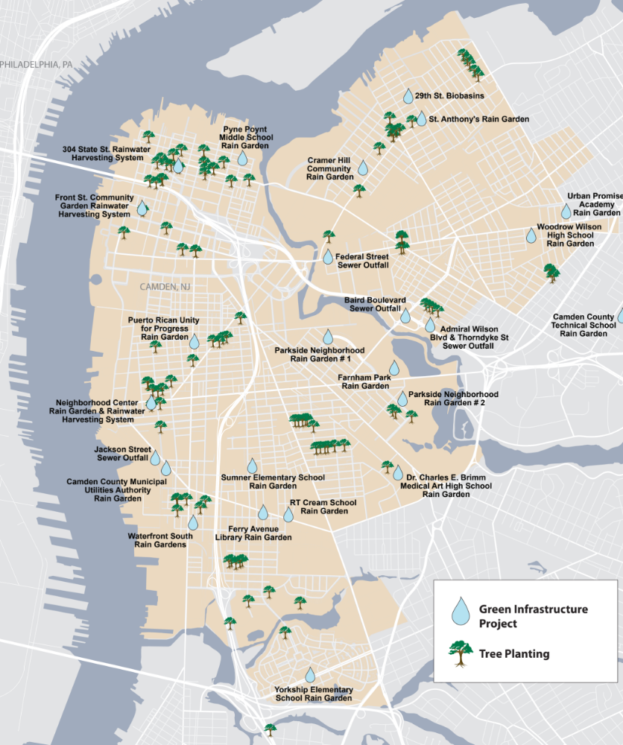
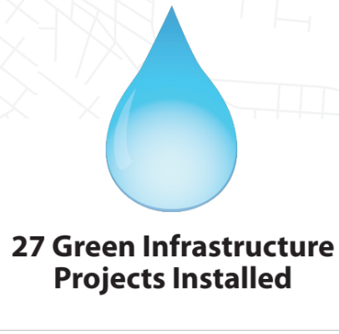

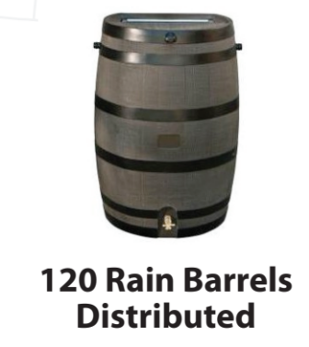
Accomplishments
4.3 Million
Estimated Gallons of Stormwater Managed Annually
33
1458
223
Notes:
And our work since 2011 speaks volumes… literally… volumes of stormwater captured, as the result of installing 27 green infrastructure projects, distributing 120 rain barrels to Camden residents, and planting 992 trees.

Slide 19
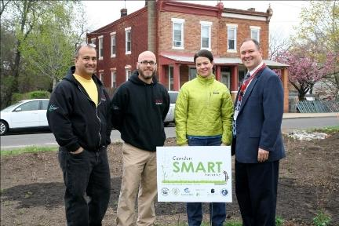
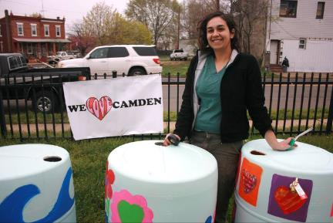
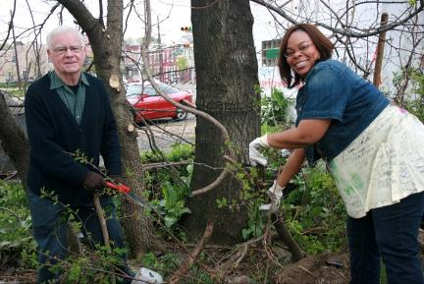
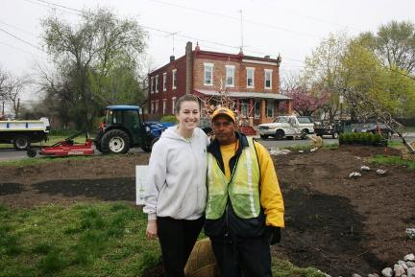
It’s all about relationships
Notes:
How did we do all this? By developing relationships in the communities and building trust among the residents and local NGOs.

Slide 20
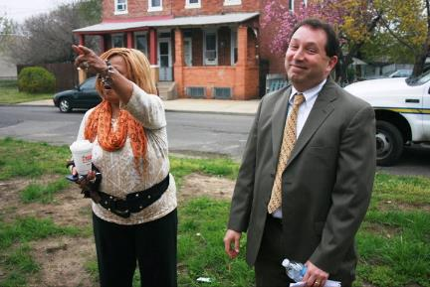
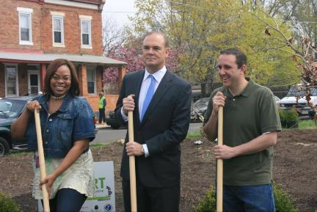
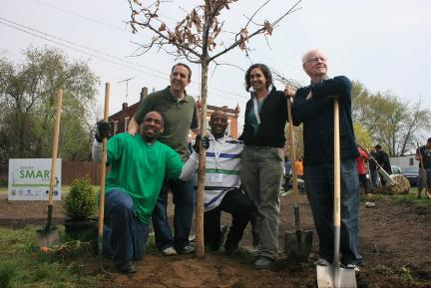
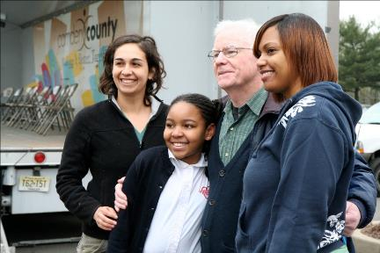
It’s all about local champions
Notes:
By identifying local champions and providing them resources.

Slide 21
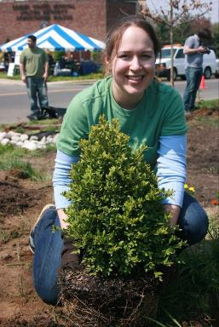
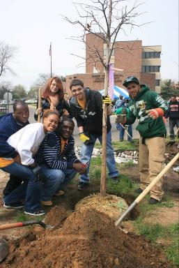
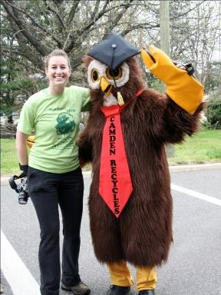
It’s all about commitment
Notes:
By sharing the commitment of the community

Slide 22
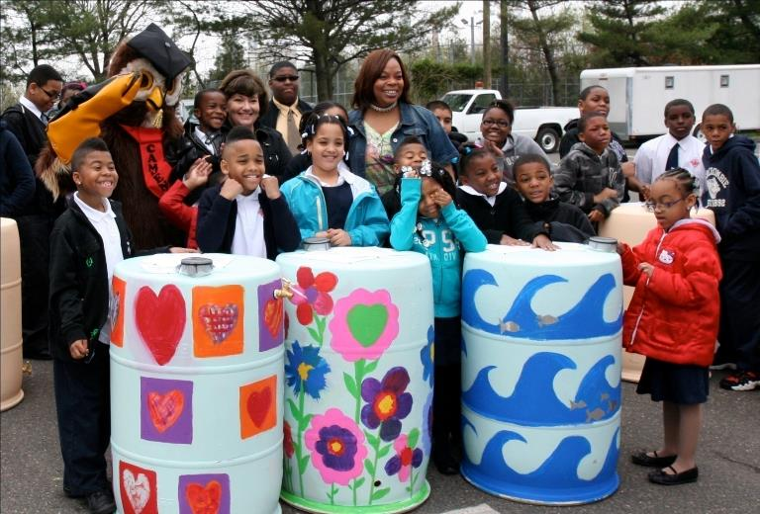
It’s all about future generations
Notes:
By caring about the people. Cooperative Extension job is to improve the quality of life of all residents of NJ. Where better to start than the poorest city in the nation.

Slide 23
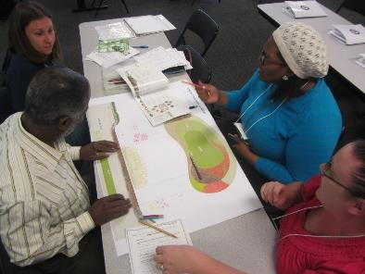
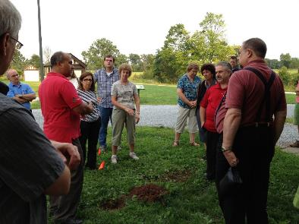
Driving Force = Municipal Action Team
A collaborative group of local and state governments officials, utility authorities, residents, and community organizations.
Notes:
Yesterday I heard a presentation that a regulatory hammer is needed as a driving force to move environmental restoration activities forward. In this case, there was no regulatory hammer. The only driving force was the will of the people. To harness this force, a municipal action team was formed.

Slide 24
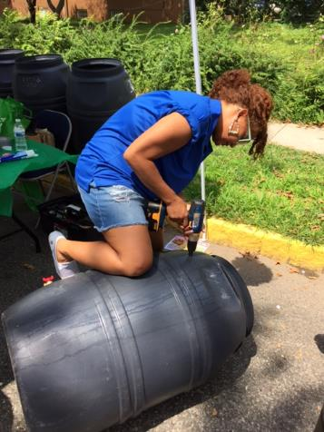
GOALS
Foster collaboration and collective action that helps the municipality speak with a common voice to achieve a common goal
Educate and improve advocacy for green infrastructure as one solution to manage stormwater in our communities
Notes:
The goals are …

Slide 25

A Collective Impact Approach
COMMON
AGENDA
MUTUALLY REINFORCING
ACTIVITIES
SHARED MEASUREMENT
CONTINUOUS COMMUNICATION
BACKBONE
SUPPORT
Notes:
With various stakeholders coming together to form a municipal action team, it is important to have a clear direction in setting a green infrastructure initiative and collectively identify what the impacts of the group will be. Municipal Action Teams are utilizing what is called a Collective Impact Approach. Taking this approach, the team is able to collaborate and achieve substantial impacts on a much larger scale than one individual organization can. There are 5 steps to achieve a collective impact.

Slide 26
Collective Impact Approach: Common Agenda
Identify the issue to address and develop a strategic action plan to guide the initiative
Create the boundaries of the system or issue to be address
GREEN INFRASTRUCTURE AS THE FIRST LINE OF DEFENSE TO STORMWATER MANAGEMENT
COMMON
AGENDA
Notes:
With multiple stakeholders coming together, it is important to answer – what’s the issue and why are we all coming together? The common agenda helps set the tone of your municipal action team and enables each organization to check other agendas at the door to really focus on the one initiative the municipal action team is focused on and that is green infrastructure.

Slide 27
Collective Impact Approach: Backbone Support
Identify an influential leader and/or organization
Obtain adequate financial resources needed to keep the overall strategic direction
Tasks of the backbone support include:
  facilitating dialogues between partners
  managing data collection
  communication
  coordinating community outreach
  mobilizing funding resources
BACKBONE
SUPPORT
Notes:
A crucial piece of a municipal action team is identifying an organization to take on the role of backbone support. This can be one person or more from different organizations.
The backbone organization can alternate from organization to organization, though they play a fundamental role in keeping the Municipal Action Team on task. In identifying who will lead the backbone support, understand that this organization needs to be sufficiently well resourced to provide the support needed over time.
Later in this presentation, you will hear about the different municipal action teams and as you listen to these teams, take note at how long they have been established, the variation in stakeholders, and the models that they have put in place that works for their community.

Slide 28
Collective Impact Approach: Shared Measurement
Identify common measures to monitor performance
Track progress to the outlined goals
Learn from one another as to what is working and what is not in furthering a green infrastructure initiative in your community
  Building trust and capacity within each organization
  Performance set at a level that each organization can achieve
Set a small, but comprehensive set of indicators to establish progress along the common agenda
SHARED MEASUREMENT
Notes:
One of the most challenging aspects to achieve a collective impact is shared measurement. Traditional evaluation is not as easily transposed when trying to measure the impacts of multiple organizations or people together. It is important, as you will see in our example municipal action teams, that participants gather regularly to share results, learn from one another, and refine their individual and collective work based on their learning.

Slide 29
Collective Impact Approach:
Mutually Reinforcing Activities
Planning and doing!
Stakeholders working together, each undertaking the specific set of activities to support the common agenda
  Activities will and can differ from organization to organization
Activities excels in a way to support the coordinated actions of the municipal action team
MUTUALLY REINFORCING
ACTIVITIES
Notes:
Participant activities must be differentiated while still being coordinated through a mutually reinforcing the plan of action that the municipal action team has. Plans are set by the municipal action team, and it is the individual organizations that then do their part to reinforce the common agenda of the team.

Slide 30
Collective Impact Approach:
Continuous Communication
Developing trust among all participating organizations
Stakeholder interested are treated fairly and decisions are made based on objective evidence, not any single organizations priorities
CONTINUOUS COMMUNICATION
Notes:
Consistent and open communication is needed across the many stakeholders to build trust, assure mutual objectives, and create common motivation

Slide 31



Examples of Green Infrastructure Municipal Action Teams
Camden SMART
Newark DIG
Paterson SMART
Perth Amboy SWIM
Jersey City START
Harrison TIDE

Slide 32
Camden Smart est. 2010
Stormwater Management and Resource Training

Slide 33

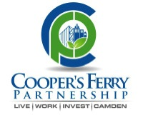
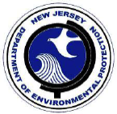
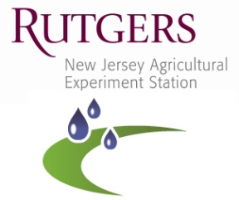
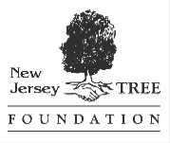

The Camden SMART Team
(Stormwater Management and Resource Training)
City of Camden
Cooper’s Ferry Partnership
NJ Department of Environmental Protection
Rutgers Cooperative Extension Water Resources Program
Camden County Municipal Utilities Authority
NJ Tree Foundation
Notes:
The Camden SMART Initiative was launched in 2011 to tackle the impacts of a combined sewer system in Camden and through a public-private partnership led by the City of Camden (City), Camden County Municipal Utilities Authority (CCMUA), Cooper’s Ferry Partnership (CFP), Rutgers Cooperative Extension Water Resources Program (RCE), New Jersey Tree Foundation (NJTF), and the NJ Department of Environmental Protection (NJDEP).

Slide 34
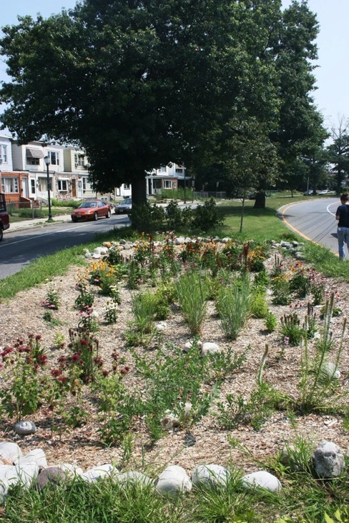
The Camden SMART Initiative
Community Education
Creating a Sustainable Network
Green & grey infrastructure project implementation
Green infrastructure training
Park Boulevard Rain Garden in Parkside
Notes:
The Camden SMART (Stormwater Management And Resource Training) Initiative presents a resident-driven comprehensive response to stormwater management issues in the combined sewer community of Camden, New Jersey. Through these 4 methods, the Camden SMART Initiative works to address public health issues that currently affect livability for residents by: preventing neighborhood flooding and combined sewer overflows; improving air, water and climate quality; providing economic development opportunities and additional recreational amenities and open space; beautifying neighborhoods; and educating residents.

Slide 35
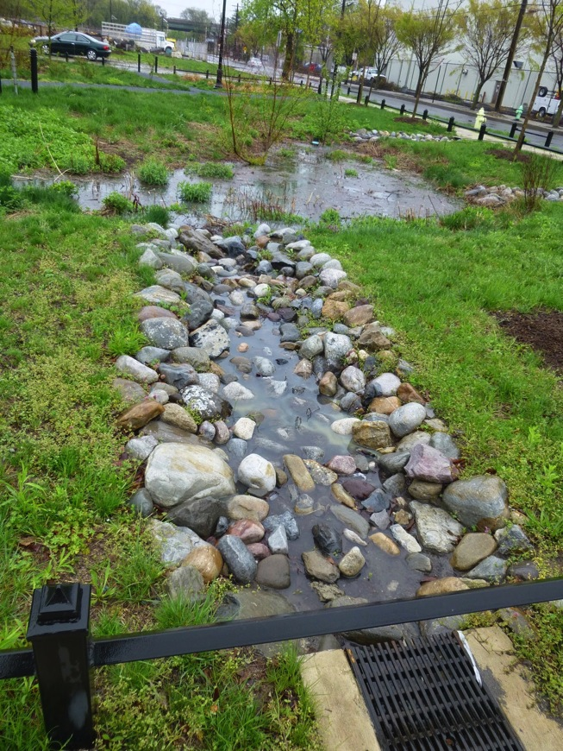
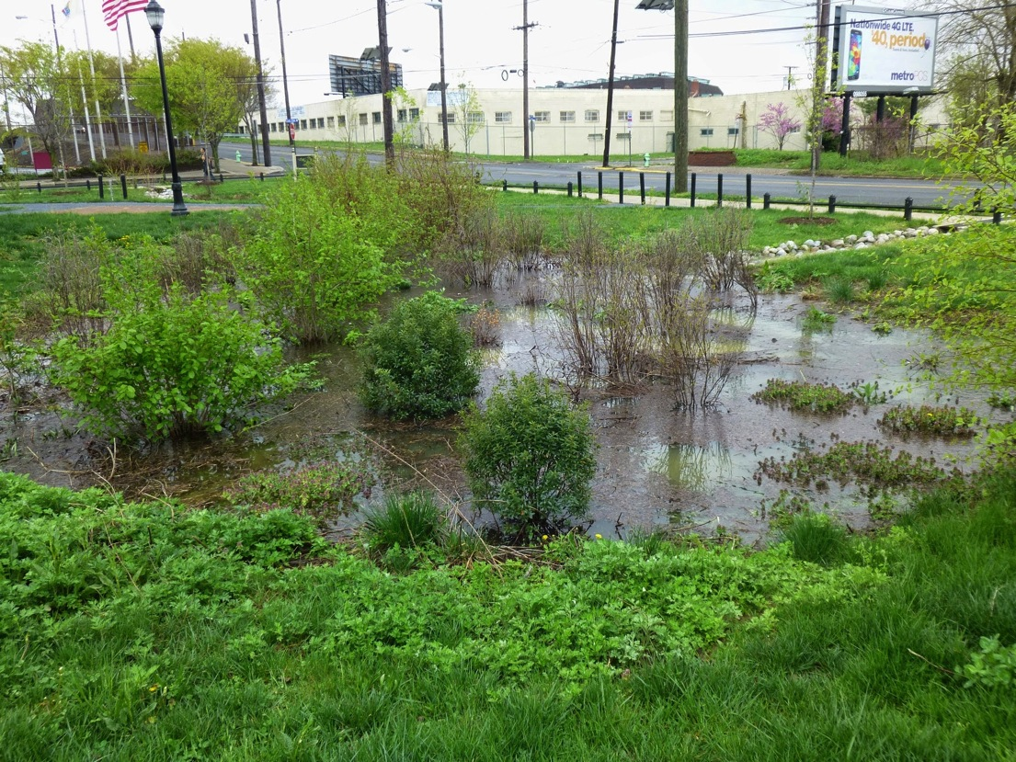
Green Infrastructure In Action
Waterfront South Rain Gardens
Notes:
Examples

Slide 36
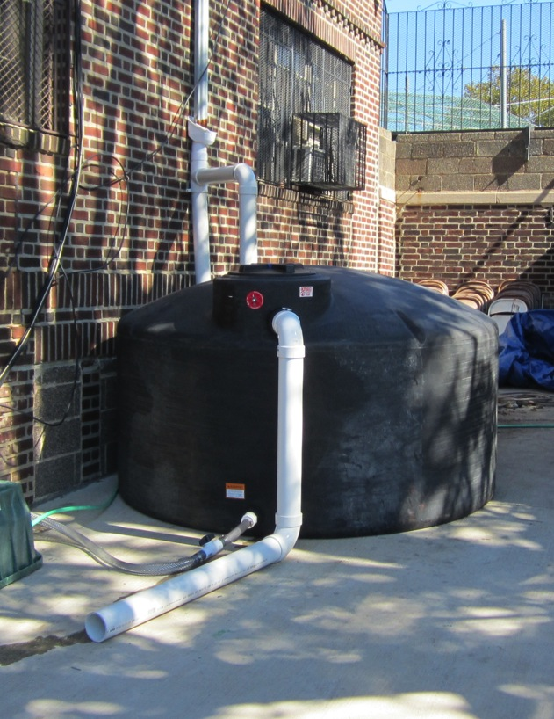
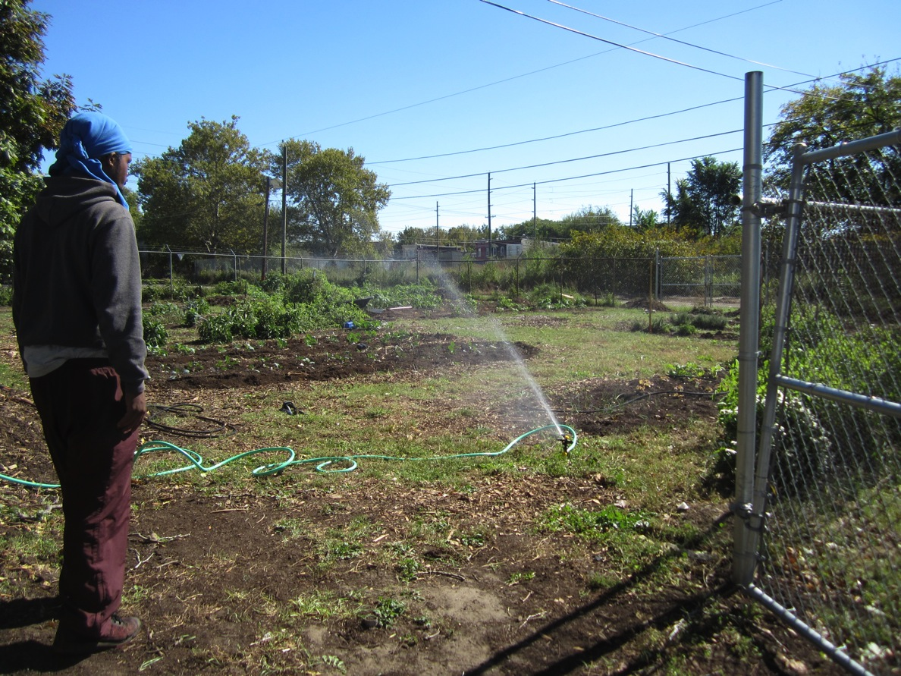
Green Infrastructure In Action
The Neighborhood Center Cistern

Slide 37
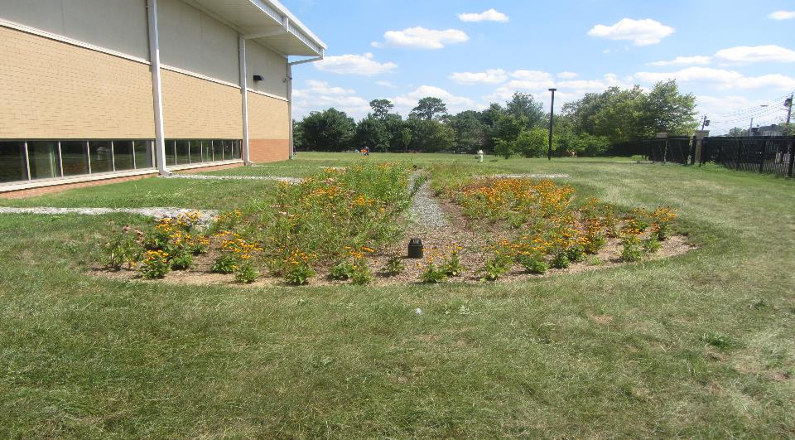
Rain garden at Catto School

Slide 38
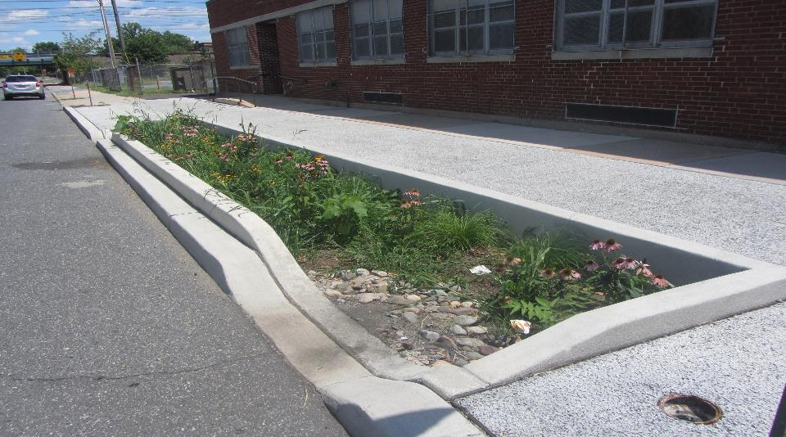
Stormwater Planter at the Brimm School

Slide 39
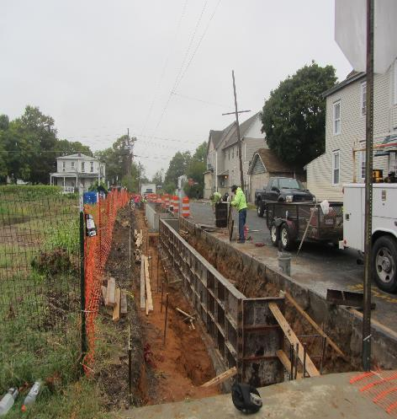
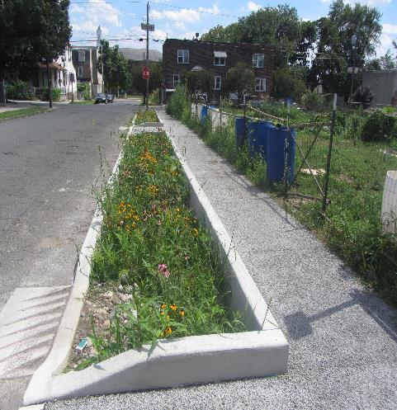
Stormwater Planters at the Vietnamese Community Garden

Slide 40


Porous Pavement at Yorkship School (Asphalt)

Slide 41


Slide 42
Open Space & Brownfield Working Group
Air Quality Working Group
Waste Management Working Group
Water (Camden SMART) Working Group

Slide 43

Newark DIG est. 2013
Doing Infrastructure Green
www.newarkdig.org
Facebook @NewarkDIG
Twitter @NewarkNJ_DIG

Slide 44











DOING INFRASTRUCTURE GREEN
City of Newark
Clean Water Action and Clean Water Fund
Greater Newark Conservancy
Ironbound Community Corporation
New Jersey Department of Environmental Protection
New Jersey Tree Foundation
NY/NJ Baykeeper
MnM Consulting
Passaic Valley Sewerage Commission
Rutgers Cooperative Extension Water Resources Program
Trust for Public Land
Unified Vailsburg Services Organization
Urban League of Essex County
Victoria Foundation

Slide 45


Engaging Your Community Members to Form a Municipal Action Team
Notes:
Learning from our own experiences and the dynamics of each municipal action team across the state, we like to provide you with ten tips to engage your community in establishing a municipal action team.

Slide 46
Tips for Engaging and Involving Community Members
Create a municipal action team comprised of stakeholders and experts that will facilitate communication and decision making for green infrastructure
Identify the community’s needs and use data to make a case for green infrastructure
Strategize through coalition building to create a sustainable initiative
Develop a common agenda encompassing the interests of all municipal action team members supporting goals/strategies of the team
Communicate with the community through as many means as possible (social media, flyers, face-to-face meetings and workshops)

Slide 47
Tips for Engaging and Involving Community Members
Build relationships with local government officials who will advocate for green infrastructure
Educate community members through mutually reinforcing activities
Involve the community from the beginning of any planning process to build public acceptance and advocacy
Implement demonstration projects using community input and volunteers
Analyze shared metrics to track progress identifying gaps, lessons learned and improvements needed

Slide 48



Green Infrastructure Champions
Green Infrastructure Champions are key players in implementing green infrastructure as a stormwater management approach in their community.
Nathaniel Sajdak works for the Wallkill River Watershed Management Group
Laura McBride created the Deal Lake Watershed Alliance
Cheryl Reardon works for the Assoc. of NJ Environmental Commissions

Slide 49
Rutgers inputs to the Green Infrastructure Champion Program
10 training classes on various aspects of green infrastructure planning and implementation
Professional staff to provide technical support to develop a design for a green infrastructure demonstration project
Networking opportunities with other Green Infrastructure Champions for mutual support
Assistance with grant writing and submission

Slide 50




GI Champions Classes
How to identify green infrastructure projects in your town
Moving from planning to implementation of green infrastructure
Maintaining green infrastructure practices/projects
Stormwater management regulations, policies, and ordinances
Green infrastructure planning and implementation for Sustainable Jersey points

Slide 51




GI Champions Classes
Green infrastructure projects for schools
How to design and build a rain garden
Retrofitting traditional detention basins with green infrastructure
Developing green infrastructure master plans for an entire site or neighborhood
Using green infrastructure to promote climate resiliency
Classes Start on January 12, 2024

Slide 52

Questions?

Slide 53
SNEP Overview and Program Partner Introduction
Forum 2023

Slide 54
Ian Dombroski
SNEP Coordinator,
EPA Region 1
Forum 2023

Slide 55

FY12 Congressional Charge

Slide 56

SNEP Overview
Southeast New England Program
EPA Led (Region 1)
Established in 2012, funded since 2014
Rhode Island and S.E Massachusetts
Foci:
  Water Quality/Habitat
  Climate Resilience
  Innovation
  Collaboration
  Transferability
  Holistic Approaches
  Environmental Justice

Slide 57
Goals and Key Actions
Program Vision 2050
A resilient ecosystem of safe and healthy waters, thriving watersheds and natural lands, and sustainable communities in the SNEP coastal watershed region
Resilient Ecosystem of Safe and Healthy Waters
Thriving Watersheds and Natural Lands
Watersheds provide essential ecological functions, species diversity, and protection from both human-based and naturally occuring environmental stressors, and healthy, connected natural lands support a variety and range of native plan and wildlife communities
Waters support native seagrasses and aquatic life, plentiful native fish and shellfish, and a variety of water-based recreation opportunities
Sustainable Communities
Communities share robust water-based economics, protect and provide access to natural lands, open spaces and parks, encourage local food sources, and are adapting for resilience to expected impacts of climate change

Slide 58
Goals and Key Actions
Increase Local Capacity to Complete Projects and Adopt New Policies
Increase Available Solutions
Ensure Diverse Representation in Program Decision-Making
Demonstrate Ways to Address Common Challenges
Increase Community Leaders’ Understanding of the Benefits of Restoration Projects

Slide 59
SNEP Committee Structure
EPA
Federal Partners
Steering Committee
Monitoring Subcommittee
Ecosystem Services Subcommittee

Slide 60
Historic Funding

Slide 61
SNEP Funding Structure
EPA
Direct Grants, Estuary Program Grants, Contracts, Interagency Agreements
SNEP Watershed Implementation Grants Program
SNEP Network
SNEP Watershed Implementation Grants
Technical Assistance
Workshops/Trainings
Pilot Projects
Community Assistance Projects

Slide 62
Overall Funding Breakdown Through FY22
Massachusetts
80 Awards
$17.3M in Federal Funds
$21.2M in Total Project Value
Rhode Island
55 Awards
$12.1M in Federal Funds
$15.6M in Total Project Value
Interstate
4 Awards
$16.0M in Federal Funds
$19.8M in Total Project Value
FY2014-FY2022
$45.5M in Federal Funds Awarded
$56.6M in Total Project Value

Slide 63


SNEP WATERSHED IMPLEMENTATION GRANTS
TOM ARDITO
RESTORE AMERICA’S ESTUARIES
SWIG Program Director
tardito@estuaries.org

Slide 64
SWIG 2018 - 2022
RAE/EPA Cooperative Agreement since 2017
Grants directly support SNEP Strategic Plan vision & Goals
Awards 2018 -- 2022
      60 Grants
      100+ Grantees
      $ 12M+ awards
      $ 7M match
      $ 19M total
      Most grants $100k - $400k; $500k max
See www.snepgrants.org for program reports and project information

Slide 65
SWIG23: $2.9 M available
Restore Ecosystems, Improve Communities
2023 Funding Themes:
Restore Small Cities & Urban Environments;
Conserve and Restore Rural and Natural Landscapes;
Innovate to Improve Water Quality;
Promote Environmental Justice and Equity;
Address Environmental Change;
Build & Sustain Local and Regional Partnerships; and
Foster Regional Learning.

Slide 66
Examples of Projects Funded
Watershed-scale Estuarine Restoration
Green Streets & Neighborhoods – Urban Restoration & Community Engagement
Environmental justice, green job training, etc.
Stormwater Demonstration & Training
Innovative Wetland & River Restoration, other habitats
Coastal resilience, shorelines, flooding
Pilot Projects: PRBs, bioreactors, innovative septic, etc.
Watershed & Regional Plans
Marine pollution, solid waste
Conferences & Tech Transfer (smaller $$$)

Slide 67
For More Information
Past & Present
SNEP Watershed Implementation Grants:
www.snepgrants.org
Contact Tom Ardito for assistance
tardito@estuaries.org
Check out “SNEP Strategic Plan”
(link from snepgrants page)

Slide 68
Martha Sheils
Director, SNEP Network
Forum 2023

Slide 69

About the Network
SNEP Network
Empower communities within the region to achieve healthy watershed, sustainable financing, long-term climate resilience through the management of stormwater and restoration projects
Notes:
Engage all levels of governance in capacity building

Slide 70


More About the Network
SNEP Network
16 Network Partners
Capacity Building through….
  FREE Technical Assistance to Communities
  Trainings and Webinars
  Regional Tools and Resources
Administered by the New England Environmental Finance Center
at the University of Southern Maine

Slide 71

Access to Technical Assistance
SNEP Network
SNEP Network Web Portal
Technical Assistance
Partner relationships
Solicitation for Community Projects
Building upon existing projects
Pre-approved consultant Pool
SNEP Network Partners
Notes:
Support throughout the project phases
On demand technical assistance
Solicitation for community assistance projects
Leveraging partner relationships
FREE consultant services through NEEFC Consultant Pool

Slide 72
Tim Pasakarnis
Chair, Monitoring Subcommittee
Forum 2023

Slide 73

SNEP Monitoring Subcommittee
Subcommittee focused on environmental monitoring for SNEP Region
  Develop capacity to measure regional baseline conditions and outcomes of restoration efforts
Membership includes Federal, State (MA and RI), and local / regional representatives

Slide 74
Bryce DuBois
Chair, Ecosystem Services Subcommittee
Forum 2023

Slide 75

Ecosystem Services Subcommittee
Subcommittee focused on the evaluation of the ecological value of the SNEP region and potential impact of restoration​
Define and quantify important ecosystem services to inform communities, increase community engagement and capacity
support ecosystem restoration and climate adaptation decisions
provide a common language that promotes better understanding of the benefits of protection and restoration at the community, ecosystem, or watershed scales.​
Membership includes Tribal, Federal, State, and local / regional representatives:
Wampanoag Tribe of Gay Head (Aquinnah)
EPA
NOAA
USFW
MA (DER)
Assc. To Preserve Cape Cod
Cape Cod Commission
College of the Holy Cross
Conservation Law Foundation
Mass Audubon
Mass Maritime Academy
NBEP
The Nature Conservancy
UMass Dartmouth
Notes:
Wampanoag Tribe of Gay Head (Aquinnah)
EPA (ORD)
EPA (ORD-AED)
EPA (Region 1)
USFW
NOAA
MA (DER)
Assc. To Preserve Cape Cod
Cape Cod Commission
College of the Holy Cross
Conservation Law Foundation
Mass Audubon
Mass Maritime Academy
NBEP
The Nature Conservancy
UMass Dartmouth
Explore ways to design management and science infrastructure that builds understanding of and support for ecosystem-based approaches to:​
Restore and maintain ecological resilience through effective, sustainable partnerships across institutional, state, and jurisdictional boundaries​
Collaborate across programs and communities for maximum environmental and public benefit, especially with respect to climate change​
Encourage, pilot, and apply innovations in technology. Support the scaling up/amplification of successful techniques. ​

Slide 76
Caitlyn Whittle
Narragansett Bay Estuary Program Project Officer, EPA Region 1
Forum 2023

Slide 77
Alicia Grimaldi
Buzzards Bay NEP Project Officer, EPA Region 1
Forum 2023

Slide 78

BUZZARDS BAY
NATIONAL ESTUARY PROGRAM
Alicia Grimaldi
EPA, Region 1
Ocean & Coastal Protection Unit

Slide 79


Buzzards Bay Stormwater Collaborative
Launched in 2016, currently a partnership between BBNEP and Mass Maritime Academy
Map stormwater infrastructure, monitor discharges, identification of failing structures
Field investigation trailer outfitted for illicit connection detection began use in 2021
Interactive map available on Buzzards Bay website

Slide 80


Buzzards Bay Salt Marsh Studies
Partnership between BBNEP, Woodwell Climate Research Center, and Buzzards Bay Coalition
Monitoring and tracking changes over many years within a dozen selected salt marshes
Study of vegetation and elevation

Slide 81

Other BBNEP Priorities and Resources
BBNEP offers minigrants to the municipalities in Buzzards Bay each year
Recently completed an Equity Strategy to reach disadvantaged communities and a Climate Vulnerability Assessment
BBNEP webpage has a wealth of historical research in Buzzards Bay
buzzardsbay.org

Slide 82
Adam Reilly
SNEP Communications Coordinator,
EPA Region 1
Forum 2023

Slide 83
Forum Purpose:
To seek input on how SNEP and its partners can best help to meet local needs while also building the framework for more effective approaches to address today’s environmental, social, and economic challenges.
The results of today’s discussions will be incorporated into our funding and policy strategies for the next several years.
Forum 2023

Slide 84
Probing Questions to Keep in Mind
What is SNEP doing well?
How can SNEP better work with you or your organization? What could SNEP improve upon or do differently?
Where do you see regional gaps in information, funding, etc. that SNEP could fill?
What do you think SNEP should do?
Forum 2023

Slide 85
Transition and Networking Break
Please be seated in your breakout room by 11:00a
Forum 2023

Slide 86
Report Out, Next Steps, and Group Discussion
Elizabeth Scott, Elizabeth Scott Consulting
Tim Pasakarnis, Cape Cod Commission
Tom Ardito, SWIG
Kimberly Groff, Kimberly Groff Consulting
Phaeng Southisombath, SNEP Network
Ian Dombroski, EPA-SNEP
Martha Sheils, SNEP Network
Bryce DuBois, College of the Holy Cross
Marcel Belaval, USGS
Matthew Stamas, EPA-SNEP
Mary Schoell, Narragansett Bay NERRS
Haley Miller, EPA-SNEP
Margherita Pryor, EPA-SNEP
Adam Reilly, EPA-SNEP
Forum 2023

Slide 87
Special Recognition to Our Poster Presenters
Rick Bishop, Friends of Bass River
Eric Andrade, Groundwork Southcoast
Edward Tanner, Town of Bristol
Susan Inglis, Commercial Fisheries Research Foundation
Tim Pac, Terra Systems, Inc.
Paul Dombrowski, ISOTEC Remediation Technologies
Karen Scott, Town of Glocester, RI
Ryan Kopp, RI Stormwater Innovation Center
Owen Placido, Kristen Hemphill, and Alissa Cox, URI
Matthew Dowling, Town of Charlestown, RI
Leah Hill, Town of Nantucket
Heather Stoffel, URI/GSO
Kelly Reed, Community MusicWorks
Alexie Rudman and Brian Baumgaertel, MASSTC
Laura Ludwig, Center for Coastal Studies
Maryann Dugan, NEIWPCC
Forum 2023

Slide 88
Thank You!
Recordings of main meeting room presentations, poster presentations, and discussion deliverables will be posted to the SNEP website.
Forum 2023

