Slide 1

Scaling Up from Pilot to Progress
SNEP Forum 2023
Session 2, Room 3
Adam Reilly, U.S. EPA Region 1
Marcel Belaval, U.S. Geological Survey

Slide 2

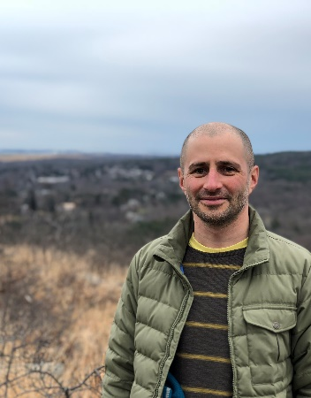
Your Moderators
Adam Reilly is the Communications Coordinator for the Southeast New England Program and has been at EPA Region 1 for nearly 4 years. He holds an M.S. in Environmental Science and a B.S. in Professional and Technical Writing.
Marcel Belaval is the Deputy Director of the USGS New England Water Science Center where he focuses on providing relevant, accessible, and innovative water science to New England. Prior to joining USGS, Marcel was a hydrologist with EPA Region 1 for 18 years, working with partners throughout the SNEP region and New England.

Slide 3
In This Session, We Will Discuss:
How our Program might better amplify the successes and lessons-learned from previously funded projects.
How should our Program share information?
How can we better support a sustained regional impact?

Slide 4

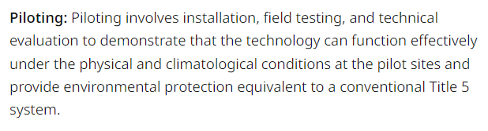
What do we mean by “pilot” ?
EPA
MassDEP

Slide 5
SNEP-funded Pilot Projects
Responsible Management Entities for I/A Septic Systems (Barnstable County - Ongoing)
Nutrient extraction with Ribbed Mussels (Narragansett Bay)
Innovative and Alternative Septic Systems
Permeable Reactive Barriers for Nitrogen in Groundwater
  Cape 208→Identified PRBs → SNEP-funded Pilot Projects (Town of Falmouth, UMass SMAST)
Pilot Watersheds Initiative

Slide 6
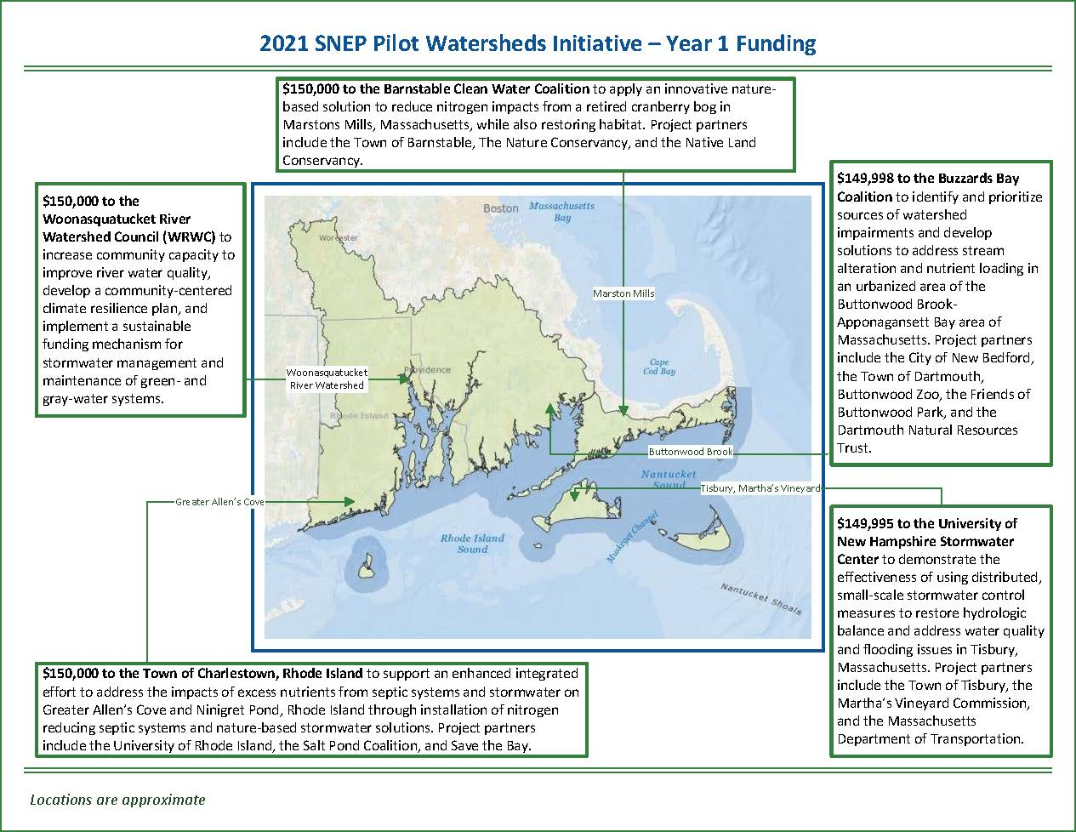

Slide 7
General Guidance and Discussion Questions
What is SNEP doing well?
How can SNEP better work with you or your organization, benefit you or your organization, or integrate your work?
What could SNEP improve upon or do differently?
Where do you see regional gaps in information, funding, etc. that SNEP could fill?
What do you think SNEP should do?

Slide 8
How can our Program better amplify the successes and lessons-learned from previously funded projects?

Slide 9
How should our Program share information?

Slide 10
How can we scale up from a site-level impact to a regional impact?

Slide 11
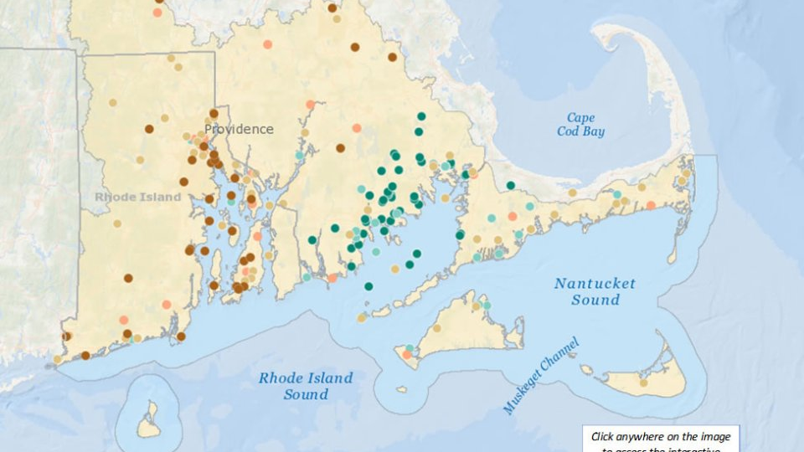
Overview of Projects Funded to Date

