Slide 1
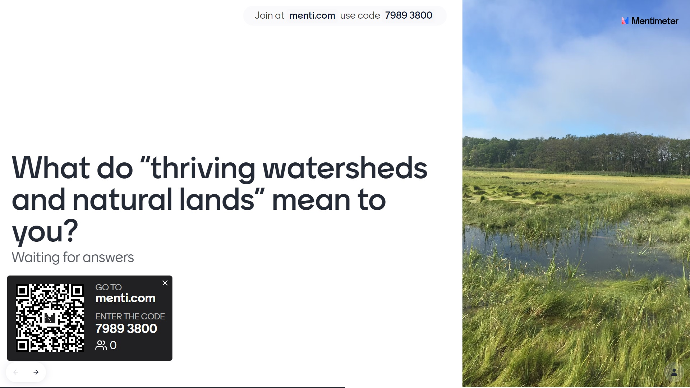
Link

Slide 2
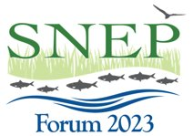
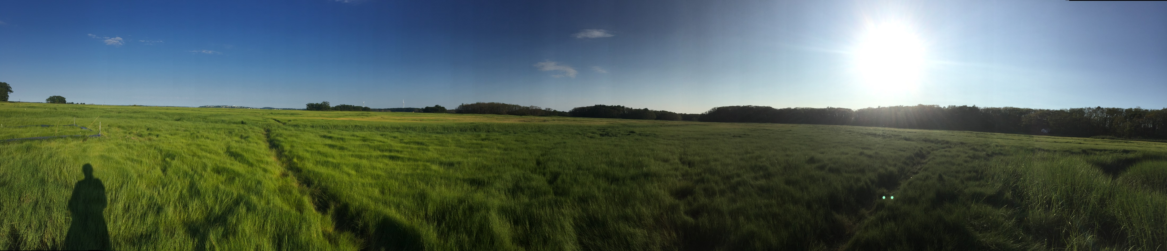
Room 3: Habitat Goals
Facilitators:
Mary Schoell, Narragansett Bay National Estuary Research Reserve
Haley Miller, USEPA Region 1
Margherita Pryor, USEPA Region 1

Slide 3
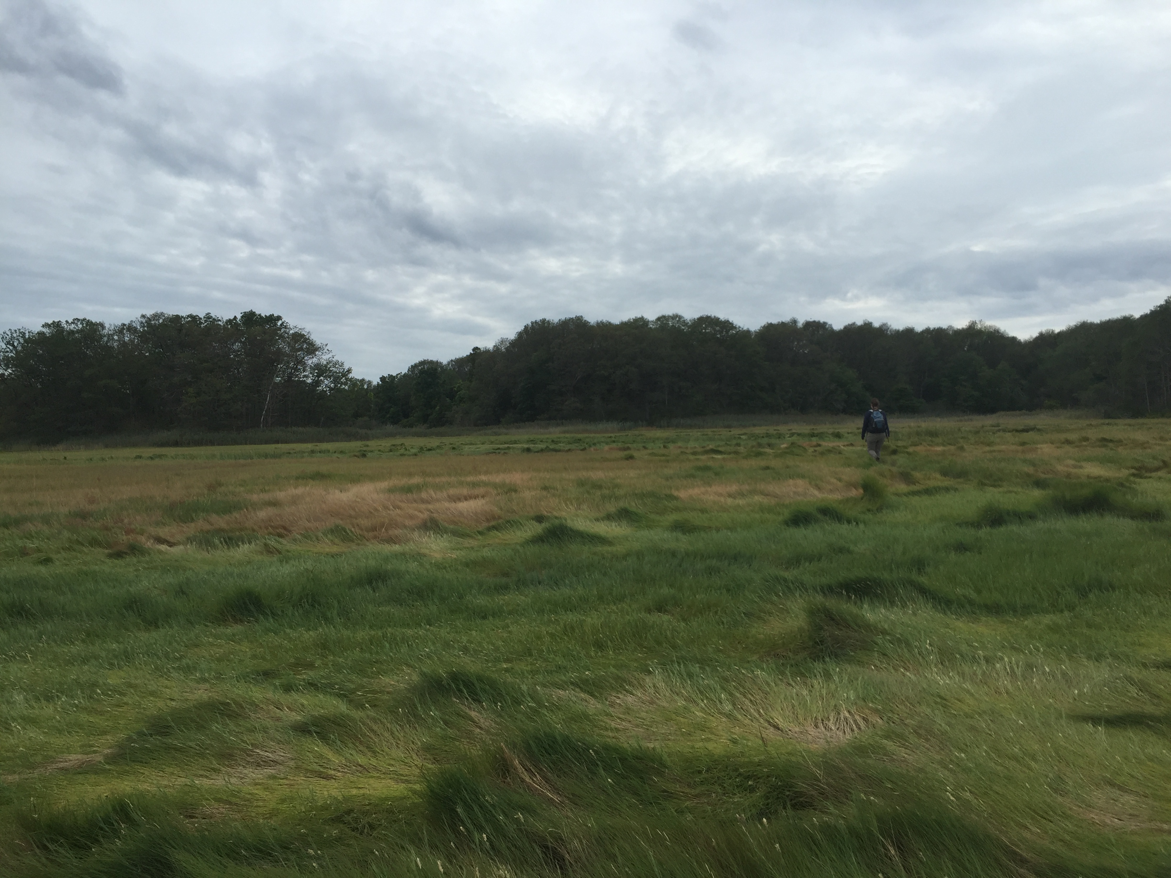
Agenda
Word Cloud Activity (5 mins)
Welcome and Introductions (5 mins)
Background on SNEP Background and Resources (5 mins)
Activity: Feedback on how participants prioritize habitat actions (25 mins)
Group Report Out (10 mins)
Wrap Up Word Cloud (10 mins)

Slide 4
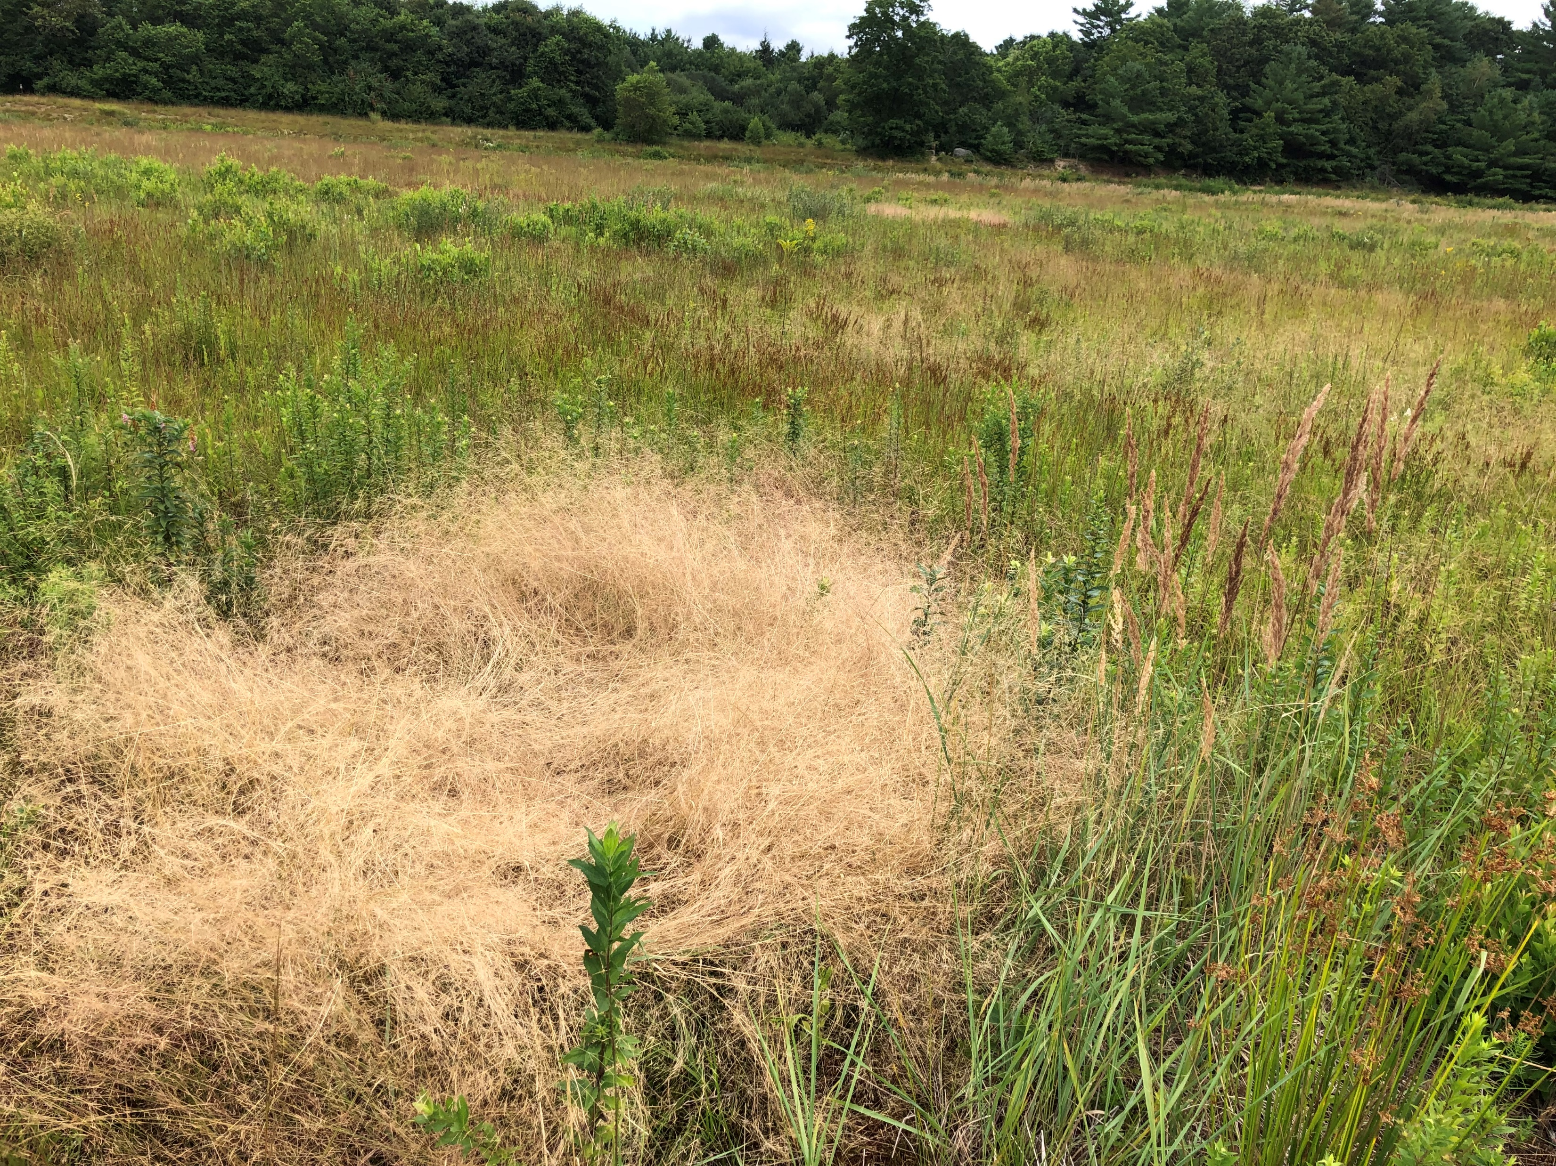
Goal of the session
Develop a common understanding of “thriving watersheds and natural lands”, and discuss critical factors that define this goal

Slide 5
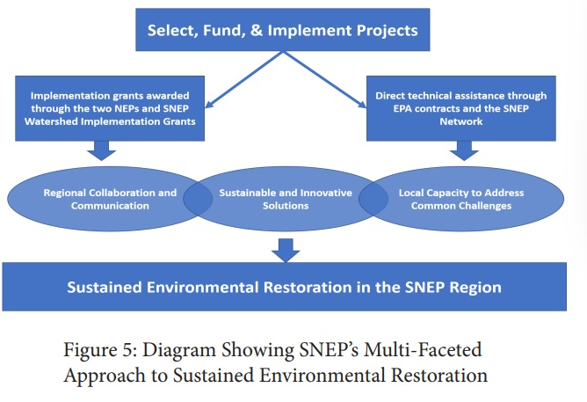

Slide 6
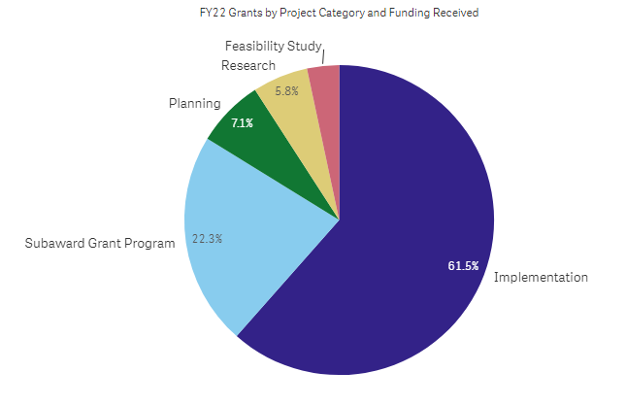

Slide 7
Project Title | Habitat Action | SNEP Funding
Annual Harvest of the Invasive Reed, Phragmites Australis: A Potential Nitrogen Mitigation Strategy with Widespread Application | Invasive Species Management | $ 135,693.00
Bioreactors for Nitrogen Removal in Cranberry Farms | Research | $232,352.00
Brandt Island Cove land Acquisition | Habitat Preservation | $ 35,000.00
Broad Meadow Brook Wetland and Stream Restoration | Floodplain Connection | $ 74,800.00
Buttonwood Brook-Apponagansett Bay Restoration Action Plan | Restoration Planning | $749,780.00
Capwell Mill Pond Dam Removal Feasibility Study and Design | Restoration Planning | $124,000.00
Childs River Dam Removal & River Restoration | Wetland Restoration | $ 450,000.00
Community-Based Habitat Restoration: Water Chestnut Management in the Blackstone & Ten Mile | Invasive Species Management | $ 262,077.00
Developing Fall River Resilience; Cook Pond Project | Restoration Planning | $ 215,569.00
Doggett Brook Land Purchase | Habitat Preservation | $ 20,640.00
Fairhaven Land Acquisition | Habitat Preservation | $ 25,000.00
Golf Course/Silver Creek Restoration | Wetland Restoration | $ 300,000.00
Great South Meadow Cedar Swamp Land Purchase | Habitat Preservation | $ 45,000.00
Hinckleys Pond - Herring River Headwaters Eco-Restoration Project | Wetland Restoration | $ 146,700.00
Maidford River and Floodplain Restoration Phase 2 | Riparian Restoration | $ 238,274.00
Marstons Mills Watershed Innovative and Alternative Watershed Management Implementation and Monitoring | Restoration Planning | $ 750,000.00
Mattapoisett River West Bank Land Purchase | Habitat Preservation | $ 45,000.00
Oyster Habitat Conservation and Restoration Planning | Shellfish Restoration | $ 150,000.00
Popponasset Bay Coastal Resilience and Habitat Restoration Project | Shellfish Restoration | $ 198,174.00
Protecting Salt Marshes | Wetland Restoration | $ 150,000.00
Promoting Salt Marsh Resilience | Research | $ 223,533.00
Quantifying potential for oyster aquaculture and impacts on estuarine nitrogen related water quality: Cockeast Pond and the East Branch of the Westport River | Research | $ 884,717.00
Regional Watershed Permit Implementation for Pleasant Bay | Shellfish Restoration | $ 250,000.00
Restoring the Ecological Resilincy of the Kickemuit River Estuary | Floodplain Connection | $ 80,000.00
Rochester Land Acquisition | Habitat Preservation | $ 70,000.00
Roth Woodlands Stream Restoration Culvert Replacement | Floodplain Connection | $ 138,842.00
Sesachacha Pond Ecological Enhancement and Resilience Strategies | Shellfish Restoration | $ 158,456.00
Snell Creek Land Acquisition | Habitat Preservation | $ 30,000.00
Tribal Commonlands Ecological Enhancements and Resiliency Project in Partnership with the Town of Aquinnah, Massachusetts | Floodplain Connection | $ 456,868.00
Upper Bass River Watershed Restoration | Riparian Restoration | $ 253,799.00
Upper Childs River & Bog Restoration | Wetland Restoration | $ 245,000.00
Weir Creek Tidal Restoration | Floodplain Connection | $ 138,616.00
 | Total | $ 7,277,890.00

Slide 8
Habitat Action | Sum of SNEP Funding
Floodplain Connection | $ 889,126
Habitat Preservation | $ 270,640
Invasive Species Management | $ 397,770
Riparian Restoration | $ 492,073
Wetland Restoration | $ 1,291,700
Shellfish Restoration | $ 756,630
Research | $ 1,340,602
Restoration Planning | $ 1,839,349
Grand Total | $ 7,277,890

Slide 9
Flip Chart Activity – Small Groups
Be as creative as you would like!
Online: Jamboard
https://jamboard.google.com/d/1lekhbu-scrbYoxutDC405_wc1LxZPkldN61iLzO3W-c/edit?usp=sharing
Q1: What are the biggest threats to your priority habitat(s)?
Q2: What are some solutions you would like to see prioritized/funded to mitigate threats?
Q3: What kinds of resources do you need to get there (e.g., $, technical assistance, policy changes, incentives, information, partnerships, new mechanisms, etc.)

Slide 10
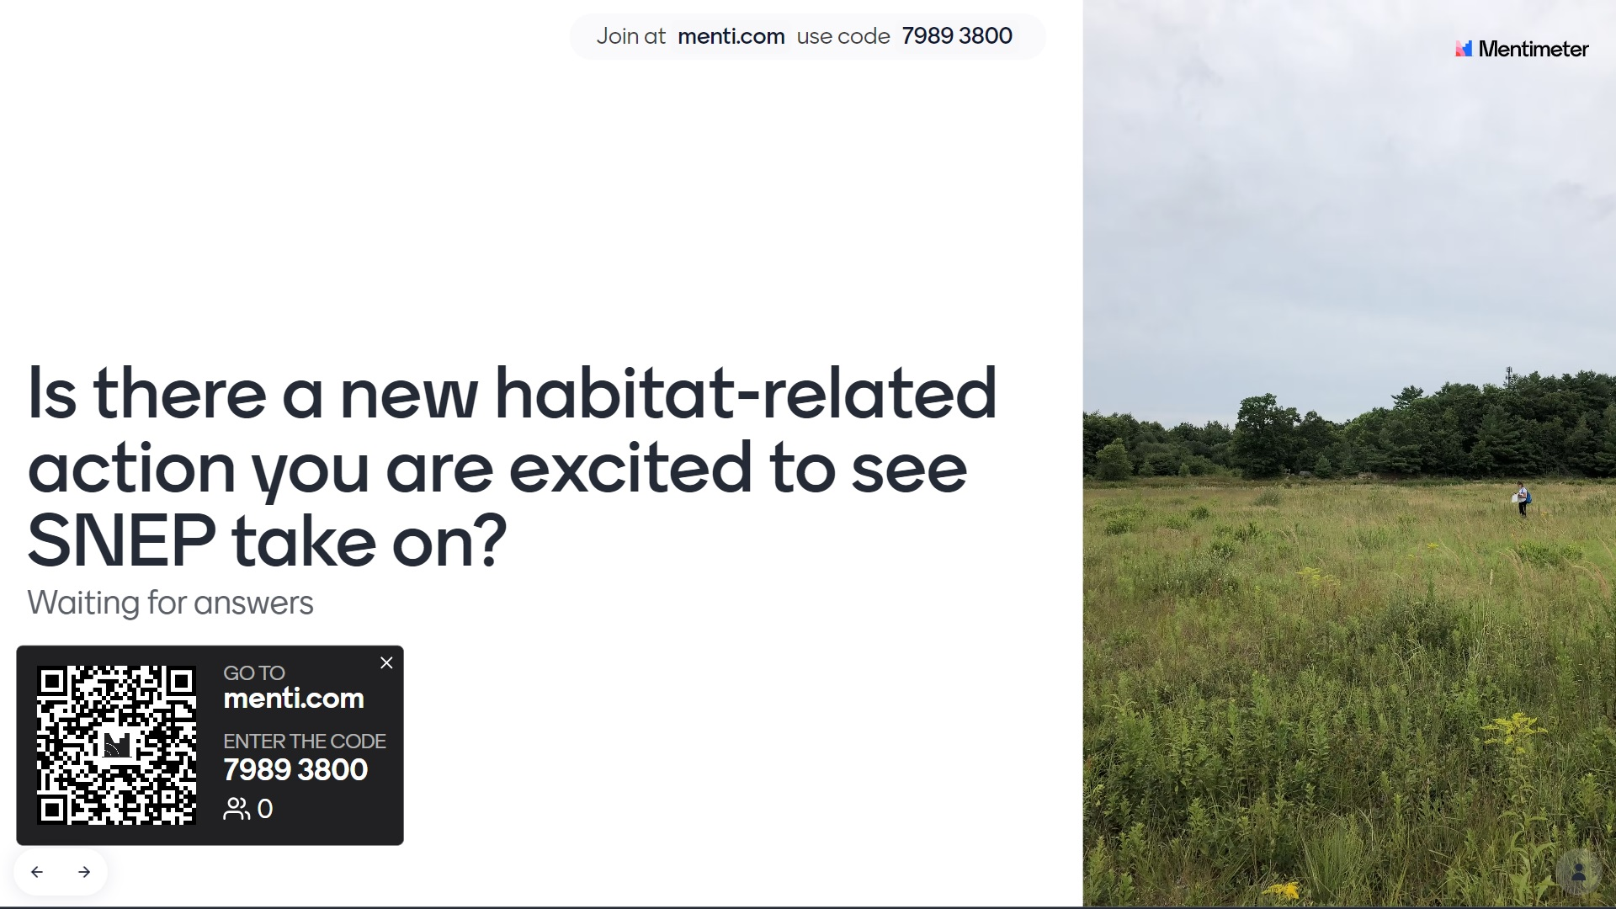
Link

Slide 11

Project Title | Habitat Goal | SNEP Funding
Popponasset Bay Coastal Resilience and Habitat Restoration Project | Oyster Reef Restoration | $ 198,174.00
Oyster Habitat Conservation and Restoration Planning | Oyster Reef Restoration | $ 150,000.00
Community-Based Habitat Restoration: Water Chestnut Management in the Blackstone & Ten Mile | Invasive Species Management | $ 262,077.00
Annual Harvest of the Invasive Reed, Phragmites Australis: A Potential Nitrogen Mitigation Strategy with Widespread Application | Invasive Species Management | $ 135,693.00
Quantifying potential for oyster aquaculture and impacts on estuarine nitrogen related water quality: Cockeast Pond and the East Branch of the Westport River | Oyster Reef Restoration | $ 884,717.00
Childs River Dam Removal & River Restoration | Wetland Restoration | $ 450,000.00
Upper Childs River & Bog Restoration | Wetland Restoration | $ 245,000.00
Upper Bass River Watershed Restoration | Riparian Restoration | $ 253,799.00
Broad Meadow Brook Wetland and Stream Restoration | Floodplain Connection | $ 74,800.00
Hinckleys Pond - Herring River Headwaters Eco-Restoration Project | Wetland Restoration | $ 146,700.00
Restoring the Ecological Resilincy of the Kickemuit River Estuary | Floodplain Connection | $ 80,000.00
Marstons Mills Watershed Innovative and Alternative Watershed Management Implementation and Monitoring | Wetland Restoration | $ 750,000.00
Mattapoisett River West Bank Land Purchase | Habitat Preservation | $ 45,000.00
Great South Meadow Cedar Swamp Land Purchase | Habitat Preservation | $ 45,000.00
Doggett Brook Land Purchase | Habitat Preservation | $ 20,640.00
Weir Creek Tidal Restoration | Floodplain Connection | $ 138,616.00
Sesachacha Pond Ecological Enhancement and Resilience Strategies | Oyster Reef Restoration | $ 158,456.00
Rochester Land Acquisition | Habitat Preservation | $ 70,000.00
Brandt Island Cove land Acquisition | Habitat Preservation | $ 35,000.00
Snell Creek Land Acquisition | Habitat Preservation | $ 30,000.00
Fairhaven Land Acquisition | Habitat Preservation | $ 25,000.00
Total |  | $ 4,198,672.00

