Slide 1

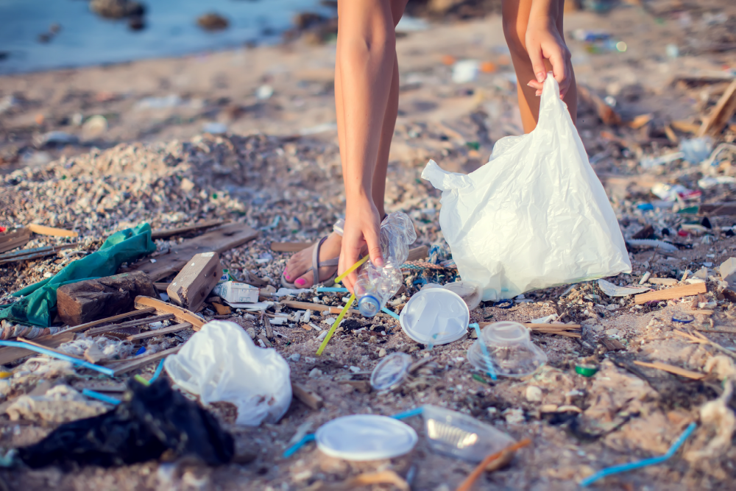
South Atlantic Strategy Stakeholder Meeting
March 28, 2023

Slide 2
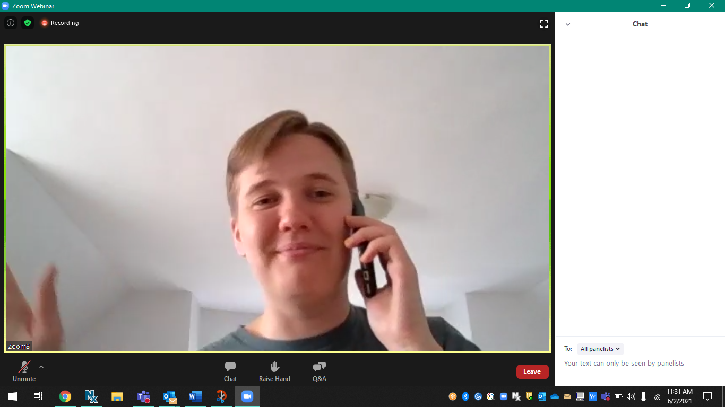

Meeting Logistics & Housekeeping
Questions for Presenters,
Tech Support
To ask a question: Type your question in the Chat box or click the Raise Hand icon and we will ask you to unmute.
Technical difficulties: If you are having technical difficulties, please send a message through the Chat or email Kathryn.Harrison@erg.com
Slides: A PDF of these slides are available in the Chat.

Slide 3
SAS Stakeholder Meeting Agenda
Welcome & Meeting Objectives
South Atlantic Strategy Background
Overview of SAS Project Tracker
Action Implementation!
  Litter Enforcement Workshop Grants
  Reducing Single Use Plastics in Durham, NC
  Trash Traps
SAS Funding Compendium
EPA Funding Sources
Meeting Feedback
Closing & Next Steps

Slide 4
Welcome & Meeting Objectives
Wade Lehman, USEPA Region 4

Slide 5
South Atlantic Strategy Background
Chris Plymale, USEPA Region 4

Slide 6
Overview of SAS Project Tracker
Sargon DeJesus, ERG

Slide 7
Action Implementation!

Slide 8


Slide 9


Slide 10
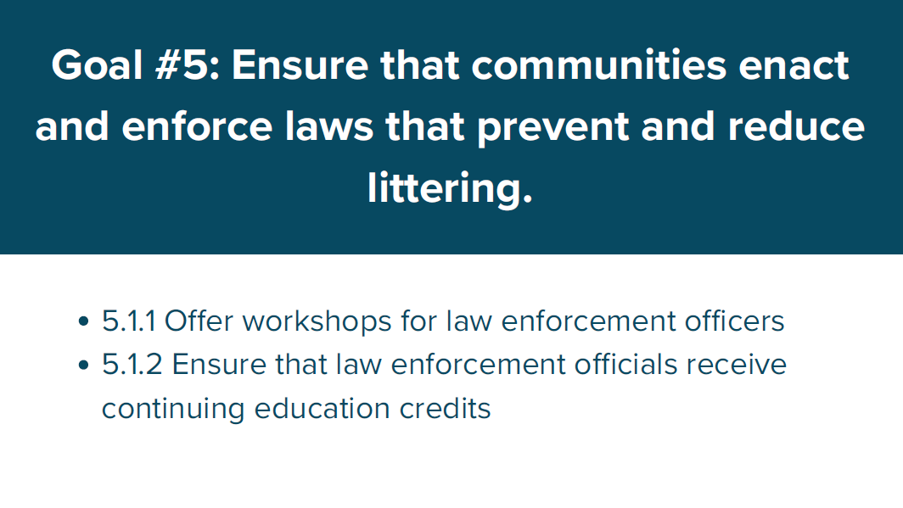

Slide 11
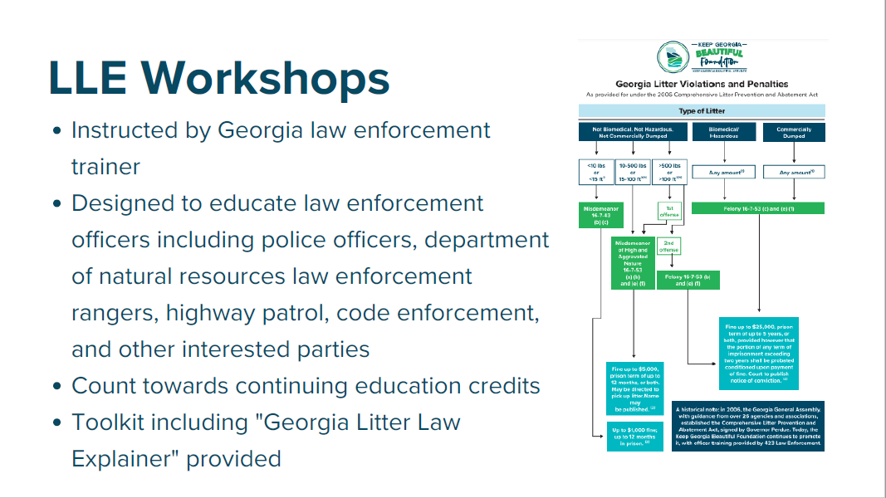

Slide 12


Slide 13
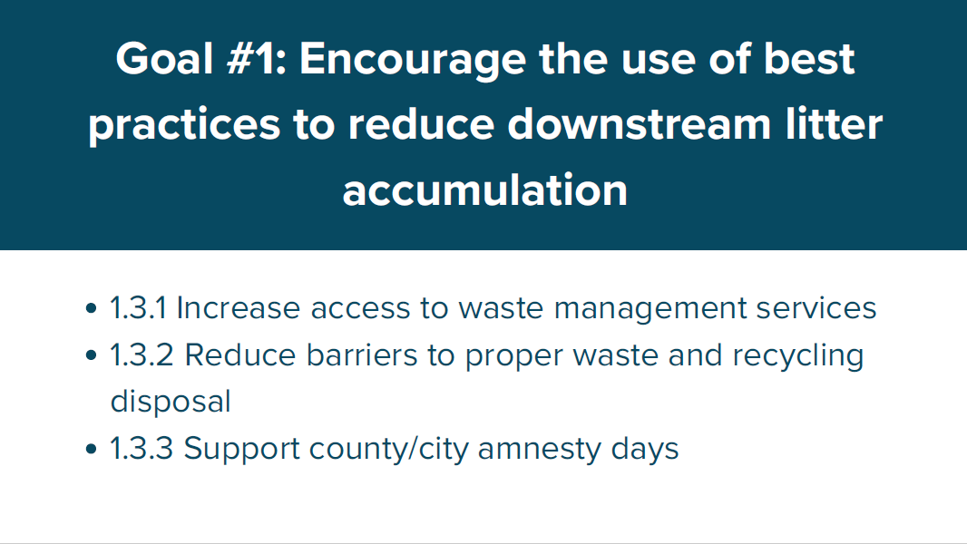

Slide 14
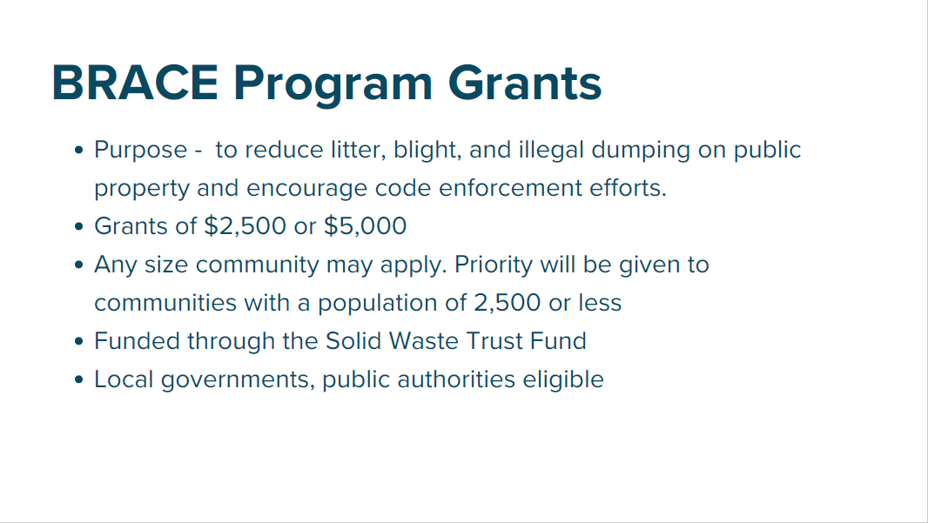

Slide 15
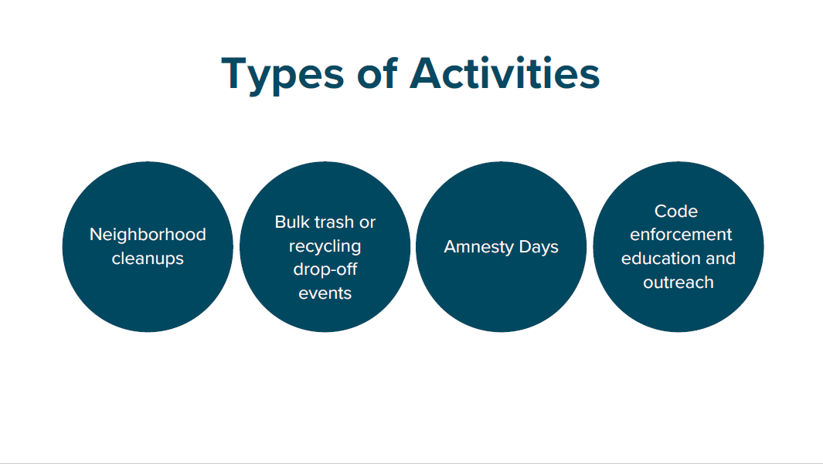

Slide 16


Slide 17
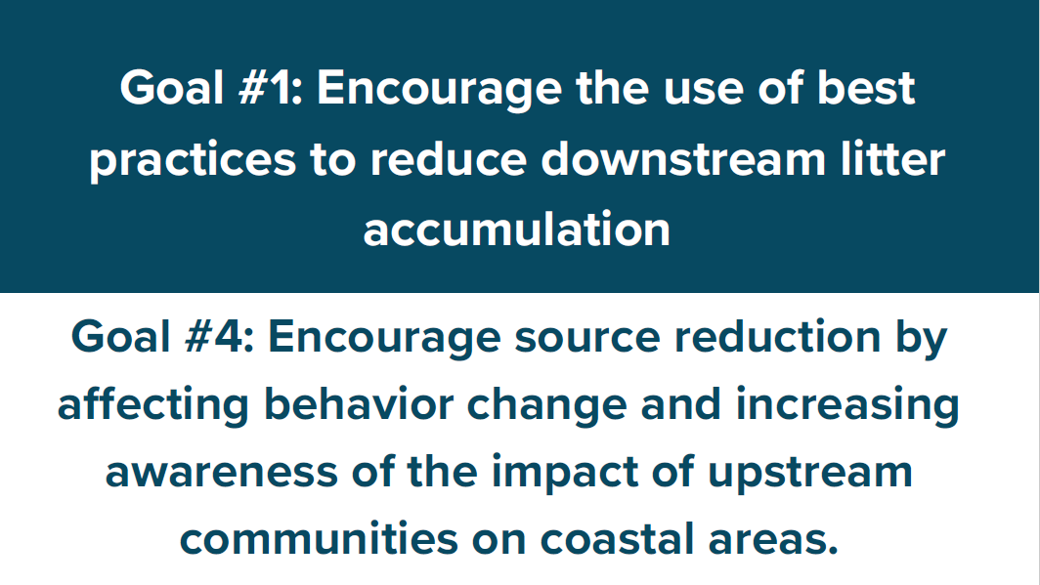

Slide 18
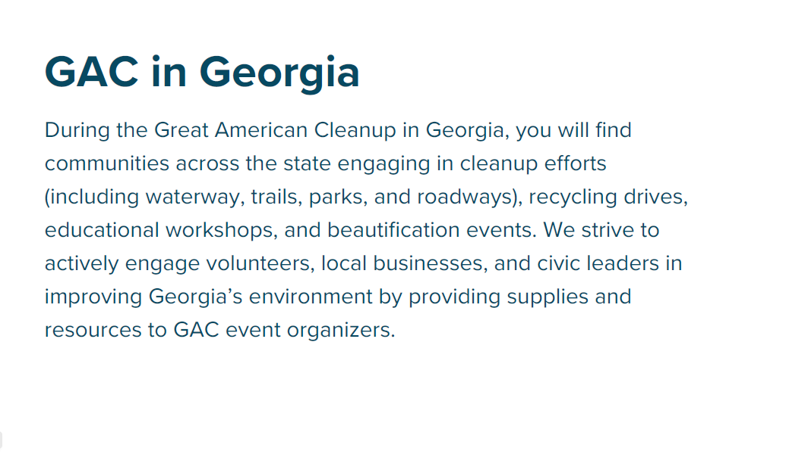

Slide 19


Slide 20


Slide 21
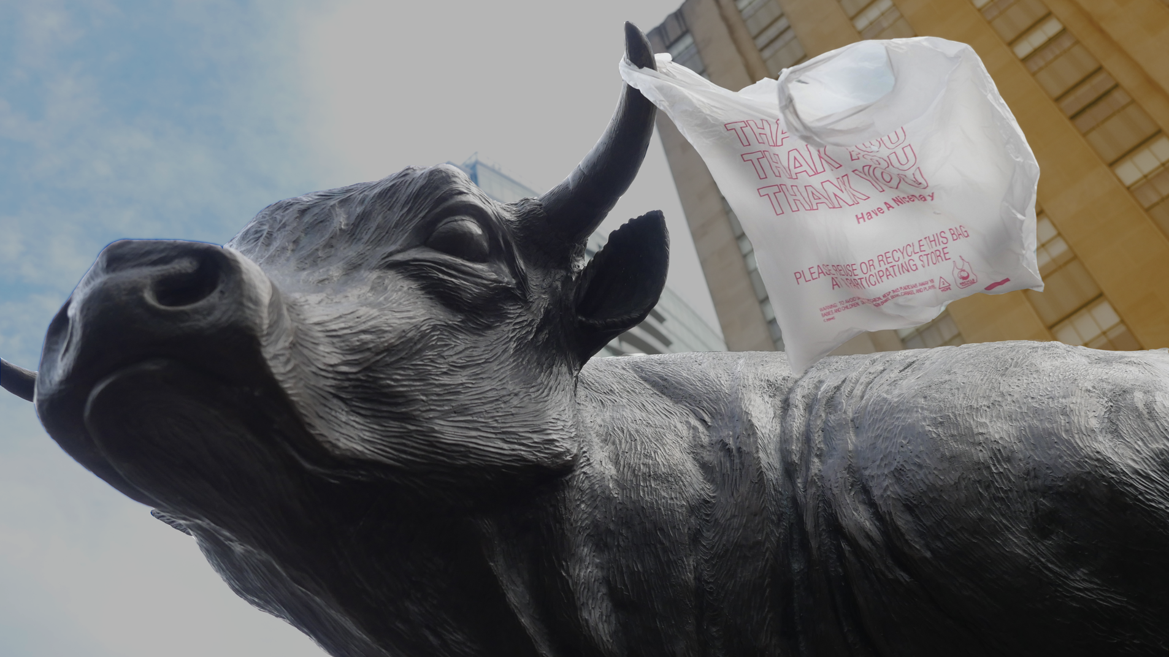


Reducing Single-use Plastics in Durham, NC
Nancy Lauer, PhD, Policy Fellow, nancy.lauer@law.duke.edu
Michelle Nowlin, Co-Director, nowlin@law.duke.edu
http://www.dontwastedurham.org/plastic-waste-prevention-policy

Slide 22
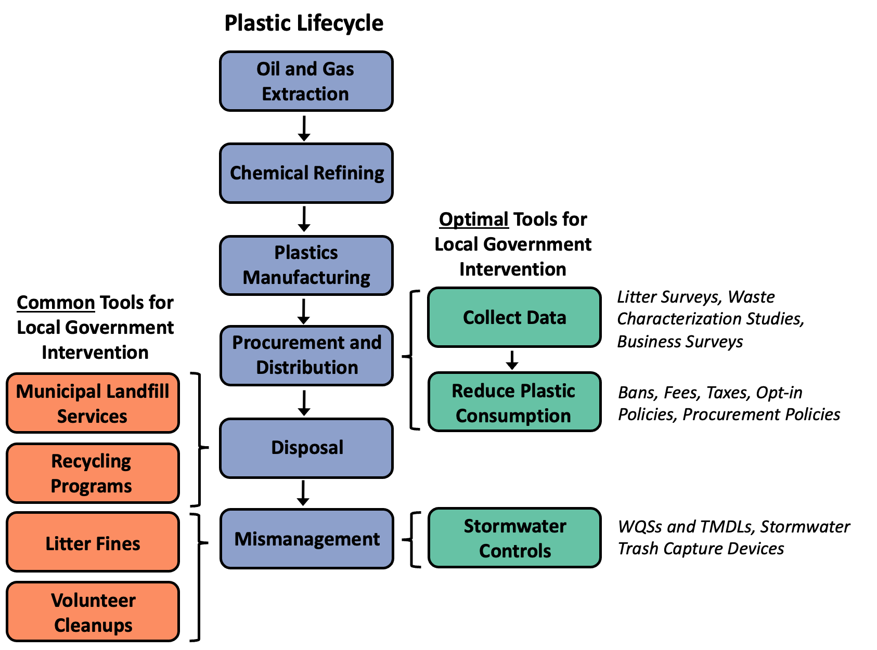

Slide 24




Slide 25
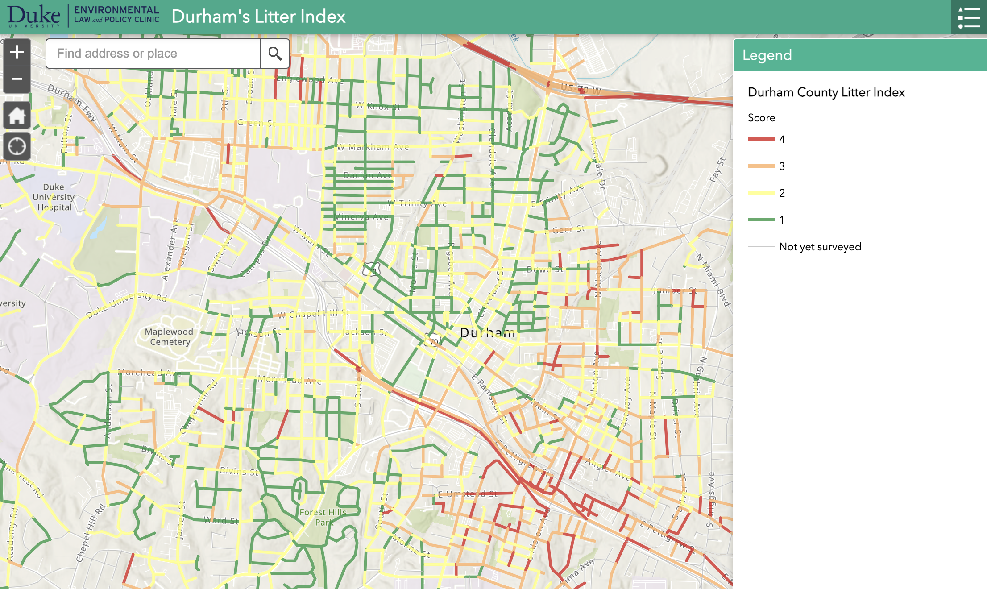
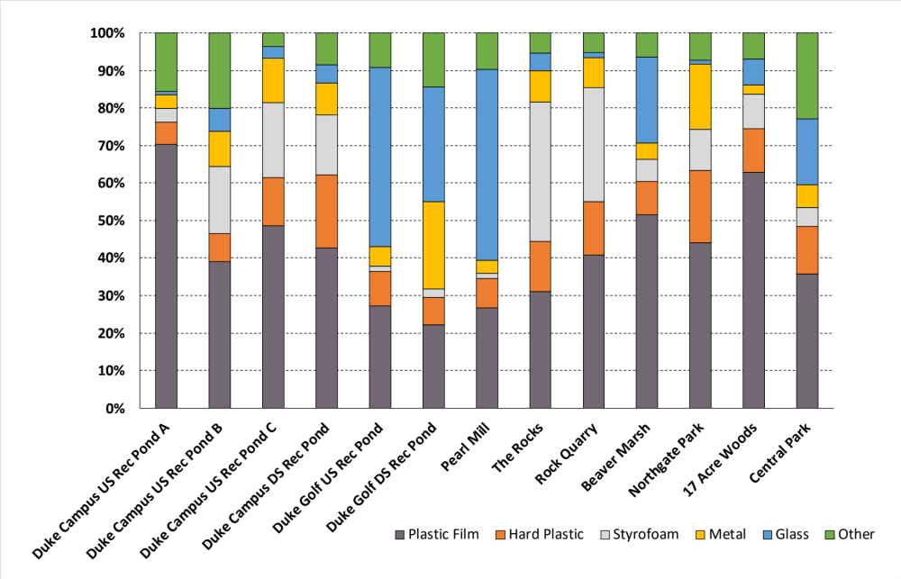
https://arcg.is/yf4uO0

Slide 26
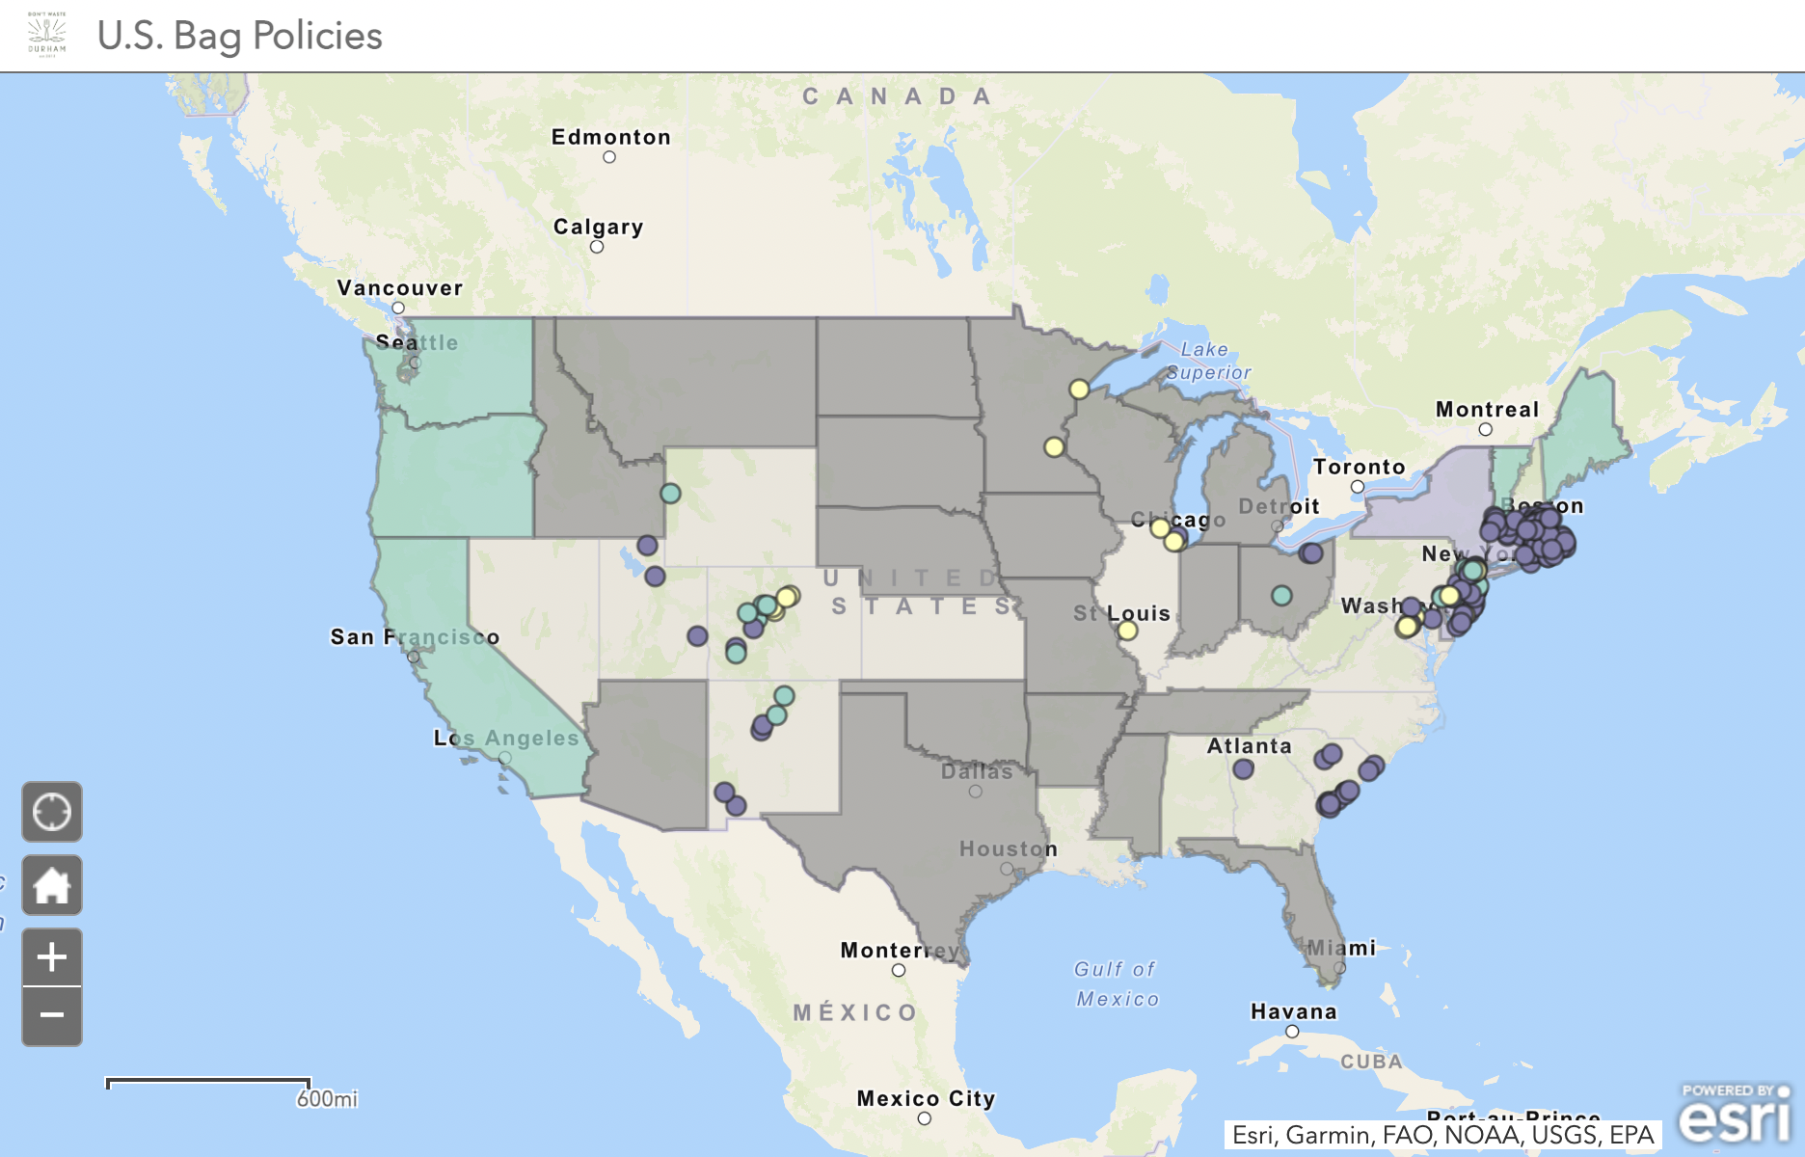
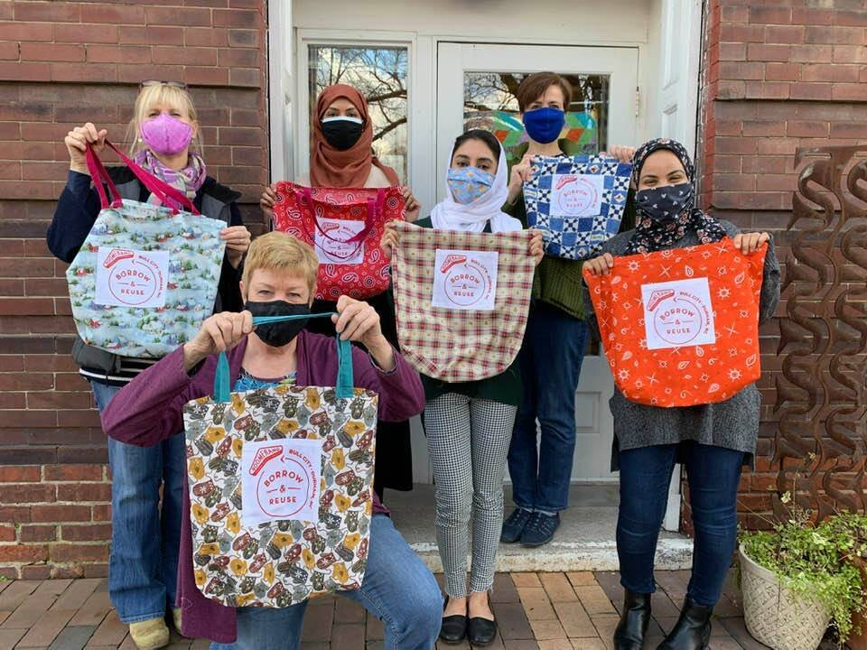
Proposal:
The City and County of Durham adopt an ordinance that requires businesses to charge a fee of at least $0.10 on all single-use bags, no matter their material, at the point of sale.
Establish reuse programs as a line item in the City Solid Waste Management Department’s and County Solid Waste Division’s annual budgets to receive the collected $0.10 fees.
https://arcg.is/1KjiHn

Slide 27
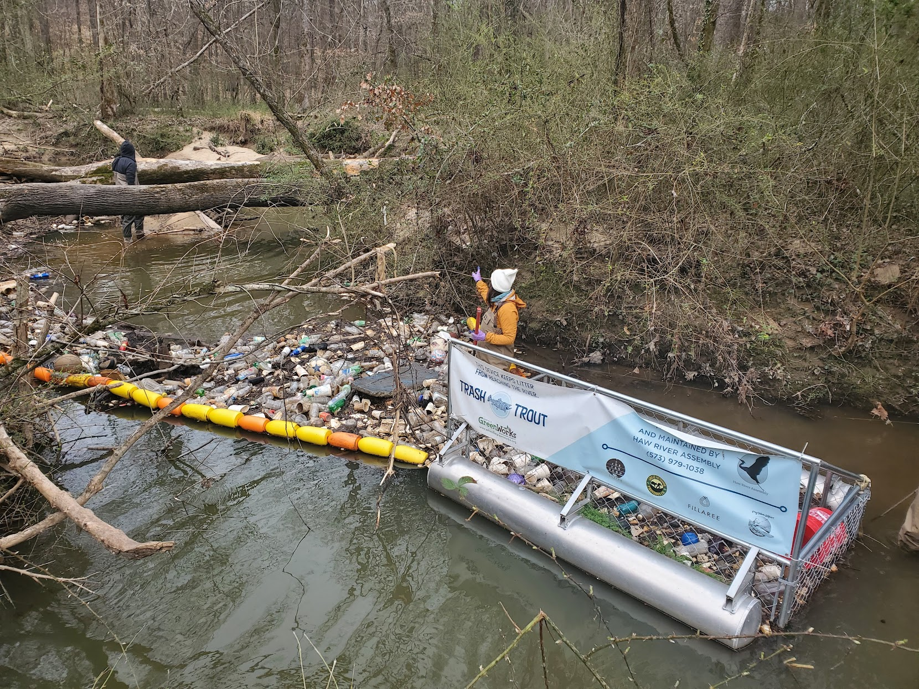
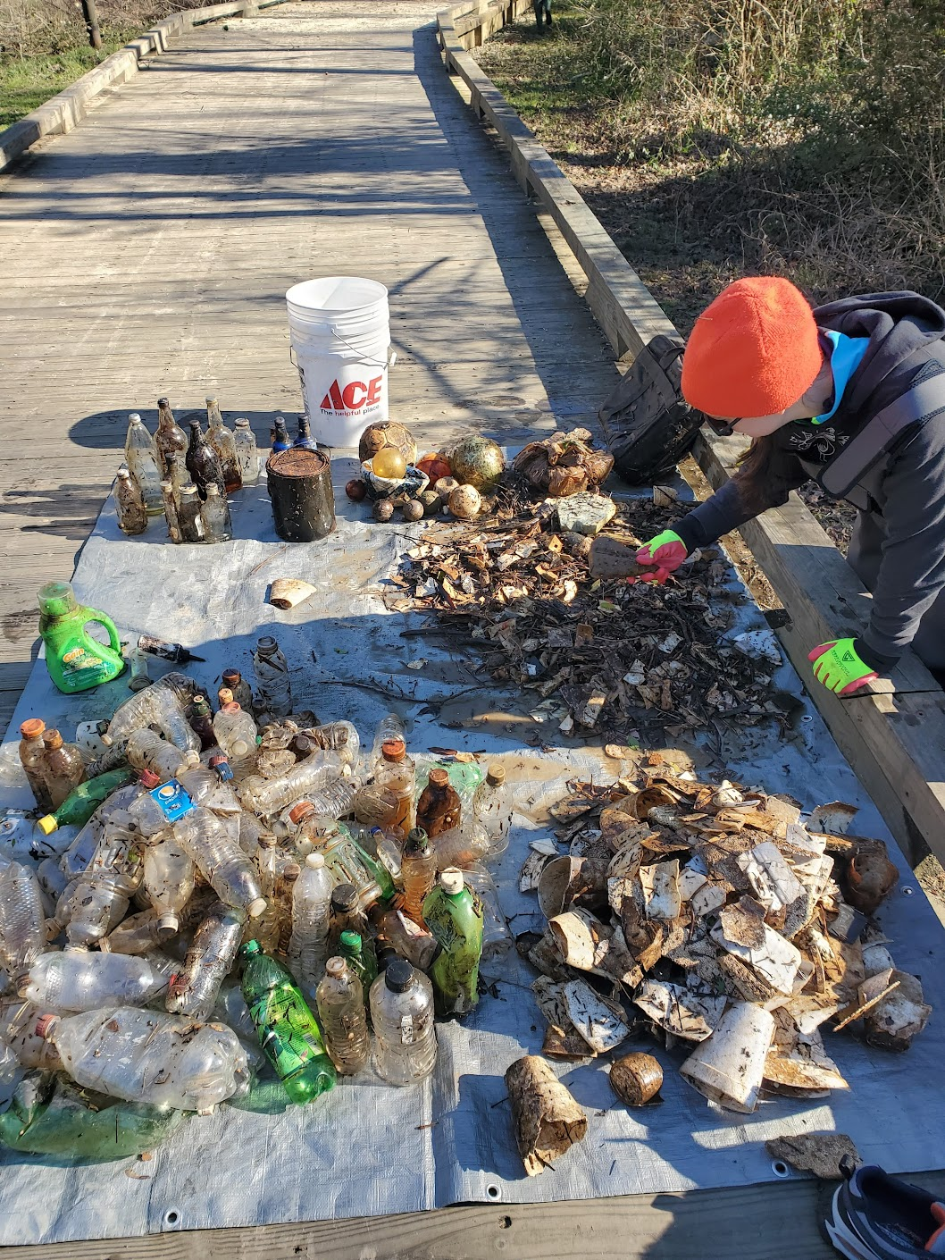

Slide 28
Thank you!
Nancy Lauer, PhD, Policy Fellow, nancy.lauer@law.duke.edu
Michelle Nowlin, Co-Director, nowlin@law.duke.edu
http://www.dontwastedurham.org/plastic-waste-prevention-policy

Slide 29

Trash Traps
Jordan Yu
Watershed Protection Specialist

Slide 30
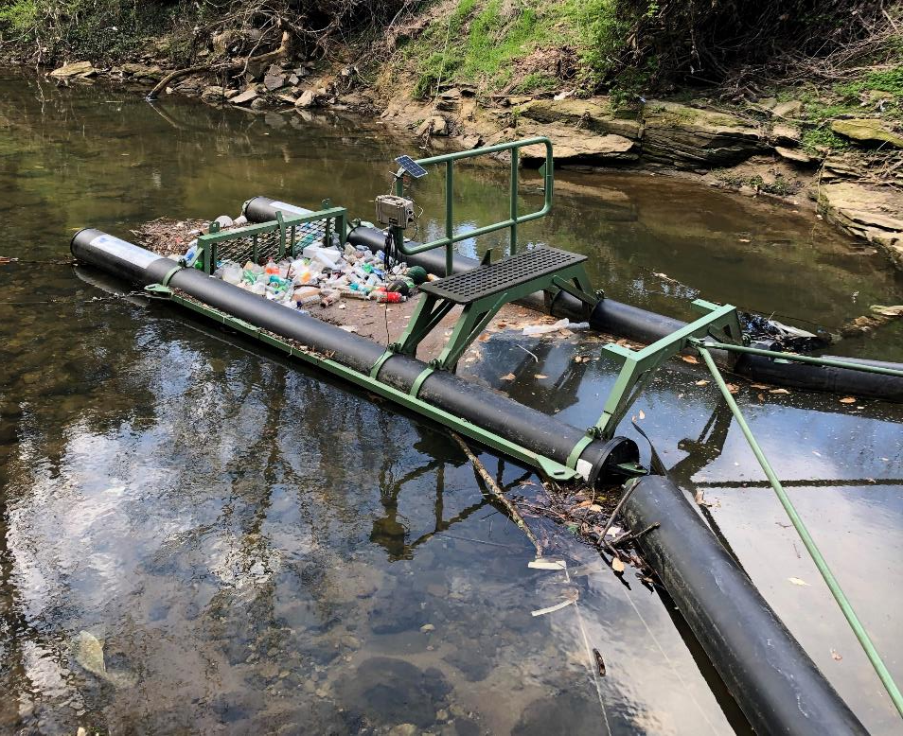
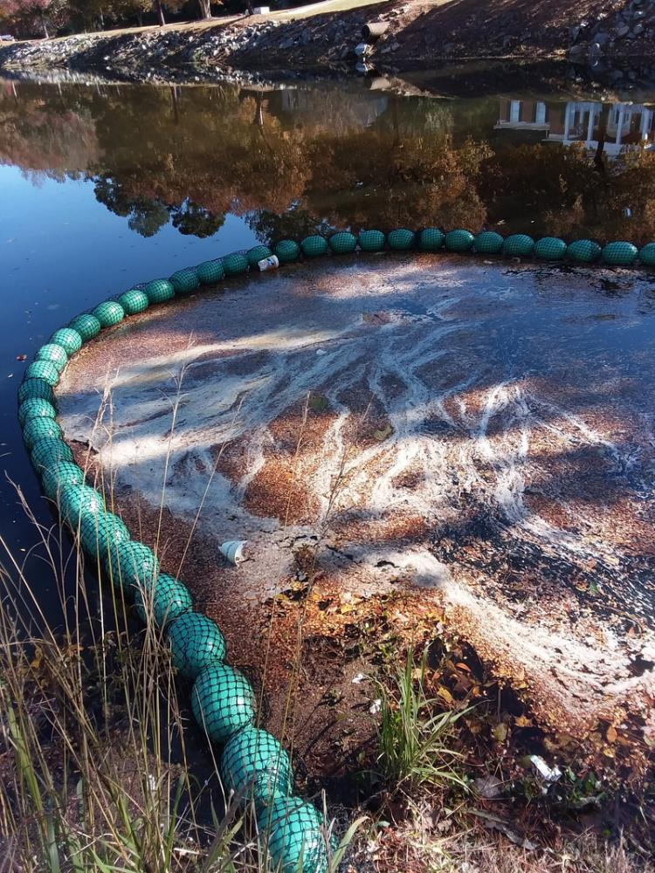
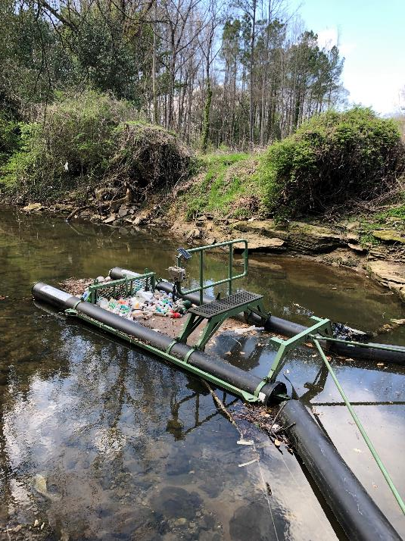

Types of Traps:
“Watergoat” & “Bandalong”

Slide 31
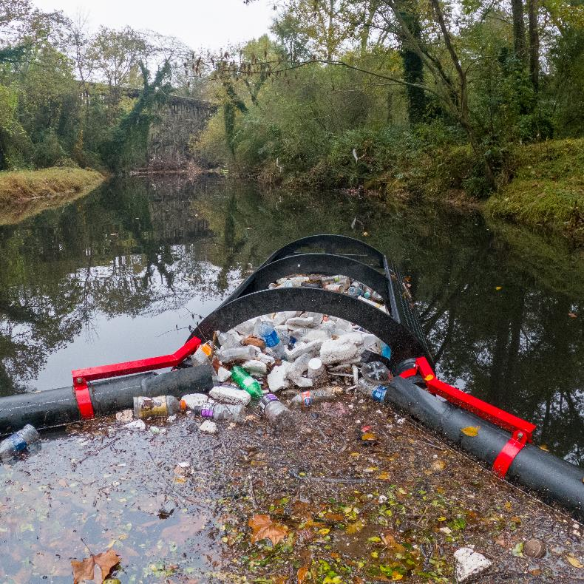
Trash Collection Results
CRK currently operates 13 trash traps in 4 Georgia counties
Collected over 3,300 lbs of trash in 2022
Over 760 lbs of recycling: 25% by weight & 45% by volume
Litter collection rates vary greatly depending on geography and weather patterns
CRK utilized EPA’s Escaped Trash Assessment Protocol (ETAP) for data collection

Slide 32
ETAP Results – Proctor Creek 2021-2022
Littered Item Use | # of Items
Plastic Beverage Bottles | 1994
Misc. Foam Pieces | 395
Foam Cups | 264
Metal Bottles & Cans | 130
Toys & Recreational Items | 122
Tobacco & Smoking | 118
Foam Clamshells | 111
Plastic Bottle Caps | 105
Foam Plates & Bowls | 71
Plastic Grocery Bags | 67

Slide 33
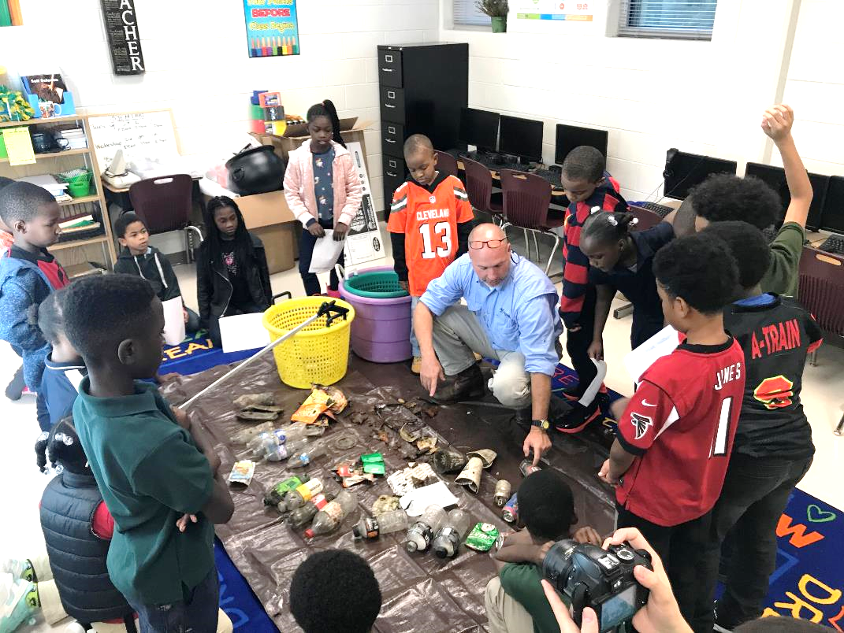
Educational Programming
As part of our educational programming, CRK has spoken to hundreds of students about trash trap technology and the harmful effects of littering
Cleanup and ETAP data is shared with corporate sponsors and university researchers
CRK features ETAP demonstrations at festivals and community events

Slide 34
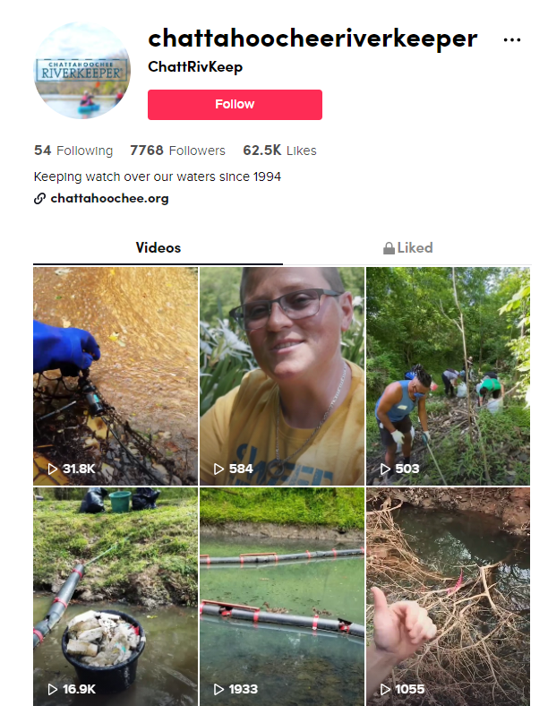
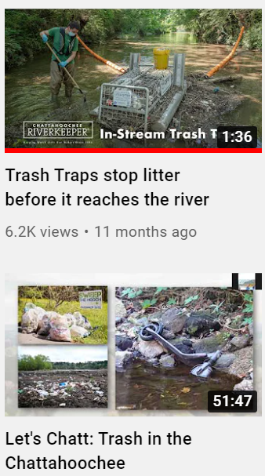
Outreach & Social Media
CRK’s TikTok, Youtube, and Facebook videos have reached over 170,000 people around the globe
Trash traps and trash cleanups in general can be leveraged to draw attention to other forms of pollution
CRK is developing an interactive StoryMap combining data from our trash traps and traditional cleanups

Slide 35
SAS Funding Compendium
Helen Anthony, ERG

Slide 36
EPA Trash Project Funding Sources

Slide 37




Clean Water State Revolving Funds
March 2023

Slide 38
Clean Water State Revolving Funds
Federal/state partnerships designed to create, in each state, a perpetual source of financing for drinking water and wastewater infrastructure​
Combines federal and state funds to provide low-cost financing for water quality improvement projects​
State implemented and operated ​
Flexibility in assistance provided​
Type of assistance: loans, refinancing, loan guarantees, technical assistance​
Availability of special financing terms to disadvantaged communities to help address equity and affordability

Slide 39
CWSRF Eligible Entities
  Municipalities, intermunicipal, interstate, or State agencies.
  Nonprofit entities*
  Private, for-profit entities*
  Watershed groups*
  Community groups*
  Homeowners Associations*
  Individuals*
*some states do not fund private systems/private entities.
Notes:
There are a wide variety of eligible projects and flexibilities available in the CWSRF.
Included in a long list of eligible recipients are communities, individuals, citizens groups, non-profit organizations, and the 28 NEPs themselves. Since the program is managed by the states, the funding of eligible projects may vary according to the priorities of each state.
There are also many types of projects that the CWSRF may finance- from watershed and nonpoint source, many projects that protect water quality - not just wastewater treatment system investment and upgrades are eligible. In order to address the water quality impairments, we’re seeing across the country we’re eager to see state revolving funds increase investments in things like natural and green infrastructure taking advantage of the wide scope of eligible projects for the CWSRF.
Overview of CWSRF Eligibilities (epa.gov)

Slide 40
CWSRF Eligible Projects
Clean Water Act
603(c)(1) Construction of publicly owned treatment works (POTW)
603(c)(2) Implementation of a nonpoint source management program
603(c)(3) Implementation of a national estuary program CCMP
603(c)(4) Decentralized systems
603(c)(5) Stormwater management
603(c)(6) Projects that reduce the demand for POTW capacity through water conservation, efficiency, and reuse
603(c)(7) Watershed pilot projects
603(c)(8) Projects that reduce the energy consumption needs for POTWs
603(c)(9) Reuse of wastewater, stormwater, or subsurface drainage water
603(c)(10) Security measures at POTWs
603(c)(11) Technical assistance to small and medium POTWs
603(3)(12) Assistance to a qualified nonprofit entity to provide assistance to an eligible individual for the repair or replacement of household decentralized treatment systems
https://www.epa.gov/sites/default/files/2016-07/documents/overview_of_cwsrf_eligibilities_may_2016.pdf
Notes:
There are a wide variety of eligible projects and flexibilities available in the CWSRF.
There are also many types of projects that the CWSRF may finance- from watershed and nonpoint source, many projects that protect water quality - not just wastewater treatment system investment and upgrades are eligible.
If a trash capture project implements a NPS management plan or NEP CCMP, then it would be CWSRF eligible. A capital project like in-stream trash traps would be eligible. The NPS management plan does not have to explicitly name the project, but rather generally cover the pollutant of concern.
Another eligibility includes “cooperative efforts to address nonpoint sources of pollution” so projects to address trash in waterways may fall under that.
Overview of CWSRF Eligibilities (epa.gov)
Trash capture projects that I have noticed in our reporting system were usually stormwater management improvement plans that had aspects of trash capture like catchment basins, or ‘trash removal structures’ as part of larger projects like streambank restoration and stormwater management.

Slide 41
CWSRF Funding in the Bipartisan Infrastructure Law
EPA is making $12,713,000,000 in additional capitalization grants available to the state CWSRFs over the next five years (FY22-26)
Most of this money may fund any project eligible under the CWSRF; some funding is targeted towards projects focused on “emerging contaminants.”
States have the authority to waive repayment on some of this new funding (e.g., forgive some or all of the loan’s principal or provide grants)- 49% must go disadvantaged communities/address affordability
Clean Water for Communities | $12.7 billion
General: Clean Water State Revolving Funds | $11.7 billion
Addressing Emerging Contaminants: Clean Water SRFs | $1 billion
Notes:
The Bipartisan Infrastructure Law, signed by President Biden in November 2021, is a historic investment by Congress and President Biden in key programs and initiatives implemented by EPA to build safer, healthier, cleaner communities across the nation.
It includes $50b dollars to strengthen the nation’s wastewater and drinking water systems. Over $43 billion of this funding will go through the existing Clean Water and Drinking Water State Revolving Funds.
The Clean Water SRF has $12.7 an ADDITIONAL capitalization grants available above and beyond the annual appropriations that the programs receive.
$11.7 billion of this will be available as “general supplemental” and could go towards any CWSRF eligible project.
$1 billion is to address emerging contaminants- that I’ll talk a bit about in a second.
Projects addressing microplastics are eligible for the BIL EC funds, but they must also meet the normal CWSRF eligibility criteria to be eligible. Also, to be eligible for BIL EC funds, any trash capture projects would need to remove microplastics 5 microns or smaller (basically, it has to pick up microplastics, not just larger plastics that could turn into microplastics.)
Additionally, States have the authority to waive repayment of 49% of the general supplemental funds will be available as subsidy in the form of grants and forgiveable loans, while 100% of the emerging contaminants funds will be provided as subsidy

Slide 42
CWSRF Intended Use Plans
An “IUP’ is a document developed by SRFs each year describing how the program expects to use its funds
Includes a ranked list of all projects that applied for CWSRF assistance- aka the Project Priority List
Notes:
An Intended Use Plan, or IUP, is a document developed by states each year describing how their CWSRF program expects to use its funds over the course of the fiscal year. It is submitted to EPA annually when the state applies for its capitalization grant and is statutorily required for the life of the program, even when there is no capitalization grant. The IUP spells out program goals and operations, describes how CWSRF funds will be used, and demonstrates compliance with CWSRF regulations to EPA and the public. The IUP includes a ranked list of all projects that applied for CWSRF that year, otherwise known as the Project Priority List. The IUP also captures the projects that CWSRF programs anticipate funding; the Annual Report (also required) describes how CWSRF program funds were actually used.
For instance, on Georgia CWSRF’s 2022 IUP has a project $1m project for the City of Villa Rica for the Installation of an automated trash screen at the influent pumps station for a Wasteater Treatment plant and another project in the City of Morgan for $950,000 for replacing a pump station at the City’s wastewater treatment system for the Calhoun State Prison. The project includes a manual bar screen to remove trash.

Slide 43
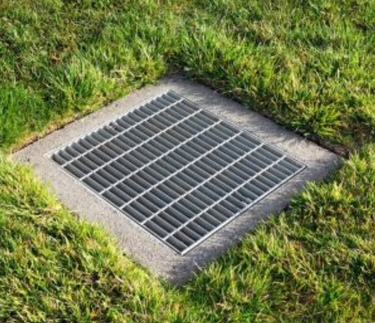
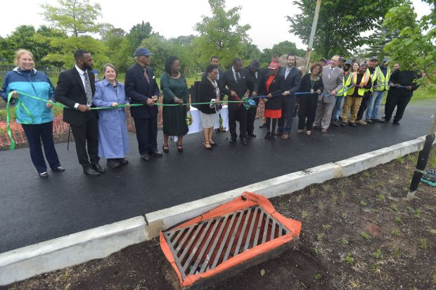
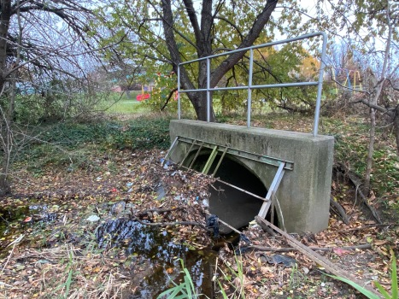
CWSRF financing to implement the City of Chester Green Stormwater Infrastructure Plan
Rehabilitation/improvement program for the City’s stormwater system
Catch Basin Retrofit Program including installation of inlet inserts and filters to remove trash and sediment from stormwater
Pennsylvania CWSRF Example:
City of Chester Stormwater Authority
Notes:
Financing from PA SRF, PennVEST, will fund the implementation of a comprehensive infrastructure rehabilitation/improvement program for the stormwater system throughout the City of Chester.
The infrastructure improvements include the installation of approximately pipe, catch basins, manholes, and roadway restoration.
Over 250 catch basins will be retrofitted or replaced.
Includes the installation of inlet inserts and filters to remove trash and sediment from stormwater.
https://www.wateronline.com/doc/corvias-and-stormwater-chester-improve-local-stormwater-infrastructure-0001

Slide 44
Next Steps
Develop your plans and identify needs.
  Develop a capital improvement plan.
Engage with your state SRF program.
  Each state has a process and timeline for applications.
  Discuss funding options (SRF base, SRF BIL, state funding, etc.) to build a plan.
  State SRFs may provide planning and development assistance.
Build an ongoing relationship with the state SRF.
  BIL funds are FY 2022-2026.
  Base SRF programs are ongoing.
Notes:
States are the leaders and manage the SRF programs, they are the primary contacts to help you through the funding process.
It’s important to engage with your state SRF and get an understanding of the process and funding options that may be available to you.

Slide 45
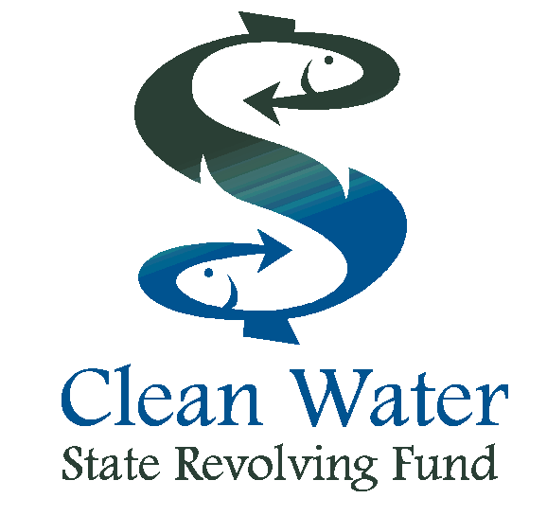
SRF Websites and Contact Info
EPA CWSRF: https://www.epa/gov/cwsrf
Souders.alison@epa.gov
cwsrf@epa.gov
North Carolina - Clean Water State Revolving Fund | NC DEQ
South Carolina - State Revolving Fund (SRF) Program | SCDHEC
Georgia - Clean Water State Revolving Fund | Georgia Environmental Finance Authority
Florida- CWSRF Program | Florida Department of Environmental Protection

Slide 47
Bipartisan Infrastructure Law Recycling Grant Opportunities
Solid Waste Infrastructure for Recycling (SWIFR) Grant Program
Recycling Education and Outreach (REO) Grant Program
U.S. EPA Office of Resource Conservation & Recovery
Resource Conservation and Sustainability Division

Slide 48
Grant Programs
SWIFR
Grants
for Political Subdivisions
Grants for Tribes and Intertribal Consortia
Grants for States and Territories
Recycling Education & Outreach
Notes:
There are three types of grants within the SWIFR program, which are designed to fund a range of projects that will enable EPA to help states, territories, tribes, local governments, and communities advance from “where they are” to significantly transform their recycling and materials management infrastructure.
1. SWIFR Grants for Political Subdivisions will establish, increase, expand, or optimize collection and improve materials management infrastructure; reduce contamination in the recycled materials stream; and identify, establish, or improve end-markets for the use of recycled materials.
2. SWIFR Grants for Tribes and Intertribal Consortia will provide funds for tribes and intertribal consortia to develop or update plans focused on encouraging environmentally sound post-consumer materials management; establish, increase, or expand materials management infrastructure, and identify, establish, or improve end-markets for the use of recycled materials.
3. SWIFR Grants for States and Territories will provide states and territories with capacity building grants to support their long-term planning and data collection needs to demonstrate progress toward the National Recycling Goal and Food Loss and Waste Reduction Goal and advance a Circular Economy for materials. Territories also will be able to utilize funds for equipment and construction related costs as part of their implementation of plans.
This presentation is for the SWIFR Grants for States and Territories category. This Program Guidance is only applicable to the first round of funding described under this document and does not pertain to the entire three-year grant program.

Slide 49
SWIFR Political Subdivisions
Eligible Entities:
  Local government, city, county, township, village, parish, district, etc.
  State or territorial institutions of higher education, special districts, housing authorities must provide documentation that they are considered a political subdivision of the state.
Estimated Funding: Approximately $40,000,000.
Projects for political subdivisions of states and territories must achieve one or more of the following objectives:
  Establish, increase, expand, or optimize collection, improve materials management infrastructure, and capacity for materials management
  Fund the creation and construction of tangible infrastructure, technology, or other improvements in the recycled materials stream
  Establish, improve, expand, or optimize end-markets for the use of recycled commodities; or
  Demonstrate a significant and measurable increase in the diversion, recycling rate, and quality of materials collected for municipal solid waste.
Applications Were Due: February 15, 2023
https://www.epa.gov/rcra/grants-political-subdivisions

Slide 50
SWIFR States and Territories
Eligible Entities: States and Territories
Estimated Funding: About $30,000,0000
Projects for states and territories may include:
  Develop or update plans to advance post-consumer materials management
  Develop, strengthen, and/or implement comprehensive data collection efforts that demonstrate progress towards the National Recycling Goal and Food Loss and Waste Reduction Goal
  Support the state-led implementation of plans
  Only for territories: equipment and construction
https://www.epa.gov/rcra/grants-states-and-territories

Slide 51
SWIFR Tribes and Intertribal Consortia
Eligible Entities:
  Federally Recognized Tribes, and
  Intertribal consortia.
Estimated Funding: Approximately $40,000,000 ($100,000 - $1.5M per award).
Projects for tribes and intertribal consortia must achieve one or more of the following objectives:
  Develop or update plans focused on encouraging environmentally sound post-consumer, materials management such as source reduction (e.g., repair clinics, reuse centers), collection, storage, transportation, composting, recycling, and/or markets for recyclables
  Develop, strengthen, and/or implement comprehensive data collection efforts that demonstrate progress towards the National Recycling Goal and Food Loss and Waste Reduction Goal
  Establish, increase, or expand materials management infrastructure, such as facilities for reuse, recycling or composting; collection and storage bins for recyclable or organic material, purchasing and maintaining equipment or supplies such as scales, crushers, balers, and sorting equipment, trucks, forklifts, and safety equipment);
  Establish or identify end-markets for the use of recycled materials; or
  Demonstrate an increase in the diversion recycling rate, and/or quality of materials collected.
Applications Due: April 4, 2023
https://www.epa.gov/rcra/grants-tribes-and-intertribal-consortia

Slide 52
Recycling Education and Outreach
Eligible Entities:
    U.S. States, including Washington, D.C.; Puerto Rico, Virgin Islands, Guam, American Samoa, Commonwealth of Northern Mariana Islands; Local governments; Federally recognized tribal governments; Native Hawaiian organizations, Department of Hawaiian Home Lands, Office of Hawaiian Affairs; Nonprofit organizations; Public-private partnerships.
Estimated Funding: Approximately $30,000,000
Grant program for education and outreach projects that:
  inform the public about recycling programs,
  provide information about recycled materials and/or,
  increase collection rates and decrease contamination.
Statutory Set-Aside: The legislation directs that at least 20% of this funding ($6,000,000) must go to projects that serve low-income, rural, or Native American Communities
Applications Were Due: February 15, 2023
https://www.epa.gov/rcra/consumer-recycling-education-and-outreach-grant-program

Slide 53
THANK YOU!

Slide 54
Meeting Feedback
Christy Williams, ERG

Slide 55
Input on Future Meetings
Continue to have implementor presentations?
Outside speaker/topic ideas
  Continue to include funding?
  Industry representatives, e.g. Cup Zero, Perpetual
  Circularity Assessment Protocols
Facilitated Peer-to-Peer Exchange

Slide 56
Closing and Next Steps
Chris Plymale, USEPA Region 4

