Slide 1

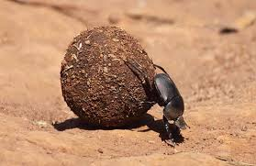


"Communication and Pesticide Risk Reduction Programs. "
Marc L. Lame, Indiana University's School of Public and Environmental Affairs
Notes:
1
Which statement about the biological effects of pesticides is untrue?
Effects always increase in a linear fashion, as the dose increases the effects on exposed biological organisms increases, e.g. if the dose is doubled it causes twice the mortality
Agricultural pesticides are the most common means of suicide worldwide
Certain pesticides are linked to risks for cancer, birth defects, hormonal disruption, kidney, liver damage and neurological disorders
Humans exposed to certain chemicals can give birth to children with health problems caused by the parents exposure
The term pesticide includes (select the most accurate and complete answer) …
Insecticides and miticides
Insecticides and herbicides
Insecticides, miticides, fumigants, rodenticides, fungicides, nematicides, herbicides, wood preservers, pest related growth disrupters, pest related endocrine disrupters
Only insecticides
Signal words are found on pesticide product labels, and they describe the acute
(short-term) toxicity of the formulated pesticide product. Focusing on what you know about signal words please indicate the sentence that contains inaccurate information.
The U.S. Environmental Protection Agency (EPA) requires a signal word on most pesticide product labels. They also require it to be printed on the front panel, in all capital letters, to make it easy for users to find. The only pesticide products that are not required to display a signal word are those that fall into the lowest toxicity category by all routes of exposure (oral, dermal, inhalation, and other effects like eye and skin irritation).
CAUTION means the pesticide product is slightly toxic if eaten, absorbed through the skin, inhaled, or it causes slight eye or skin irritation; WARNING indicates the pesticide product is moderately toxic if eaten, absorbed through the skin, inhaled, or it causes moderate eye or skin irritation; DANGER means that the pesticide product is highly toxic by at least one route of exposure. It may be corrosive, causing irreversible damage to the skin or eyes. Alternatively, it may be highly toxic if eaten, absorbed through the skin, or inhaled. If this is the case, then the word “POISON” must also be included in red letters on the front panel of the product label.
Before the EPA can determine the appropriate signal word for a pesticide product, the manufacturer performs research on laboratory animals to determine the toxicity of the formulation. Required studies include oral exposure (eating the product), inhalation exposure (breathing in the product), dermal exposure (spreading the product on the skin) and exposures to the skin and eyes to check for irritation. The study that shows the highest toxicity is used to determine the signal word. E.g. if a product demonstrated low toxicity when eaten, moderate toxicity when inhaled, and high toxicity when applied to skin, the EPA would assign the signal word DANGER, based on the most sensitive route of entry.
Signal words do not alert users to special hazards of a pesticide product. The signal word should not be used by shoppers to select the least toxic product(s).
4) Which are not pesticides?
Natural chemicals used to kill pests
Household disinfectants and some industrial disinfectants
Biological insecticides
Baits

Slide 2

PREFACE: Where Am I Coming From?
As an entomologist & former Researcher U of AZ IPM Specialist
As an ex-environmental Regulator
As an appointed advisor to EPA & CDC
As a policy entrepreneur for IPM
As a Clinical Prof teaching grad students to become environmental managers

Slide 3
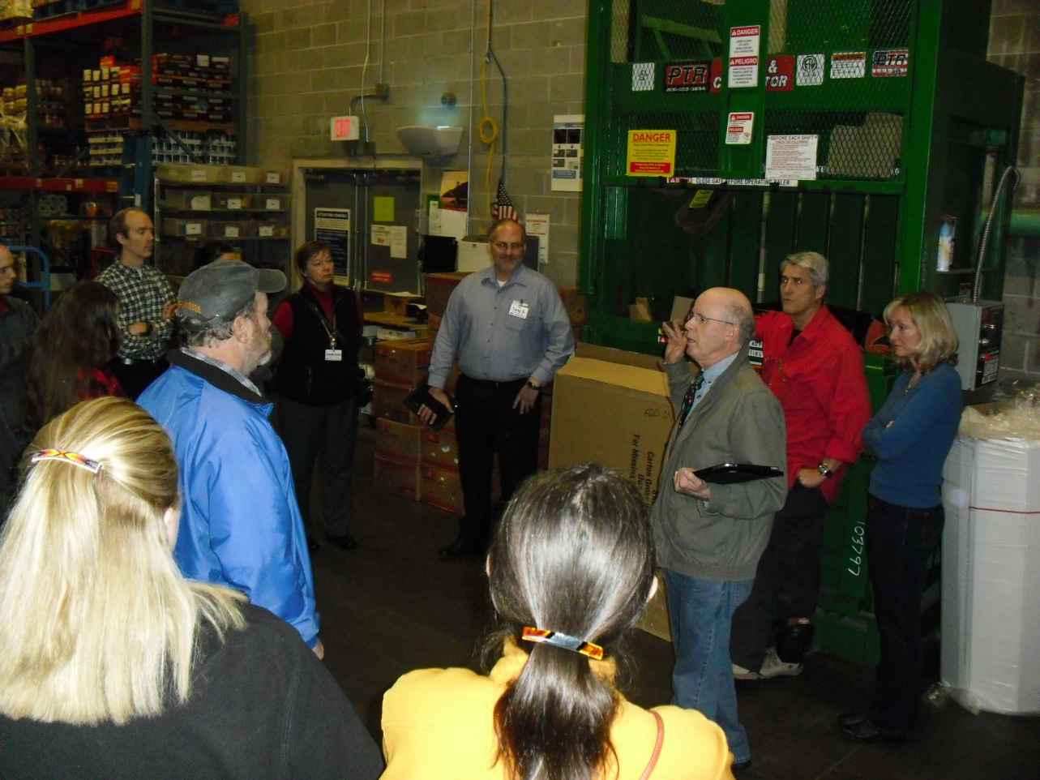
Scientific Leadership
Have a role in providing decision makers with information that is:
  Understandable
  Relevant
  Accessible
  Credible
Do more than push science… change behavior!

Slide 4
5 basic steps of risk communication (must be in order)
Credibility
Awareness
Understanding
Solutions
Enactment or implementation

Slide 5
The scientific continuum
Applied science
(solution)
Demonstrate the solution
bench science
Problem ID
Incorporation
(diffusion)

Slide 6
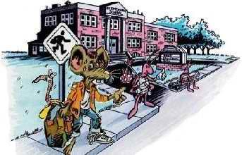


Pest Control In The School Environment: Adopting Integrated Pest Management – 1992(3)
Ralph Wright & Bill Currie - EPA 735-F-93-012 (controversial)
Information For School Districts
So, “IPM Is A Process Not A Miracle”
Notes:
Everyone in the school community can help.

Slide 7
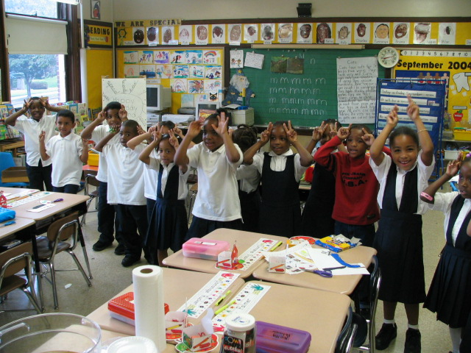
“Hope” given – 3 States (1996) to 41 States (2014)

Slide 8
Diffusion – changing behavior
A Shift in Pest Management
A SAFE
ENVIRONMENT
SAFE
ENVIRONMENT
C
U
L
T
U
R
A
L
M
E
C
H
A
N
I
C
A
L
B
I
O
L
O
G
I
C
A
L
G
E
N
E
T
I
C
C
H
E
M
I
C
A
L
S
ch
e
d
u
l
e
d
EDUCATION:
monitoring, prevention, treatment
(identification, biology, technology)
Treatments

Slide 9
DIFFUSION THEORY
“The process by which new ideas or practices (called innovations) are communicated through certain channels over time, and are either adopted or rejected by, members of a social system over time.” (Rogers, 1983, 1995, 2003)

Slide 10
Elements of Diffusion:
Innovation
Communication Channels
Time
Social System

Slide 11
INNOVATION:
is an idea, practice, or object that is perceived as new by an individual or other unit of adoption.

Slide 12
Attributes
Relative Advantage – over the idea that preceded it. Over traditional controls (costs and perceptions)
Compatibility – within the adopters’ current system of operations and values
Trialability – inserted into current management system
Observability – apparent and meaningful results
Complexity – degree it is perceived as difficult to understand and use

Slide 13
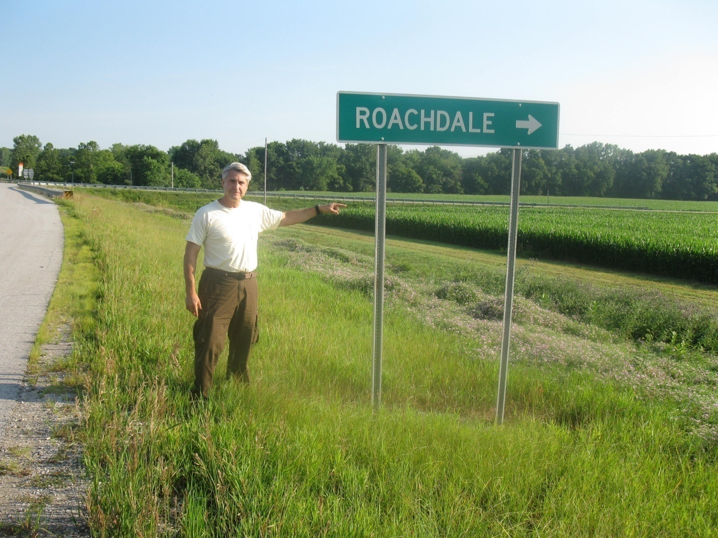
How Do We Get There From Here?

Slide 14
The Communication Process for getting the communities to adopt IPM or PRM
THE INNOVATION/DECISION PROCESS
MODEL ADAPTED FROM ROGERS 1983
AWARENESS
PERSUASION
DECISION
IMPLEMENTATION
CONFIRMATION
1. Adoption
2. rejection

Slide 15
Variables that affect rate
Attributes
Types of innovation-decision
Communication channels
Nature of the Social System
Extent of change agents’ promotion efforts (and competition)

Slide 16
The Change Agent – sequence of roles
Develop a need for change
Establish an information exchange relationship
Diagnose problems
Create an intent to change in the client
Translate an intent into action
Stabilize adoption and prevent discontinuance
Achieve a terminal relationship

Slide 17
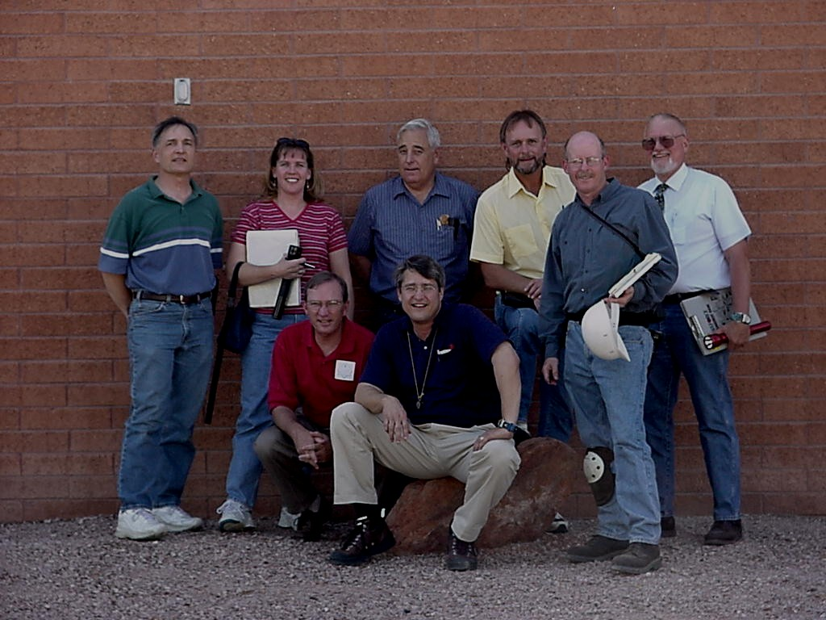
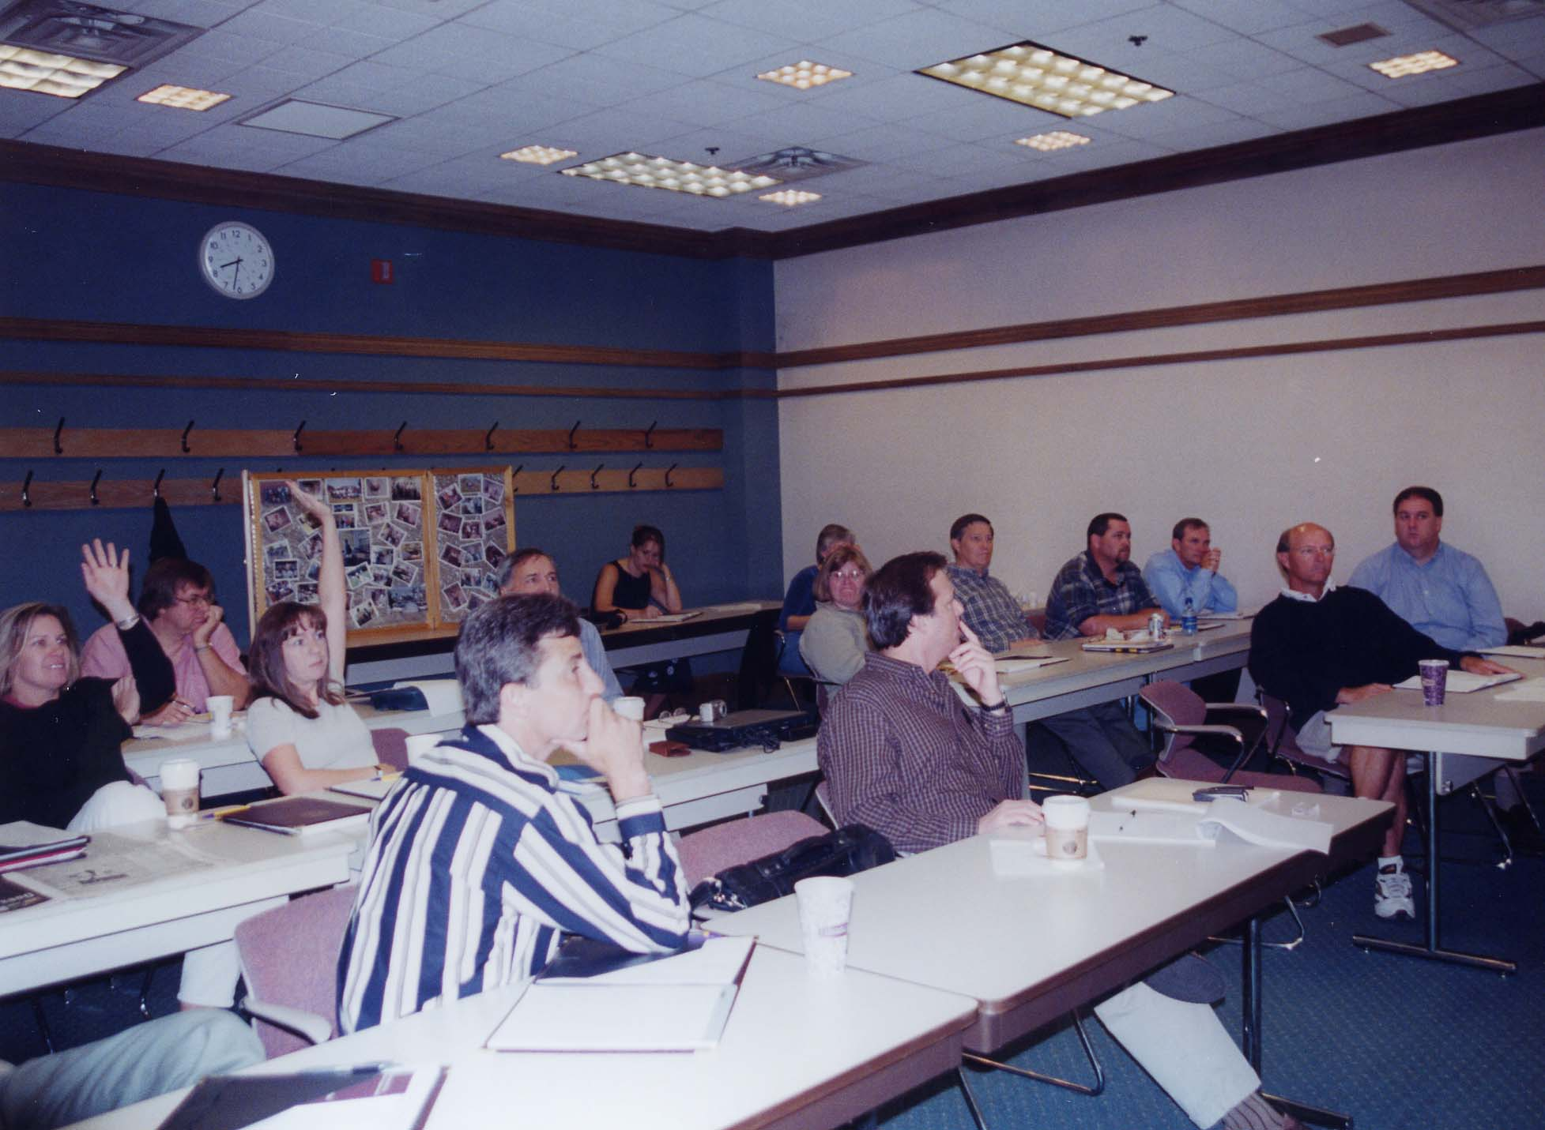
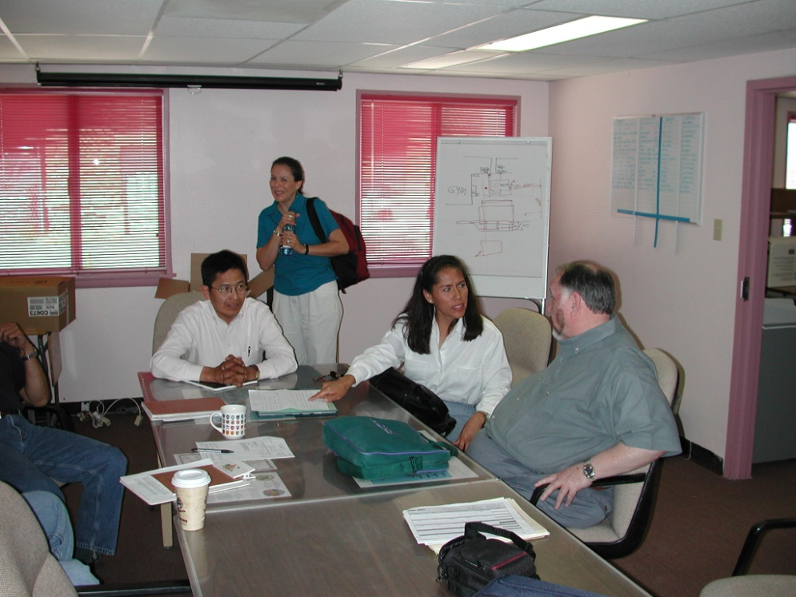
Change Agent:
Who are the Change Agents and Champions who focus on prevention?
Notes:
Everyone in the school community can help.

Slide 18
A Social System:
is a defined set of interrelated units that are engaged in joint problems solving to accomplish a common goal.
Cliques and opinion leadership

Slide 19
Models of Communication Flows – wholesale vs. retail???
Hypodermic Needle Model – traditional & inferior
“Injecting” information directly into the social system ex. Propaganda, Madison Avenue advertising
Ignored the role of opinion leaders.
Two Step Flow – for proven behavioral change
Step one – transfer of INFORMATION from media to opinion leaders
Step two – spread of interpersonal INFLUENCE from opinion leaders to their followers
Horizontal diffusion - a combination of opinion leaders and peers

Slide 20
IPM Defined As An INNOVATION To Be Adopted:
IPM is a cluster of technologies (cultural, mechanical, biological, genetic, and chemical) which is an integrated application (based on biological information) designed to allow humans to compete with other species (pests).
Duh, it might be helpful to define it the way folks can understand it….

Slide 21
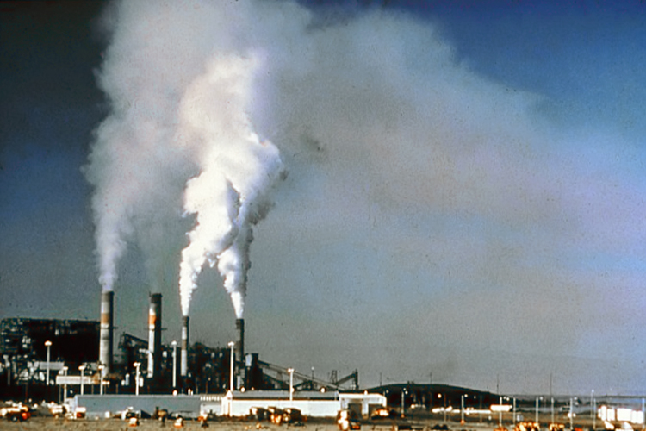
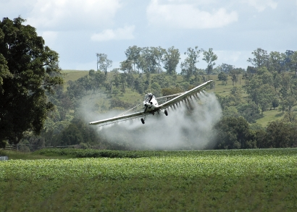
Recognizing IPM as a Pollution Prevention INNOVATION:
Source Reduction for pesticides is preventing pests such that pesticide applications are not AS necessary or at all.

Slide 22
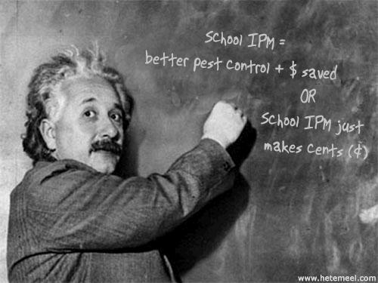
Some Un-Recognized Truths About IPM
It is more effective because it is proactive.
It is sustainable because it is based on ecological underpinnings.
It is precautious regarding risks to environmental health.
It is less expensive because it leverages existing operations.
It WORKS!!!

Slide 23
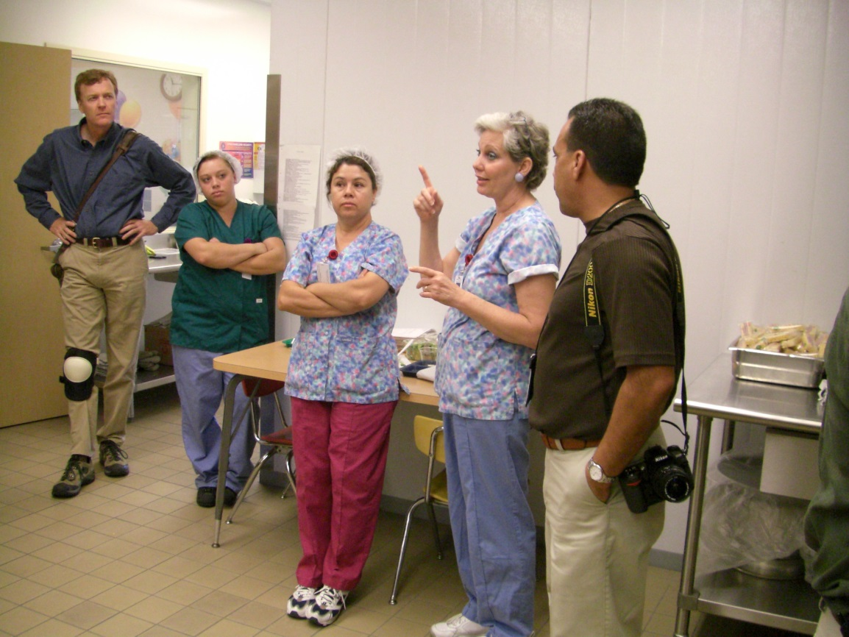
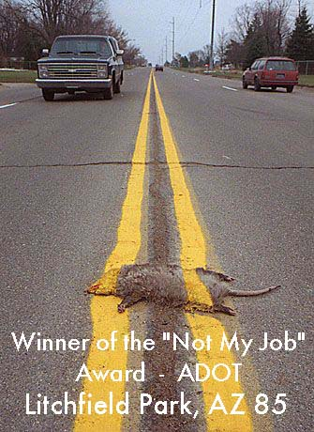
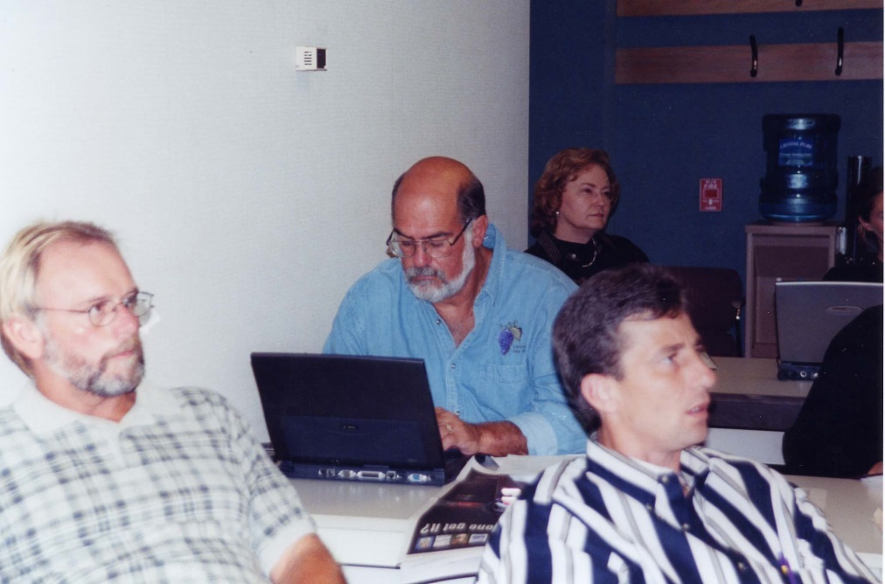
Pest Prevention is Everyone’s Job

Slide 24
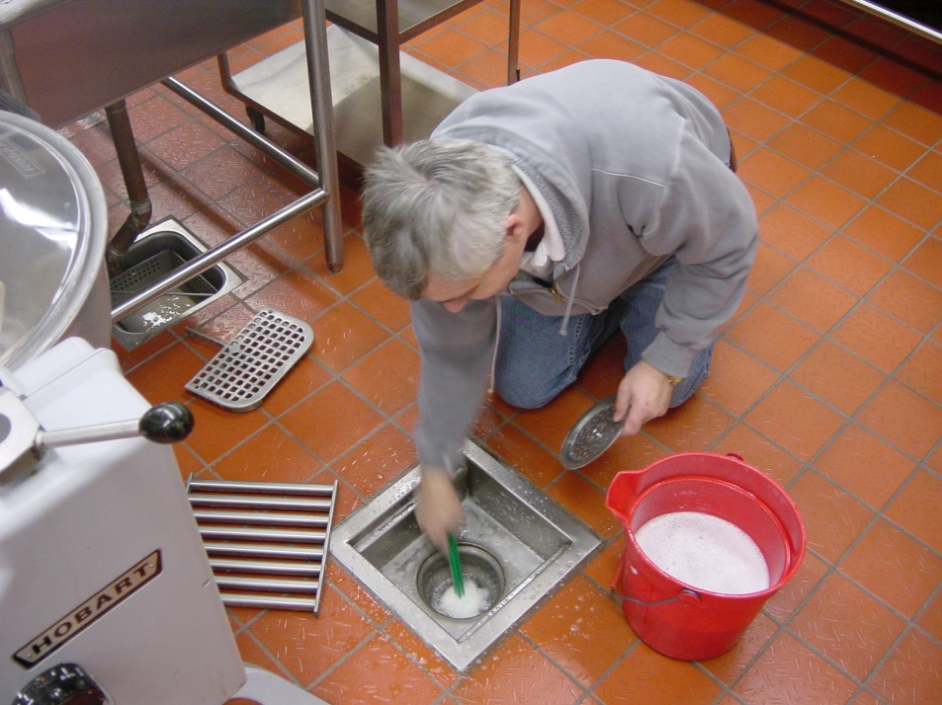
Implementers Must Demonstrate IPM Is Compatible With The District’s Current Operations
Doing what you do now---just think pests!!!
Security = monitoring
Energy conservation = exclusion
Sanitation = nothing to eat
Clutter control =
no place to live
Food Water Shelter
Notes:
Pests need the same things we need to survive, food, water and shelter.

Slide 25
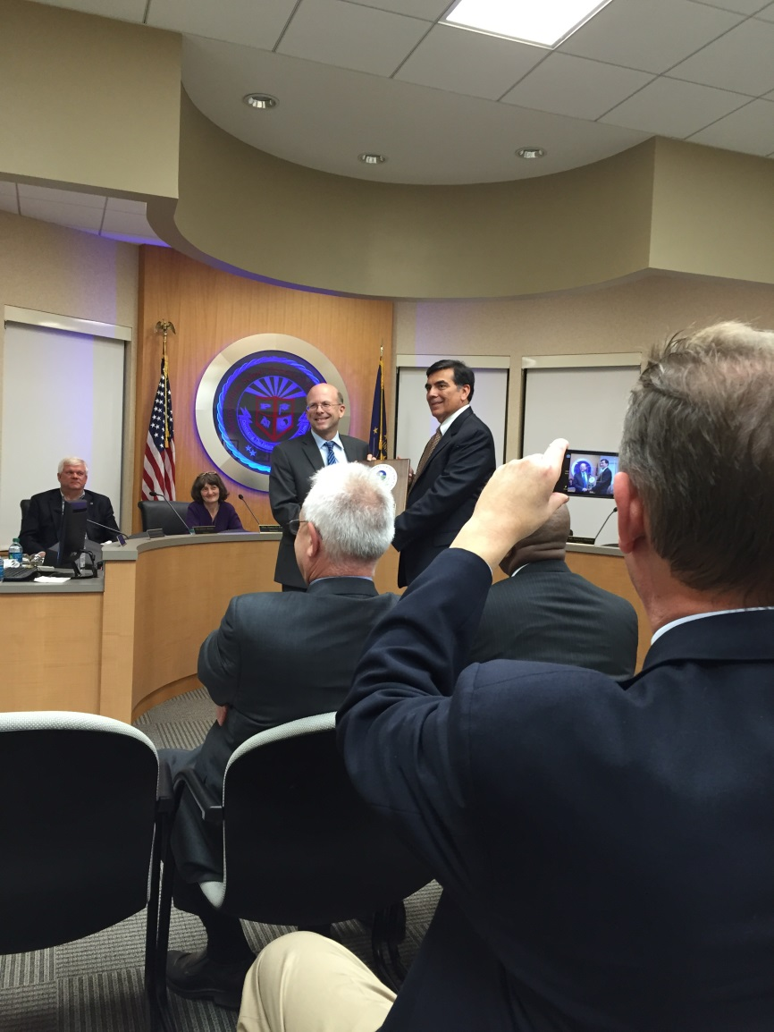

Know How To Work With The Media
Rule 9: Share Credit!
Rule 13: Perpetual
optimism is a force multiplier!

Slide 26
Public Participation
“Public Participation is any process that works to understand people’s values and uses their input to make better decisions” (Godec, PC, 2021).
According to the EPA:
“Public participation can be any process that directly engages the public in decision-making and gives full consideration to public input in making that decision. Public participation is a process, not a single event. It consists of a series of activities and actions by a sponsor agency over the full lifespan of a project to both inform the public and obtain input from them. Public participation affords stakeholders (those that have an interest or stake in an issue, such as individuals, interest groups, communities) the opportunity to influence decisions that affect their lives” (US EPA, 2014b, p. 3).

Slide 27
“Fundamental Understanding of Public Participation Principles”
•Clear, defined opportunity for the public to influence the decision
•Management commitment to fully consider public input in decision making
•Engagement of the full range of stakeholders from the community, including vulnerable populations and marginalized communities
•Focus on building relationships between and among stakeholders
•Creating and sharing truthful, comprehensive, and clear information” (US EPA, 2014b, p. 89).

Slide 28
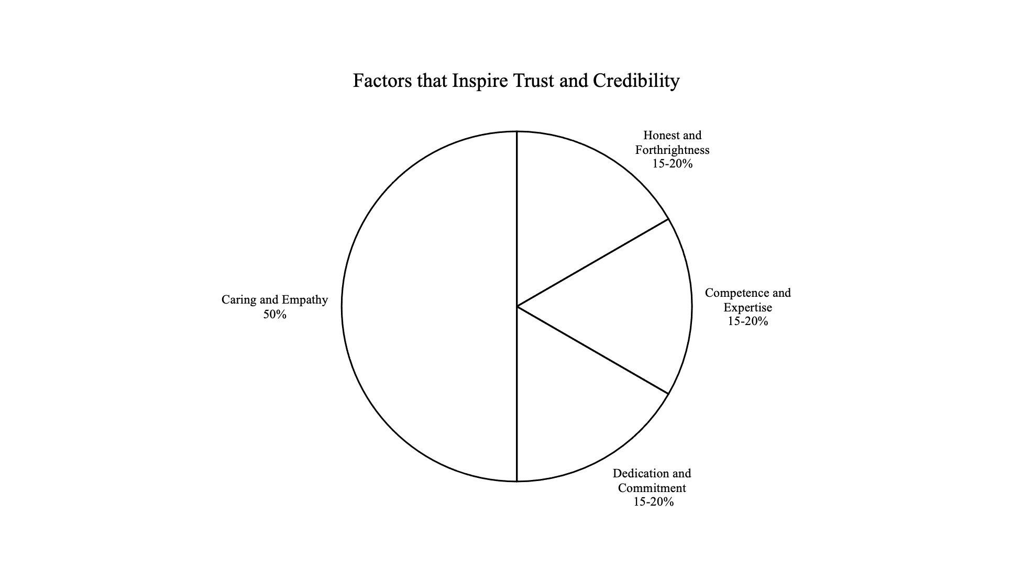

Slide 29
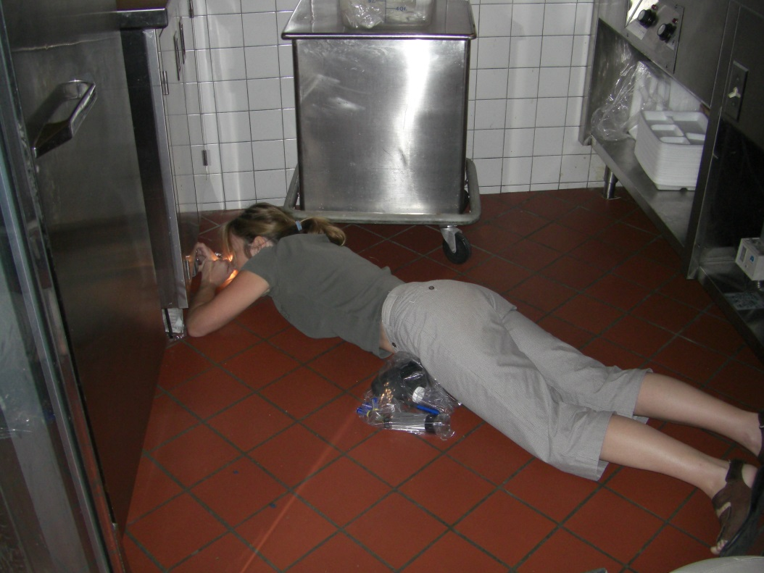
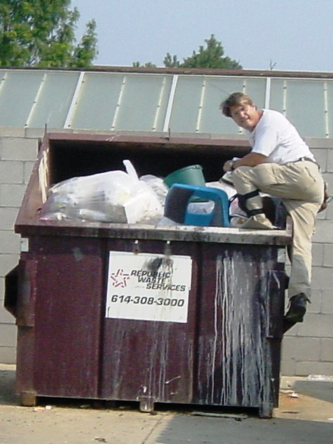
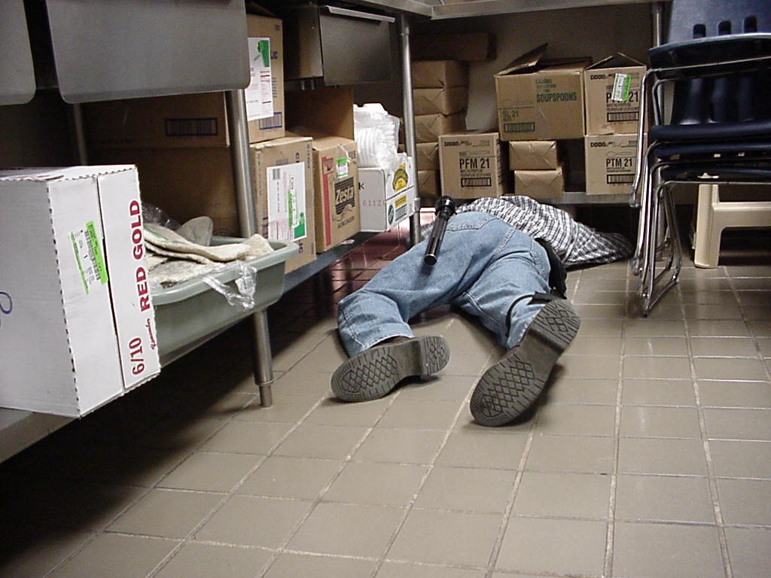
  Actions speak louder than words - Get Dirty!!!! Lead from IN FRONT and be suspicious of anyone who won’t do the same.

Slide 30
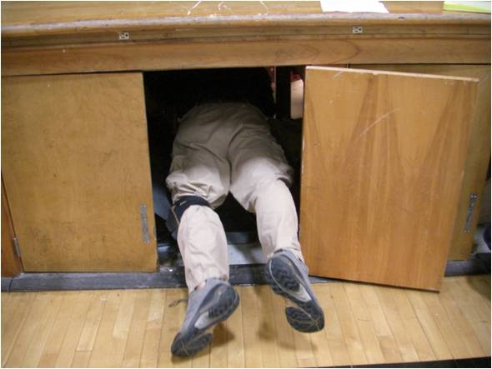
Questions And Comments
The End

