Slide 1


New Mexico Oil & Gas GHG Emissions Inventory for Year 2020
For help accessing this document, email NEI_Help@epa.gov.
Brandon Long (ERG)
New Mexico Environment Department (NMED)
September 28, 2023

Slide 2
Background
NM joined the U.S. Climate Alliance in 2019 and set a goal:
Reduce GHG emissions by 45% from 2005 levels, by 2030
NM has implemented rules that reduce GHG from oil and gas
  2021 - Title 19 Chapter 15 Parts 27 and 28 (EMNRD Methane Waste Rules)
  2022 - Title 20 Chapter 2 Part 50 (NMED Oil and Gas Ozone Rule)
NM oil and gas production substantially increased from 2016 - 2021
  Oil production 3x higher
  Gas production 2x higher

Slide 3
Goal of Inventory Project
Develop comprehensive inventory of year 2020 GHG emissions for the oil and gas industry in New Mexico
Rely on reported emissions and activity data to reflect NM-specific operations
Estimate emissions for each
  Emission source
  Industry segment
  Basin / County
Project Emissions to 2025 and 2030

Slide 4
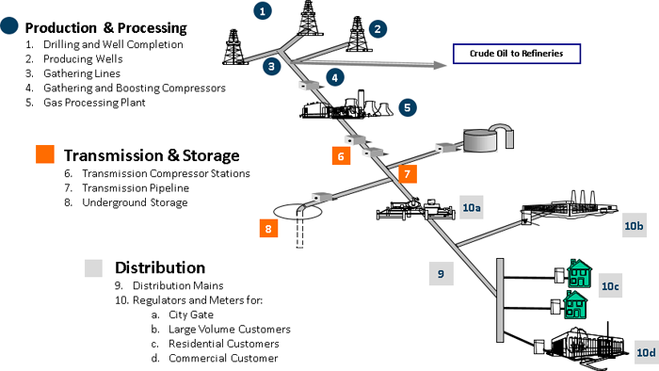
Industry Segments
Exploration and production
Gathering and boosting (G&B)
Natural gas processing
Transmission and storage
Abandoned oil and gas wells
Notes:
NM O&G GHGI includes emissions from the main oil and gas industry segments. Including exploration and production, G&B, processing, transmission and storage, and it also includes abandoned wells.

Slide 5
Emission Sources
Emission Source | Production | G&B | Processing | Transmission and Storage
Combustion | Y | Y | Y | Y
Equipment Leaks/Fugitives | Y | Y | Y | Y
Pneumatic Controllers | Y | Y | Y | Y
Acid Gas Removal Units |  | Y | Y
Flaring | Y | Y | Y | Y
Tanks | Y | Y
Associated Gas | Y
HF Completions | Y
Reciprocating Compressors | Y | Y | Y | Y
Liquids Unloading | Y
Equipment Blowdowns |  | Y | Y | Y
Pipeline Leaks |  | Y |  | Y
Produced Water | Y
Dehydrators | Y | Y | Y | Y
Centrifugal Compressors |  | Y | Y | Y
Pipeline Blowdowns |  | Y |  | Y
Key emission sources shown for each industry segment
  Ordered from highest to lowest cumulative CO₂e emissions
  Combustion = engines, turbines, heaters (i.e., non-flaring sources)
Notes:
In terms of the specific emission sources that are included, this table presents key sources for each industry segment. The sources on this table account for more than 99 percent of total CO2e emissions in the NM O&G GHGI.

Slide 6
Data Sources
EPA Data
  Greenhouse Gas Reporting Program (GHGRP) Subpart W – Petroleum and Natural Gas Systems
  GHGRP Subpart C – Stationary Fuel Combustion Sources
  EPA Greenhouse Gas Inventory (GHGI)
  National Emissions Inventory (NEI) Oil and Gas Tool
  U.S. EPA AP-42 (AP-42)
Measurement Studies
NMED Minor Source Inventory
Notes:
Companies report to GHGRP if they exceed the reporting threshold of 25,000 mt CO2e
A number of studies have been conducted over the last ten years that measured CH₄ emissions from O&G emission sources, and select studies were considered for this project.

Slide 7
NMED Minor Source Inventory
Comprehensive dataset for criteria pollutant emissions and related activity data
NMED also requested that companies submit GHG emissions following GHGRP methodologies (subparts W and C)
  No reporting threshold, requested GHG data for all facilities
GHGRP data provided only for a company’s NM operations
  Important for production and G&B industry segments, where basins can cross state boundaries
Notes:
The NMED Minor Source Inventory is a comprehensive dataset for criteria pollutant emissions and related activity data. While the Inventory has existed for multiple years, the Inventory was expanded for year 2020 in two ways. First, data from minor sources was collected for the first time. Previously, only larger facilities reported data. Second, NMED requested that companies submit their greenhouse gas emissions for 2020. NMED asked companies to follow EPA’s greenhouse gas reporting program methodologies for subpart W and subpart C, which created consistency in available data.

Slide 8
General O&G Inventory Approach
Due to the quantity of GHGRP data reported to NMED and the EPA, and its specificity to NM operations, GHGRP emissions data was used for the majority of the emission sources
In some instances, emission factors from the EPA GHGI, the NEI Tool, and measurement studies were used in conjunction with activity data from the NMED and EPA datasets

Slide 9
Unique Approaches
Key emission sources that relied on non-GHGRP emission factors
Production well pad equipment leaks/fugitives
G&B station leaks/fugitives, compressors, and tanks
Internal combustion engine exhaust (i.e., reciprocating engines)

Slide 10
Production Well Pad Equipment Leaks / Fugitives
Applied unique emission factors for equipment on well pads subject to leak detection and repair (LDAR) versus well pads NOT subject to LDAR
  Emission factors from two recent measurement studies
  Emission factors are 4 – 20 times higher for non-LDAR equipment
  Non-LDAR emission factors account for super-emitters
% of Wells Subject to LDAR | % of Wells NOT Subject to LDAR
7.5% | 92.5%
Notes:
We applied unique emission factors (emissions per equipment type, e.g., emissions per separator) for equipment on well pads subject to leak detection and repair (LDAR) versus well pads NOT subject to LDAR
The emission factors that were used are from two recent measurement studies and the emission factors are 4 – 20 times higher for non-LDAR equipment
The non-LDAR emission factors are higher because they account for super-emitters, which are large emission events that occur infrequently
The bottom table presents an overall summary for the state on wells subject to LDAR versus those that aren’t. These percentages were based on first production dates from OCD wells database and NSPS OOOOa compliance timeframes.

Slide 11
Data Coverage Analyses
Identify the total population of facilities in NM for each industry segment
Determine the percentage of the total population where reported emissions and/or activity data are available
  Used for scaling up to total state emissions

Slide 12
Data Coverage Results
Production
  68% of wells
  81% of oil production
  81% of gas production
G&B Stations = 90%
Natural Gas Processing Plants = 88%
Transmission Compressor Stations = 53%

Slide 13
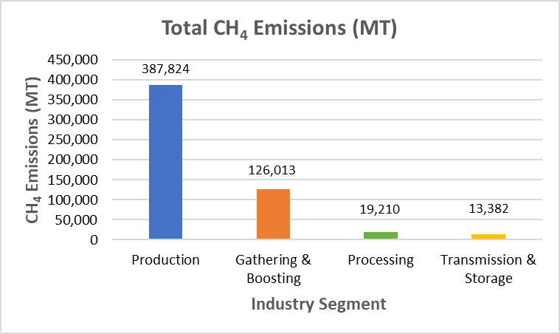
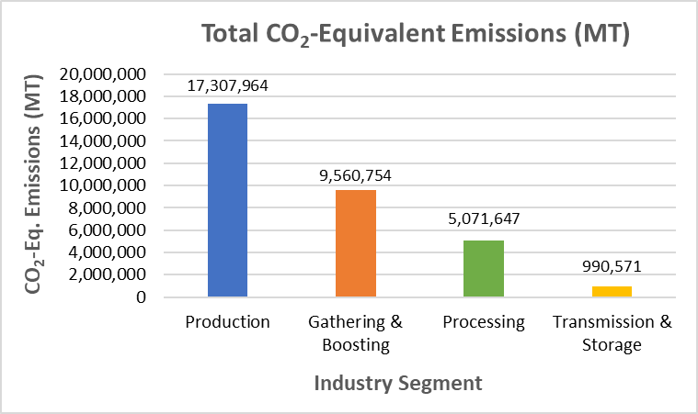
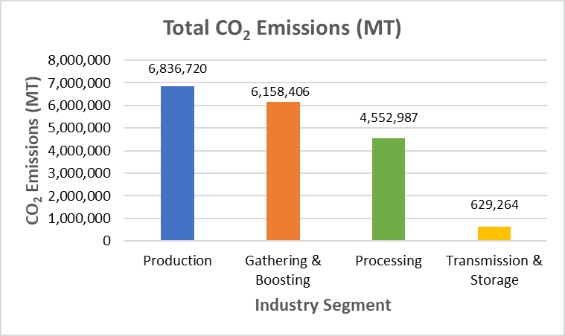
Inventory Results by Segment
CH₄ GWP 27

Slide 14
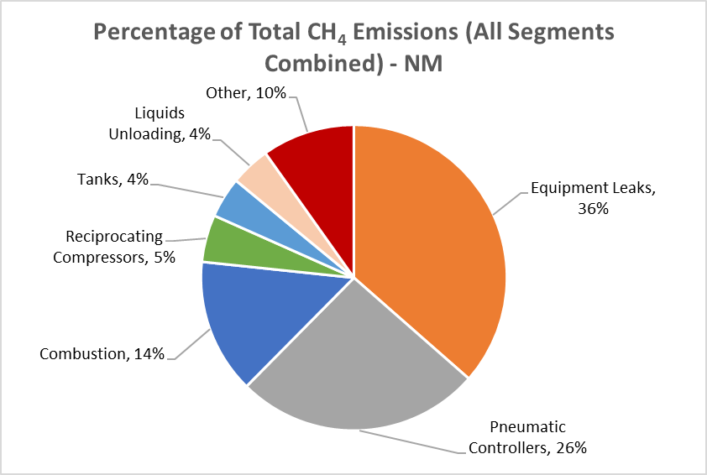
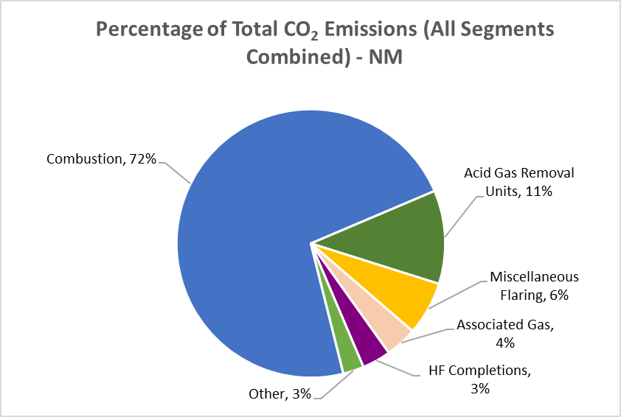
Inventory Contribution by Source

Slide 15
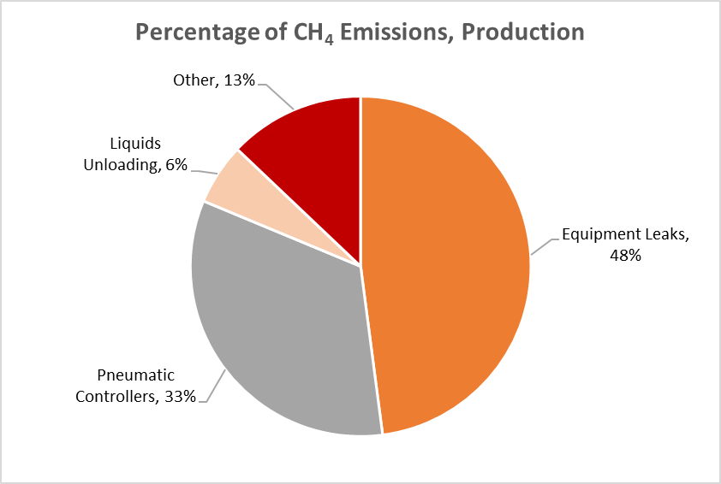
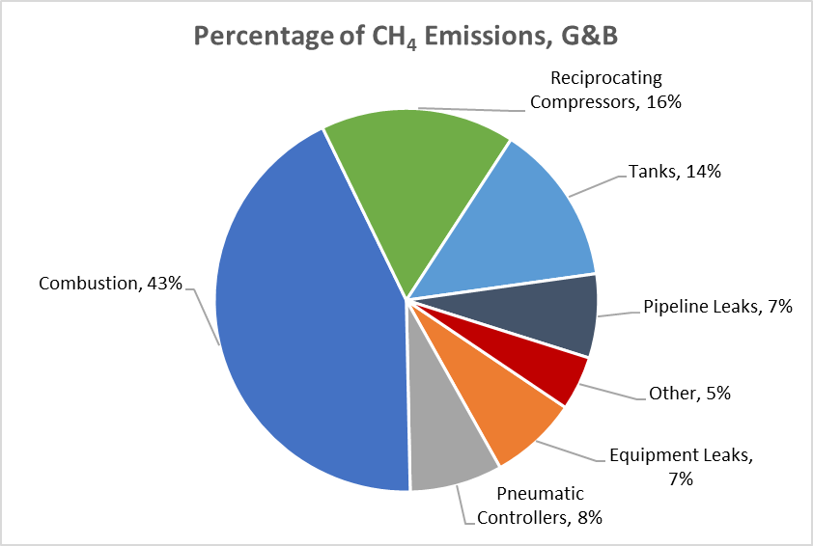
CH₄ Emissions – Production and G&B

Slide 16
NM O&G GHGI Projections
2025/2030 Projected Years
Projected inventory
  Base Year Inventory x (% Activity Growth) x (% Reductions)
Activity Growth
  US EIA Annual Energy Outlook (AEO) 2022
Reductions
  Title 19 Chapter 15 Parts 27 and 28 (EMNRD Methane Waste Rules)
  Title 20 Chapter 2 Part 50 (NMED Oil and Gas Ozone Rule)
Notes:
Title 19 Chapter 15 Parts 27 and 28 (EMNRD Rules) – these are the “Methane Waste Rules” to limit venting and flaring of natural gas.
Title 20 Chapter 2 Part 50 (NMED Rule) – this is the “Oil and Gas Ozone Rule” aimed at reducing VOC and NOx emissions and prevent ozone formation.
For the EIA outlook data, we considered the reference case along with a high oil price scenario and a low oil price scenario.

Slide 17
NM Reductions from Rules
Emission Source | 2025 CH₄ Reduction (Reductions_{x}) | 2030 CH₄ Reduction (Reductions_{x})
Engines and Turbines | 2.0% | 6.8%
Reciprocating and Centrifugal Compressors | 51.3% | 51.3%
Equipment Leaks | 75.1% | 75.1%
Liquids Unloading | 50.0% | 50.0%
Dehydrators | 42.8% | 42.8%
Pneumatic Controllers and Pumps | 80.0% | 90.6%
Storage Tanks | 10.5% | 35.0%
Associated Gas | 95% | 95%

Slide 18
NM O&G GHGI Projection Results
Year | Pollutant | Reference Case (MT) | Reference Case Change from 2020
2020 | CH₄ | 547,212 | NA
2025 | CH₄ | 283,013 | -48%
2030 | CH₄ | 265,258 | -52%
2020 | CO₂ | 18,177,400 | NA
2025 | CO₂ | 20,255,314 | 11%
2030 | CO₂ | 20,785,260 | 14%

