Slide 1
Homeowner and Community Associations and Outdoor Water Use
How to save water and why it is important.
Notes:
Hello, thank you for joining me today.
Together we are going to explore how homeowner and community associations can save water outdoors with the help of WaterSense.

Slide 2
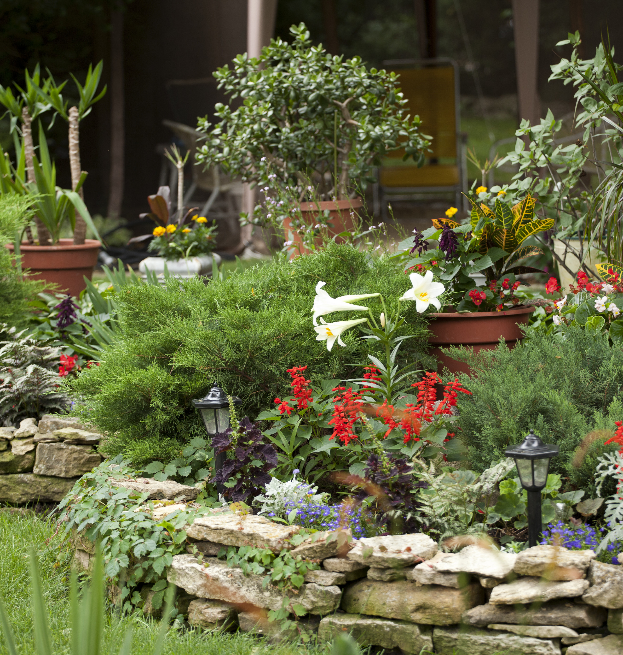
Why Should HOAs Look at Outdoor Water Use?
Water can be expensive, and rates can increase; instead of increasing HOA dues to cover water costs, look to reduce outdoor water use first
As much as 50 percent of water used outdoors can be wasted by inefficient watering methods and systems; consider opportunities to improve these items:
    Poor irrigation system design
    Improper system installation and management
    Lack of maintenance
    Improper scheduling
Outdoor water use can be restricted by utilities during droughts or other shortages; have a plan in place to use less
Notes:
Water can be expensive. As rates go up, instead of raising HOA dues, look no further than community outdoor spaces to reduce water use and costs! As much as 50 percent of water used outdoors can be lost due to wind, evaporation, and inefficient irrigation systems. Ensuring irrigation systems are designed, maintained, and scheduled for a landscape's needs can save water and save money as well. Selecting plants that are adapted to the local climate can lead to even more water savings.
In addition to simply saving water and money, limiting outdoor water use can help a community meet local water restrictions. Since outdoor water use is easy to visualize, it is a popular restriction during times of drought and supply shortages. It’s a good idea to have a plan in place to use less water in preparation for such restrictions.

Slide 3
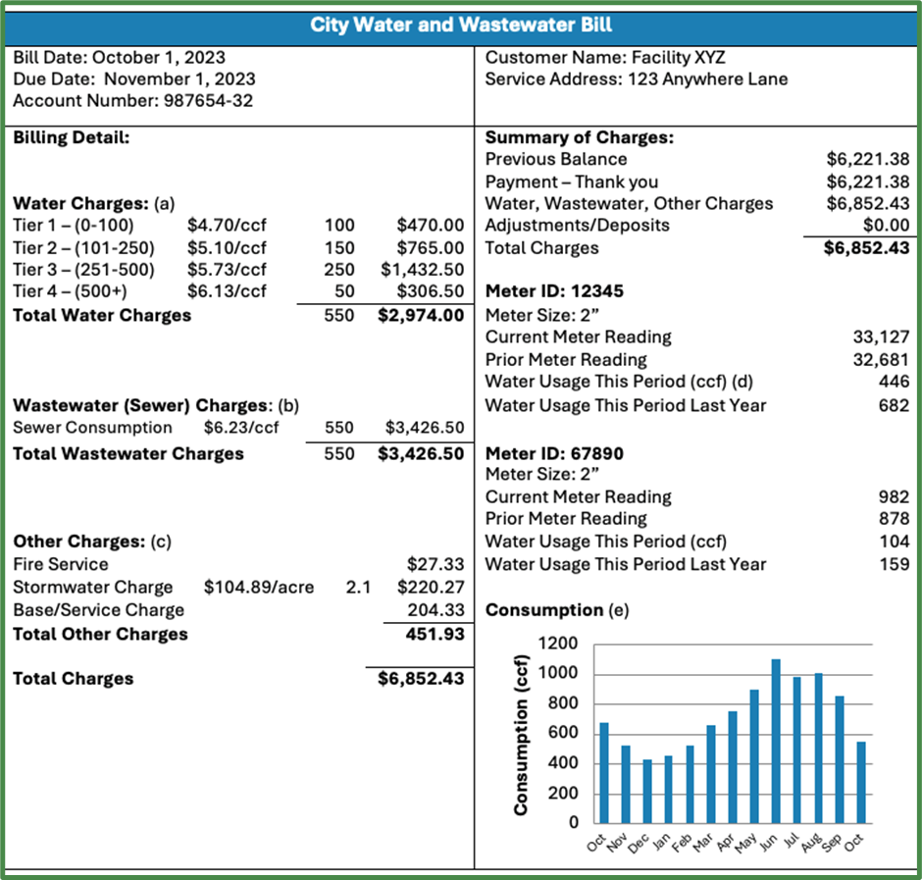
How Can HOAs Help Reduce Water Use?
HOAs can:
Understand their water use by examining utility bills
Work with their utility to identify improvements that can be made and discuss possible funding sources
Learn about and implement water-efficient irrigation and landscaping practices
Join EPA’s WaterSense program as promotional partners
Educate residents about saving water by directing them to WaterSense resources
Notes:
How do you know where to start? When it comes to saving water, always start with a water bill. Examining water bills sheds light on water use and annual trends. With the help of a water utility, a community can identify improvements on their property to limit water waste, improve efficiency, and reduce the utility costs of outdoor water use. Once areas for improvement are identified, they can be prioritized into an action plan to yield savings fast. Communities can continue their work beyond the landscape by becoming a WaterSense promotional partner and sharing water-saving resources with other residents.

Slide 4

WaterSense
Notes:
So, let’s take a step back, what is WaterSense and how could this program help a homeowner association save water?

Slide 5
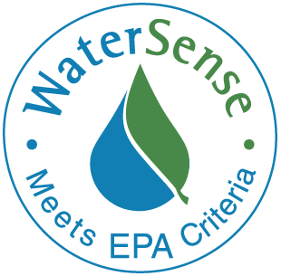
What Is WaterSense?
WaterSense is a voluntary partnership program launched by EPA in 2006 that provides a simple way to identify water-efficient:
Products
Programs
Practices
Homes
Products are independently certified for water efficiency and performance
Notes:
The WaterSense program was launched by EPA in 2006. It is a voluntary partnership program to promote water efficiency and encourage product and home innovation. ​It is both a label for water-efficient products and a resource to the public for saving water. WaterSense helps organizations and consumers save water now and helps preserve water sources for future generations. ​
The WaterSense label, which is displayed here, provides a simple way for consumers and businesses to identify water-efficient products, homes, and programs. ​The label can only be used with products that have been independently certified for water efficiency and performance. ​
Products that receive the label use 20 percent less water and perform as well or better than standard models. ​Homes earning the label are at least 30 percent more water-efficient than typical new homes.

Slide 6
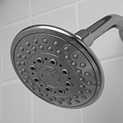
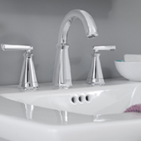
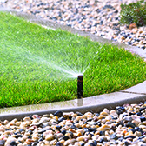
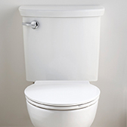
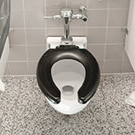
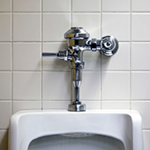
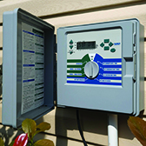
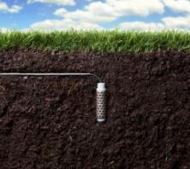
WaterSense Labeled Products
Indoor products
Outdoor products
WaterSense Product Search
As of June 2024, more than 45,000 product models have earned the WaterSense label.
Water factors are included in many ENERGY STAR certified products.
Showerheads
Lavatory
Faucets
Spray Sprinkler Bodies
Tank-Type
Toilets
Flushometer
Valve Toilets
Flushing
Urinals
Weather-based
Soil Moisture-based
Irrigation Controllers
Notes:
These are the current product categories that WaterSense labels.
WaterSense labeled products are backed by independent, third-party certification and meet EPA’s specifications for water efficiency and performance. When you use these water-saving products in the home or community, you can be confident that you are saving water and the product will perform as well or better than standard models.
These products can be found through the WaterSense website on the Product Search tool or by simply looking for the WaterSense label at a local hardware or home improvement store.
https://lookforwatersense.epa.gov/products/

Slide 7
Saving Water Outdoors
Notes:
Now let’s get back to saving water outdoors and how WaterSense can help.

Slide 8
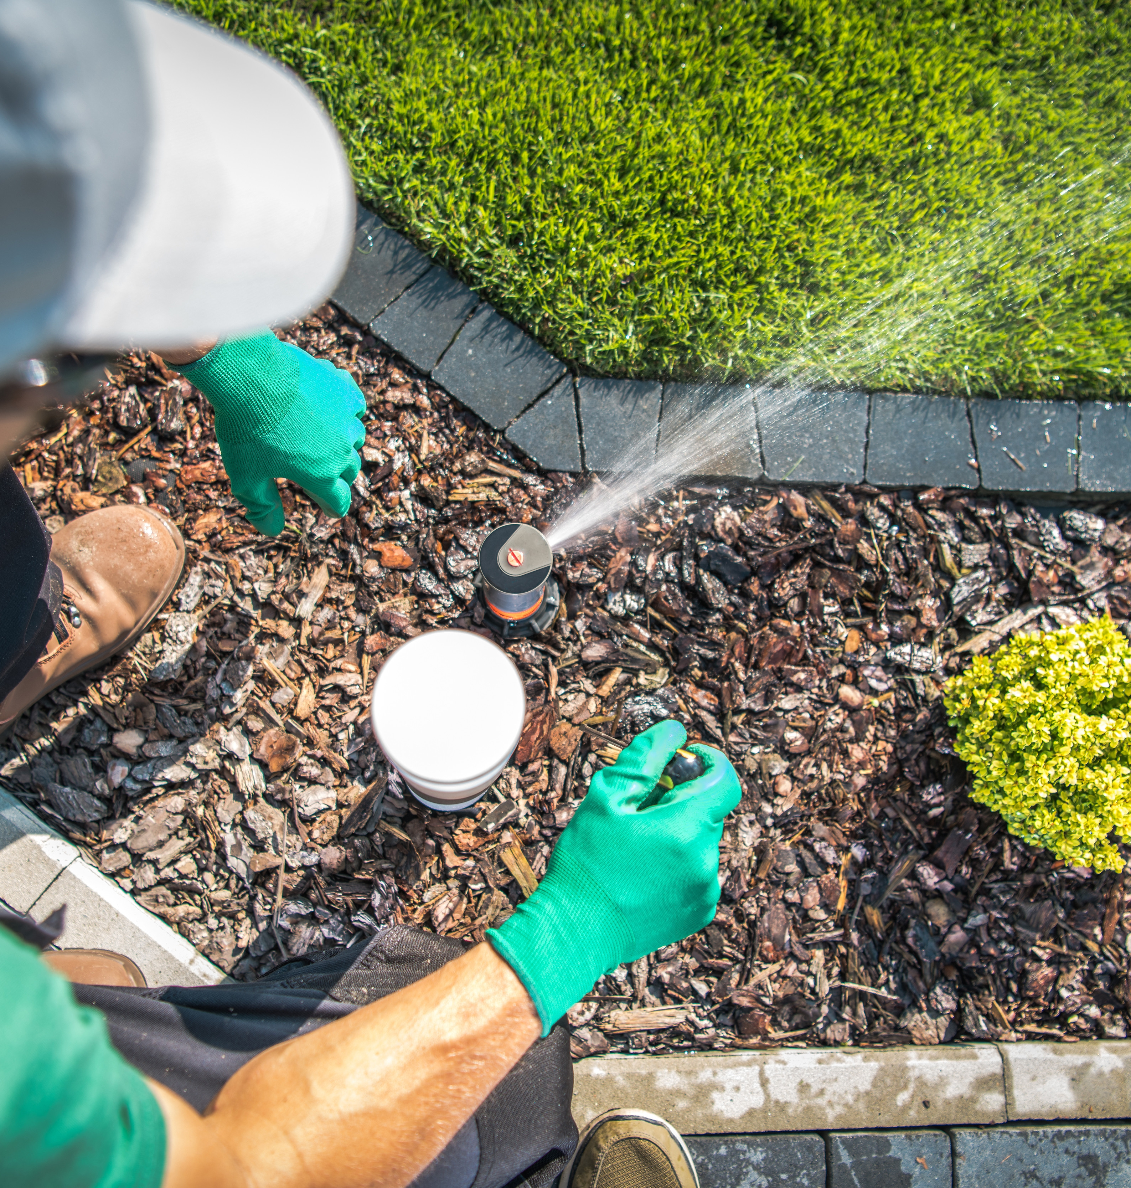
Hire a Certified Professional
WaterSense labels programs that demonstrate the water efficiency knowledge of certified:
  Irrigation system designers
  Irrigation system auditors
  Irrigation system installation and maintenance professionals
Over 1,400 irrigation professionals across the country are certified by a WaterSense labeled program
WaterSense’s sample contract language can help HOAs draft or revise landscape and irrigation contracts that focus on water efficiency
Find a certified pro in your area:
www.epa.gov/watersense/find-pro
Notes:
One of the best ways to save water outdoors is by hiring an irrigation professional trained in water-efficient technologies and techniques. WaterSense labels professional certification programs that require graduates to demonstrate their knowledge of water efficiency. WaterSense currently labels programs for irrigation designers, installation/maintenance professionals, and auditors. Over 1,400 professionals are certified by a WaterSense labeled program.
In addition to hiring a certified professional, WaterSense has created a tool with sample contract language. Including this language in a contract with a landscape contractor can ensure best managment practices are used while maintaining the landscape and achieving water savings.

Slide 9
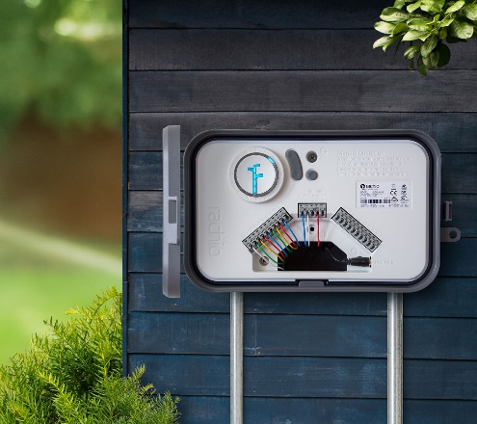
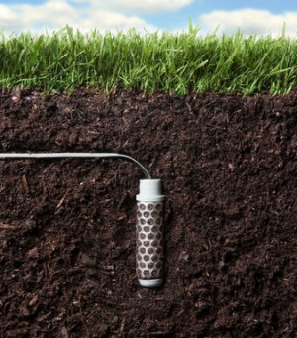
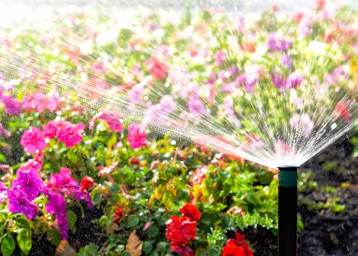
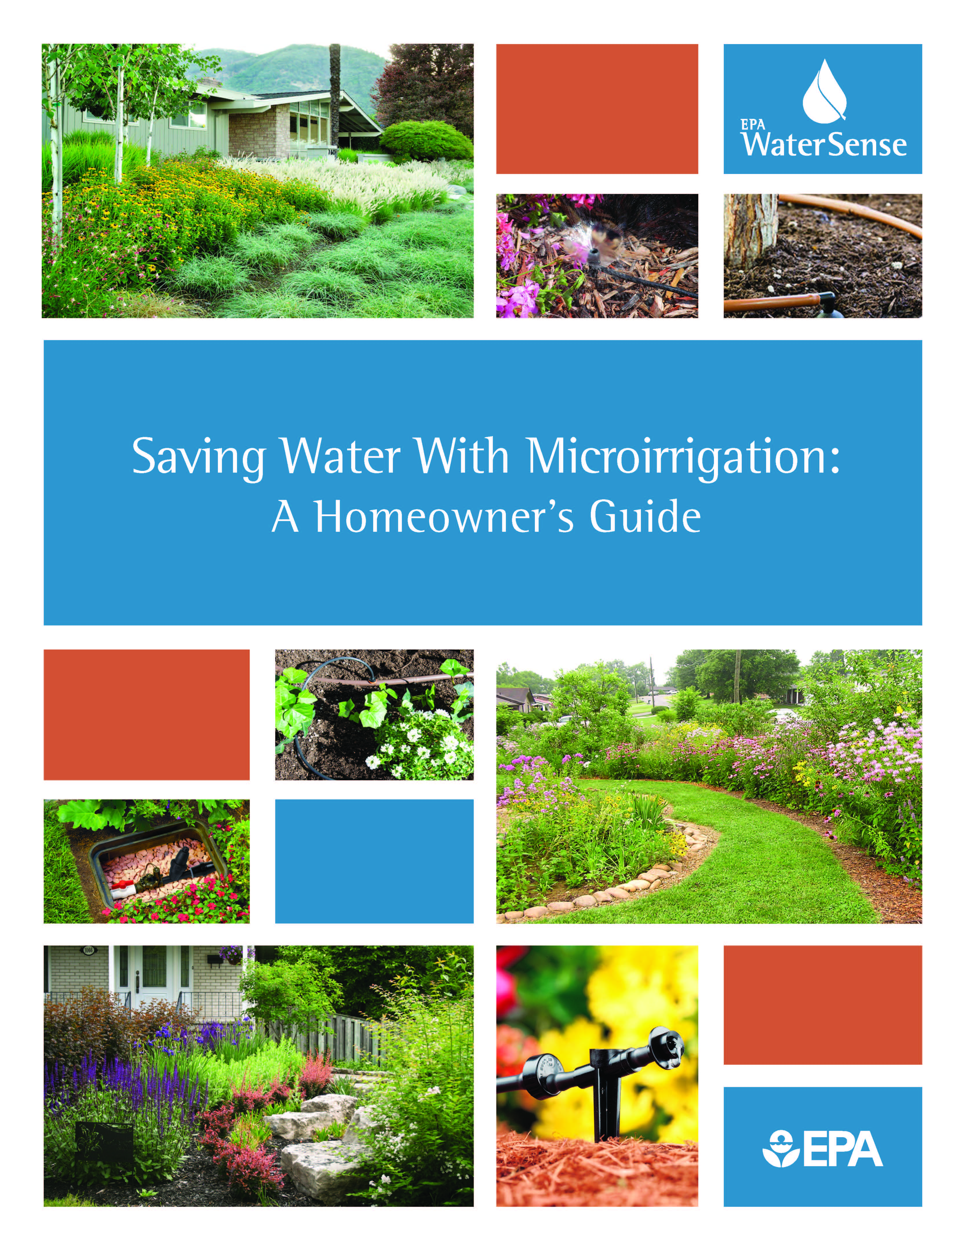
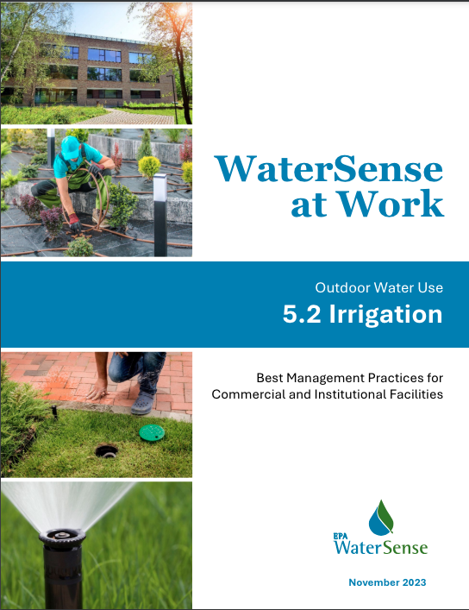
Water-Efficient Irrigation
WaterSense labeled irrigation controllers use local weather and landscape conditions to tailor watering schedules and/or monitor moisture levels in the soil to prevent irrigation when water is not needed. Both save water compared to a clock-based timer with a preset schedule.
www.epa.gov/watersense/irrigation-controllers
Spray sprinkler bodies with integral pressure regulation can reduce water waste by providing a constant flow at the sprinkler nozzle.
www.epa.gov/watersense/spray-sprinkler-bodies
Microirrigation delivers water directly to the root zone of plants slowly and over a longer period of time, preventing runoff and reducing evaporation.
www.epa.gov/watersense/microirrigation
Irrigation Best Management Practices from WaterSense include tips for operation, maintenance, and user education; options for retrofits and replacements; and calculations for potential water, energy, and dollar savings and payback periods. See WaterSense at Work Section 5.2: Irrigation.
www.epa.gov/watersense/best-management-practices
Notes:
WaterSense also labels water-efficient irrigation products that use 20 percent less water than standard models. Labeled products include weather-based and soil-moisture based irrigation controllers and spray sprinkler bodies. The guides seen here explain the benefits of WaterSense labeled products and expand on best management practices to save even more.

Slide 10
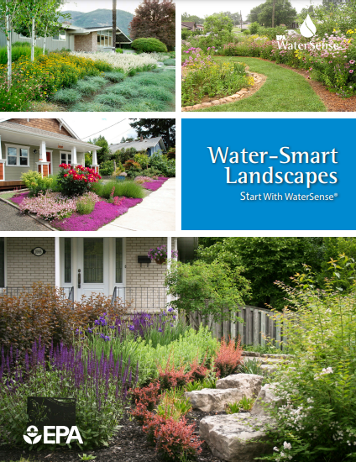
Water-Smart Landscaping
Choose native or drought-tolerant plants that need less water
Group plants according to their water needs
Maintain healthy soils
Make sure turf areas have purpose
Water wisely
Use microirrigation, such as drip irrigation
Reserve spray irrigation for turf areas
Mulch around trees and shrubs
Provide regular maintenance
For more information on water efficient landscaping, visit: www.epa.gov/watersense/landscaping-tips and WaterSense at Work Section 5.1: Landscaping at www.epa.gov/watersense/best-management-practices.
www.epa.gov/system/files/documents/2021-12/ws-outdoor-water-smart-landscapes.pdf
Notes:
Water savings don’t stop with hardware. In addition to efficient irrigation products, plant choice, landscape design, and outdoor maintenance all contribute to healthy, water-smart landscapes. WaterSense’s Water-Smart Landscapes guide will walk you through each component to a healthy and beautiful landscape suited for your specific region and space. Some of the recommendations discussed in the guide are listed on this slide.

Slide 11
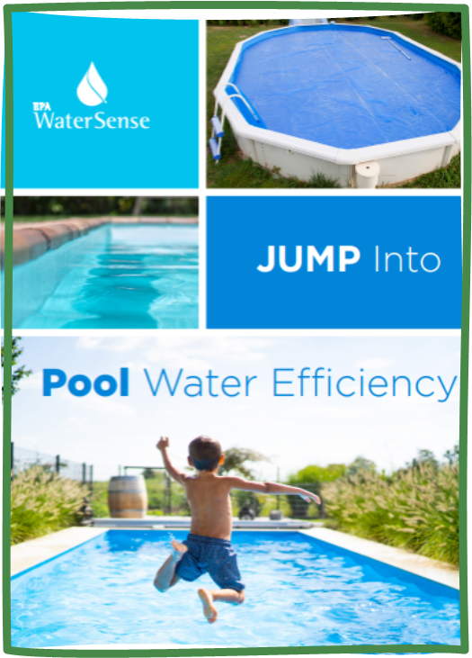

WaterSense Pool Efficiency Resources
Best Management Practices
  Tips for operation, maintenance, and use
  Retrofitting and replacing commercial pool equipment
  Savings potential for improvements
  WaterSense at Work Section 5.3: Commercial Pool and Spa Equipment: www.epa.gov/watersense/best-management-practices
Jump Into Pool Water Efficiency
  Simple guide to residential pool practices
  Applicable to commercial pools and spas
  Water-efficient design considerations, retrofits, and maintenance to improve pool efficiency
  See www.epa.gov/watersense/pool-water-efficiency
Notes:
Community pools provide a fun and relaxing way to keep cool during warmer months. However, if not maintained with water efficiency in mind, your pool could be sending water and money down the drain. Pools can consume water through evaporation, pool cleaning, leaks, and splashing. Investing in new equipment or employing targeted maintenance techniques can save water, energy (for heated pools), and money. These guides on pool water efficiency are great places to start saving water.

Slide 12
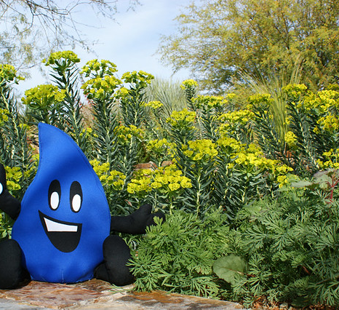
Next Steps for HOA Action
As an HOA, become a WaterSense partner: www.epa.gov/watersense/join-watersense
Review WaterSense’s HOA web page to get started saving water outdoors in your community: www.epa.gov/watersense/homeowner-associations
Review existing landscape and/or irrigation contract(s) to see how they cover water efficiency
Discuss landscaping and irrigation projects and improvements that can be made to reduce water use and utility bills
Notes:
Are you ready to start saving water in your HOA? Become a WaterSense partner to gain access to even more resources. Visit the WaterSense Homeowner Association web page listed on this slide to start your conservation journey, reduce water bills, and preserve water now and for future generations.

Slide 13
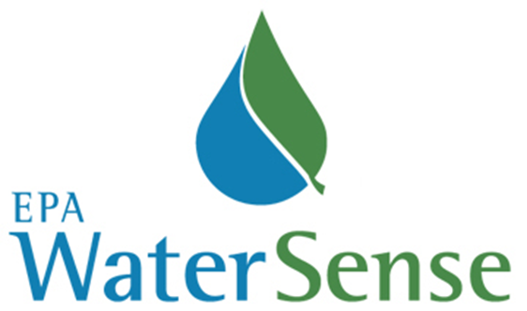
Contact WaterSense
E-mail: watersense@epa.gov
Website: www.epa.gov/watersense
Helpline: (866) WTR-SENS (987-7367)
Notes:
Thank you for your time and feel free to contact WaterSense with questions.

